Slide 1
Home Security System with Server Monitoring and Automation Control
BY: K.SRINIVASH(30123P08037)
UNDER THE GUIDANCE OF
MRS.K.SANGEETHA , MCA., M.PHIL., B.ED., ASSISTANT PROFESSOR

Slide 2
ABSTRACT
The IoT-Based Home Security System is designed to enhance residential security using Smart sensors, real-time alerts, and remote monitoring. This system integrates PIR Motion sensors, door break sensors, an ESP32 microcontroller, a buzzer, and a web Based dashboard to detect intrusions and notify homeowners instantly . When motion or unauthorized entry is detected, the ESP32 processes the data and triggers an alarm while simultaneously sending an alert notification to the user via the web or mobile interface. The system ensures 24/7 surveillance, provides real-time access, and enhances security with remote monitoring and cloud data storage. This project aims to offer a cost effective , user friendly, and scalable solution for modern Home security. Future enhancements include AI-based threat detection, mobile app integration, cloud computing, and smart home automation to further improve reliability and efficiency.

Slide 3
EXISITING SYSTEM
• Traditional home security systems lack real-time monitoring.
• No remote access or automated alerts.
• This IoT-based system enhances security with ESP32, sensors, and real-time alerts.

Slide 4
Proposed System
In our project there are two sides as consumer and producer. Producer section is the part of the web application where the producer can manage the system and interact with the consumers. The producer is the administrator of the system who can perform various tasks such as:
View, edit and delete users and their information.
View, edit , delete , create rooms and their devices.
View the graphs of the consumer and act upon it according the how much consumer like to use this project.
View , edit , delete and create devices and can handle the settings of devices.
View consumer activities and logs.
View and respond to messages from consumers.
Edit their own profile and password

Slide 5
SYSTEM DESIGN
Sensor Module: PIR motion sensor, door break switch.
Microcontroller: ESP32 processes data.
Server: PHP & MySQL store security data.
User Interface: Web application for monitoring.

Slide 6
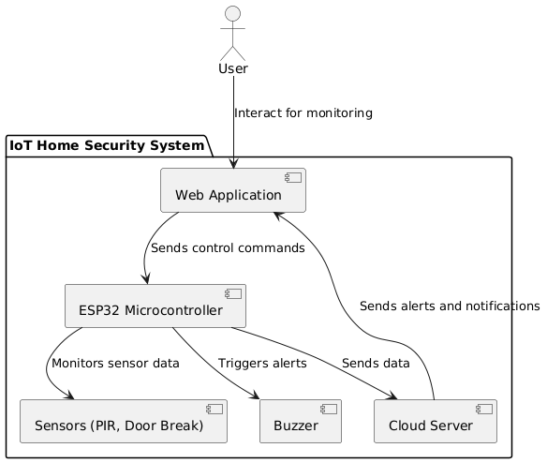
System Architecture of Iot-based Home
Security System

Slide 7
HARDWARE & SOFTWARE REQUIREMENTS
Hardware: ESP32, PIR sensor, Door Break Switch, Buzzer, Latch.
Software: Windows/Linux, PHP, MySQL, HTML, JavaScript.
Server: XAMPP for web hosting.

Slide 8
WORKFLOW & DATA FLOW
Sensors detect movement/entry.
ESP32 processes data and sends to server.
Server logs events, generates alerts.
User receives real-time notifications.

Slide 9
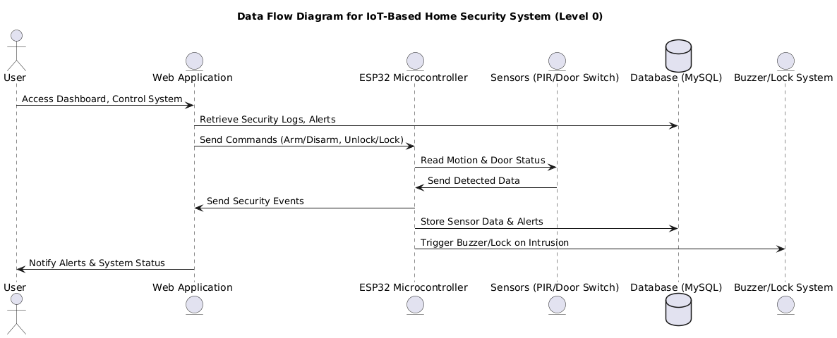
WORK FLOW

Slide 10
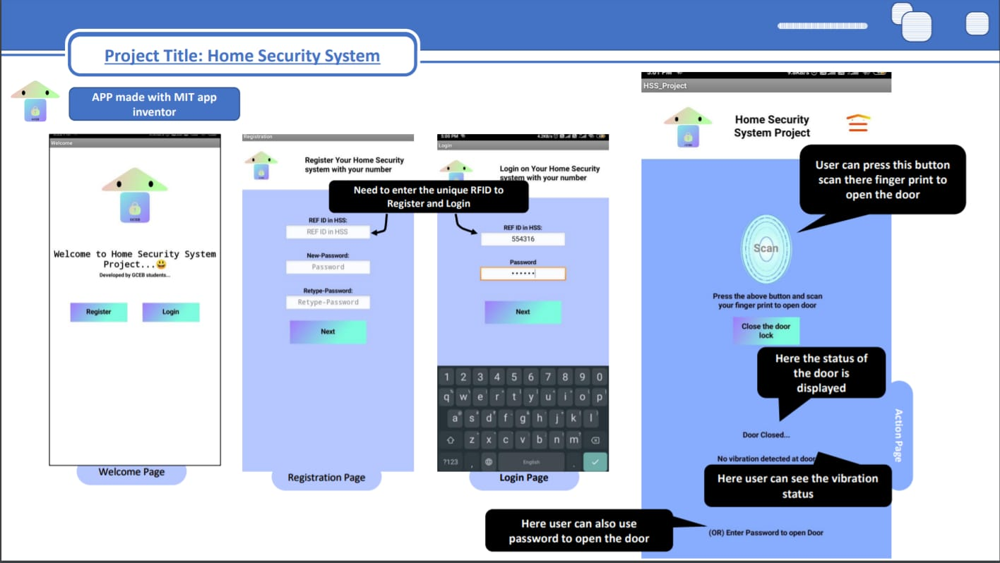
USER INTERFACE DESIGN

Slide 11
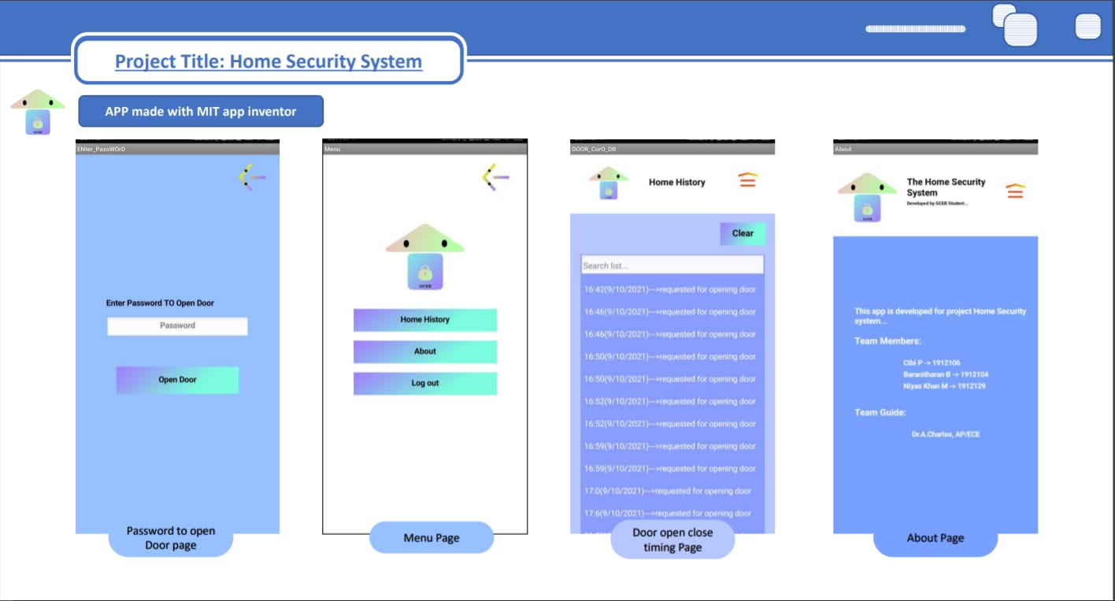
LOGS & STATUS

Slide 12
IMPLEMENTATION & TESTING
Coding: PHP, MySQL, JavaScript.
Testing: Unit, Integration, System, Security Testing.
Performance: Response time, scalability, data handling.
Security: Access control, logging.

Slide 13
Risks & Solutions
Sensor Failure → Backup sensors, maintenance.
Power Failure → Battery backups, UPS.
Network Issue → Offline mode, auto-reconnect.
Data Loss → Cloud backups, redundancy.

Slide 14
CONCLUSION & FUTURE ENHANCEMENTS
Provides real-time security monitoring.
Enhancements: AI-based detection, voice control.
Future upgrades include AI-based detection, mobile app integration, and smart home automation for improved reliability.

Slide 15
DO YOU HAVE ANY QUESTIONS?

