Slide 1

Web-Based Management System for Linux NAS Servers
Group 5
Team Members:
Uday Deep Udumula
Sreepathi Bhairu
Amrutha Chamarthi
2025SP-COMP_SCI-5531-0002
University of Missouri – Kansas City

Slide 2

Abstract
As demand for remote storage access has increased, ease of management for NAS systems has become increasingly important. We have developed a web-based interface that invites users to manage and monitor NAS servers using a Linux operating system from any location. Users can complete file operations, manage user roles, and get real-time stats such as CPU usage and used disk space. The backend is running on Flask (Python) or PHP and all user and file information is managed through MySQL. We also took advantage of Bootstrap on the front end to have a clean simple responsive user experience. The application runs on a Linux VM (virtual machine) secured through a firewall and port forwarding settings. The design of the application is modular and scalable, and has a centralized application with a user-friendly interface for management of NAS systems remotely.

Slide 3
Objective
The primary aim of the project is to develop a secure web-based solution that provides a simplified experience for administering.
Linux-based NAS servers. Instead of having to work at the command line, or only locally on the NAS device, users can execute file operations for upload and downloading, role management for users and system monitoring of performance and action logs — all through a clean and easy-to-use web interface.
The solution will be modular, scalable, and user-friendly for both technical and non-technical users, making the experience of NAS management simpler and more efficient.

Slide 4
Problem Statement
Conventional Network-Attached Storage (NAS) platforms typically necessitate localized use and some combination of command-line experience, which may make them more difficult for “everyday” users and not feasible for remote management.
With the rise to remote access of data and the need to simplify control of the systems, there has and remains a gap for ease of use solutions.This is the impetus for this project: to design a web-based interface to handle information for a Linux-based NAS server in a way that is manageable, secure, and cloud accessible to all users regardless of their technical experience or knowledge.

Slide 5
Algorithm
The user either locally or remotely through a browser from any device opens the web application.
Frontend, built with HTML, CSS, and Bootstrap, loads the interface that works well and looks good on different devices for user interaction.
After the user logs in or takes an action, the request is being sent to the backend (Flask or PHP).
The backend is responsible for the validation of the user’s authorization through the MySQL database.
When the user is authorized, he can do a lot of activities, like, for example, manage files,foldercreation, system statistics view, or user role management.
Operations are managed by the backend by talking to the Linux file system and follow the processesinthe monitoring tools for collecting CPU and disk data.
For the real-time representation on the screen, the backend delivers the results or updates to the frontend.
The application is hosted on a Linux VM and is protected from unauthorized access by firewall rules and ports through which virtual machines communicate with the host are forwarded.

Slide 6
Flowchart Overview – Web-Based NAS Management System
Start (User Login):
- Initiate with a login screen where users enter credentials.
User Authentication:
- Verify user details.
- Decision Point:
- Valid Credentials: Proceed to Role-Based Access Control.
- Invalid Credentials: Display error and offer retry.
Role-Based Access Control:
- Assign user roles (e.g., Administrator, Standard User).
- Control access to specific functions based on the role.
Core Functionalities:
- File Management: Upload, download, create, edit, and delete files.
- System Monitoring: Real-time tracking of CPU usage and disk space.
Backend Processing:
- Requests managed via Flask/PHP.
- Data storage handled by MySQL.
Error Handling:
- Branches for managing errors during file operations or monitoring.

Slide 7

Technology Stack
The proposed research project is built on full-stack web technologies including both front-end and back-end implementation for a solid NAS interface.
Front end Technologies: HTML, CSS, JavaScript, and Bootstrap
These technologies are used for developing a responsive web interface.
Backend Technology: Flask (Python) or PHP
These Technologies are used to manage user requests, file access, and application logic.
Database: MySQL
This is used to store user credentials, file metadata, and access roles.
Deployment : Linux Virtual Machine
This is used to set up with firewall rules and port forwarding for secure remote access.

Slide 8

Key features
This system is designed to simplify and secure NAS server management from anywhere. Based on our analysis of remote storage needs, we’ve focused on delivering the core features listed below.
File Management: Users may upload, download, and structure files or folders using a clean and simple to use web interface, which will eliminate the need for command line access, or local access to files or folders.
User management: The system provides support for creating and managing users with role based access, ensuring that permissions are defined and secure.
System Monitoring: Providing real time information about, CPU usage and used disk space will provide administrators the means to monitor overall performance and quickly respond to possible issues.
Secure Deployment: The system is hosted on Linux (virtual machine), configured with firewall rules and port forwarding, and can be accessed safely and securely from a remote location.

Slide 9
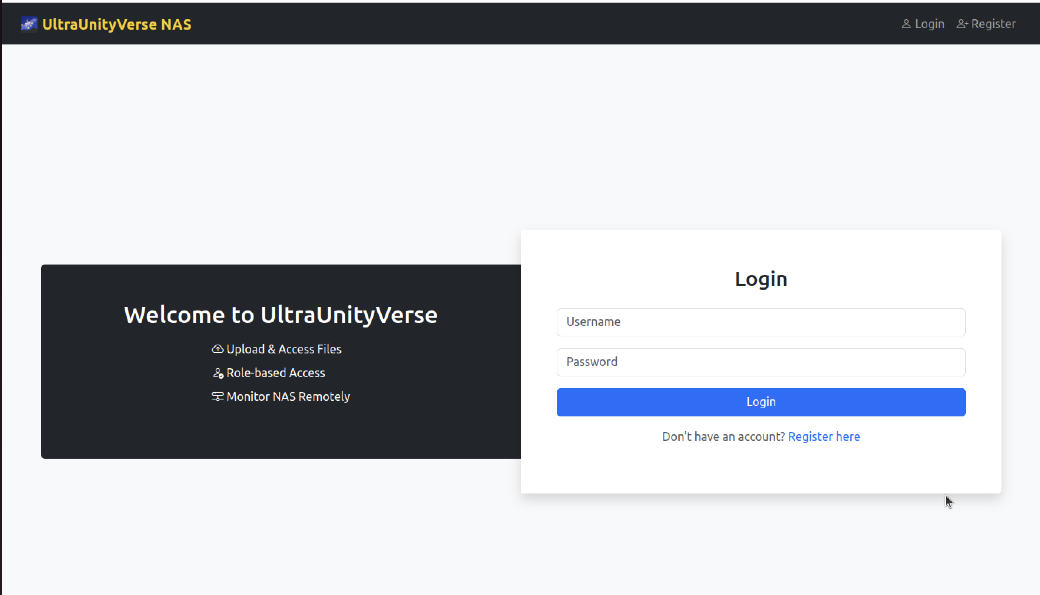
O/P Snap Shots
Login Page: Helps user to login

Slide 10
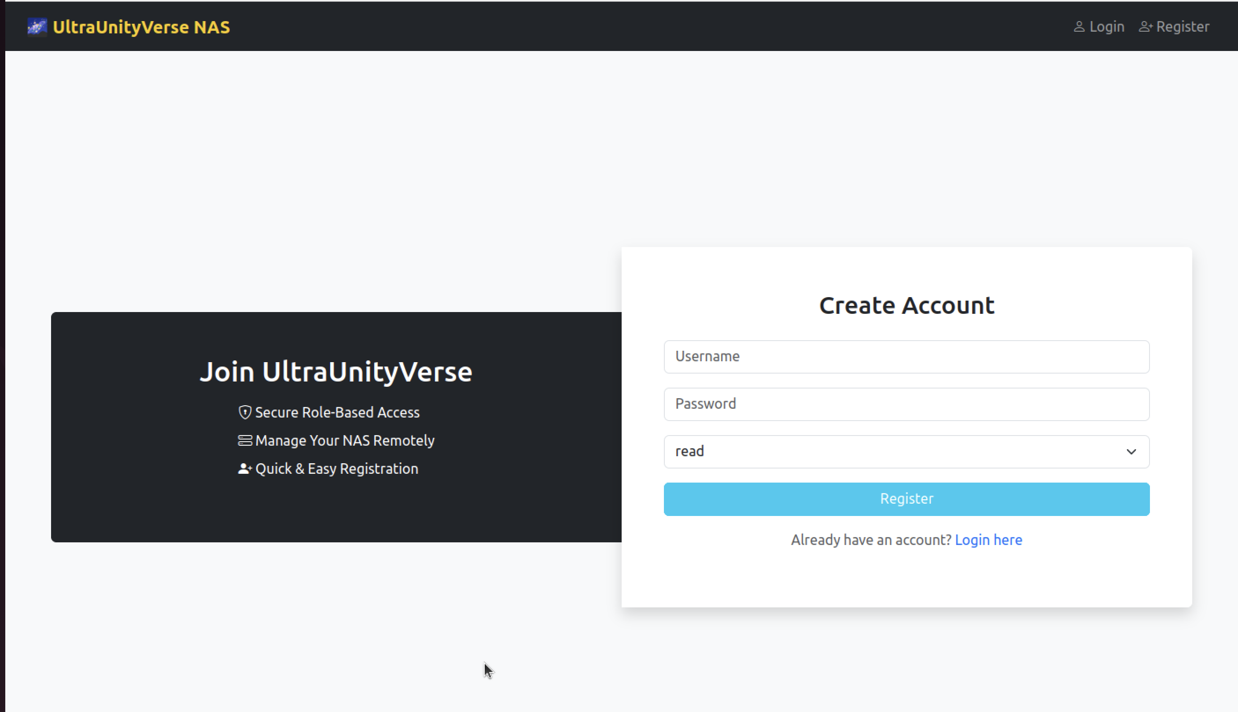
O/p Snap Shots
Registration Page: It helps user to login to create account with user roles read and write

Slide 11
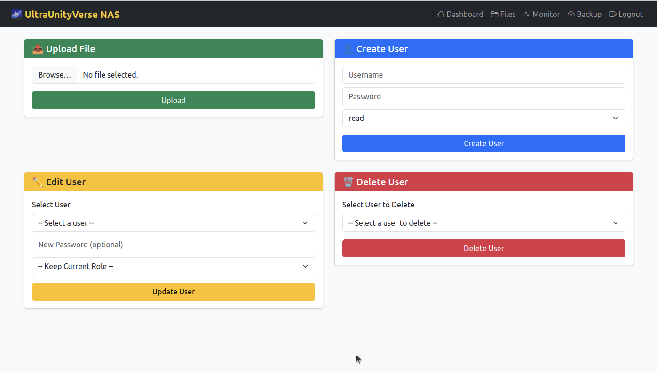
O/p Snap Shots
User Role Adjustment and File Uploads

Slide 12
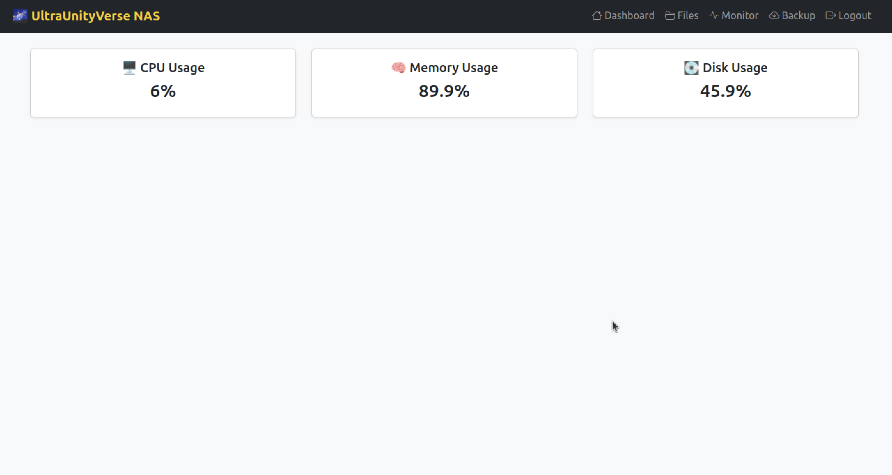
O/p Snap Shots
Memory Management Tracking

Slide 13
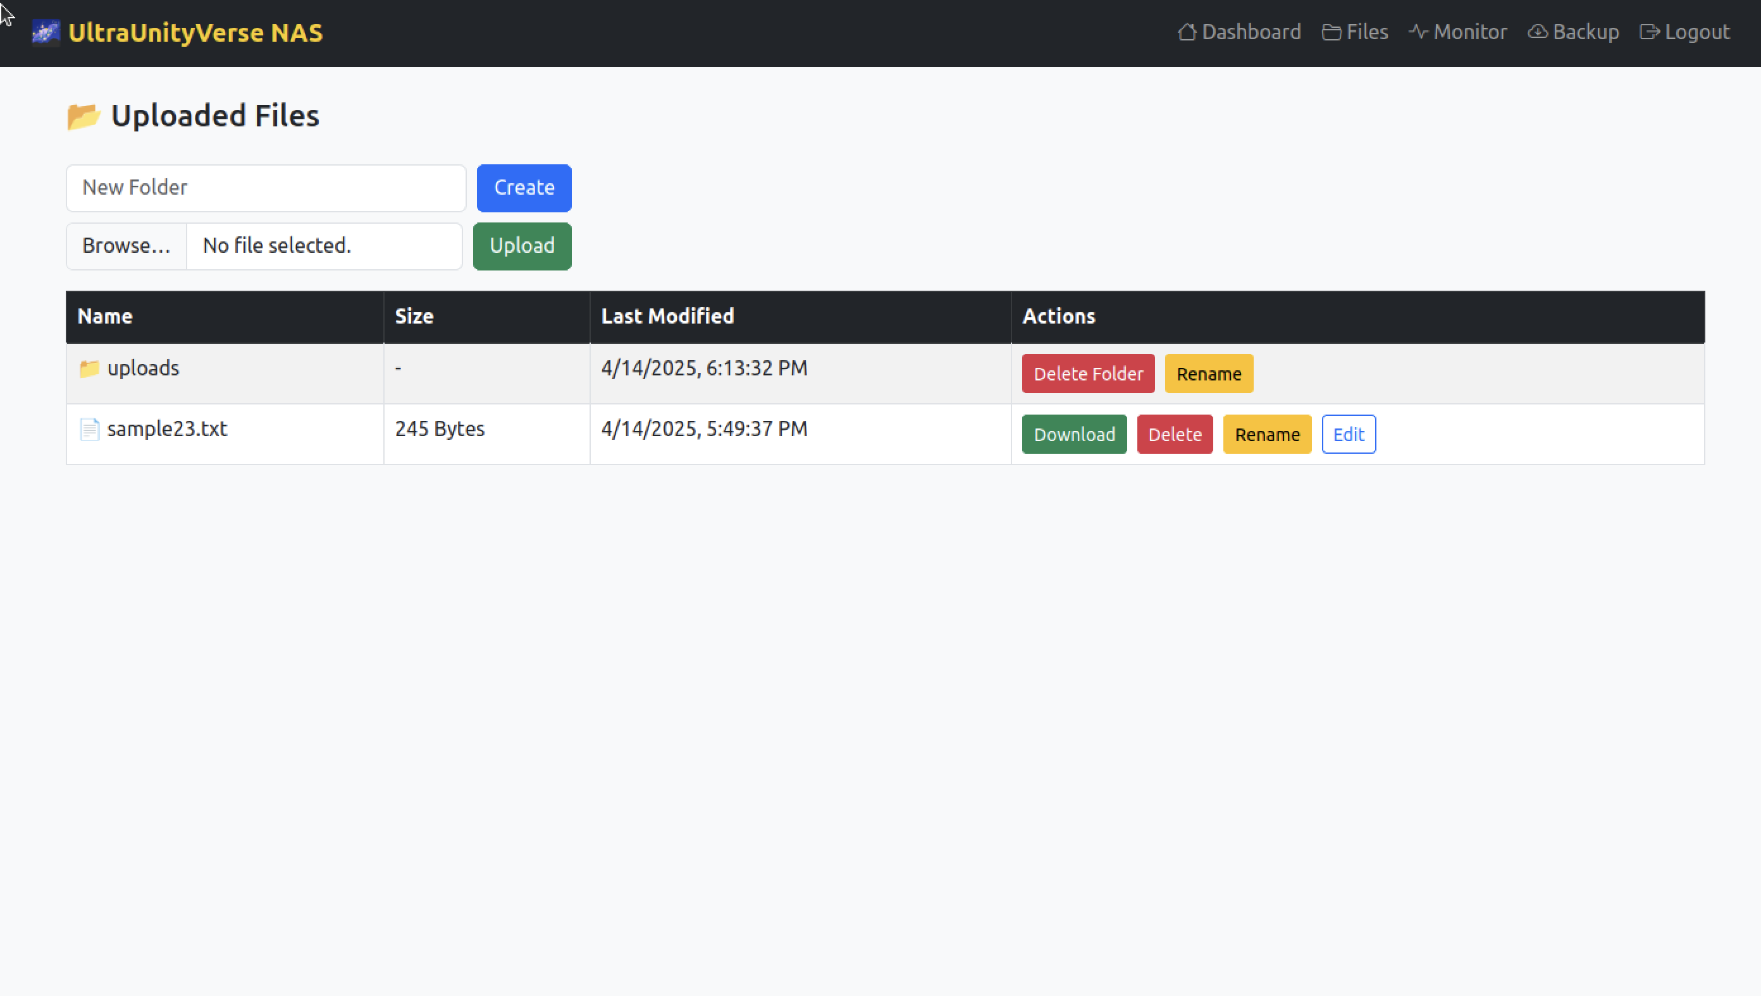
O/p Snap Shots
File Upload, Create, Edit , Update according to user roles.

Slide 14
Comparison with Traditional NAS Approach
In our investigation into existing NAS systems, we found that conventional approaches to managing these systems are limited to having local access to the NAS system, requiring use of terminal commands as well as multiple manual configuration steps. These practices also also require technical experience, limits remote access, and give little visibility to overall system health or usage.
The system proposed in this paper addresses these limitations through the introduction of a secure web-based portal for NAS management, which is especially beneficial for non-technical users. With features such as real-time monitoring, user role control, and file operations, this solution provides an updated NAS experience while increasing usability, control, and security.

Slide 15
Challenges Faced
During the development process, we encountered several real-world challenges that directly influenced the design and rationale for the entire app:
The sudo restrictions that exist for a Linux VM delayed the setup and installation of packages.
There were errors authenticating the user to MySQL, which led to the careful handling of user roles and access and security.
Deploying Flask was arduous because of needing to configure the port and firewall settings.
We had to iterate on our design of the UI to enhance usability based on early usability feedback from users.
These challenges informed our knowledge and understanding of system behavior and the final solution.

Slide 16

THANK YOU

