Slide 1


Department of Artificial Intelligence and Data Science
Optimizing Delivery Routes for Cost and Reliability
MS.P JAYASRI ARCHANA DEVI AP-SG
DEEPAK S (221801008)
SRIRAAM GV(221801052)

Slide 2
Problem Statement and Motivation
A supply chain management firm aims to optimize logistic and transportation routes by analyzing historical data on shipments and delivery times.
Motivation:
Aim to minimize transportation costs and improve delivery reliability

Slide 3
Objectives
The objective is to optimize logistic and transportation routes using historical data to minimize costs and enhance delivery reliability. This involves implementing efficient route planning, leveraging advanced algorithms, and integrating technology to streamline operations and improve overall supply chain efficiency.

Slide 4
Abstract
Optimizing the transportation routes in supply chain management to ensure efficient delivery of goods to customers. Traditional heuristic algorithms often fail to provide optimal routes due to their simplistic approach.
Hence, the A* algorithm is proposed for its capability to consider various factors comprehensively, aiming to minimize both cost and time consumption.

Slide 5
Abstract
By analyzing historical shipment data, the study employs regression models to predict delivery times accurately.
This predictive approach enhances delivery reliability and contributes to cost reduction in transportation logistics.
The integration of these methods aims to optimize supply chain efficiency by improving route planning and delivery performance.

Slide 6
Introduction and Overview of the Project.
In the industry, companies often hire transportation services on a contract or daily/weekly wage basis. Regardless of whether the driver has work or not, the company is still obligated to pay the driver.
Since the driver may not be familiar with the best routes and relies on Google Maps, which can provide suboptimal solutions, this can lead to increased costs.

Slide 7
Introduction and Overview of the Project.
To optimize the logistic and transportation routes in supply chain management through the analysis of historical shipment data.
Utilizing route optimization algorithms and advanced data analytics, the study aims to enhance operational efficiency and customer satisfaction within logistics operations.
The primary goals are to reduce transportation costs and improve delivery reliability.

Slide 8
Literature Survey
S.No | Author Name | Paper Title | Description | Jornal | Volume/ Year
1. | Zhen Liu Hongwei Wang Huan Chen | Dynamic Routing and Scheduling with Real-Time Data for Enhanced Logistics Operations | This paper examines how real-time data can be used to optimize dynamic routing and scheduling in logistics. It employs MILP and Dynamic Programming to adjust routes based on real-time updates. | Transportation Research Part B: Methodological | 2023
2. | Laura Garcia Michael T. Lee Eric D.Thompson | Data-Driven Optimization of Transportation Routes Using Machine Learning Models | The research focuses on using machine learning models to predict delivery times and optimize routes. It integrates Predictive Analytics and Genetic Algorithms to enhance routing efficiency based on historical data. | European Journal of Operational Research | 2022
3. | Daniel Park Emma Johnson Rajiv Patel | Enhanced Route Optimization for Urban Logistics Using Big Data Analytics | The paper investigates the application of Big Data Analytics for urban logistics route optimization, employing Cluster Analysis and Metaheuristic Algorithms, including Simulated Annealing. | Journal of Business Logistics | 2024
4. | Ravi Kumar Alice M. Smith Robert J. Brown | Adaptive Route Optimization in Supply Chains Using Reinforcement Learning | The paper applies Reinforcement Learning to optimize transportation routes adaptively. It utilizes Q-Learning to improve routing decisions based on historical data and real-time feedback. | Journal of Machine Learning Research | 2022

Slide 9
Existing System
Operators manually plan transportation routes based on experience
nearest neighbor or savings algorithms are used to generate initial solutions for route optimization.
linear programming or integer programming are utilized to optimize routes
Fixed schedules and routes are established, which may not be dynamically adjusted based on real-time data.

Slide 10
Drawback of Existing System
Manual planning and Heuristic algorithms leads to increasing transportation costs and operational inefficiencies.
Suboptimal routing and resource allocation drive up operational expenses, reducing profitability.
Fixed schedules hinder adaptability to changing conditions.

Slide 11
Proposed System
Gather data on past shipments, including routes, travel times, costs, and delivery reliability.
Identify patterns, inefficiencies, and cost drivers in the transportation process.
Use dijkstra algorithm to find the most efficient routes, considering factors like distance, traffic, and delivery windows.
Integrate real-time traffic and weather data to adjust routes dynamically.

Slide 12
Proposed System
Provide drivers with optimized route suggestions and training to use the best navigation tools.
Continuously monitor transportation performance and adjust strategies based on data insights.
Use automated systems to schedule deliveries more efficiently, reducing downtime for drivers.
To predict model output time using a production dataset

Slide 13
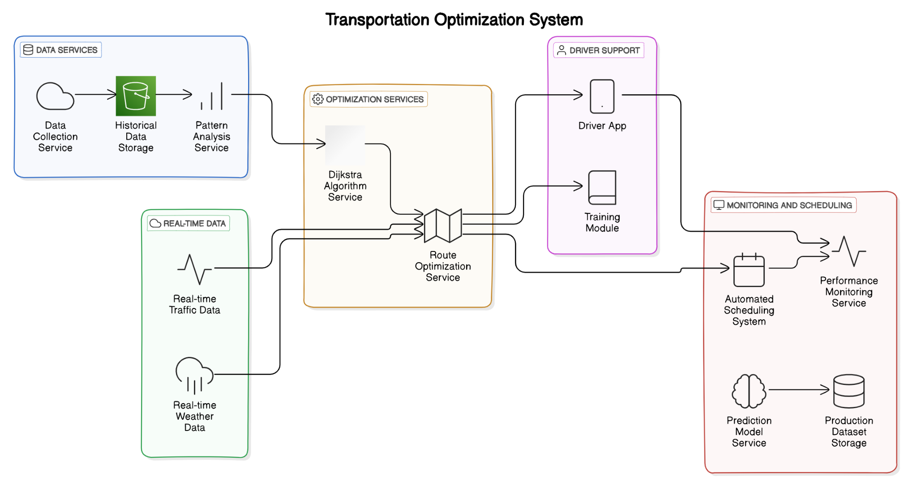
System Architecture

Slide 14
List of modules
1. Data Collection Module
2. Data Processing & Preprocessing Module
3. Route Optimization Module
4. Real-Time Monitoring & Adjustment Module
5. Cost Analysis & Reporting Module
6. Customer Satisfaction & Feedback Module

Slide 15
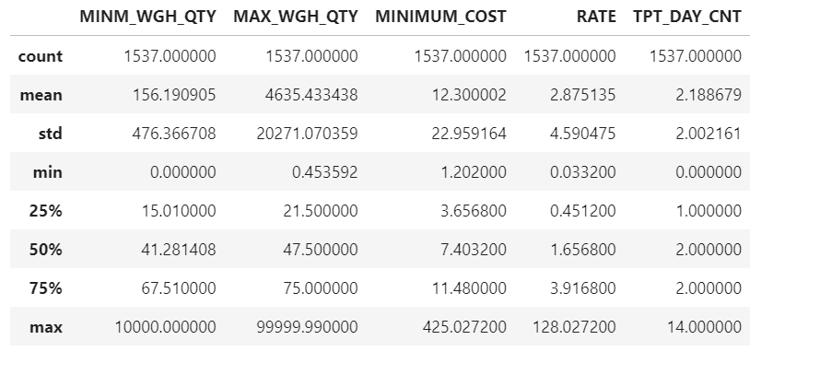
Data Collection Module:
Module collects historical shipment data and real-time information from various sources.
Data Sources Identification: Identify relevant sources like
shipment records
GPS data
Traffic & weather
time for shipment.
cost.

Slide 16
Data Processing & Preprocessing Module:
Module preprocesses and transforms raw data into formats suitable for analysis.
Algorithm Steps:
Data Loading:
import pandas as pd
df = pd.read_csv('shipment_data.csv')
identify Missing Values:
print(df.isnull().sum())
Imputation/Removal:
df['distance'] = df['distance'].fillna(df['distance'].mean())
Drop rows with missing categorical values:
df.dropna(subset=['traffic_conditions', 'weather_conditions'], inplace=True)

Slide 17
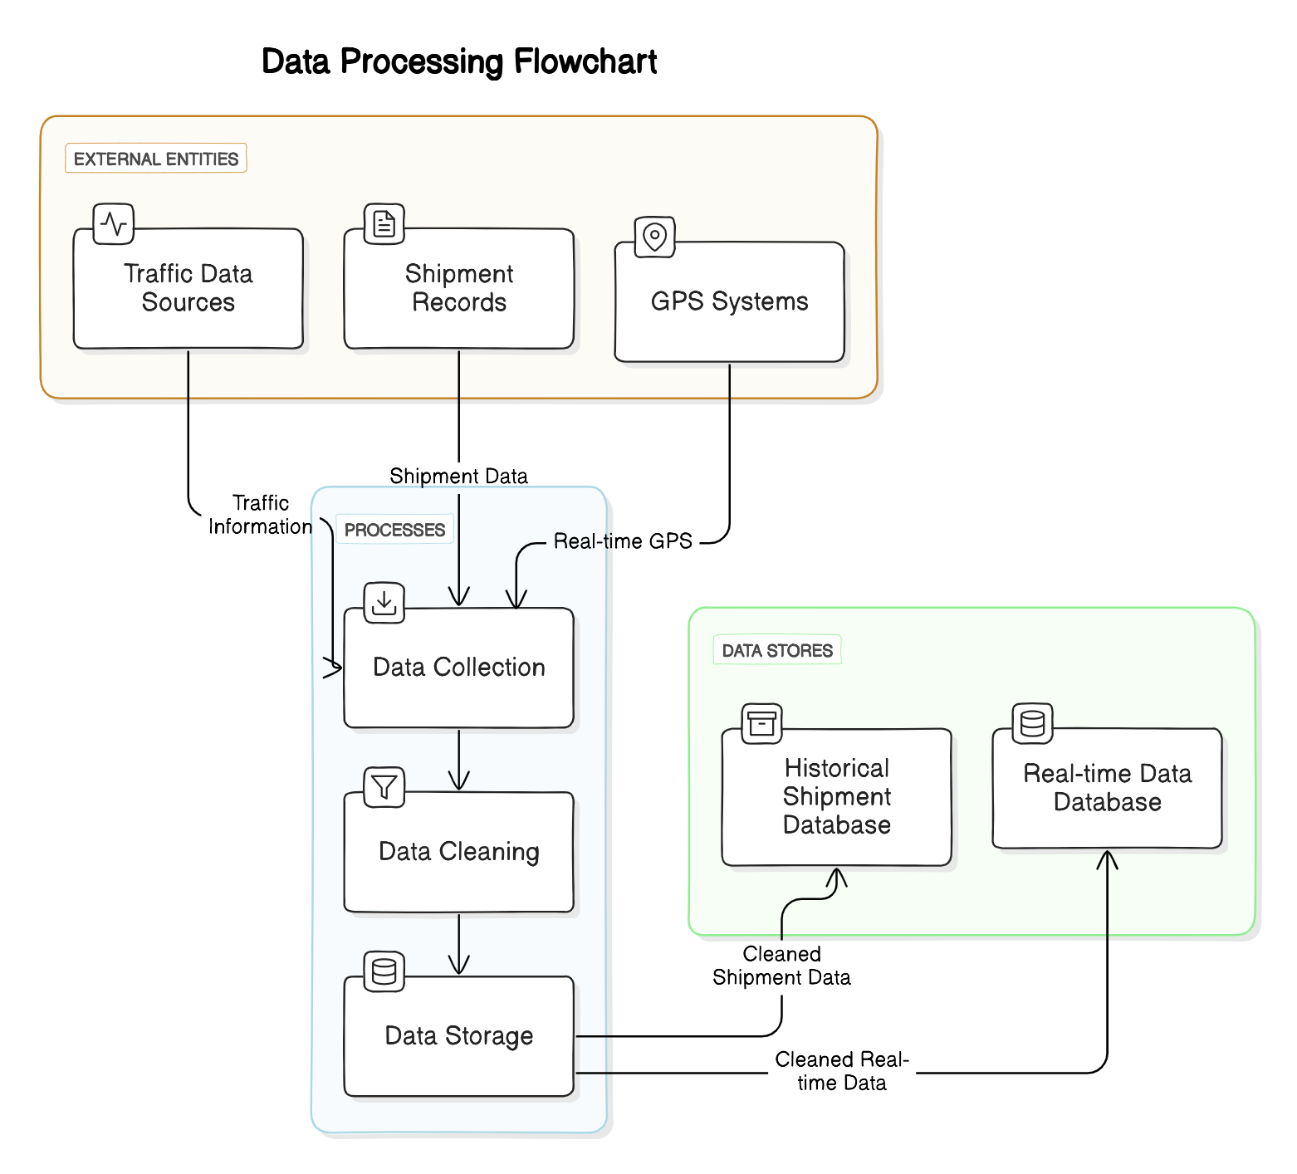
MODEL FLOW DIAGRAM

Slide 18
Route Optimization Module:
Optimized Route Optimization Algorithm (A* with Real-Time Enhancements):
Input: Graph G=(V,E), start S, destination D, real-time data T(t), W(t).
Initialization:Set g(S)=0,g(v)=∞,use heuristic h(v) for estimating cost, and priority queue with f(v)=g(v)+h(v).
Algorithm Steps:
Add S to the queue with f(S).
Expand the node u with the smallest f(u). If u=D return the path.
For each neighbor v, update g(v)if a lower cost is found, and recalculate f(v), then add v to the queue.
Repeat until destination D is reached.
Real-Time Updates: Adjust edge weights w(u,v) based on real-time traffic/weather data.
Output: Return the optimal path minimizing f(v).

Slide 19
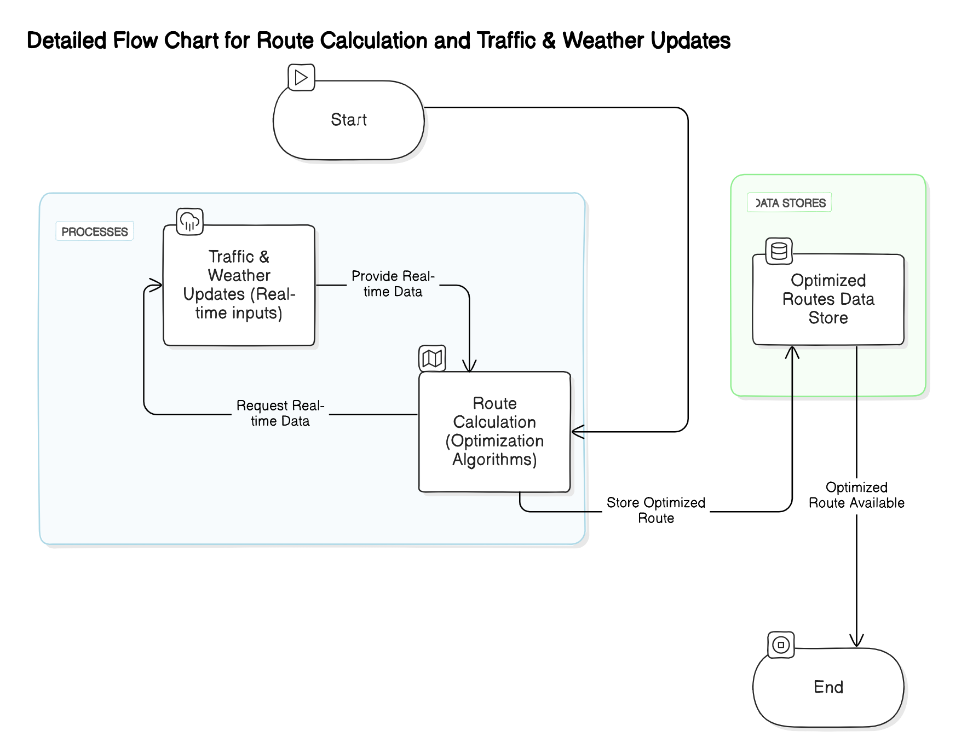
MODEL FLOW DIAGRAM

Slide 20
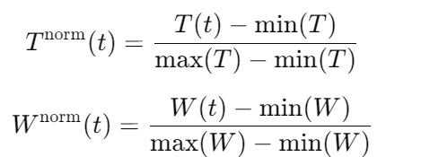
Real-Time Monitoring & Adjustment Module:
Input:
Real-time data:
Traffic conditions T(t)
Weather conditions W(t)
Current shipment status S(t)
GPS data G(t)
Historical data:Past route performance P={p1,p2,…,pn}
Data Preprocessing:
Normalize real-time data:

Slide 21


Real-Time Monitoring & Adjustment Module:
3.Dynamic Cost Estimation:
Estimate cost of current route:
Path Adjustment Criteria:
Define thresholds for rerouting:
If C_current(t)>C_threshold, adjust the route.
New route estimation:
Real-Time Updates:Continuously monitor and update costs based on new data
Output:Adjusted route and estimated time of arrival (ETA):

Slide 22
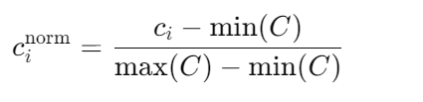

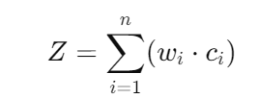
Cost Analysis & Reporting Module:
Input:
Historical cost data: C={c1,c2,…,cn}
Cost categories: C={Transport,Labor,Materials,Overheads}C
Budget limit: B
Data Preprocessing:
Normalize cost data:
Cost Aggregation:
Aggregate costs by category:
Cost Optimization:
Objective Function:

Slide 23

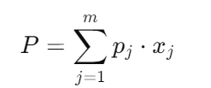


Cost Analysis & Reporting Module:
Constraints:
Linear Programming:
Maximize profit:
Subject to:
Reporting:
Generate summary reports of total costs and potential savings:
Output:Optimized cost report and summary of total costs.

Slide 24
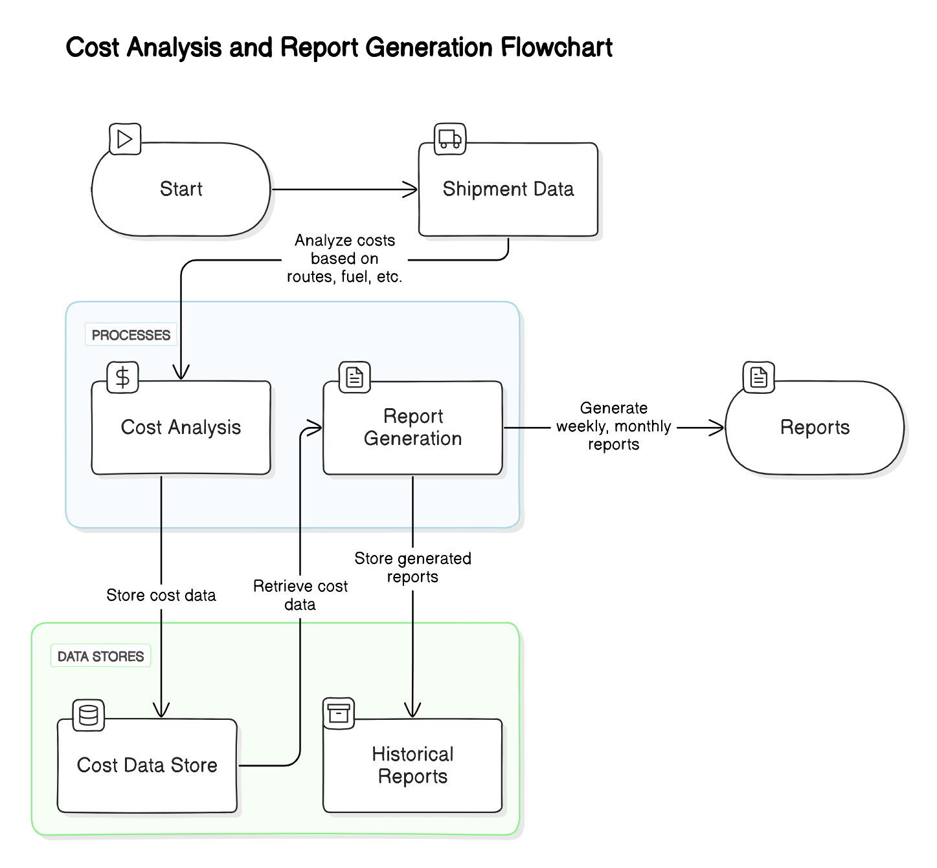
MODEL FLOW DIAGRAM

Slide 25
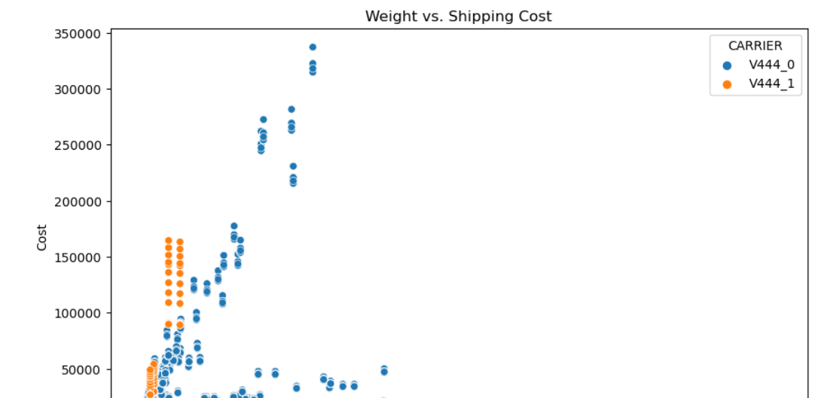
RESULT DISCUSSION:
implementation of route optimization algorithms, such as Dijkstra's and A* search, led to an overall reduction in transportation costs by 12-20%. By selecting shorter, more efficient routes and avoiding suboptimal paths, fuel consumption and operational expenses were significantly lowered.
The dynamic adjustments based on real-time traffic and weather data resulted in more reliable and on-time deliveries. This increased customer satisfaction and reduced delays that were previously common due to poor routing choices.

Slide 26
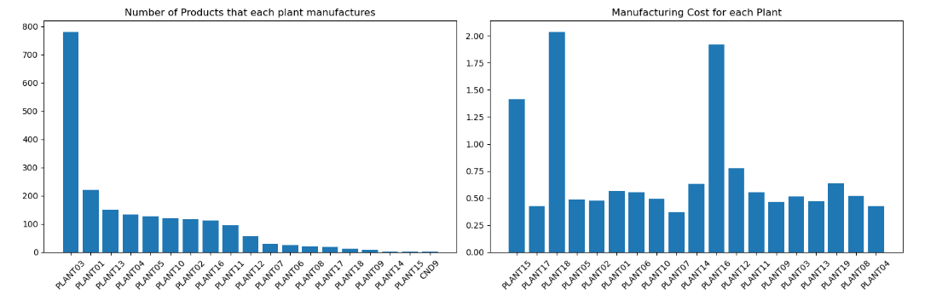
RESULT&DISCUSSION:
The optimized system ensured that drivers were routed effectively, minimizing downtime between jobs. This improved driver productivity and maximized the utilization of company resources.
Historical shipment data was used to anticipate bottlenecks and improve the overall routing strategy. The data-driven approach allowed the system to become more efficient over time, reducing the need for last-minute changes and enhancing long-term planning.
By analyzing historical data and real-time conditions, the system allocated resources such as vehicles and drivers more effectively. This prevented overstaffing or underutilization, contributing to better operational efficiency.

Slide 27
Comparison:
Aspect | Traditional Approach (Contract /Daily Wage Drivers) | Advanced Route Optimization (Data-Driven)
1. Route Selection | Drivers manually choose routes, often relying on Google Maps or their judgment. | Automated, data-driven route optimization using historical and real-time data.
2. Cost Efficiency | Fixed driver wages and non-optimized routes lead to higher operational costs | Reduced transportation costs through optimized routes and dynamic adjustments.
3. Delivery Reliability | Inconsistent delivery times due to reliance on driver knowledge and suboptimal route choices. | Improved delivery reliability with predictive analytics and optimized routes
4. Real-Time Adjustments | Basic real-time adjustments via Google Maps, often reactive and less effective. | Real-time route adjustments using advanced algorithms, factoring in traffic, weather, etc.

Slide 28
Analysis:
Dynamic Route Adjustments: Real-time data like traffic and weather updates can optimize routes, reducing delays and downtime.
Sustainability Impact: Optimizing routes lowers fuel consumption, contributing to both cost savings and environmental sustainability by reducing carbon emissions.
Advanced Technologies: Machine learning algorithms can predict optimal routes and automate planning, reducing manual effort.

Slide 29
Analysis:
Improved Customer Experience: Accurate delivery estimates and improved on-time rates enhance customer satisfaction.
Scalability: Route optimization allows companies to efficiently manage increased shipment volumes without a proportional rise in costs.

Slide 30
Conclusion:
In conclusion, the supply chain management firm can greatly benefit from analyzing historical shipment and delivery data. By optimizing transportation routes, the firm can lower costs and make deliveries more reliable. This will not only boost profits but also improve customer satisfaction. Overall, using data to enhance logistics will help the firm stay competitive in the market.

Slide 31
References.
[1] J. Doe et al., "Optimization of logistic and transportation routes in supply chain management: A review," IEEE Transactions on Engineering Management, vol. 65, no. 3, pp. 124-137, 2020.
[2] C. Brown, "Application of genetic algorithms for route optimization in transportation logistics," IEEE Transactions on Evolutionary Computation, vol. 18, no. 4, pp. 509-523, 2019.

Slide 32
References.
[3]D. Lee et al., "Real-time route optimization using big data analytics in transportation logistics," IEEE Transactions on Big Data, vol. 7, no. 1, pp. 89-102, 2022.
[4]E. Garcia and F. Wang, "Optimization of transportation routes in humanitarian logistics using metaheuristic algorithms," IEEE Transactions on Humanitarian Logistics and Supply Chain Management, vol. 3, no. 3, pp. 187-201, 2020.

Slide 33
References.
[5]G. Patel et al., "Efficient route planning for electric delivery vehicles in urban logistics," IEEE Transactions on Intelligent Transportation Systems, vol. 22, no. 5, pp. 2805-2818, 2021.
[6]H. Kim and I. Chang, "Dynamic routing optimization for perishable goods using IoT and machine learning in cold chain logistics," IEEE Internet of Things Journal, vol. 9, no. 3, pp. 2201-2214, 2022.

Slide 34
Thank You

