Slide 1
Machine Learning
-Supervised Learning

Slide 2




Discussion on
Introduction to Machine Learning
Supervised Learning
Linear Regression
Logistic Regression

Slide 3

Introduction to ML
Field of study that gives computers the ability to learn without being explicitly programmed.
A computer program is said to learn from experience E with respect to some task T and some performance measure P, if its performance on T, as measured by P, improves with experience E.

Slide 4
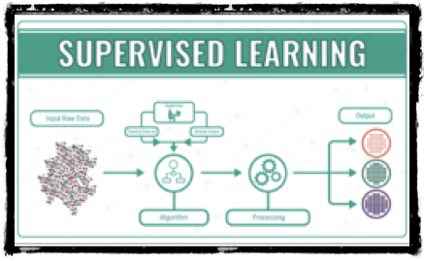
Supervised Learning
Supervised learning is said to be a type of learning in Machine Learning where both input and output data is available.

Slide 5
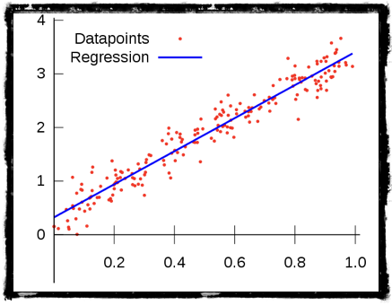
Linear Regression
In statistics Linear regression is a linear approach of modelling the relation between dependent variable and independent variable (which are also called as scalar response and explanatory variable) by examining two factors.

Slide 6
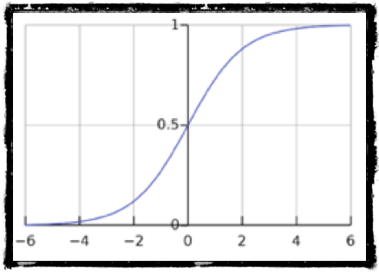
Logistic Regression
It is mainly used for classification problems. Classification problems include classifying whether an email is a spam or not, classifying whether phone number is genuine or not, checking if a website is fraudulent or not.

Slide 7

THANKYOU

