Slide 1
ABSTRACT
With the rise of automated and unmanned restaurants, understanding customer feedback has become a challenge due to the absence of direct human interaction. To address this, we propose a facial expression-based rating system that evaluates customer satisfaction using pre-trained Convolutional Neural Network (CNN) models. By leveraging Human-Computer Interaction (HCI), our system bridges the gap between customers and machines, enabling computers to interpret human emotions accurately. This allows restaurants to gather real-time feedback in a more natural and seamless manner. By utilizing advanced facial recognition techniques, our approach ensures an intuitive and efficient way to assess customer satisfaction and improve service quality in automated dining environments.

Slide 2
INTRODUCTION
Our system is designed to capture the facial expressions of customers and processes it to understand customer satisfaction.
We use Mini Xception, a lightweight Convolutional Neural Network (CNN), to analyze facial expressions.
The model classifies emotions into three categories: 😊 Satisfied, 😐 Neutral, and 😞 Disappointed, providing valuable insights.
This eliminates the need for human intervention, making the feedback process more accurate, unbiased, and efficient.
By analyzing facial expressions, restaurants can identify areas for improvement, such as food quality or service experience.

Slide 3
EXISTING SYSTEM
1️⃣ 📝 Traditional Feedback Forms & Surveys
Restaurants often use paper forms, digital surveys, or rating apps to collect customer opinions.
However, many customers skip or provide generic answers, making it inefficient and unreliable for genuine feedback.
2️⃣ 👨‍💼 Manual Customer Interaction & Reviews
Some restaurants depend on staff asking customers directly about their experience.
This method is time-consuming and often leads to biased responses, as customers may hesitate to share honest opinions.
3️⃣ ⭐ Online Reviews & Social Media Ratings
Many businesses rely on Google Reviews, Zomato, or Yelp to gauge customer satisfaction.
However, these reviews are often influenced by extreme opinions (either too positive or too negative) and do not provide real-time insights.

Slide 4
Disadvantages of Existing System
1️⃣ ❌ Low Response Rate
Many customers ignore or skip traditional feedback forms, leading to insufficient data for accurate analysis.
2️⃣ 💬 Biased & Inaccurate Feedback
Customers may give false ratings due to social pressure, staff presence, or personal biases.
3️⃣ ⏳ Time-Consuming & Manual Effort
This process is slow, inefficient, and requires additional manpower, increasing costs.
4️⃣ 📉 Lack of Real-Time Insights
Traditional feedback methods do not provide instant analysis, delaying improvements.
5️⃣ ⚠️ Prone to Manipulation & Fake Reviews
Some customers give extreme ratings (either too high or too low) without genuine reasoning.

Slide 5
PROPOSED SYSTEM
1️⃣ Our project is an AI-powered facial expression recognition system designed to analyze customer emotions in restaurants.
2️⃣ It captures customer expressions in real-time and classifies them as Satisfied, Neutral, or Disappointed using a deep learning model.
3️⃣ The system automatically assigns ratings based on facial expressions and stores the data for analysis.
4️⃣ A web-based admin dashboard allows restaurant owners to view feedback, track customer satisfaction trends, and manage ratings.
5️⃣ This system eliminates manual feedback collection, providing real-time, unbiased, and automated customer insights to help restaurants improve their services.

Slide 6
Advantages Of PROPOSED SYSTEM
1️⃣ 🎯 Eliminating Manual Feedback Collection
Instead of relying on customers to fill out surveys or answer questions, the system automatically captures their expressions while they dine.
This removes the need for human effort in collecting feedback, making the process seamless.
2️⃣ 🤖 AI-Powered Emotion Recognition
The system processes images using advanced deep learning algorithms to analyze emotions with high accuracy.
3️⃣ 📡 Instant Feedback Generation & Data Logging
Ensures that customer satisfaction trends can be observed over time without manual calculations.
4️⃣ 📊 Admin Dashboard with Analytics & Insights
Restaurant owners can access a web dashboard to monitor customer satisfaction trends.
5️⃣ ⚙️ Smart Feedback Management System
The admin has full control over the collected data, with options to filter, sort, and delete ratings if necessary.

Slide 7

SOFTWARE & HARDWARE REQUIREMENTS:
◆ SOFTWARE REQUIRMENTS :
Front end Technologies : HTML, CSS, JavaScript (Bootstrap for styling)
Back end Technologies : Python, Django, OpenCV.
Framework : Django
Database : MySQL
◆ HARDWARE REQUIRMENTS :
Processor : Intel Core i5/i7
Hard Disk : Minimum 256GB SSD
RAM : 8GB or higher

Slide 8
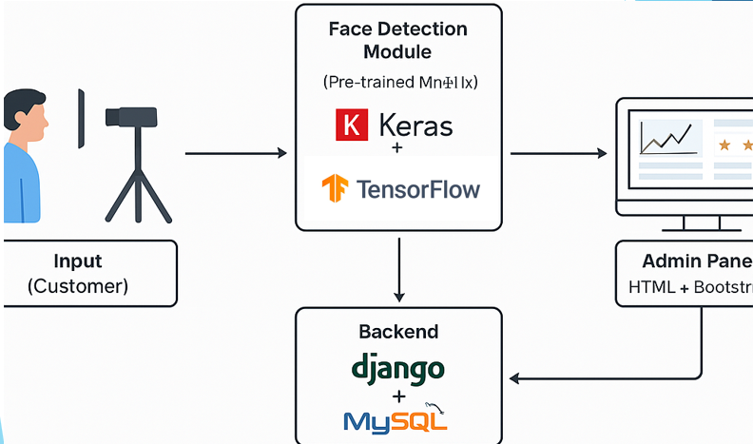
SYSTEM ARCHITECTURE

Slide 9
MODULES
1. User Module (Customer Side)
Allows the customer to enter details, upload a photo, and submit feedback.
Interface is built using Django templates (HTML/CSS + Bootstrap).
2. Face Detection Module (OpenCV)
Captures the face from the uploaded image using Haar Cascade classifier.
Prepares the face for further analysis by cropping and converting to grayscale.
3. Expression Recognition Module (Mini Xception + TensorFlow)
Loads a pre-trained Mini Xception CNN model.
Classifies the facial expression into Satisfied, Neutral, or Disappointed.

Slide 10
MODULES
4. 💾 Database Module (MySQL)
Stores user details, images, predicted emotion, and rating.
Supports data retrieval for analytics and admin viewing using Django ORM.
5. 🛠️ Admin Module (Dashboard)
Allows admin to log in, view feedback, filter/search ratings, and delete entries.
Displays satisfaction stats and rating summaries in a user-friendly interface.

Slide 11
ALGORITHM
Step-1 Start → Capture or upload the customer’s image through the web interface.
Step- 2 Face Detection (OpenCV) → Apply Haar Cascade to detect and crop the face from the image. → Convert the image to grayscale for uniformity.
Step- 3 Image Preprocessing → Resize the cropped face image to 48x48 pixels. → Normalize pixel values to improve model prediction accuracy.
Step- 4 Emotion Prediction (Mini Xception + TensorFlow) → Load the pre-trained Mini Xception CNN model. → Pass the processed image into the model. → Model predicts the expression: - 😊 Satisfied - 😐 Neutral - 😞 Disappointed

Slide 12
ALGORITHM
Step- 5. Generate Rating → Assign a rating based on the emotion detected → Store the result in the MySQL database.
Step- 6. Display Output → Show the customer their feedback result. → Allow admin to view and manage all ratings from the dashboard.

Slide 13
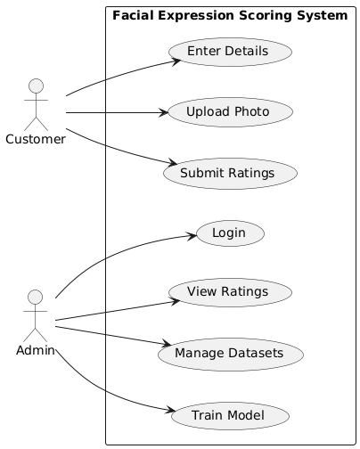
UML DIAGRAMS
USE CASE DIAGRAM

Slide 14
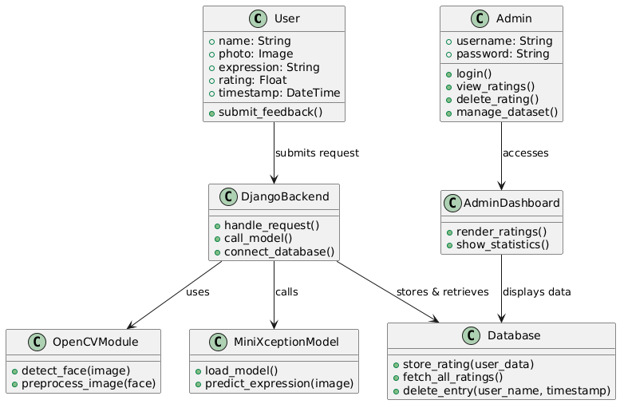
UML DIAGRAMS
CLASS DIAGRAM

Slide 15
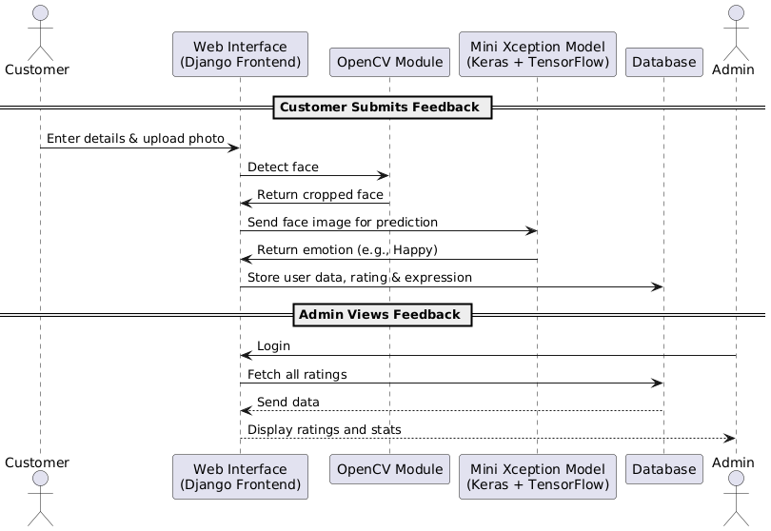
UML DIAGRAMS
SEQUENCE DIAGRAM

Slide 16
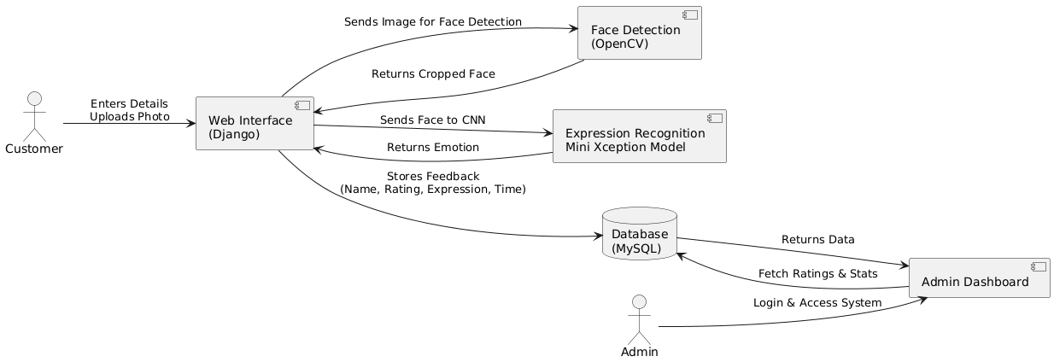
UML DIAGRAMS
DATAFLOW DIAGRAM

Slide 17
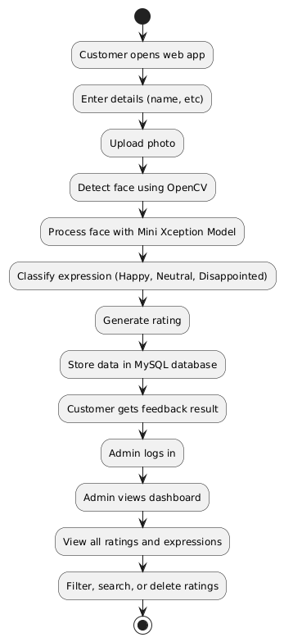
UML DIAGRAMS
ACITIVITY DIAGRAM

Slide 18
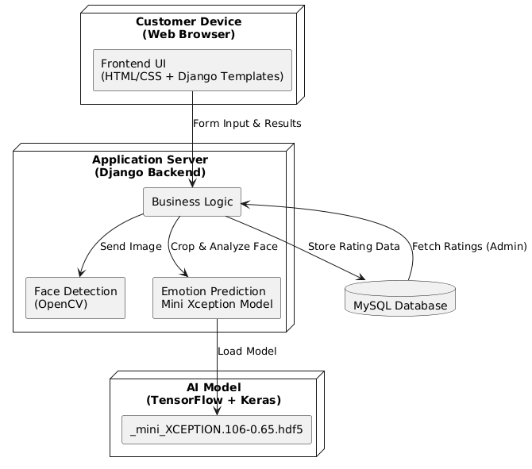
UML DIAGRAMS
DEPLOYMENT DIAGRAM

Slide 19
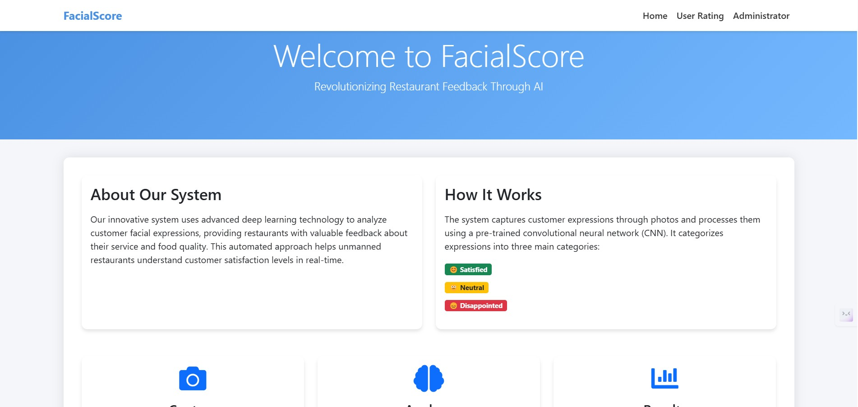
Sample Screenshots
HOME PAGE

Slide 20
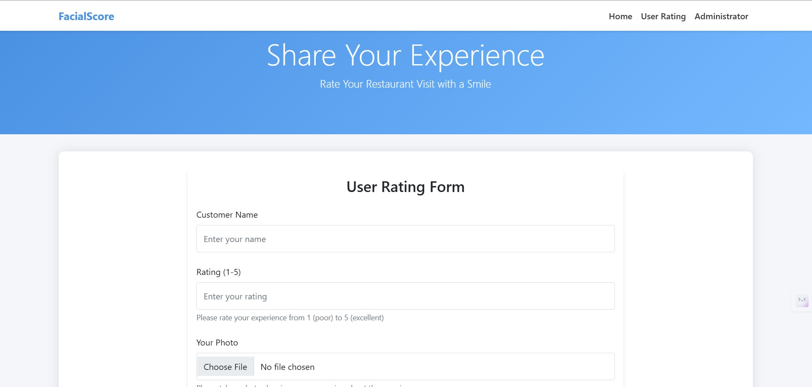
Sample Screenshots
USER RATING PAGE

Slide 21
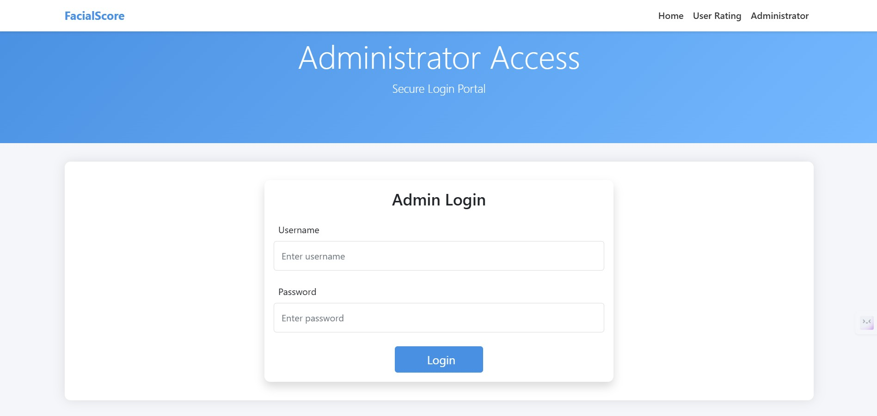
Sample Screenshots
ADMIN LOGIN PAGE

Slide 22
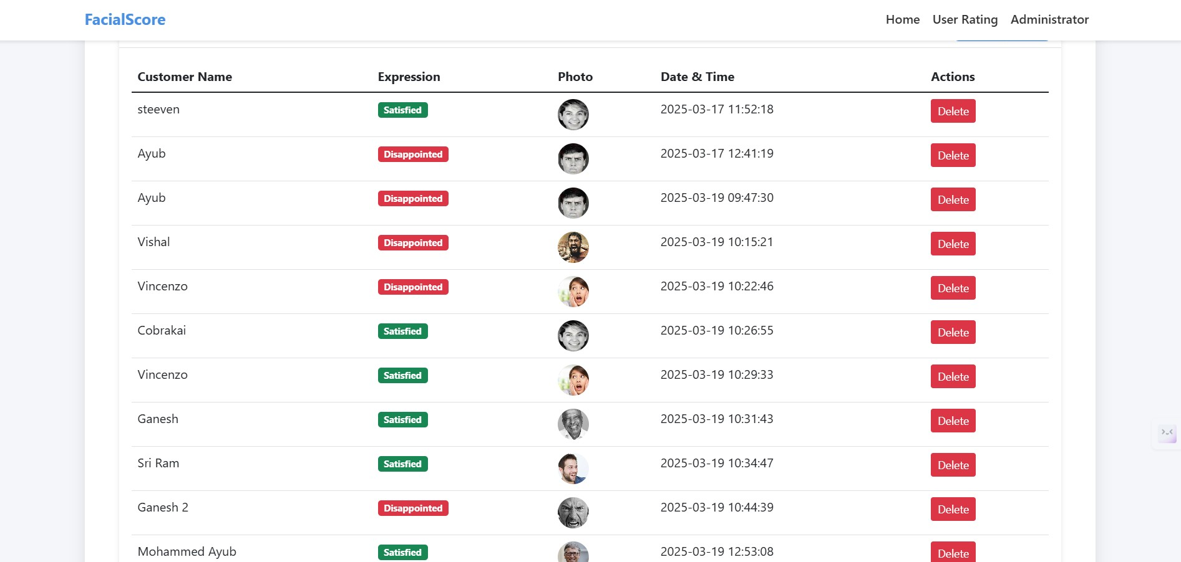
Sample Screenshots
ADMIN DASHBOARD

Slide 23
CONCLUSION
In a world where customer feedback is crucial for business growth, our AI-powered facial expression recognition system transforms the way restaurants understand their customers. By eliminating the need for manual surveys, we ensure real-time, unbiased, and fully automated feedback collection based on genuine emotions. Using deep learning and computer vision, our system detects expressions, assigns ratings, and presents insightful analytics through an intuitive admin dashboard. This not only enhances decision-making but also revolutionizes the dining experience by allowing businesses to adapt and improve instantly. With cutting-edge technology replacing outdated methods, we are not just solving a problem—we are redefining customer satisfaction in the restaurant industry. So,
Why ask for feedback when AI can read it for you.

Slide 24


