Slide 1


V. R. S. College of Engineering and Technology Arasur-607107, Villupuram District (Reaccredited by NAAC and An ISO 9001:2008 Recertified Institution)
DEPARTMENT OF COMPUTER SCIENCE AND ENGINEERING
NEIGHBOURGUARD: SMART HAZARD REPORTING & RESPONSE SYSTEM
FINAL REVIEW
PRESENTED BY, UNDER THE GUIDENCE,
NAME REGISTER NUMBER Mrs. N. KAVITHA , B.E., M.Tech., AP/CSE
Mr. SRIRAM S 422722104048
Mr. SURIYA PRAKASH K 422722104049
Mr. YOKESHWARAN R 422722104057
Mr. CHANDRU M 422722104302

Slide 2
Scope of the project
To develop a smart hazard reporting system for local communities.
Enables users to report hazards with multimedia evidence (image/audio).
Provides real-time alert generation and monitoring.
Ensures data authenticity using AI-based validation.
Supports role-based access (User & Admin dashboards)

Slide 3
Abstract
NeighbourGuard is a web-based smart hazard reporting and response system designed to enhance community safety. The system allows users to report hazards by submitting descriptions along with multimedia evidence such as images and audio recordings. It integrates geolocation to accurately capture the location of incidents.
An AI-based validation mechanism is implemented using a trust scoring approach to filter fake or low-quality reports. Verified reports are converted into categorized alerts and displayed across dashboards for monitoring. The system also includes role-based access, real-time communication features, and an interactive user interface, making it efficient, secure, and user-friendly.

Slide 4
Introduction
NeighbourGuard provides:
Easy hazard reporting
Real-time alerts
Secure authentication
Smart validation using AI logic

Slide 5
Literature Survey
Year | Title | Usage
2025 | Real Time Alert System Based On Crime Area Mapping | This system using GIS and real-time data processing to identify crime-prone areas and send alerts to users. It enhances public safety through location-based notifications and predictive crime analysis.
2025 | Neighbourhood Safety Alarm System | This a mobile/web-based system that sends real-time alerts about crimes and emergencies using GPS and Firebase. It supports community participation and improves awareness through interactive mapping.

Slide 6
YEAR | TITLE | USAGE
2024 | Smart Crime Detection and Alert System | This paper focuses on detecting crimes using sensors, surveillance. It provides instant alerts to authorities and users, helping in faster response and improving overall security.

Slide 7
Existing System
Manual reporting (phone calls, complaints).
No centralized monitoring system
Limited verification of reports
No fake report detection

Slide 8
Disadvantages:
Slow response time
No real-time updates
High chances of fake reports
No multimedia evidence support
Lack of proper tracking and management

Slide 9
Proposed System
Web-based NeighbourGuard system
Smart reporting with AI validation
Map-based Hazard location selection
Multimedia evidence (image + audio)
Real-time alert system
Monitoring and Control Users

Slide 10
Advantages
Faster hazard reporting
Accurate location tracking
Fake report filtering using Trust Score
Centralized monitoring (Admin dashboard)
Improved user experience with modern UI

Slide 11
Requirements
Hardware Requirements
Computer / Laptop
Internet connection
Microphone (for audio recording)

Slide 12
Software Requirements
Frontend: HTML, CSS, JavaScript
Backend: PHP
Database: MySQL
APIs/Libraries:
- Leaflet (Map integration)
- MediaRecorder API (Audio recording)
Server: XAMPP
Hosting(free) - infinityfree

Slide 13
List of Modules & Explanation
Authentication Modules
User Authentication Module – Either Google login or Create an account.
Admin Management Module – View reports, manage responses ,Manage Users.
Hazard Modules
Hazard Reporting Module - Submit hazard details, attach photo/audio, select location.
Hazard Mapping Module – Display hazards Location on Leaflet Maps for users and authorities/admins.
AI Validation Module – This module verify the user submitted report that is fake or Real
Dashboard Module – Admin Dashboard , User Dashboard .
Forgot Password Module - If the users forgot their password , then utilize this module
they can reset the password.
Database Module – Store and retrieve reports, user data, and status updates
Database Name: Neighbourguard_db.
Tables: Reports, Users .

Slide 14
Authentication Module - User & Admin login system, Session management, Password hashing, Google login integration.
Flowchart (Login → Verify → Redirect to dashboards(User/Admin).
Login
Verify user/admin
If User
If Admin
User Dashboard
Admin Dashboard

Slide 15
2.Hazard Reporting Module - Users submit reports That Contains: Name ,Description , Image , Audio, Location(on Leaflet Map) , Data stored temporarily before validation.
User → Form → Database
After Login
(User)
Report form + Hazard Location
Text +Image
Audio(optional)
Submit Report
AI Validation

Slide 16
3.AI Validation Module - Trust score based on: Text length , Keywords , Image presence, Audio evidence
Use : Filters fake reports If only Storing Valid reports in the reports table .
Input → AI Check → Accept/Reject
Receive Inputs
(From reports page)
True
If
Trust score >= 50%
False
Report Accepted
(then Stored in DB)
Report Rejected
(Try Again)

Slide 17
4.Admin Module - View all users reports , Delete users (or Managing Users) , Monitor alerts.
login
If admin exist
No
Yes
View Reports
Admin Not Found
Admin Dashboard
Manage Users
Live Alerts

Slide 18
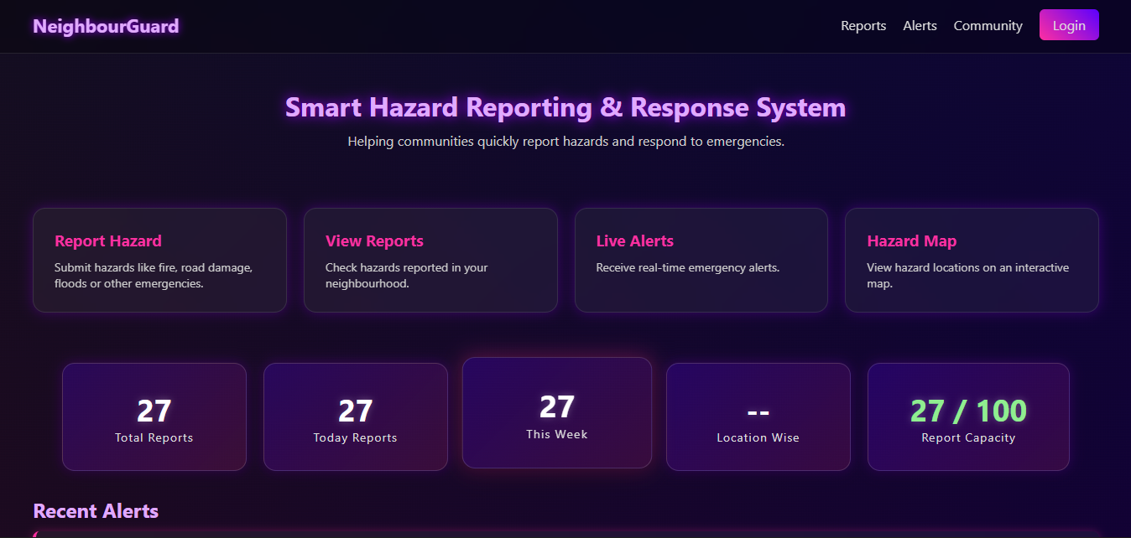
Output Screenshots – Home Page

Slide 19
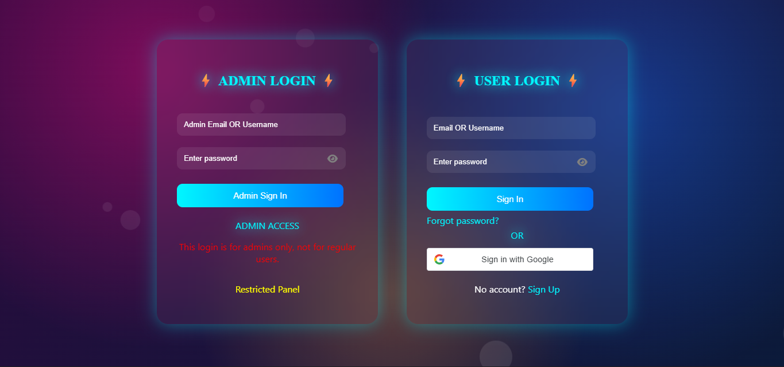
Login Page

Slide 20
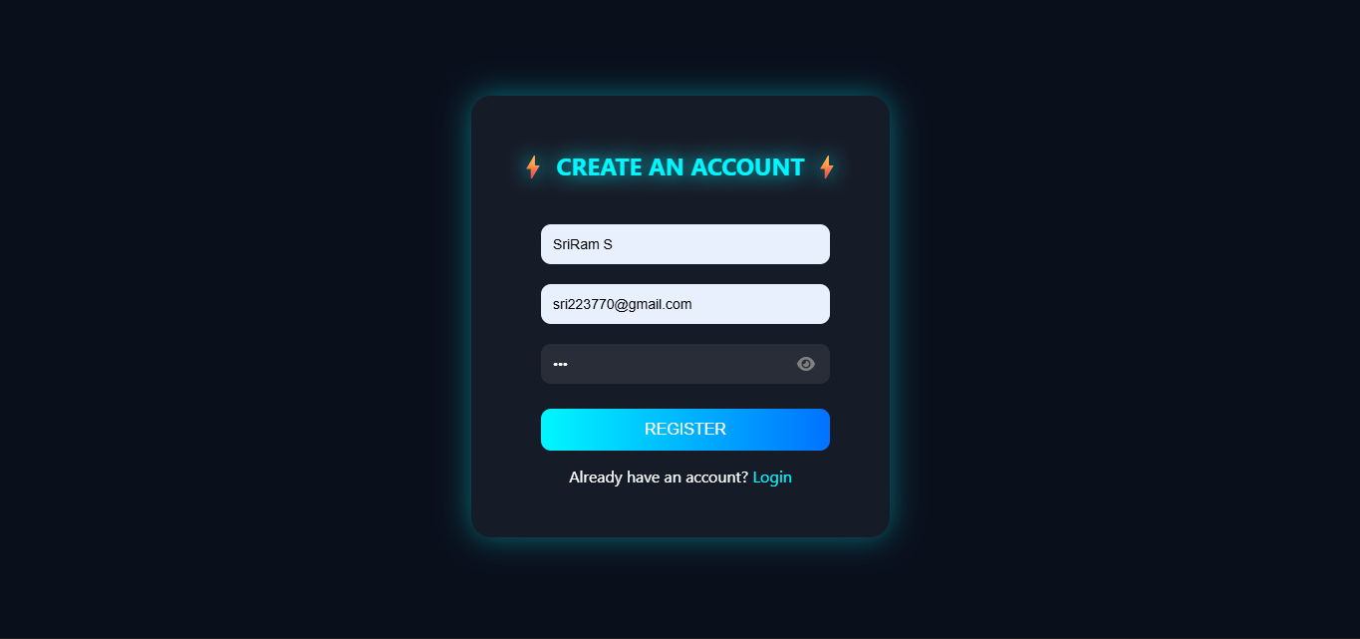
New User Registration Page

Slide 21
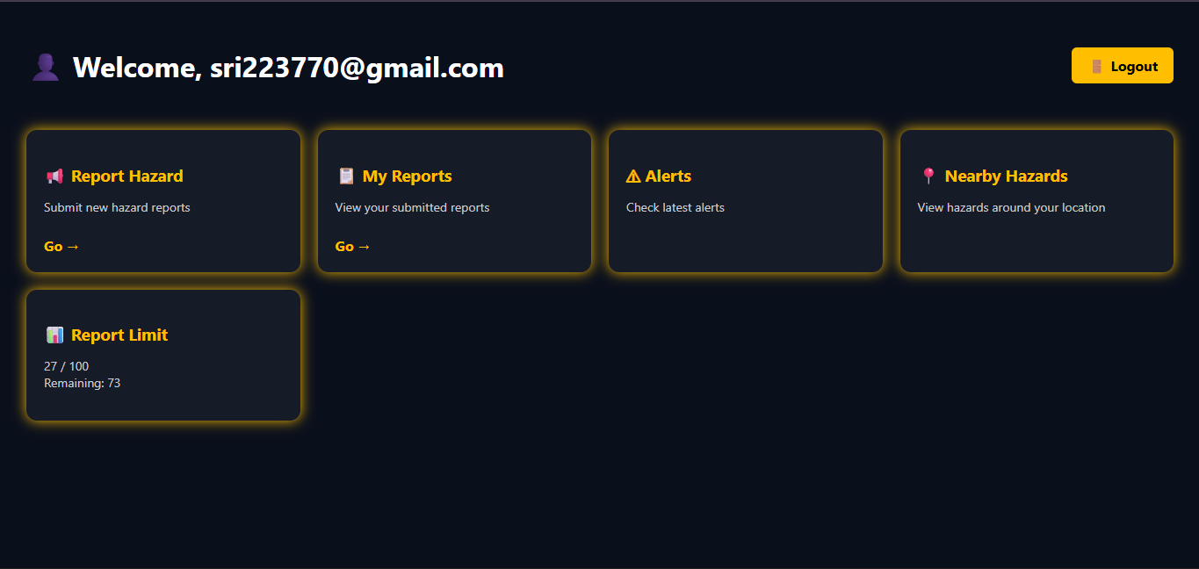
Users Dashboard

Slide 22
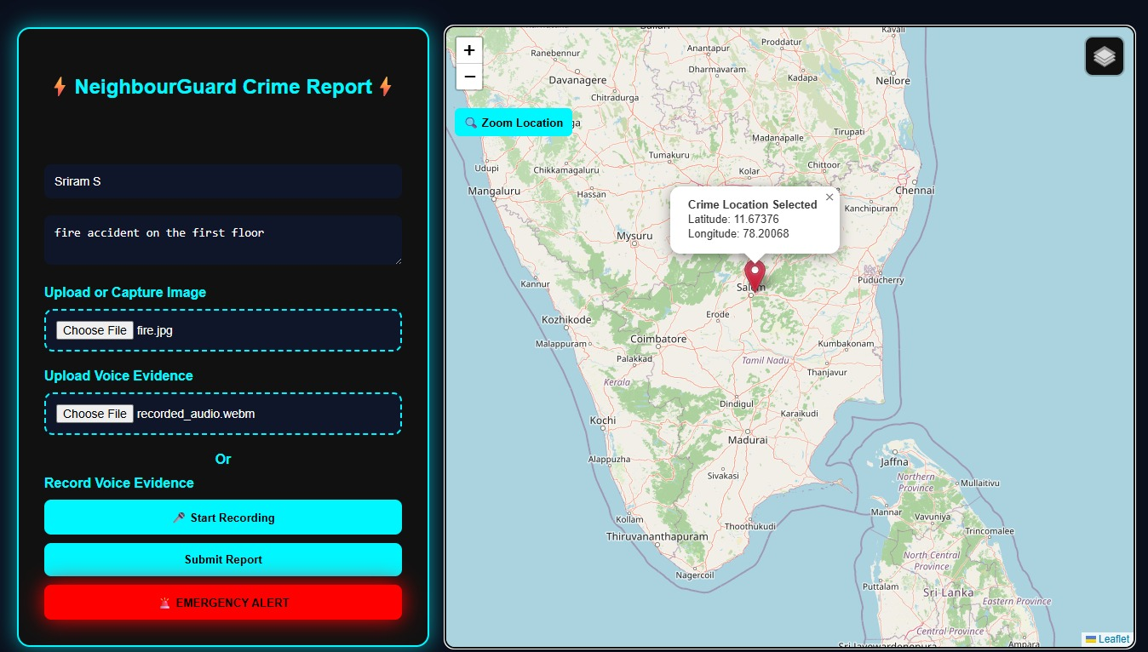
Repot Hazard

Slide 23
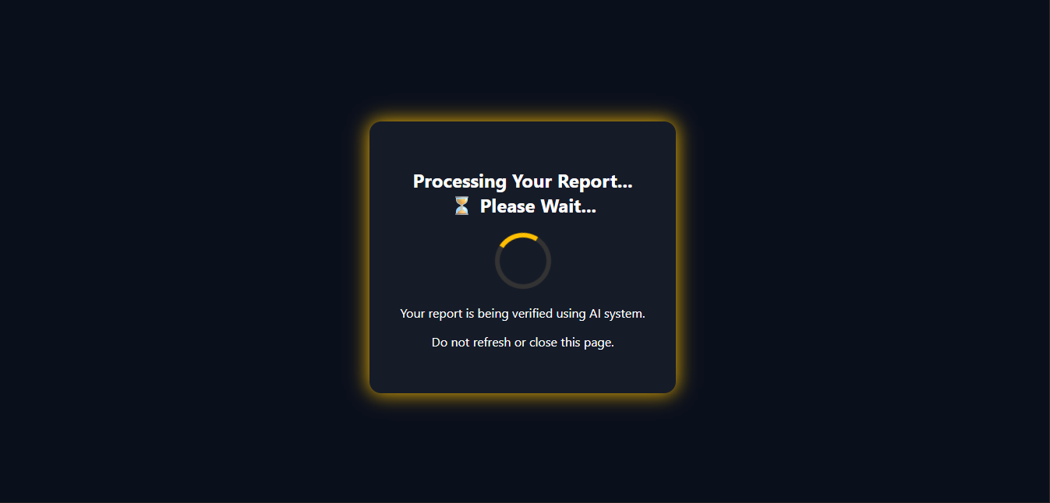
Processing Your Report

Slide 24
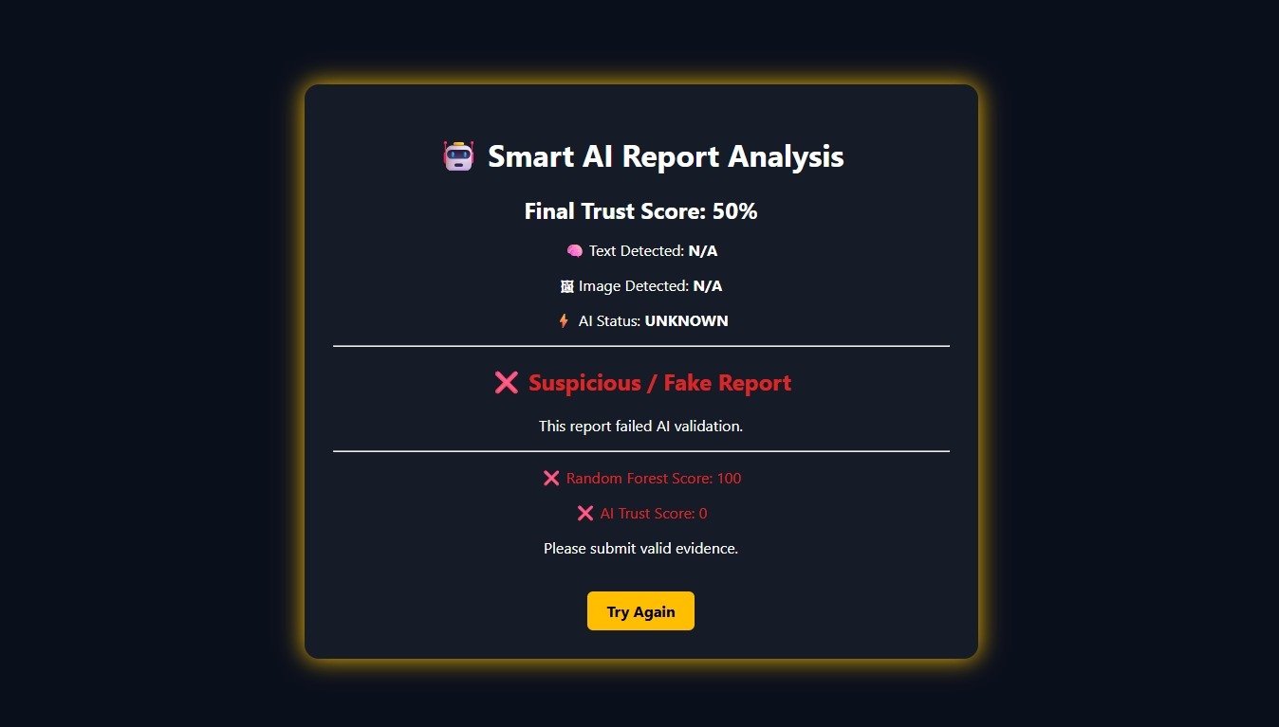
AI Report Validation Fails

Slide 25
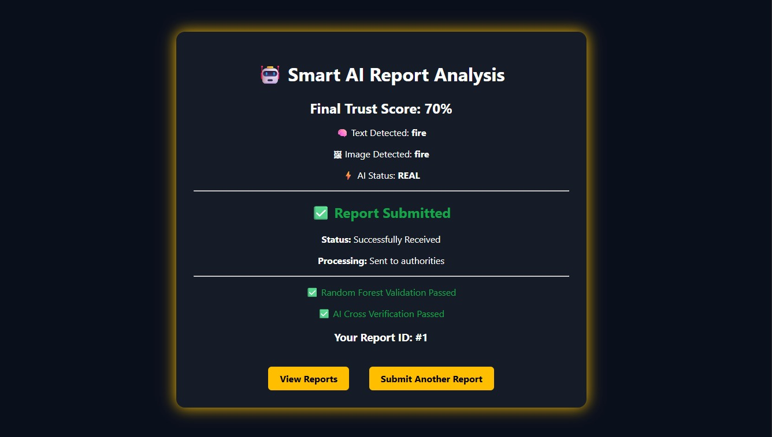
AI report Validation Success

Slide 26
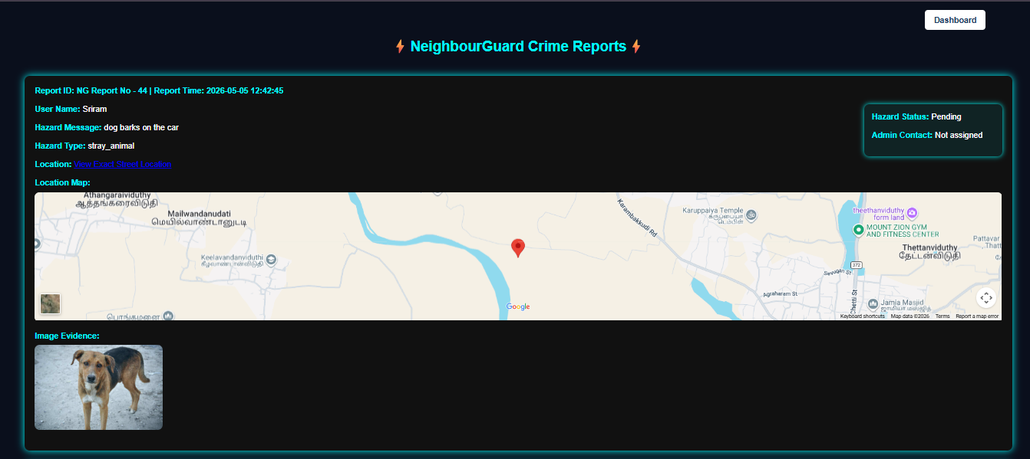
View Reports

Slide 27
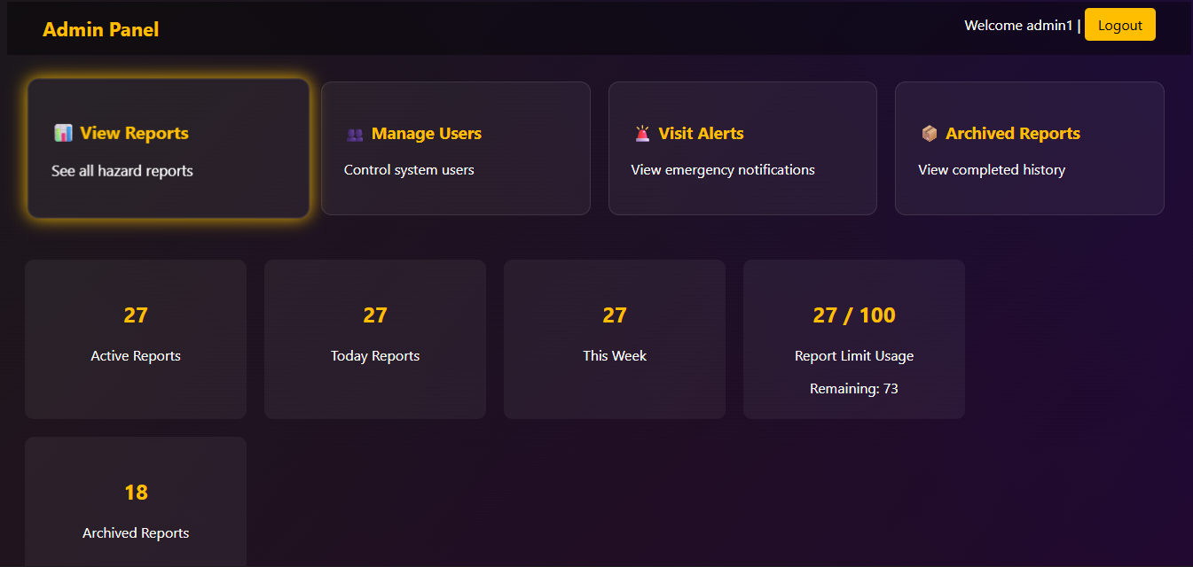
Admin Dashboard

Slide 28
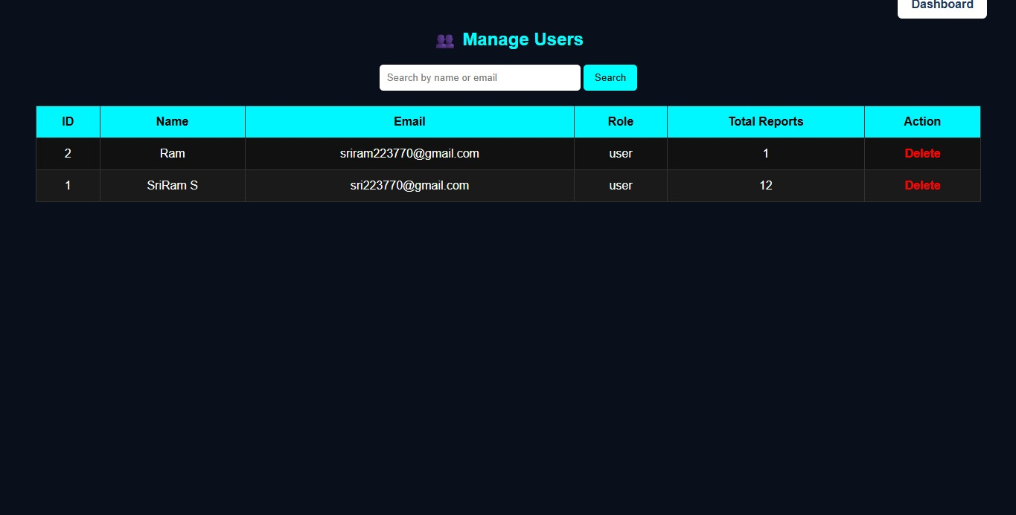
Manage Users

Slide 29
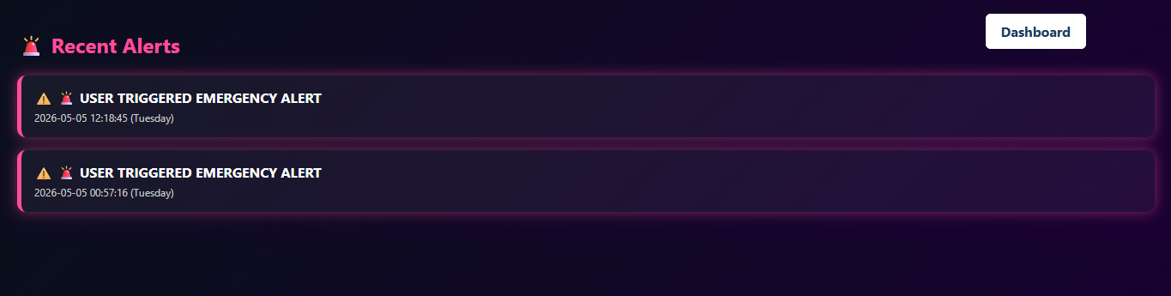
Recent Alerts

Slide 30
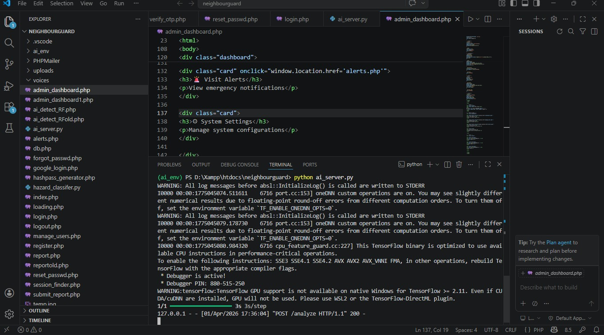
Coding

Slide 31
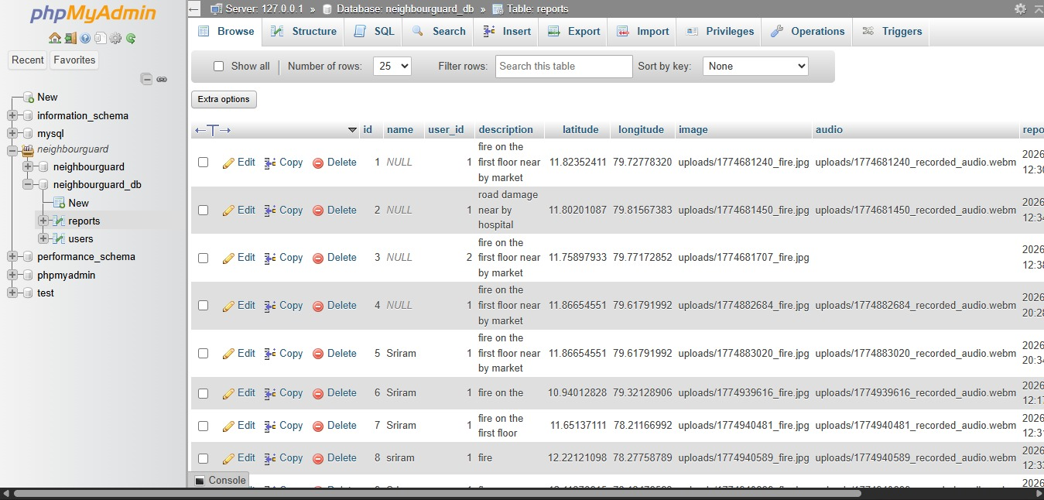
Reports Table

Slide 32
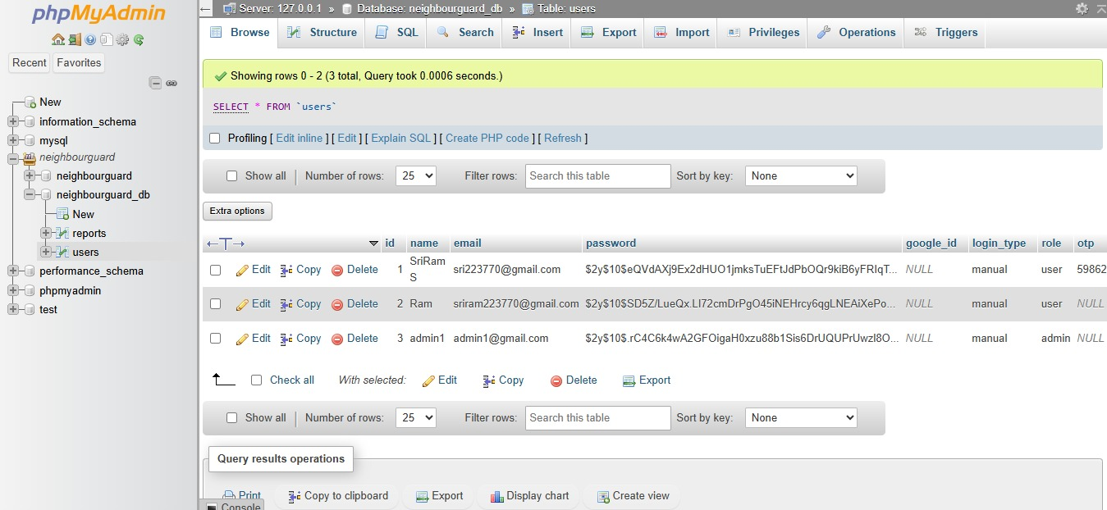
Users Table

Slide 33
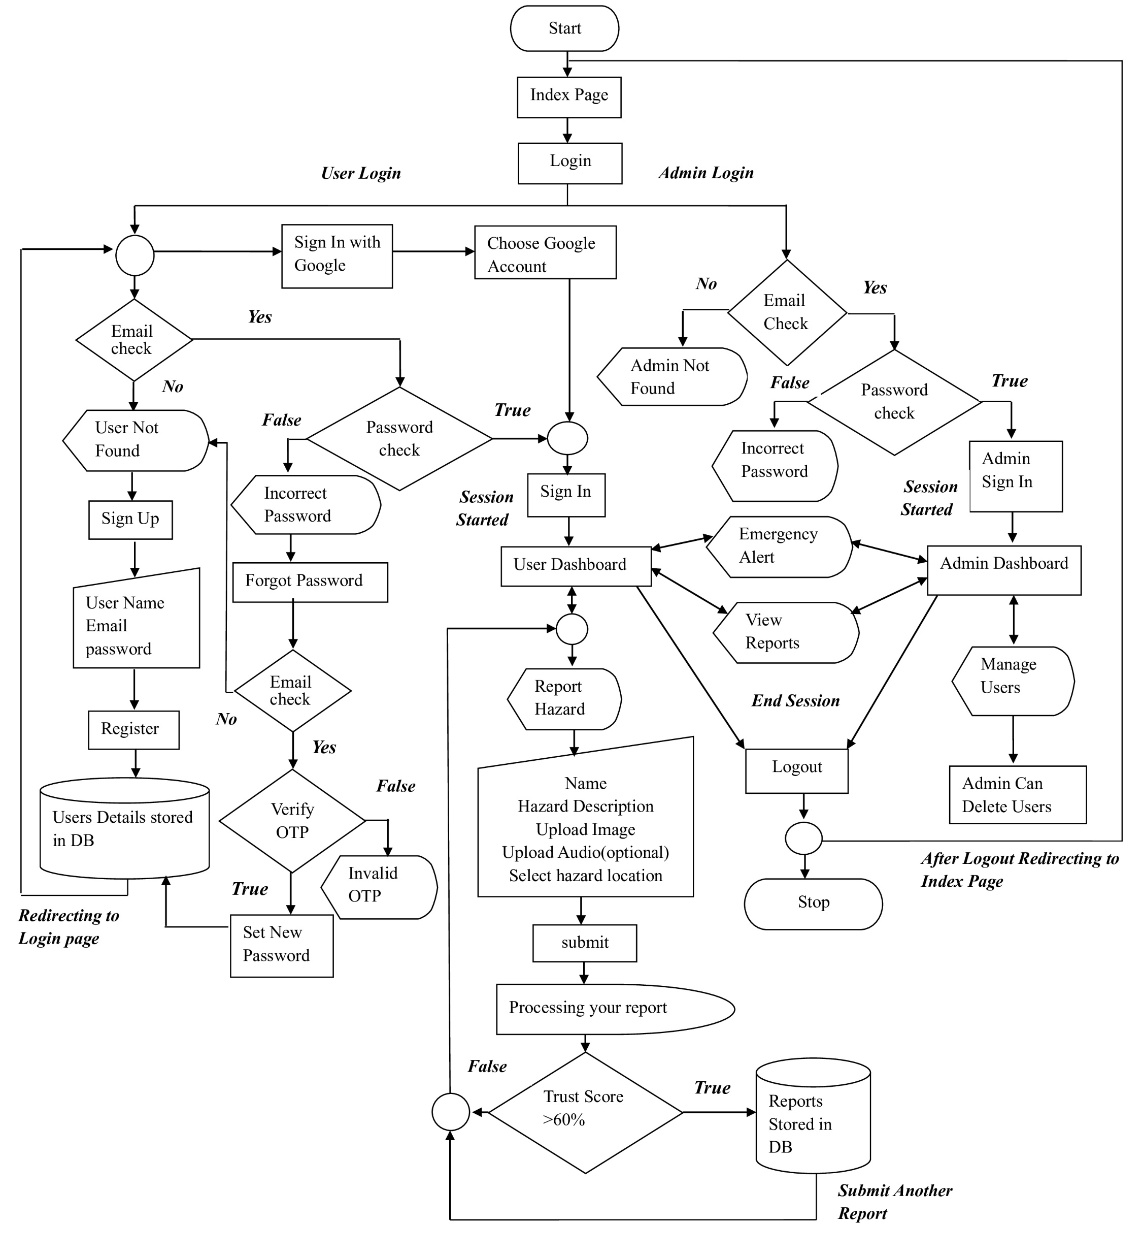
System Control Flow

Slide 34
Applications & Future Enhancement
Applications:
Smart cities
Community safety monitoring
Future Enhancements:
Integration with emergency services
Mobile app development

Slide 35
Conclusion
Successfully developed a smart hazard reporting system
Implemented AI-based validation for reliability
Integrated map, multimedia, and real-time features
We Designed a secure and user-friendly system
Provides a strong foundation for real-world deployment.

Slide 36
References
1. Kumar, S., Reddy, P.K. and Sharma, R. (2022) 'Smart Hazard Detection Using IoT and Real-Time Systems', IEEE Access, Vol.10, pp.45231-45245.
2. Sharma, R. and Singh, P. (2023) 'Real-Time Monitoring in Smart Cities', International Journal of Smart Technology, Vol.5, No.2, pp.112-125.
3. Alam, F., Ofli, F. and Imran, M. (2022) 'Robustness of Deep Learning Models for Image-Based Hazard Classification', IEEE Transactions on Computational Social Systems, Vol.9, No.3, pp.789-802.
4. Patel, K., Mehta, A. and Joshi, R. (2025) 'Automation in Smart Safety Systems Using Machine Learning', IEEE Access, Vol.13, pp.23456-23470.

