Slide 1
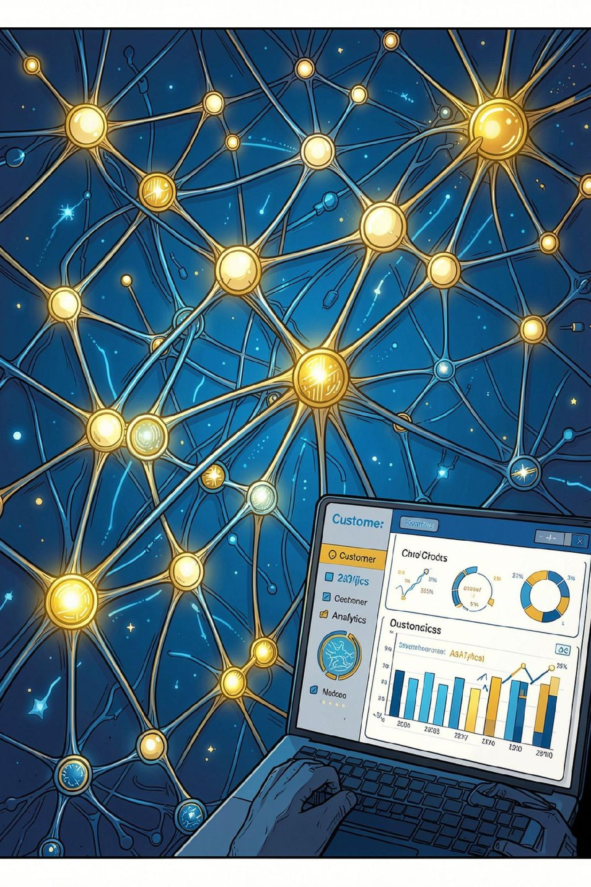
Personalized Customer Retention using Causal Uplift Modeling, CatBoost X-Learner & Generative AI RAG
AI-POWERED CUSTOMER RETENTION DECISION SUPPORT SYSTEM
Project Vision: From predicting who may churn to identifying who should receive a retention intervention.
Name
Srishha D
Course
POST GRADUATE PROGRAM IN ML AND AI

Slide 2
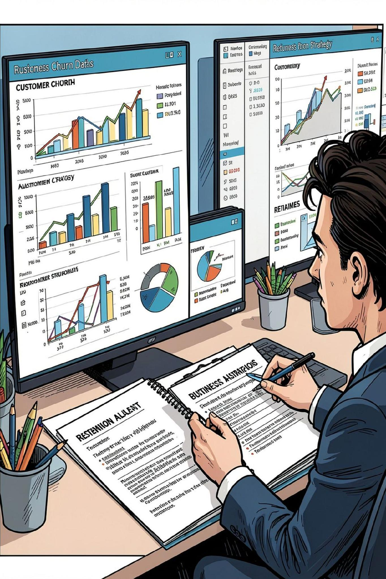



Problem Statement & Business Motivation
Traditional churn prediction asks "Who is likely to churn?" — but businesses actually need to know: "Who should receive a retention offer to maximize incremental business value?"
High Risk ≠ High Response
A high churn probability does not mean the customer will respond to an offer.
Unnecessary Spend
Some customers stay without intervention; others churn regardless. Blanket discounts inflate costs.
ROI, Not Just Accuracy
Businesses need to maximize retention ROI — not simply predict churn.
Key Objective: Identify customers whose behavior is most likely to improve because of a retention intervention, and prioritize them by expected business value.

Slide 3
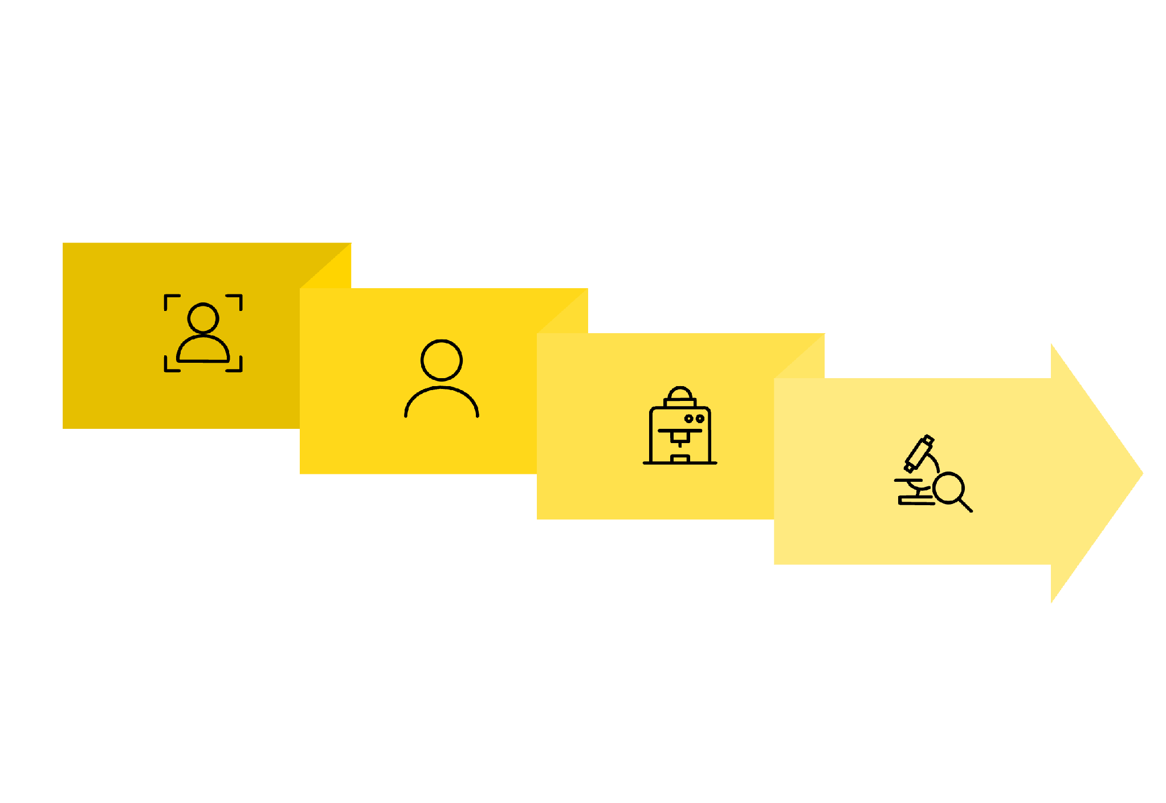
Overall Solution Approach
An end-to-end pipeline transforms raw customer data into grounded, actionable retention decisions.
Group Split
Explain & ROI
Data Prep
Uplift Model
Each stage builds on the last: Prediction → Causal Effect → Explanation → Business Decision → Generative AI Recommendation — ensuring every output is interpretable, actionable, and grounded in business context.

Slide 4
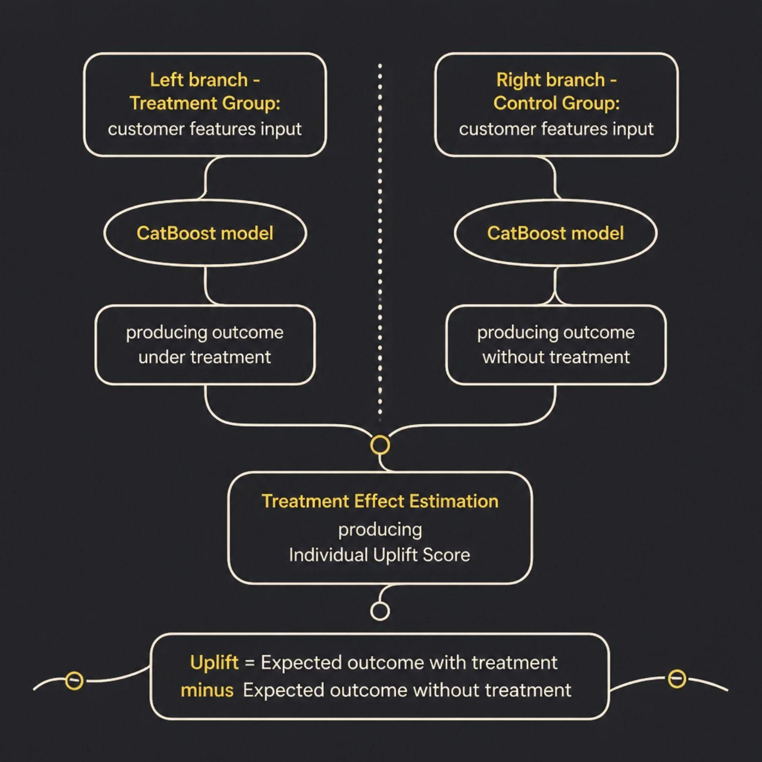
Causal Uplift Modeling: CatBoost X-Learner
Why CatBoost?
Handles nonlinear relationships in customer behavior
Native support for categorical features (contract type, internet service)
Robust on tabular data with heterogeneous patterns
Captures diverse customer response profiles
Four Uplift Segments
Persuadables — respond only if treated ← Highest-value targets
Sure Things — stay regardless of treatment
Lost Causes — churn regardless of treatment
Sleeping Dogs — may churn because of treatment

Slide 5
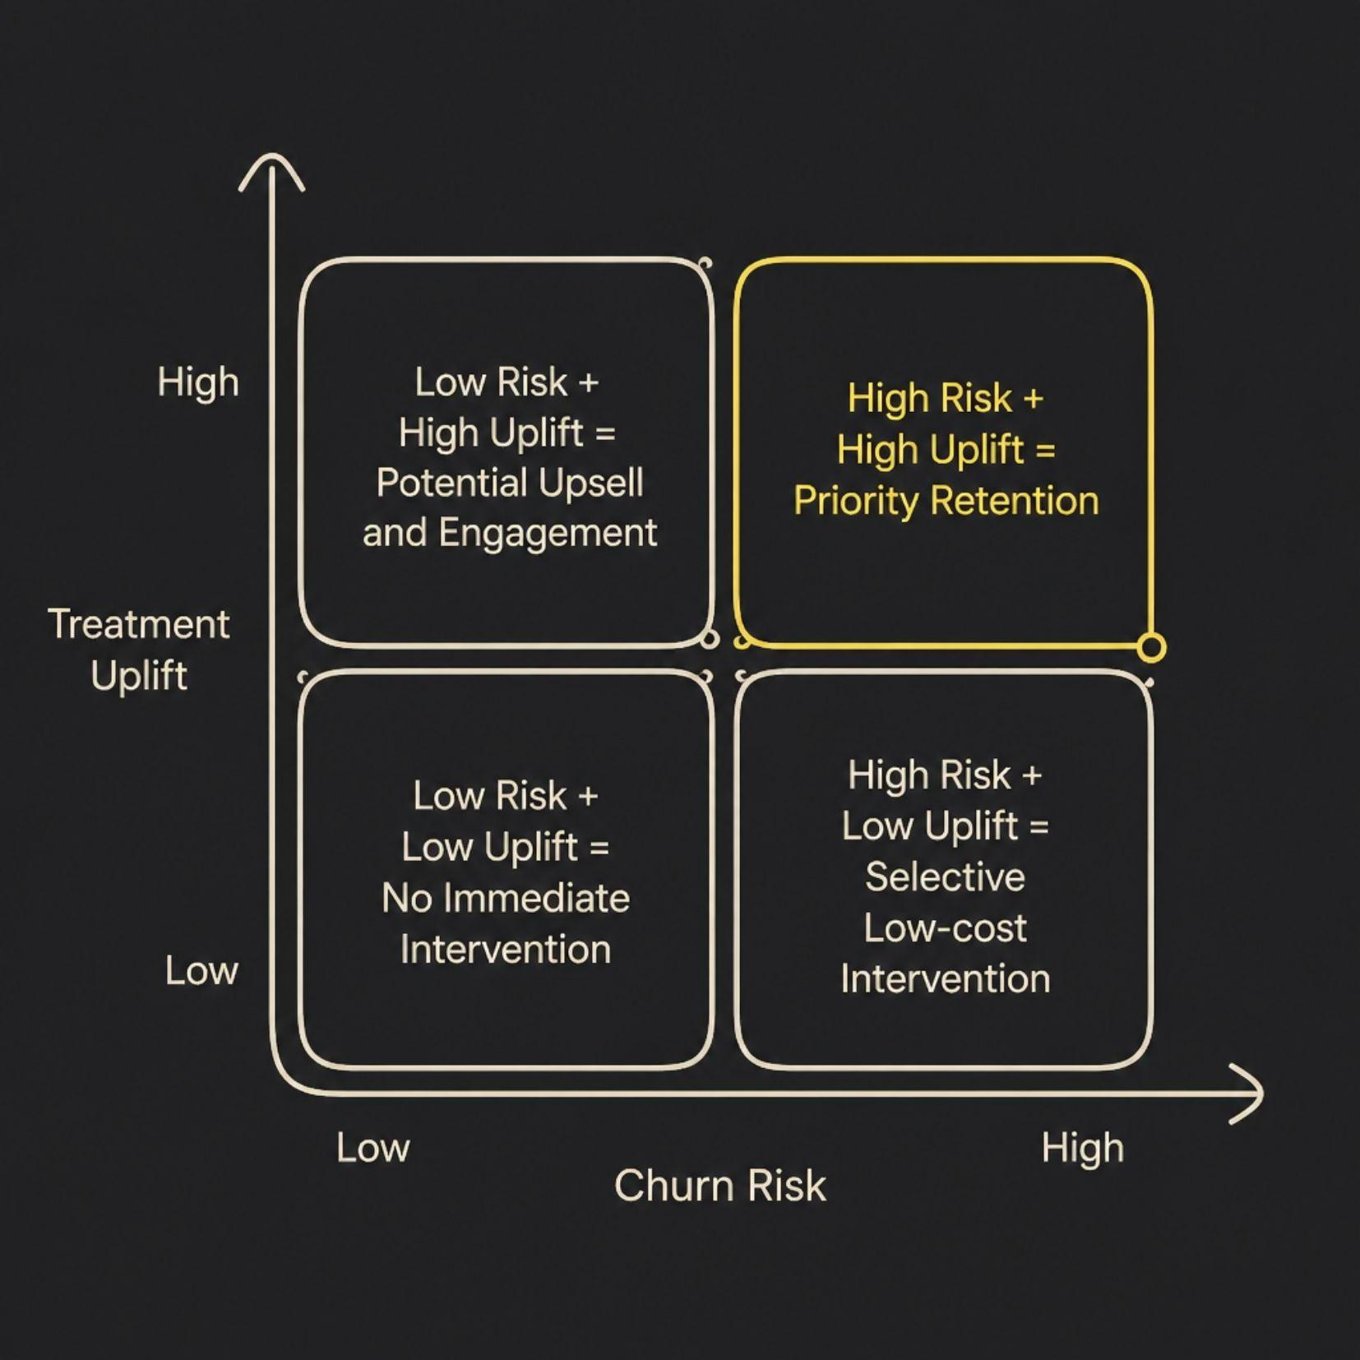

Customer Segmentation, SHAP & Decision Explainability
Segmentation Logic
Customers are mapped by churn risk (X-axis) and treatment uplift (Y-axis), enabling differentiated intervention strategies per segment.
SHAP Explainability
SHAP answers: "Why does the model believe this customer is responsive?" Example feature contributions include:
Contract type & tenure
Monthly charges
Internet service type
Support & service usage patterns
SHAP provides customer-level model transparency — enabling business users to trust and act on model outputs.

Slide 6


ROI-Driven Retention Strategy & Generative AI / RAG
ROI Optimization Framework
Gemini + RAG Architecture
The system ranks customers not by churn probability alone, but by expected incremental business value:
High Uplift + High Value + Positive ROI → High Priority
01
Customer Profile + Model Results
02
Business Documents & Retention Policies
03
RAG Retrieval → Relevant Context
04
Gemini Generative AI → Grounded Recommendation
RAG connects model insights with business knowledge — enabling natural-language Q&A on targeting, strategy, and uplift drivers.
Uplift Score
Customer Value
Offer Cost
Likelihood of responding to treatment
Expected retention value
Intervention expense

Slide 7

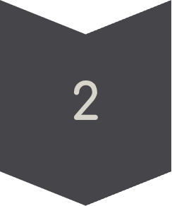
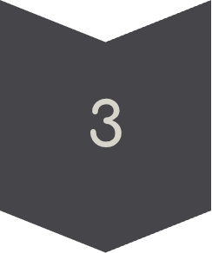
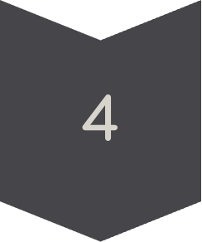

Streamlit AI Decision Support System
The dashboard converts complex ML and causal insights into actionable business decisions through a structured user journey.
Select Customer
View profile, contract & services
View Risk & Uplift
Churn probability + uplift score
Understand Drivers
SHAP feature contributions
Evaluate Business Value
Expected incremental value & ROI
Receive AI Recommendation
RAG-grounded intervention strategy

Slide 8
Key Findings & Business Impact
Machine Learning
Business Impact
Generative AI
Uplift modeling offers a decision-oriented alternative to churn prediction
Customer treatment responsiveness is heterogeneous
CatBoost handles nonlinear tabular customer behavior effectively
SHAP improves model interpretability at the individual level
Not every high-risk customer should receive an incentive
Persuadable customers are the highest-value retention targets
ROI-based targeting reduces unnecessary campaign spend
Personalized interventions improve overall campaign efficiency
RAG provides contextual business knowledge to the AI assistant
Gemini converts analytical outputs into understandable recommendations
Streamlit delivers an accessible, interactive decision-support interface

Slide 9



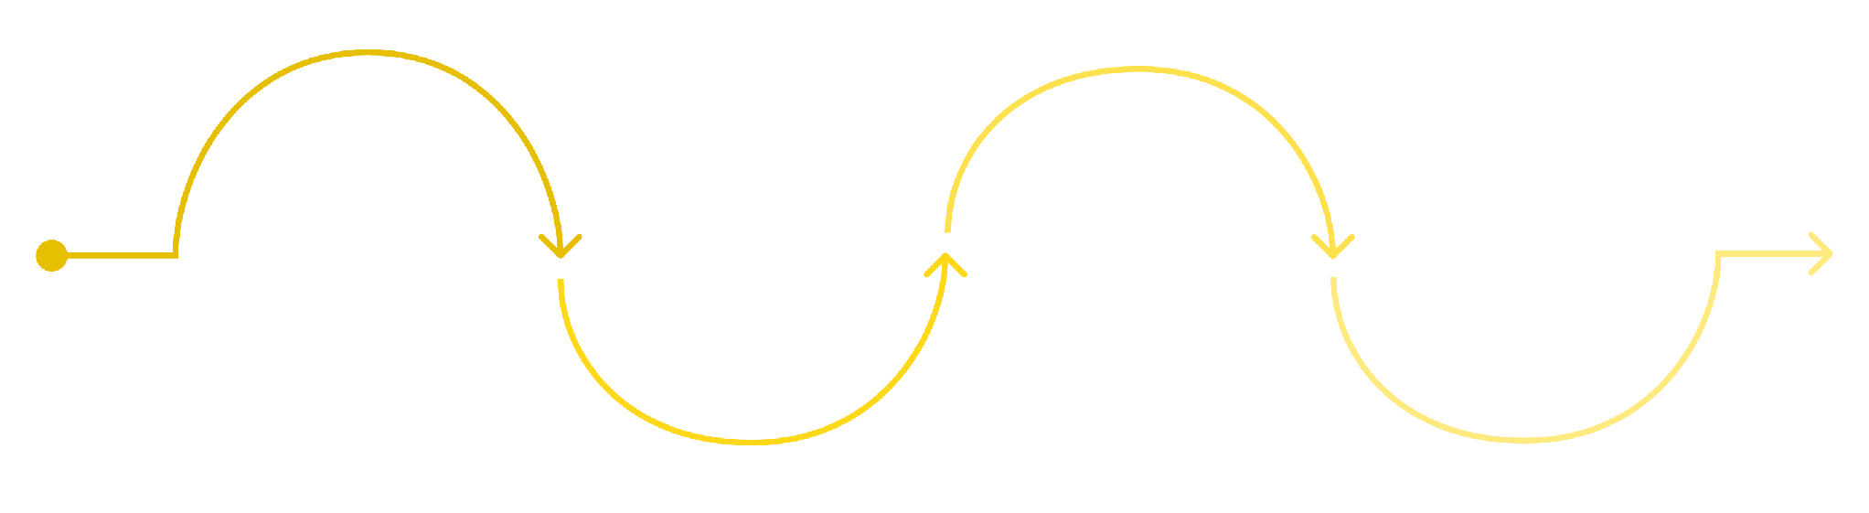
Future Improvements & Next Steps
A structured roadmap from validation to production deployment.
Business Optimization
Generative AI & RAG
Introduce multiple retention offers
Integrate Customer Lifetime Value (CLV)
Add citations & source attribution
Implement hallucination guardrails
Production Deployment
Real-time scoring & CRM integration
Automated campaign triggering
Current System
Optimization
Production
Validation
CLV integration and multi-offer strategy
Real-time scoring and CRM integration
Baseline uplift model and dashboard
A/B testing and causal validation

Slide 10






Why This Project Matters
Business Value
Causal ML Value
Explainability
Better targeting, lower unnecessary incentives, and higher potential ROI through ROI-ranked prioritization.
Moves beyond predicting churn toward estimating the true impact of an intervention.
SHAP helps business users understand and trust model decisions at the customer level.
Generative AI Value
Practical Value
Gemini + RAG transforms analytical outputs into grounded, natural-language recommendations.
Streamlit provides an interactive decision-support interface accessible to non-technical stakeholders.
Estimate
Predict
Identify users at churn risk.
Compute uplift as causal impact.
Explain
Optimize
Surface SHAP drivers for each user.
Rank actions by expected ROI.
"The project does not simply identify customers who may churn. It identifies customers for whom a retention intervention is most likely to create incremental value."
THANK YOU

