Slide 1

DIGITAL IDENTIFICATION-AI
Technology Partner
PRESENTED BY
[S.SRIRAM]

Slide 2
Problem Statement
physical identity documents that are straightforward to issue, manage and verify, delivering a powerful tool to fight ID fraud, reduce red tape and boost efficiency.

Slide 3
User Segment & Pain Points
Customer service executives are often loaded with too many requests and they fail to provide the required attention to each customer
examples : Cusomter verification process takes long time to open a new account.

Slide 4
Pre-Requisite
Digital Identification system –using Artifical Intelligence Techniques

Slide 5
Azure tools or resources
Azure tools - CloudMonix

Slide 6
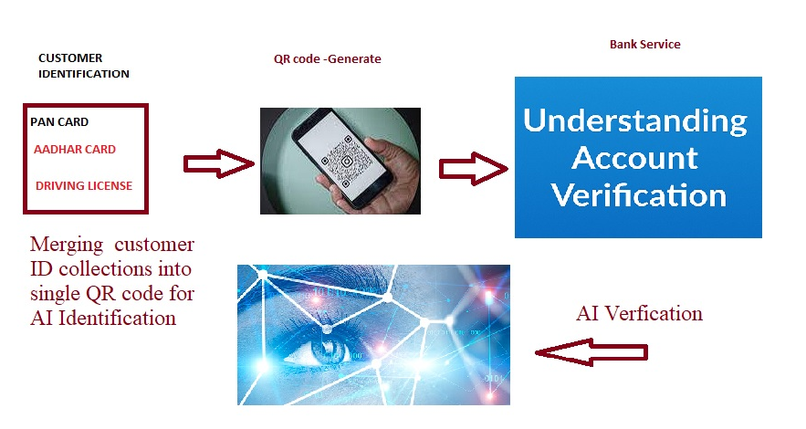
Any Supporting Functional Documents
Present your solution, talk about methodology, architecture & scalability

Slide 7
Key Differentiators & Adoption Plan
solution :
AI technology is an ecosystem, it’s a framework built around people, their experience, skills, and ability to make sense of the data analysis and findings. People in the KYC, AML, and identity verification industries would not get replaced, but reassigned. Their roles would simply develop and evolve around the new technology. AI is not something that would take their jobs but a powerful tool that would help them do their job better.

Slide 8
GitHub Repository Link & supporting diagrams, screenshots, if any
AI identification-Methodology

Slide 9
Thank You
Team member names
S.Sriram

