Slide 1
STARTUP-YOUR MISSION/ TAGLINE
Get well soon
AI Based Digital Health Care Monitoring System for Older Person
Presented by
[ S.SRIRAM ]
1

Slide 2
ABOUT THE IDEA / BRAND
Description
Summary :
Older people can become quickly unwell, and despite having people around them who are monitoring them closely, without clinical evidence to back up their concerns, it can be hard for care teams to know the seriousness of the person’s condition.

Slide 3
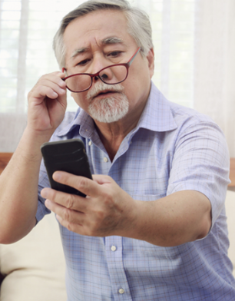
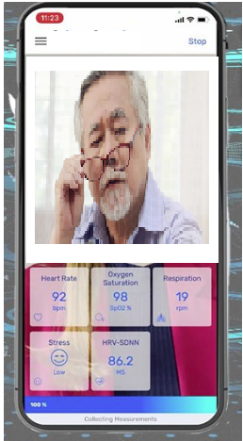
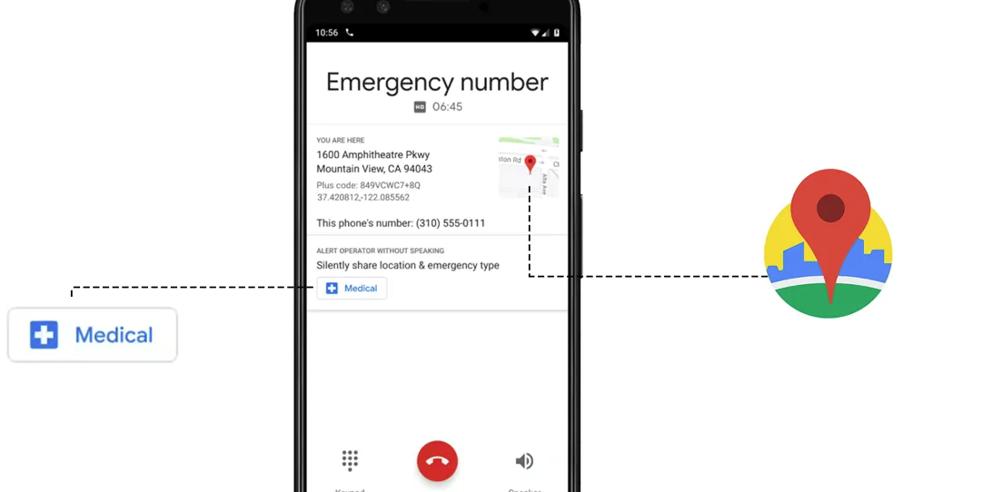
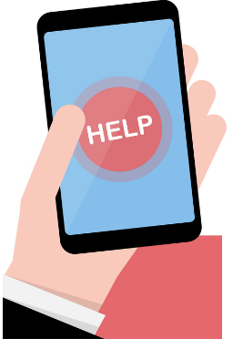
AI Based Digital Health Care Monitoring System for Older Person

Slide 4
The new mobile application system that can track medical observations like oxygen levels in the blood and blood pressure and they can be instantly shared with a team of professionals who can quickly and decidedly intervene, armed with clinical information that is guiding their decision making.

Slide 5
NOVELTY / INNOVATION
(Problem and solution)
WHAT? - Old person get immediate Medical help through the Mobile application by a Health care team through General practitioners.
WHY? -health care data collected for administrative purposes are evermore available and less expensive to analyze, it is not surprising that such data bases are increasingly used in technology assessment .System-wide coverage allows us to monitor the effectiveness of clinical treatments. Since administrative data bases are not limited to specific institutions, they include poor health outcomes.
Why Now? –According to Population recent Census there are nearly 104 million elderly persons (aged 60 years or above) in India 53 million females and 51 million males. A report released by the United Nations Population Fund and HelpAge India suggests that the number of elderly persons is expected to grow to 173 million by 2026.Healthcare is demand at present Situation 2022.

Slide 6
TARGET AUDIENCE
Who is your target customer?
Senior Citizens (old Person)
During an emergency, please press the HELP button on the home page. It will start a 5 second count down. After 5 seconds, the app will automatically send your current location along with Recent Medical reports to the Medical Helthcare team. Within a minute, the team will contact you. Simultaneously, your location will also be sent to your registered emergency contacts as an SMS alert.

Slide 7
COST ANALYSIS
ESTIMATED GROWTH FIRST YEAR
Program Development | 3 Lakhs
Marketing | 1 Lakhs
Monitoring Team{workers} | 1 lakhs

Slide 8
COMPETITORS PROFILE AND MARKETABILITY
Who are your biggest competitors? How do you compare?
Many health care apps already available in today .Few no of people
only get benefitted Except old persons
2. Highlight the size of the market and explain the market opportunity.
A report released by the United Nations Population Fund and HelpAge India suggests that the number of elderly persons is expected to grow to 173 million by 2026.Healthcare is demand at present Situation 2022.

Slide 9
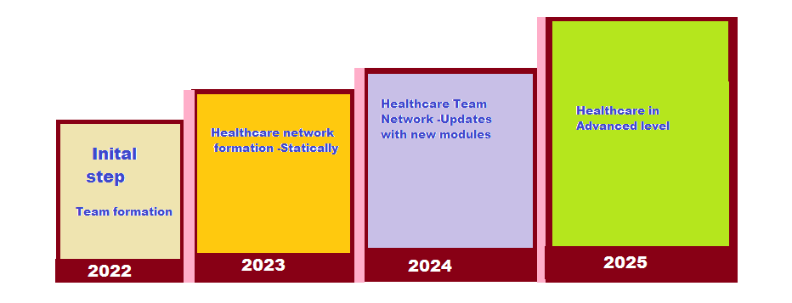
TIMELINE OF THE STARTUP

Slide 10
CONCLUSION
AI can undoubtedly bring new efficiencies and quality to healthcare outcomes in India. However, gaps and challenges in the healthcare sector reflect deep-rooted
issues around inadequate funding, weak regulation, insufficient healthcare infrastructure, and deeply
embedded socio-cultural practices.

Slide 11
THANK YOU

