Slide 1


PLEDGE TO PROGRESS Sustainability Hackathon
Sponsored By
Your Team Name : BIT
Your team bio : S.Sriram
Title : Industry specific solution -Healthcare
Date :19-04-2023

Slide 2
Problem Statement?
Why did you decide to solve this Problem statement?
Hazardous biomedical waste exposure can result in disease or harm to human health. Due to inappropriate handling of medical wastes, the three most often disseminated viruses globally are hepatitis B, C, and HIV. They spread through injuries caused by contaminated needles and syringes. Those most at risk from the negative impacts of biomedical waste are doctors, nurses, and sanitation personnel. The significance of proper treatment of medical wastes cannot be overstated at a time when new coronavirus strains are rapidly emerging.

Slide 3
User Segment & Pain Points
Which user /advertiser segment would be early adopter of your product & why?
The hospital staff's lack of sufficient training and instruction regarding the segregation and disposal of biomedical waste products is a major issue in the management of biomedical waste. The improper treatment of biological waste may cause foetid odours and possible environmental damage.

Slide 4
Pre-Requisite
What are the alternatives/competitive products for the problem you are solving?
Recycling remains the most effective way to keep Medical -waste from damaging our environment and our health.

Slide 5
Tools or resources
Azure tools - Docker

Slide 6
Any Supporting Functional Documents
Present your solution, talk about methodology, architecture & scalability
Designing a mobile Application for Medical e-waste Management.It acts a role that arrange to take Medical e-waste to a recycling firm.

Slide 7
Key Differentiators & Adoption Plan
How is your solution better than alternatives and how do you plan to build adoption?
A Mobile Application is created for the Medical Community to interconnect with the recycling firm .

Slide 8
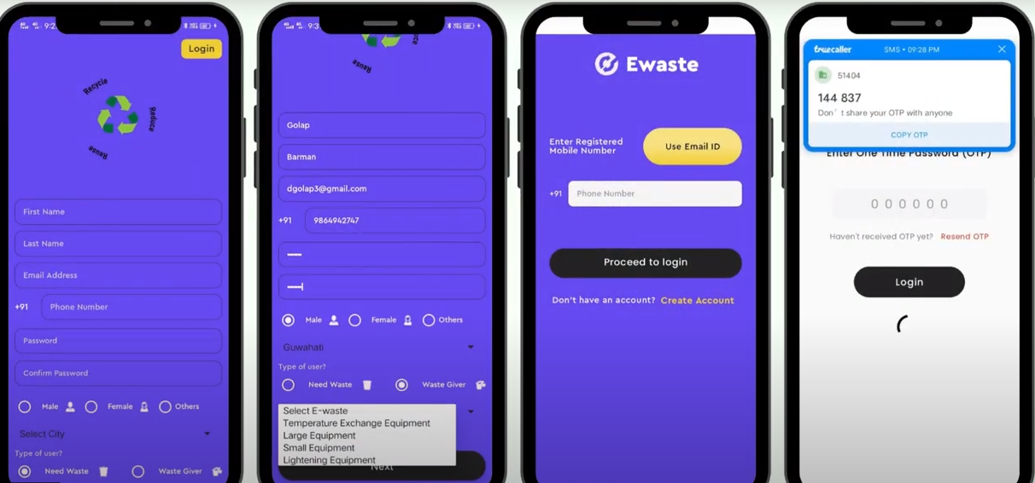
GitHub Repository Link & supporting diagrams, screenshots, if any
It serves customers both large and small, from private customers to large corporations.

Slide 9
Thank You
Team member names
Rajeshkumar.G
RajeshKanna.P

