Slide 1



PLEDGE TO PROGRESS
Sustainability Hackathon
Your Team Name : BIT
Your team bio : S.Sriram
Title : Industry specific solution -Healthcare
Date :20-05-2023

Slide 2
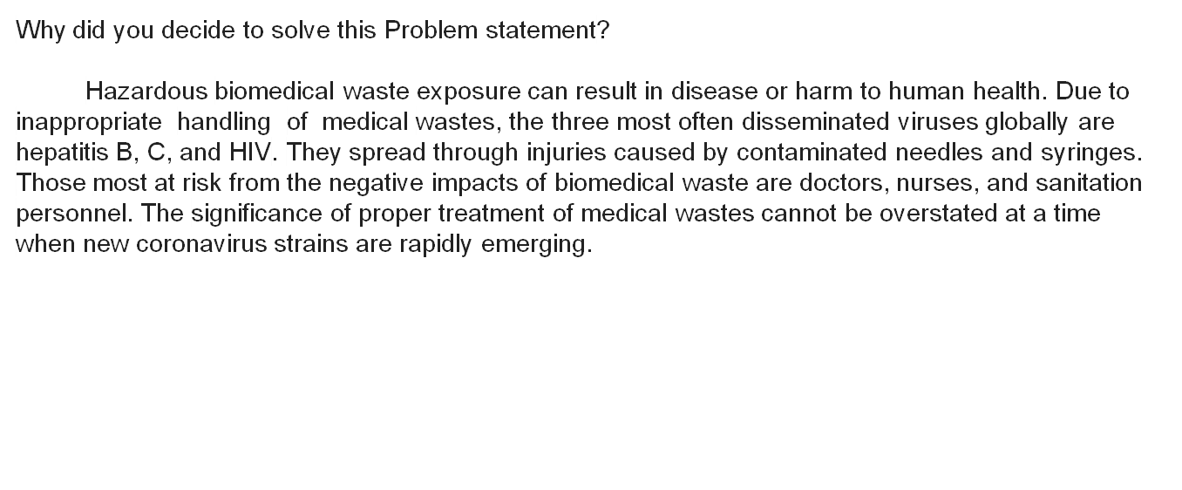
Problem Statement?

Slide 3
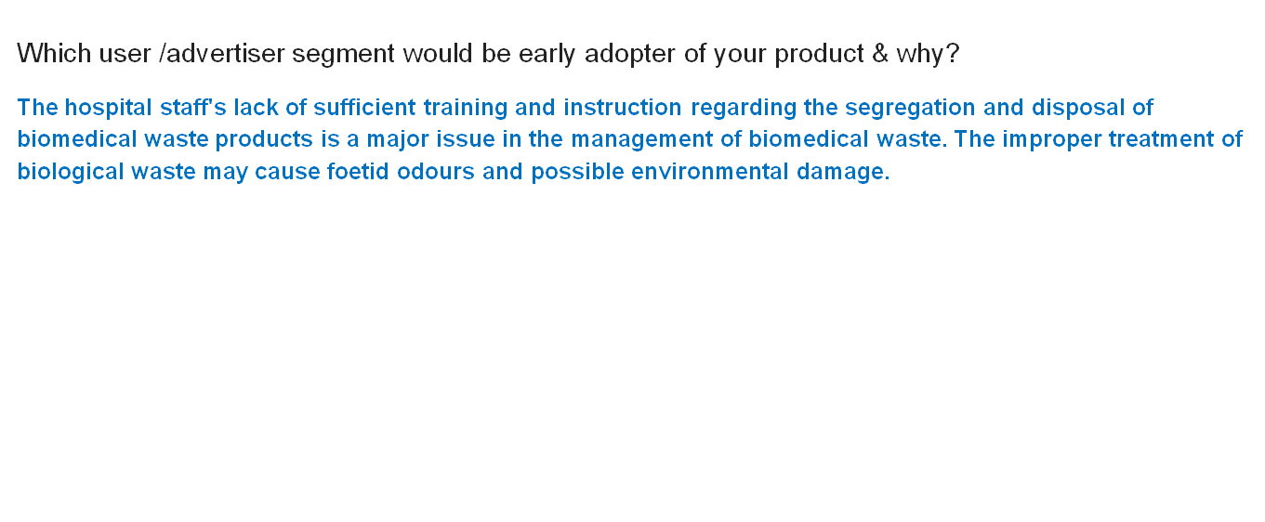

Slide 4
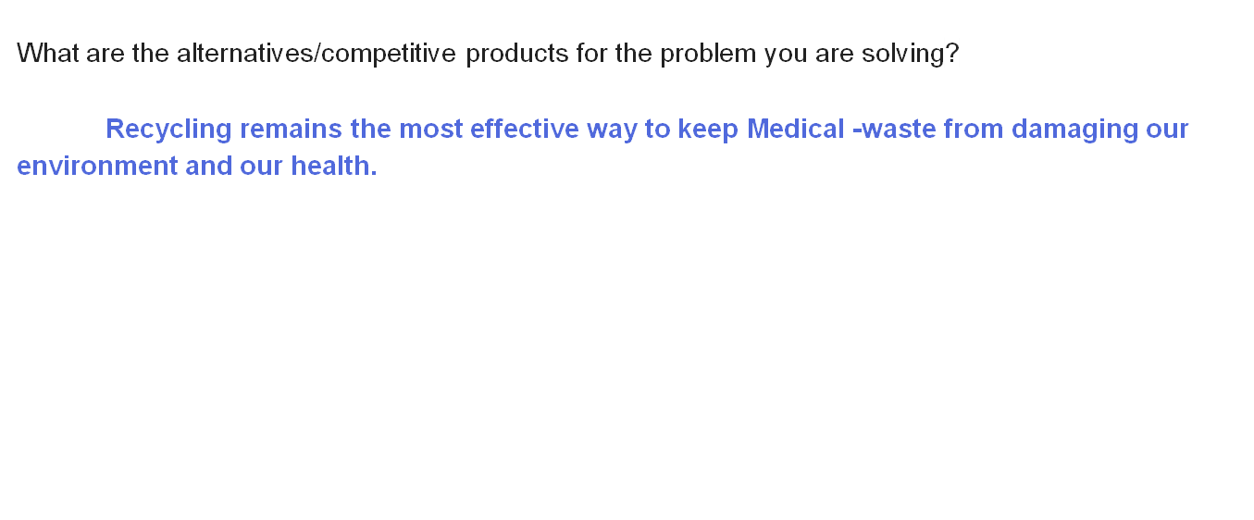
Pre-Requisite

Slide 6
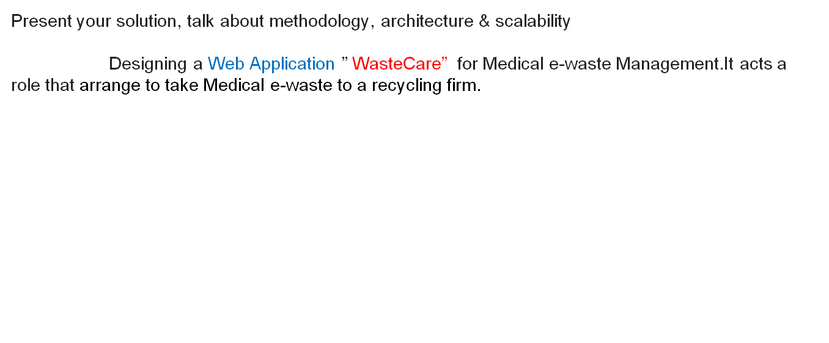
Any Supporting Functional Documents

Slide 7
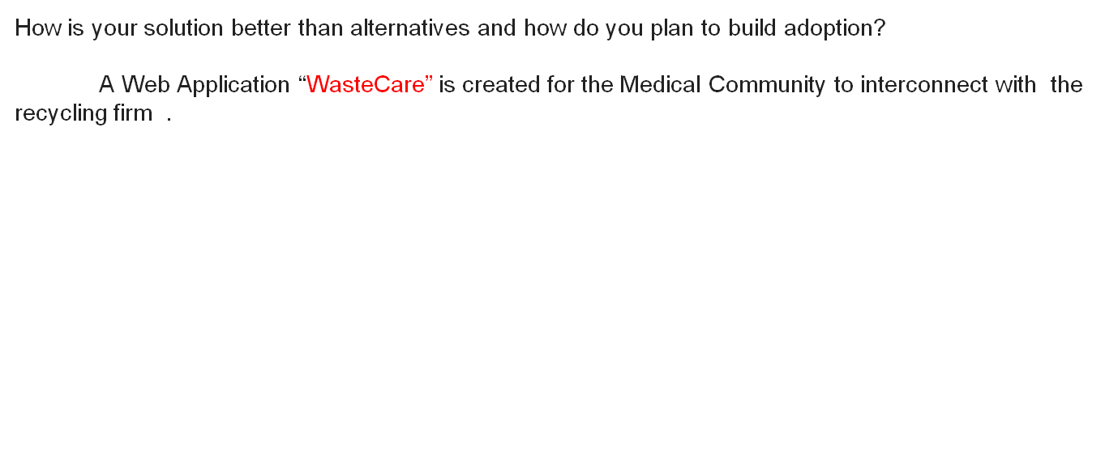

Slide 8
GitHub Repository Link
https://github.com/SRISUDIV/Industry-specific-solution-Healthcare
coding : https://drive.google.com/drive/folders/1VeAWwQqDmVrZFTGP-Tb_04vaXilLw-dm?usp=sharing
Youtube Video Link : https://youtu.be/R8T9b5dRwiI

Slide 9
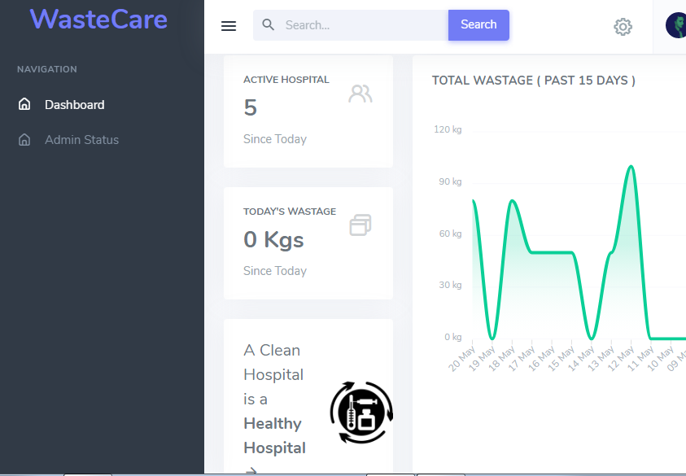
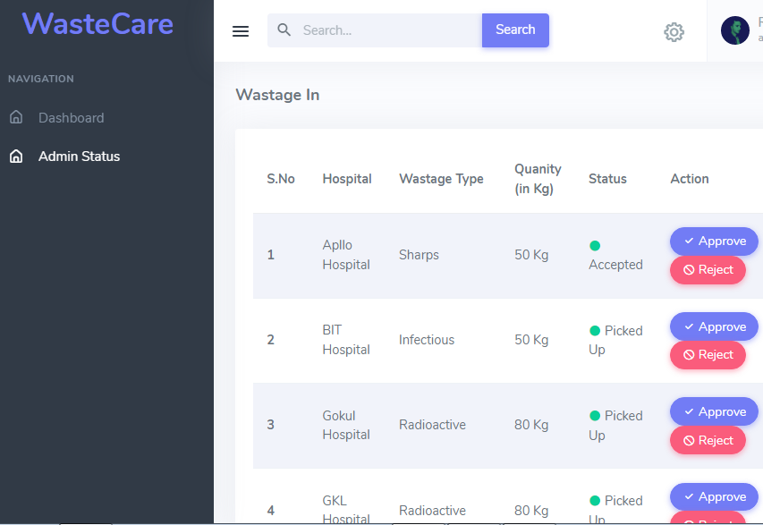
WasteCare : It serves customers both large and small, from private customers to large corporations.

Slide 10
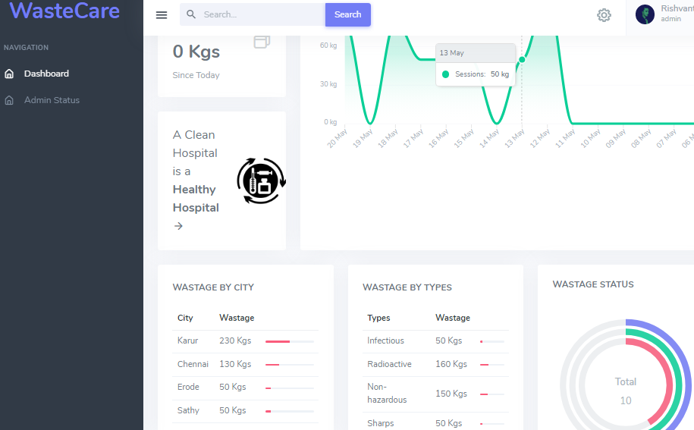
Admin Dashboard

Slide 11
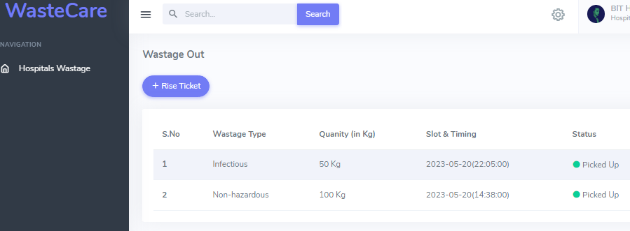
User portal – [ Hospitals ]

Slide 12
Thank You
Team member names
Rajeshkumar.G
RajeshKanna.P

