Slide 1


Machine Learning Hackathon
Team Name- BIT
Team Leader Name- S.SRIRAM
Team Leader Email Address- srsriramengg1@gmail.com

Slide 2
Brief Description of the Problem at hand:
The ad server logs contain valuable information such as browser details, IP addresses, geographic locations, search patterns , site urls , and other relevant data. The objective is to build a robust model that can accurately predict whether a user belongs to the HCP category and its specialization id/taxonomy.

Slide 3
Solution proposed and description:
Identifier entry's taxonomy code(s) should describe the provider's job (e.g., doctor) and any specializations (e.g., orthopaedic surgery). Although the taxonomy system's original purpose was to evaluate medical appropriateness and the levels, Experts are also using to identify providers and their practices.

Slide 4
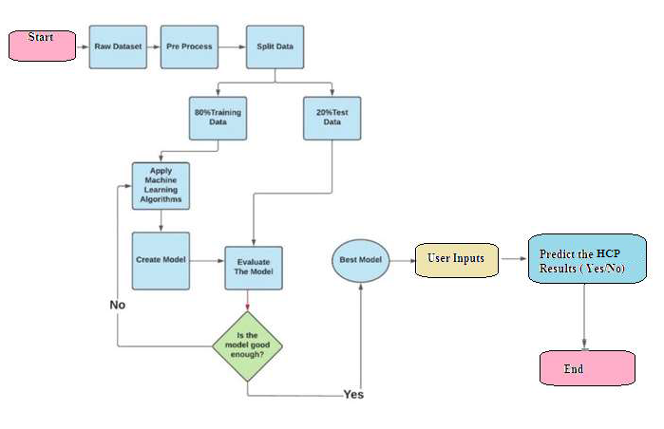
Approach:

Slide 5
XGBoost
Benefits : Analyze large datasets with available compute resources. Make better predictions faster. Optimize data ingestion and algorithmic compute simultaneously. Support offline, streaming, and distributed usage models.

Slide 6
Approach:
Optimization : A better understanding of HCP identification based on the specialization.

Slide 7
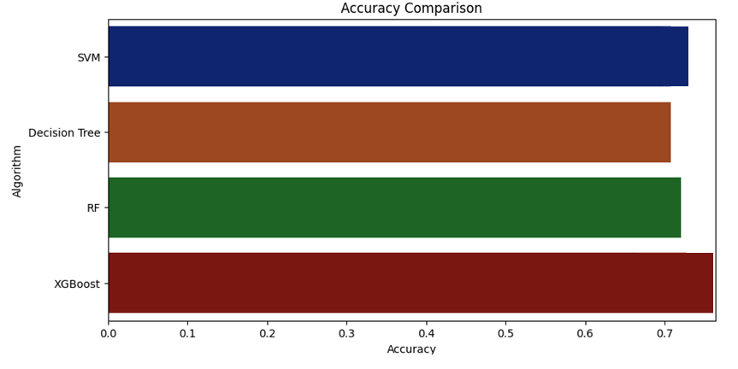
Results Summary

Slide 8
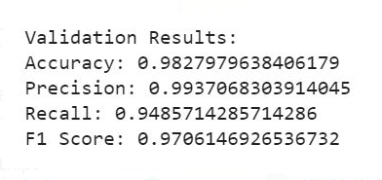

Slide 9
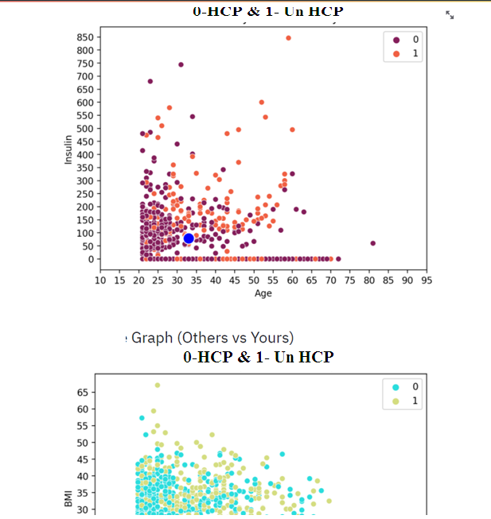
Execution Demo (Video/ Screenshots) of the solution:

Slide 10
Source code in ZIP file/Github URL:
https://github.com/SRISUDIV/ML-Hackathon-TechGig

Slide 11
THANK YOU!

