Slide 1

NFC and Augment Reality Techniques in Integrated Digital Label
Presented by
MR.S.SRIRAM

Slide 2
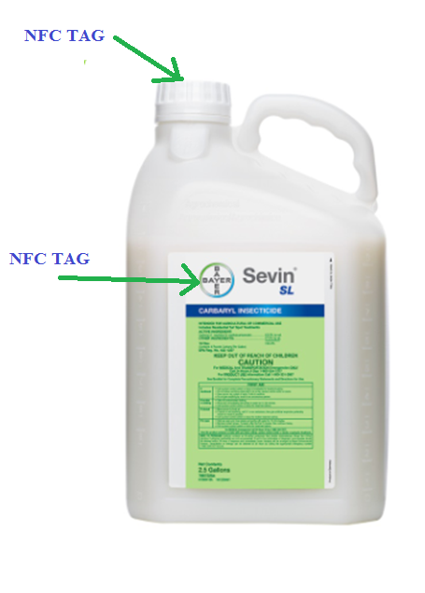
NFC and Augment Reality Techniques in Integrated Digital Label

Slide 3
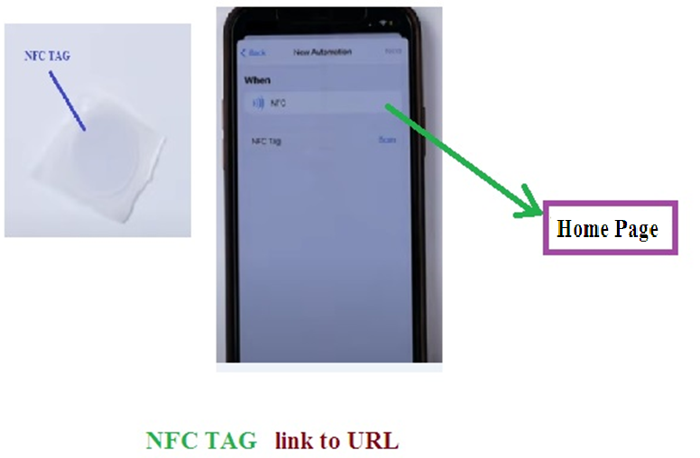
NFC TAG

Slide 4
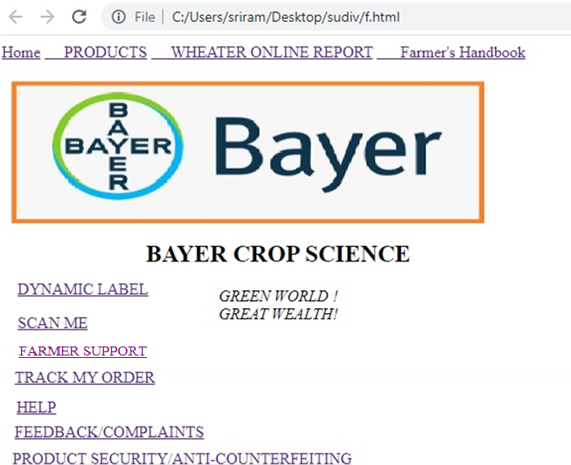
Home Page

Slide 5
NFC TAG PROCESS
It provides
Dynamic Label
QR scan (farmer support)
Customer Feedback and Complaints (Chat Bot)
Tracking my orders
product Security / Anti-counterfeiting

Slide 6
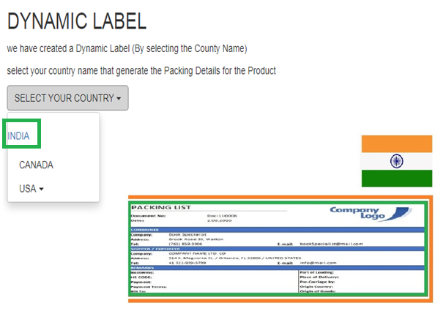

Slide 7
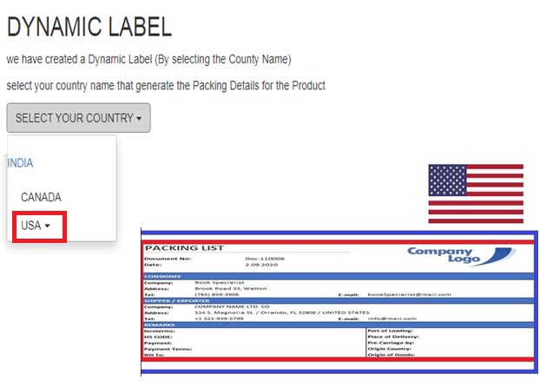

Slide 8
NFC TAG PROCESS
It provides
Dynamic Label
QR scan (website)
Customer Feedback and Complaints (Chat Bot)
Tracking my orders
product Security / Anti-counterfeiting

Slide 9
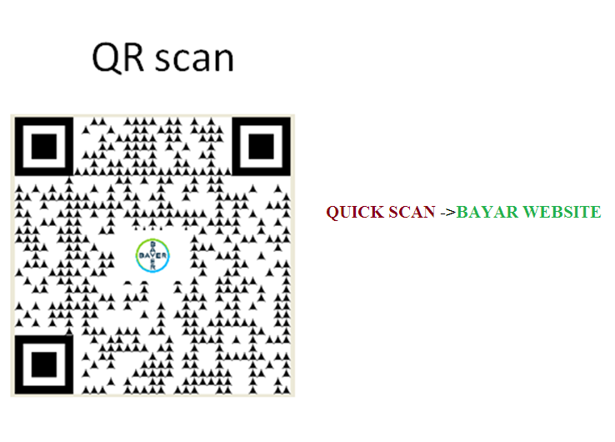

Slide 10
NFC TAG PROCESS
It provides
Dynamic Label
QR scan
Farmer Support
Customer Feedback and Complaints
Tracking my orders
Help(Chat bot)
product Security / Anti-counterfeiting

Slide 11
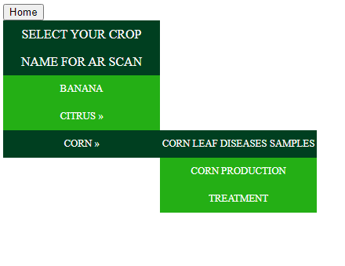
Former Support [ Augment Reality]

Slide 12
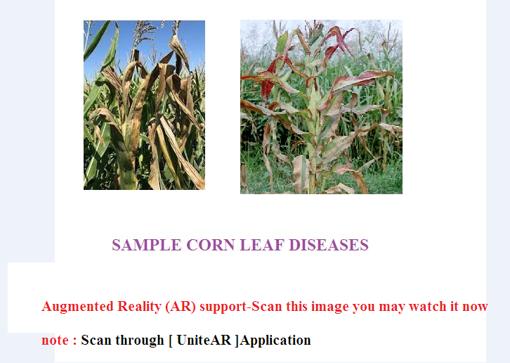
AR (Augmented Reality) scan

Slide 13
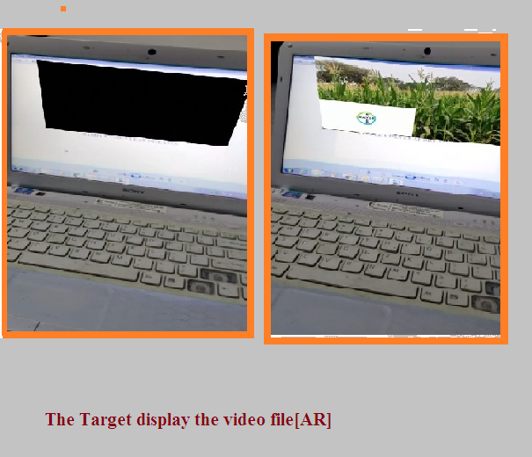

Slide 14
NFC TAG PROCESS
It provides
Dynamic Label
QR scan
Farmer Support
Customer Feedback and Complaints
Tracking my orders
Help(Chat bot)
product Security / Anti-counterfeiting

Slide 15
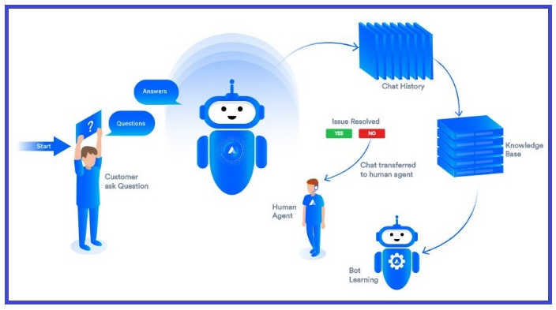
Chatbot

Slide 16
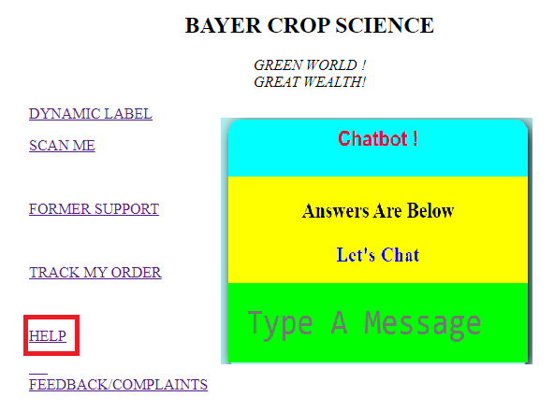

Slide 17
NFC TAG PROCESS
It provides
Dynamic Label
QR scan (farmer support)
Customer Feedback and Complaints
Tracking my orders
Help(Chat bot)
product Security / Anti-counterfeiting

Slide 18
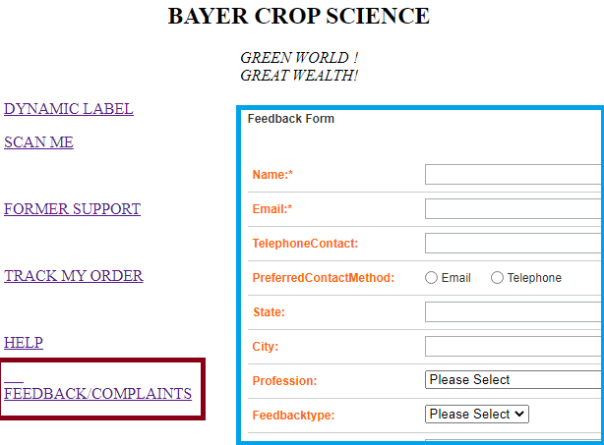

Slide 19
NFC TAG PROCESS
It provides
Dynamic Label
QR scan (farmer support)
Customer Feedback and Complaints (Chat Bot)
Tracking my orders
product Security / Anti-counterfeiting

Slide 20
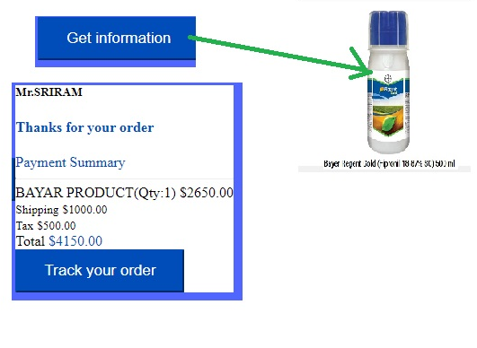
Tracking my orders-samples

Slide 21
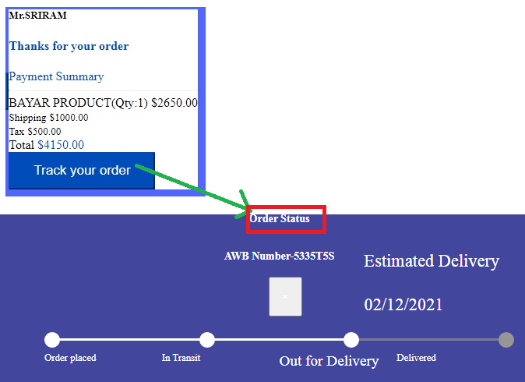
Tracking my orders status-samples

Slide 22
NFC TAG PROCESS
It provides
Dynamic Label
QR scan (farmer support)
Customer Feedback and Complaints (Chat Bot)
Tracking my orders
product Security / Anti-counterfeiting

Slide 23
NFC based Anti-Counterfeit Solution
The NFC Tag embedded in system cannot be cloned as it is protected by proprietary algorithm enhanced by blockchain technology.
This open architecture gives assurance of data integrity, ownership information and trace of origin of any physical object.

Slide 24


GREEN WORLD
GREAT WEALTH

Slide 25



