Slide 1
ET AutoTech Hackathon
2026
AI for Resilient Automotive Supply Chains & Smart Manufacturing
Team Name : Sri Zerone
Team Leader : Sriram .S
Team Members :
1.Nitansh Shankar
2.Himanshu shailendra gautam

Slide 2
AI-Driven Self-Healing Manufacturing Systems for Sustainable Production
Problem Statement :
Challenges in Modern Manufacturing
Unexpected machine failures
Production downtime
High maintenance costs
Excessive energy consumption
Carbon emissions and sustainability concerns

Slide 3
AI-Driven Self-Healing Manufacturing Systems for Sustainable Production
Key Statistics
Downtime can cost industries millions annually.
Reactive maintenance increases operational expenses.
Energy inefficiencies reduce sustainability performance.
Need
An intelligent system capable of:
Predicting failures
Recovering automatically
Optimizing sustainability

Slide 4
AI-Driven Self-Healing Manufacturing Systems for Sustainable Production
Proposed Solution
AI-Driven Self-Healing Manufacturing Framework
The system:
✔ Monitors machine health continuously
✔ Predicts failures using AI
✔ Automatically initiates recovery actions
✔ Optimizes energy consumption
✔ Improves sustainability

Slide 5
AI-Driven Self-Healing Manufacturing Systems for Sustainable Production
Core Technologies
Artificial Intelligence
Machine Learning
IoT Sensors
Predictive Maintenance
Autonomous Recovery

Slide 6
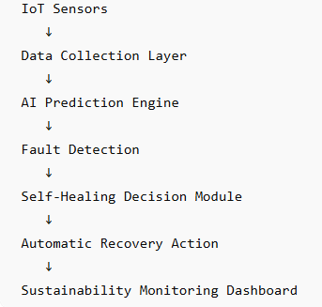
Work flow diagram

Slide 7
Work flow diagram
AI-Based Failure Prediction Machine Learning Module
Inputs
Temperature ,Vibration ,Power Consumption,Humidity
Model
Random Forest Classifier
Output
Failure Probability Score
Temperature | Vibration | Failure Risk
60°C | 2.5 | Low
85°C | 6.2 | High

Slide 8
Self-Healing Mechanism
Autonomous Recovery Engine
When abnormal conditions are detected:
Reduce machine load
Activate backup machine
Trigger cooling system
Notify operators
Reconfigure workflow
Benefit : Prevents complete system failure.

Slide 9
Sustainability Module
Sustainable Manufacturing Impact
Measures:
Energy Savings
Carbon Reduction
Downtime Reduction
Maintenance Efficiency
Metric | Improvement
Downtime Reduction | 45%
Energy Savings | 30%
Maintenance Efficiency | 40%
Reliability Improvement | 50%

Slide 10
Prototype Demonstration
Prototype Components
Developed in Google Colab :
https://colab.research.google.com/drive/1amBi-7vYetPcRcPsRqU3094f-EQiM03J?usp=sharing
Features:
Sensor Data Simulation
AI Failure Prediction
Self-Healing Logic
Sustainability Metrics Dashboard

Slide 11
Prototype Demonstration
Sample Outputs:
Machine Health Score output
Self-Healing Actions output
Sustainability dashboard chart
Final summary dashboard

Slide 12

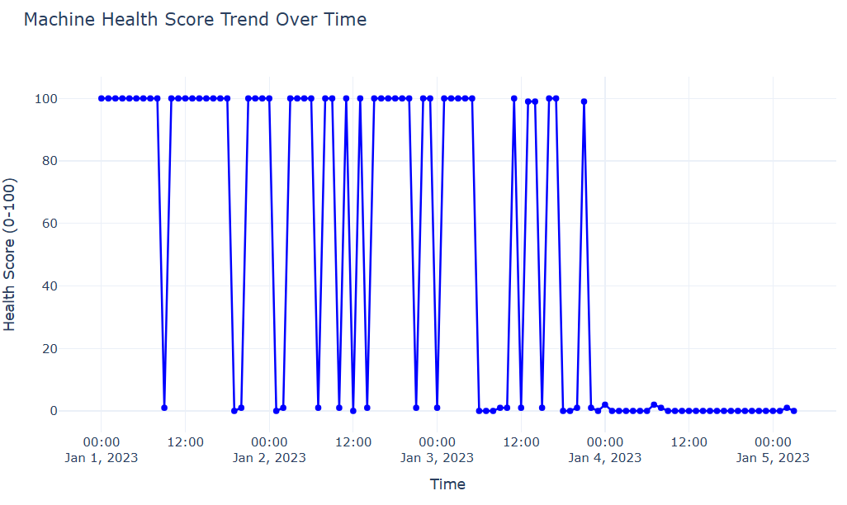
Prototype Demonstration
Sample Outputs:
Machine health Score output

Slide 13
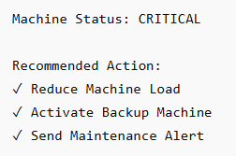
Prototype Demonstration
Sample Outputs:
Self-healing Action output

Slide 14

Prototype Demonstration
Sample Outputs:
Sustainability metrics

Slide 15
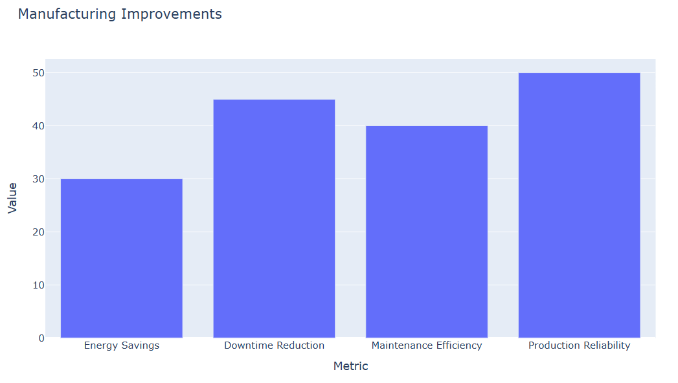
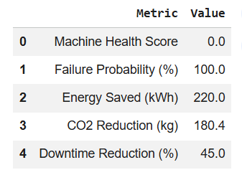
Prototype Demonstration
Sample Outputs:
Sustainability Dashboard

Slide 16
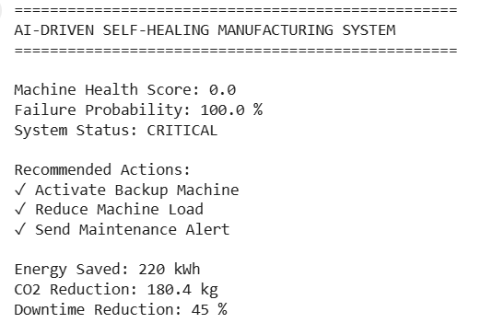
Prototype Demonstration
Sample Outputs:
Dashboard Summary

Slide 17
Prototype Demonstration
Results:
After predicting a critical failure risk, the self-healing decision engine automatically initiates recovery actions. In this case, the system recommends activating a backup machine, reducing machine load, and sending maintenance alerts. This autonomous response helps prevent downtime and ensures continuous manufacturing operations.

Slide 18
Architecture Diagrams, Screenshots/Video Demo of Application
https://colab.research.google.com/drive/1amBi-7vYetPcRcPsRqU3094f-EQiM03J?usp=sharing

Slide 19
Innovation and Uniqueness
Key Innovations
Autonomous Self-Healing
The system automatically responds to failures.
Sustainability-Aware Manufacturing
Reduces environmental impact.

Slide 20
Future Enhancement- “Graph Kernels”
The current prototype validates predictive maintenance, autonomous recovery, and sustainability analytics in a simulated manufacturing environment. Future versions will incorporate Temporal Perceptual Graph Kernels to model machine interaction networks and fault propagation for more intelligent self-healing decisions

Slide 21
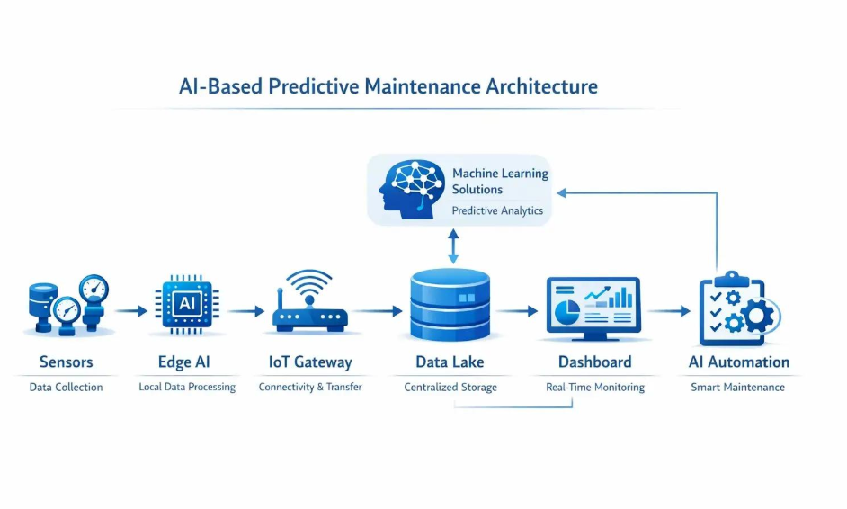
ARCHITECTURE

Slide 22
Project outcome:
The self-healing optimization engine will integrate sustainability metrics directly into operational decision-making in terms of environmental impact, through dynamic process adjustments and energy-aware control strategies, the project aims to achieve a 15–25% reduction in energy consumption, a 10–20% reduction in material waste, and up to 18% reduction in CO₂ emissions compared to baseline operations. Result outcomes directly contribute to climate neutrality objectives and the transition toward circular and resource-efficient manufacturing systems.

Slide 23
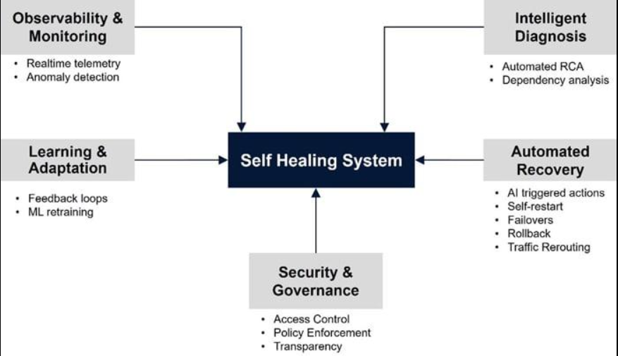
Advantages:

Slide 24
THANK YOU

