Slide 1
ET AutoTech Hackathon
2026
AI for Resilient Automotive Supply Chains & Smart Manufacturing Team Name : Sri Zerone
Team Members :
1.Nitansh Shankar
2.Himanshu shailendra gautam

Slide 2
AI-Driven Self-Healing Manufacturing Systems for Sustainable Production
Project summary:
This project proposes the development of an AI-driven self-healing manufacturing system capable of autonomously detecting, diagnosing, and mitigating production faults in real time. Done through the process of integrating Deep Learning , Digital Twins, and Reinforcement Learning, the system will predict equipment failures , simulate corrective actions in a virtual environment , and dynamically reconfigure production parameters to minimize downtime, material waste, and energy consumption. Unlike conventional predictive maintenance systems , the proposed approach moves beyond fault detection toward automated recovery and adaptive optimization. A human-centred AI interface will ensure transparency and operator trust while enabling seamless collaboration between humans and intelligent systems. The project aims to demonstrate measurable improvements, including reduced production downtime, enhanced equipment lifetime, improved energy efficiency, and lower carbon emissions. By enabling resilient and sustainable manufacturing processes, the solution directly contributes to circular economy objectives and green industrial transition.

Slide 3
AI-Driven Self-Healing Manufacturing Systems for Sustainable Production
Objectives and Ambition :
To design and test an AI-based self-healing manufacturing that works on Deep learning, Digital twins and Reinforcement Learning to detect, diagnose, and address errors in manufacturing processes in real-time.
Specific Objectives :
Design an AI predictive fault detection model, which uses time-series sensor data.
Digitally simulate the production system in real time and test scenarios by creating a high-fidelity Digital Twin of the production system.
Develop a Reinforcement Learning-based dynamic process reconfiguration adaptive recovery engine.
Add human explainable AI interface to trust and transparency by operators.
Test the system in an industrial pilot

Slide 4
IMPACT OF PROPOSED SOLUTION
The Proposed solution AI-Driven Self-Healing Manufacturing System will provide measurable technological, economic, environmental, and societal impacts through a structured and credible pathway from research results to industrial adoption and market deployment. project will develop an integrated AI framework combining deep learning, digital twins, and reinforcement learning to enable autonomous fault detection and recovery at the technical level. That will significantly advance the state of the art by shifting from predictive maintenance to self-adaptive manufacturing systems capable of real-time process reconfiguration. The result validation of the system in a relevant industrial environment will ensure technical maturity and readiness for commercialization.The project is expected to reduce unplanned downtime by up to 30%, decrease maintenance costs by approximately 20%, and extend equipment lifetime by at least 15% according to economic perspective.

Slide 5
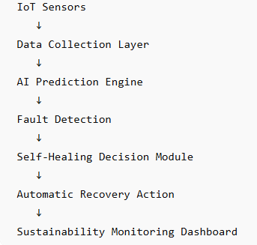
Work flow diagram

Slide 6
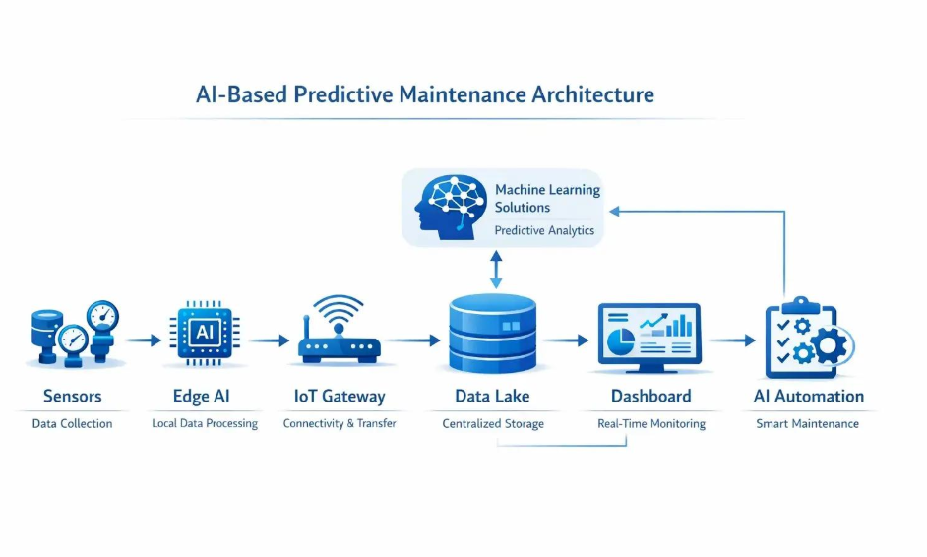
ARCHITECTURE

Slide 7
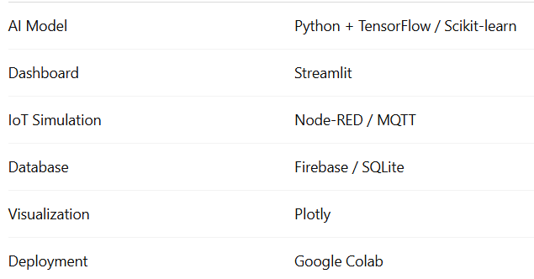
Software utilized

Slide 8
Architecture Diagrams, Screenshots/Video Demo of Application
You should share architecture diagrams to give clarity to your solution. In case, you have done some work on the proposed idea, share the screenshots/ video demonstration. It is highly rewarded. If the solution is hosted on Git, you can share the git url (make it accessible for us to judge).

Slide 9
Project outcome:
The self-healing optimization engine will integrate sustainability metrics directly into operational decision-making in terms of environmental impact, through dynamic process adjustments and energy-aware control strategies, the project aims to achieve a 15–25% reduction in energy consumption, a 10–20% reduction in material waste, and up to 18% reduction in CO₂ emissions compared to baseline operations. Result outcomes directly contribute to climate neutrality objectives and the transition toward circular and resource-efficient manufacturing systems.

Slide 10
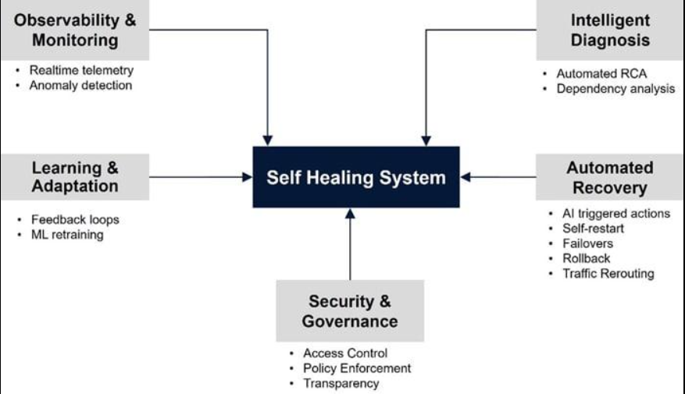
Advantages:

Slide 11
THANK YOU

