Slide 1

GitHub Copilot Hackathon
Team Name- BIT
Team Leader Name- S.SRIRAM
Team Leader Email Address- srsriramengg1@gmail.com

Slide 2

Brief Summary of Project:
Agriculture and farming are greatly influenced by the seasons and nature. Temperature is crucial when it comes to growing different fruits, vegetables, and pulses. Before, farmers relied on estimates to complete their work since they lacked a deeper understanding of weather forecasts.
Technological advancements and the adoption of novel weather forecasting techniques, farmers will soon receive all of their forecasts on their cellphones. Education in this area is important, of course, but the majority of farmers today are familiar with the basics, making it easy for them to use the features.

Slide 3
Business Challenge /Use Cases
A preferred approach is to recognize there is a reason demand exists, just as there is a scientific reason why the temperature today is warmer than yesterday. The best forecasters understand their products and markets and know scientifically and intuitively what’s happening, how it’s happening and why it’s happening.

Slide 4
Proposed Solution
Weather forecasts may be classified according to the space and time scale of the predicted phenomena . Atmospheric fluctuations with a length of less than 100 m (330 ft) and a period of less than 100 s are considered to be turbulent. Prediction of turbulence extends only to establishing its statistical properties, insofar as these are determined by the thermal and dynamic stability of the air and by the aerodynamic roughness of the underlying surface.
It is of importance for understanding the diffusion of air pollutants and other aspects of the climate near the ground. Standard meteorological observations are made with sampling techniques that filter out the influence of turbulence.
Common terminology distinguishes among three classes of phenomena with a scale that is larger than the turbulent microscale: the mesoscale, synoptic scale, and planetary scale.

Slide 5
Technology/Tool Stack Used:
Machine Learning,Python,Html &CSS.

Slide 6
Mention of usage of Github Copilot
GitHub Copilot, an AI pair programmer, provides autocomplete-style suggestions. By starting to write the code you wish to use or by leaving a comment in natural language outlining what you want the code to perform, you can get ideas from GitHub Copilot.

Slide 7
Source code in zip file / Github link :
https://drive.google.com/file/d/1NxSt12NSvWwA98SJ9kfD6uvmMpRe65Fo/view?usp=sharing

Slide 8
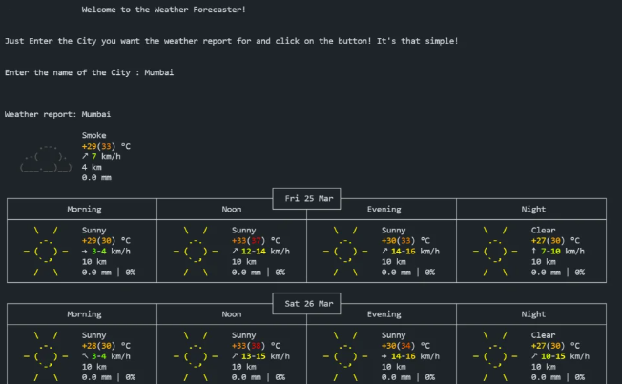
Execution Demo(Video/Screenshots) showing usage of the GitHub Copilot Platform :

Slide 9
THANK YOU

