Slide 1
Video Analytics - SBI
Powered By - Microsoft Corporation Pvt Ltd.

Slide 2
Anomalous Detection with Surveillance Analytics
Presented by
Mr S.SRIRAM

Slide 3

Object Detection
Violent behavior detection[illegal activities]
fire detection system
Problem Being Solved

Slide 4
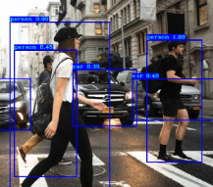
Object Detection

Slide 5
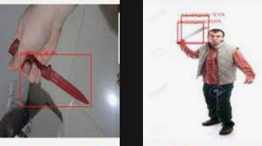
Violent behavior detection

Slide 6
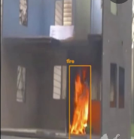
fire detection system
This project provides a computer vision based technique for detecting fire and identifying hazardous fire by processing the video data generated by an ordinary camera.

Slide 7
Fire detection system
fire detection system is a security system. The primary function of this system is to detect fires and turn on alarm to warn fire accidents.
This system is written in python with OpenCV computer vision module. It is using the HSV color algorithm to detect fires.

Slide 8
Approach taken to create the model
Sample dataset taken for Pattern matching process.

Slide 9
reason why your solution should be considered
Safety and Secure Monitoring.

Slide 10
Source code (Github Repository Link)
https://github.com/SRISUDIV/video-Analytic

Slide 11
Demonstration Video showing the
functionalities/working of the solution.
https://youtu.be/8AO_h3r7rw4

Slide 12

Submitted By : S.SRIRAM
Email : srsriramengg1@gmail.com
Mobile No: 8754714534

