Slide 1

Google Android Developer Virtual Internship
by
Mounika M
Roll No. 204G1A0561
Department of Computer Science and Engineering
Srinivasa Ramanujan Institute of Technology
Autonomous
Rotarypuram Village, B K Samudram Mandal, Ananthapuramu – 515701.
2023-2024

Slide 2

Contents
Introduction
Modules
Modules Explanation
Conclusion
References

Slide 3

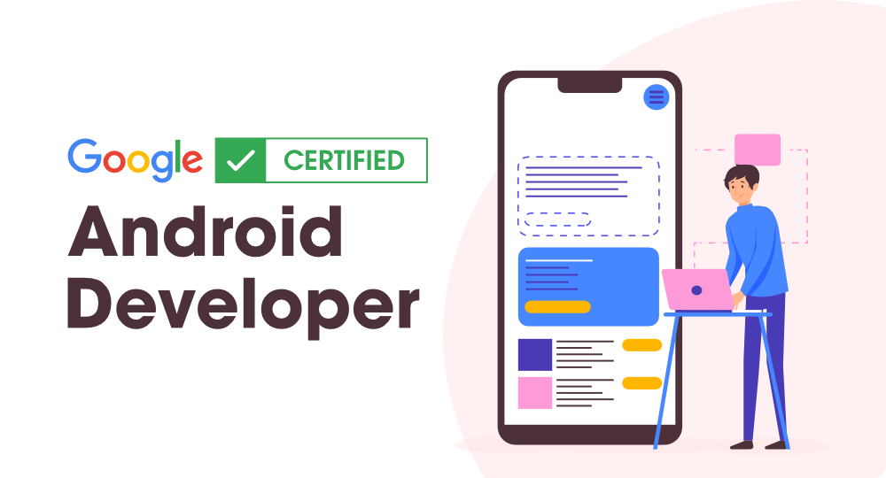
Introduction
Google Android Developer is a virtual internship offered by AWS academy through AICTE, the All India Council for Technical Education.
AICTE internship is a program designed to provide students with hands-on experience in various technical fields.
An Android developer is responsible for developing applications for devices powered by the Android operating system.
Google Central to Android's development is Google, offering core software, services, and updates. The Google Play Store serves as the official app distribution platform, granting users access to millions of applications.

Slide 4
Introduction
Android UI is touch-centric, featuring customizable home screens and widget support for intuitive interactions.
The Android Open Source Project allows for OS customization based on user needs.
Its integrated WebKit browser supports modern web standards like HTML5 and CSS3.
Android employs diverse technologies for a robust mobile platform.
It supports various image and audio formats for multimedia content compatibility.

Slide 5
Modules
Your first Android app
Building app UI
Display lists and use Material Design
Navigation and app architecture
Connect to the internet
Data persistence
WorkManager
Views and Compose

Slide 6
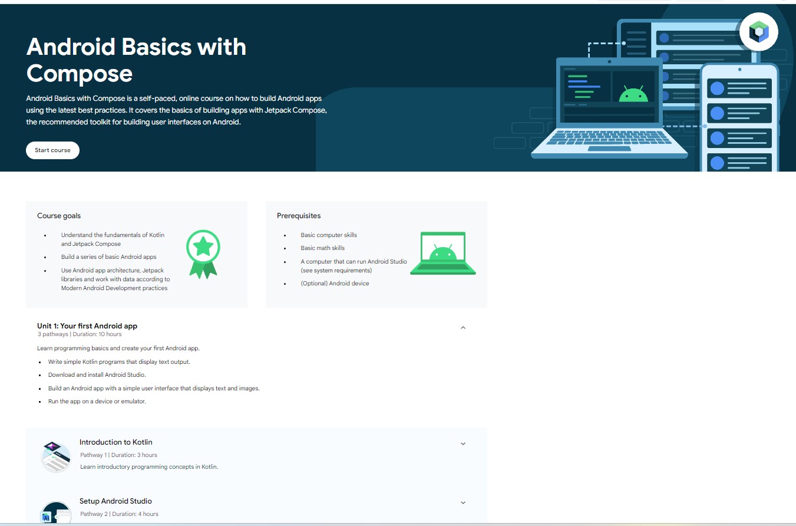
Dashboard

Slide 7
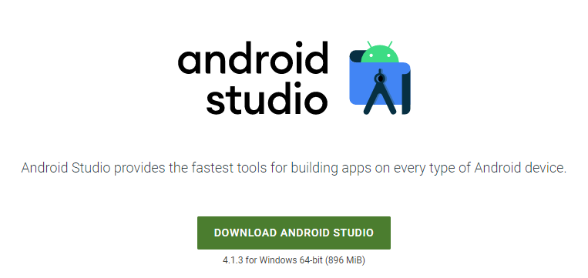
Your first Android app
The prerequisites entail familiarity with the Kotlin programming language and the setup of Android Studio. Additionally, it involves instructions for creating a fundamental layout.
Kotlin, a contemporary and succinct programming language, has risen as a favored option for developing Android applications.
Kotlin offers a seamless integration with existing Java code and brings a host of features like null safety, concise syntax, and improved code readability.
Its expressive and pragmatic nature accelerates development, making it an excellent fit for Android projects.

Slide 8
Building app UI
This module offers an overview of fundamentals of Kotlin, widgets in android studio, and interacting with UI.
The core aspects of Kotlin comprise essential characteristics of a modern and succinct programming language, such as robust support for object-oriented programming (OOP) principles. Kotlin smoothly integrates with pre-existing Java code, offering functionalities like null safety, concise syntax, and enhanced code legibility.
Object-oriented programming principles such as encapsulation, inheritance, and polymorphism are foundational concepts in Kotlin, enabling developers to create modular and maintainable code structures.
Additionally, Kotlin introduces the concept of lambdas, allowing for concise and expressive functional programming.
Lambdas facilitate the creation of anonymous functions, enhancing code conciseness and promoting a more functional programming style within the Kotlin language.

Slide 9
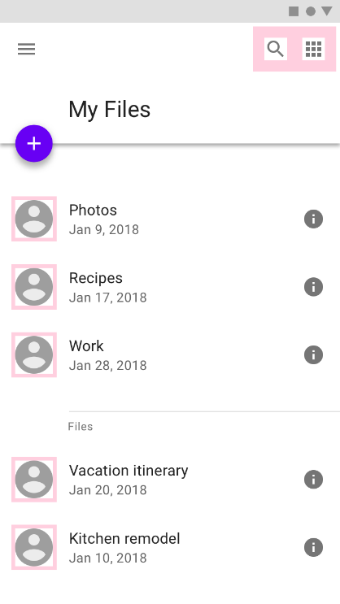
Display lists and use Material Design
Starting with a concise summary, this encapsulation provides an overview of key Kotlin programming concepts crucial for developers aiming to create dynamic and captivating Android applications.
From Kotlin's tidy and easily comprehensible syntax to its facilitation of asynchronous programming through coroutines, these concepts empower developers to create responsive, efficient, and feature-rich applications.
In this module, we investigate building an app with Compose that presents a scrollable list comprising both text and images.
The app's functionality involves smoothly blending text and images within a scrollable layout, illustrating fundamental techniques for crafting captivating and visually appealing user experiences.

Slide 10
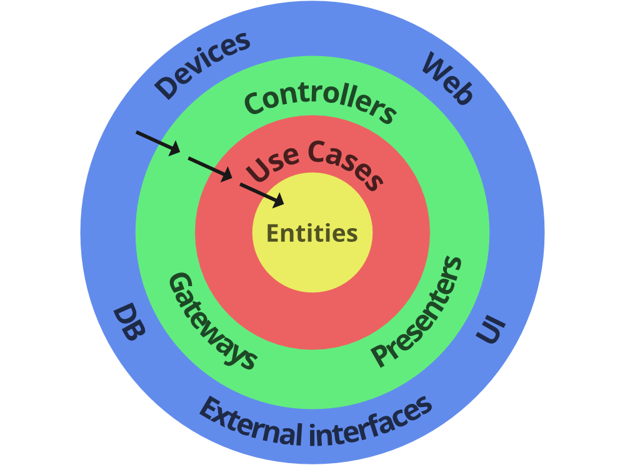
Navigation and app architecture
This module provides insight into how developers can leverage the Navigation component to build complex Android applications with multiple screens. Discover the skill of smooth navigation between various composables while effectively transferring data between screens.
Effectively tailor your app to different screen sizes and enhance user experiences with this thorough documentation. Delve into techniques for responsive design that enhance your application's visual appeal across a range of devices.

Slide 11
Connect to the internet
Establishing internet connectivity is a fundamental aspect of contemporary application development, facilitating communication between devices and servers. Here's a brief overview of essential concepts when setting up internet connections in software:
Network Permission:
Ensure that your application has the necessary network permissions declared in the AndroidManifest.xml file. This is crucial for the app to access the internet.
Network Requests:
Use HTTP or HTTPS protocols to initiate network requests from your application to remote servers. Commonly, this is done using the following methods:
HTTPURLConnection: A basic API provided by Java for sending HTTP requests and receiving responses.
HttpClient: An alternative for sending HTTP requests, though it has been deprecated in recent Android versions.

Slide 12
Connect to the internet
URL Connection:
Utilize the URLConnection or HttpURLConnection classes in Java to establish a connection with a remote server. Create a URL object specifying the target endpoint, initiate a connection, and configure it to receive the response.
HTTP Methods:
Choose the appropriate HTTP method for your request:
GET: Retrieve data from the server.
POST: Send data to the server to create a new resource.
PUT or PATCH: Update an existing resource on the server.
DELETE: Remove a resource on the server.
Loading and Displaying Images from the Internet:
In numerous applications, particularly those involving dynamic content or user-generated media, the common need arises to load and display images from the internet.

Slide 13

Connect to the internet
Load Image from URL:
Utilize the library's API to load images directly from a URL. Typically, this involves passing the URL to the library's loading function.
Resize and Crop:
Consider resizing or cropping images based on the target ImageView size to optimize memory usage and improve loading speed.

Slide 14
Data persistence
Data persistence in software development refers to the process of storing and retrieving data to and from a persistent storage medium, such as a database or file system. Here's a concise summary of key concepts related to data persistence:
Types of Data Persistence:
Local Storage: In-app storage using methods like SharedPreferences, SQLite databases, or file storage.
Remote Storage: Storing data on remote servers, typically accessed through APIs.
Local Data Persistence:
SharedPreferences: Lightweight key-value pairs for storing simple data.
SQLite Databases: Relational databases embedded within the app for structured data storage.

Slide 15
Data persistence
Remote Data Persistence:
APIs (Application Programming Interfaces): Interacting with remote servers through APIs to retrieve and send data.
Cloud Storage: Storing data on cloud platforms, offering scalability and accessibility across devices.
Databases:
Databases are structured collections of information or data, usually stored electronically within a computer system. They provide efficient and systematic methods for managing, organizing, and retrieving data.

Slide 16
WorkManager
The Android WorkManager, a robust API within the Android Jetpack library, is crafted to streamline and oversee background tasks in Android applications. Below is a concise overview of the key features offered by WorkManager:
Background Task Management: WorkManager allows developers to schedule and manage tasks that run in the background, such as data syncing, periodic updates, or content downloads.
Flexible Scheduling: Developers can schedule tasks as one-time or periodic, offering flexibility based on the nature of the background work needed.
Debugging Tools: WorkManager comes equipped with a Background Task Inspector in Android Studio, providing tools for monitoring and debugging background tasks effectively during development.
Result Handling: Developers can handle the results of background tasks using the Result object, allowing for proper handling of success, failure, or retry scenarios.

Slide 17
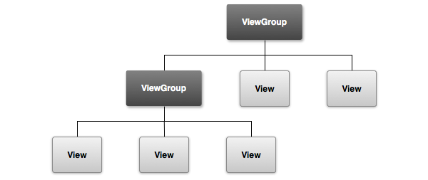
Views and Compose
A View is a fundamental element for any user interface (or design) in android. The View is a base class for all UI components in android. . For example, the EditText class is used to accept the input from users in android apps, which is a subclass of View.
Following are the some of common View subclasses that will be used in android applications.
TextView
EditText
Button
CheckBox
RadioButton
ImageButton

Slide 18
Conclusion
Enrolling in Google's Android development course offers a succinct yet thorough exploration into the realm of mobile app development. Leveraging Google's expertise in shaping the Android platform, students can anticipate a targeted curriculum encompassing vital subjects such as programming languages, the Android SDK, and API integration.
The course's practical approach ensures a comprehensive understanding of constructing resilient applications, in line with industry norms and standards.
Google's direct involvement assures access to up-to-date content, reflecting the latest trends and tools in Android development.

Slide 19
References
[1] https://developer.android.com/courses/android-basics-compose/course
[2] https://internship.aicte-india.org

Slide 20
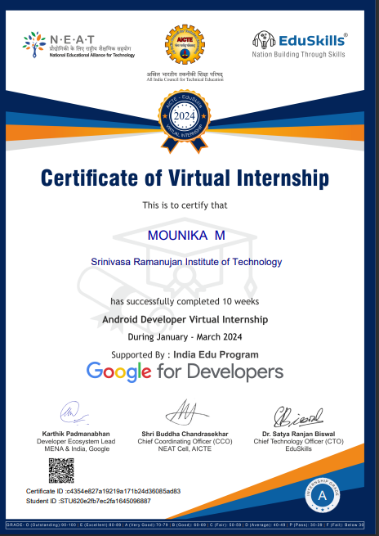
Internship Certificate

Slide 21
Thank You!!!

