Slide 1

Air Quality Monitoring System Using IoT
by
B. Padmini
Roll No. 184G1A0555
P. Manasa
Roll No. 184G1A0541
M. Lakshmi jyoshna
Roll No. 184G1A0532
G. Aravind
Roll No. 184G1A0503
S. Muni vinod
Roll No. 194G5A0505
Under the guidance of
Dr. B. HariChandana M.Tech.Ph.D
Assistant Professor
Department of Computer Science and Engineering
Srinivasa Ramanujan Institute of Technology
(Autonomus)
2023 - 2024

Slide 2

Contents
Abstract
Problem statement
Objectives of Project
Literature survey for first objective
Literature survey for second objective
Proposed Work -(Methods to be followed for proposed system)
References
GitHub Link
Queries

Slide 3
Abstract
The context or background information for your research
The general topic and specific research question or problem
The main objectives and goals of your research
The methods you used to conduct your research
The results or findings of your research
The conclusions or implications of your research
Note : The above points should be specified in an abstract using paragraphs mostly 1 or 2

Slide 4
Problem Statement
Increasing concentration of harmful gases in atmosphere. All living organisms may suffer form diseases.
To save human life and to control hazardous air pollution that is increasing day by day.
With the help of the monitoring air pollutants with real time data can take preventive ,measures which gradually help in controlling the air pollution.

Slide 5
Objectives of Project
Two Objectives of the project should be mentioned.
Research Objective:
[Verb] + [Specific Focus] + [Scope/Target]
Research Objective: To analyze the impact of social media on academic performance among college students.

Slide 6
Literature survey for first objective

Slide 7
Literature survey for second objective

Slide 8
Proposed System
To overcome the difficulty of the existing system, we will monitor the air quality over an application using internet and will trigger a notification when the air quality goes down beyond certain level
The proposed system uses ESP32 WIFI module and Blynk application.

Slide 9
References
[1].A.Matin,F.Mahmud, and T.Ahmed , “Title of the Paper”,” International Conference on Electrical,Computer and Communication Engineering(EECE), vol. 2, pp. 1-4, Feb. 2017.
Note : Authors,Published title,Publication details,Volume details,Page details,Published date.

Slide 10
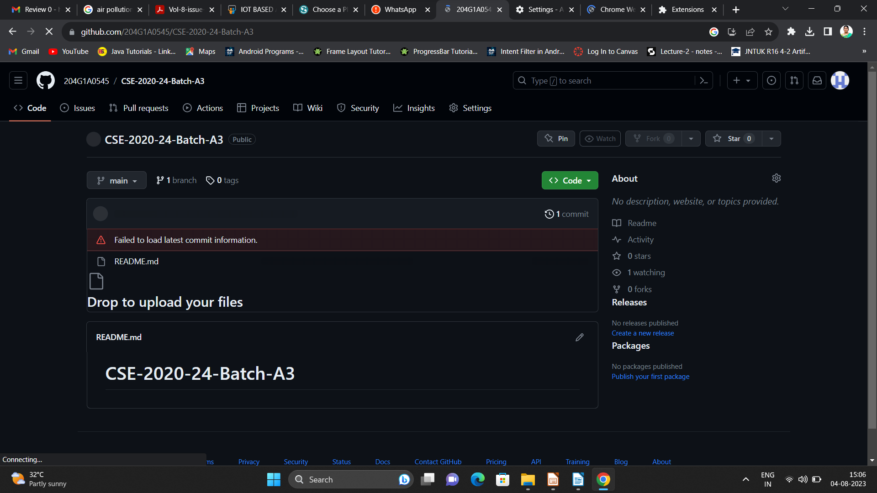
Git Hub Dashboards of each student

Slide 11
Any Queries?

