Slide 1

Security Improvement of Cloud Data using hybrid Cryptography & Steganography
by
G. Ajay Kishore
Roll No. 204G1A0506
M. Mounika
Roll No. 204G1A0561
T. Harsha Sri
Roll No. 204G1A0536
B. Bhavana
Roll No. 204G1A0522
Under the guidance of
Mr. M. Narasimhulu M.Tech (Ph.D)
Assistant Professor
Department of Computer Science and Engineering
Srinivasa Ramanujan Institute of Technology
(Autonomus)
2023 - 2024

Slide 2

Contents
Abstract
Problem statement
Objectives of Project
Literature survey for first objective
Literature survey for second objective
Proposed Work -(Methods to be followed for proposed system)
References
GitHub Link
Queries

Slide 3
Abstract
In Today's world , Many organizations use cloud environment for storing the data. As cloud technology becomes popular, data security is a big concern. To fix this issue, here we are securing cloud data by using Hybrid Cryptography, Steganography, Information Concealment, and Hashing Functions.
In this procedure, we perform data encryption through combining Asymmetric and Symmetric Algorithms. To optimize storage and enhance the security layers, we introduce a compression Algorithm immediately after the initial encryption phase. The compressed data will be hidden in an image using steganography algorithms. Finally we use hashing algorithm for validation purpose.
Keywords- Encryption, Information Concealment, Hashing

Slide 4
Problem Statement
The increase in data breaches in cloud computing puts all users at risk of business problems, highlighting the need to improve security measures.
To mitigate the growing risks of data threats faced by users in the Cloud Environment, proactive measures are essential.
Here, We use Cryptography, Steganography, and Hashing algorithms to secure and authenticate data effectively.

Slide 5
Objectives of Project
By Utilizing a Hybrid Encryption scheme, Data security is significantly strengthened, and the risk of hacking is reduced.
With the help of Steganography, Storing data in multimedia formats like Images, Audio, and Video adds another level of complexity for potential attackers, making it even harder to compromise data security.

Slide 6
Literature survey for first objective
This paper was proposed in order to increase the privacy of file storage, the survey suggests a method to encourage secure encryption and decryption of data using a combination of cryptography and steganography[1]. In this project a novel steganographic method for two-person private communication is given. The approach used in this study combines steganographic and cryptographic methods. A cryptography algorithm is RSA. To hide data in steganography, we use picture steganography. We also employ the Mutual Authentication method to provide Access Control, Confidentiality, Integrity, and Authentication for all cryptographic services. With this strategy, the data may be preserved more safely[2].

Slide 7
Literature survey for second objective
The Research provided a new cloud strategy to improve data security, addressing the aforementioned problem while establishing a reliable and secure cloud storage service[3]. The proposed work says that We can create a robust security posture, as well as effective key management and distribution for various users, using Steganography and AES. The model creates a stego-image with good quality, security that makes it difficult to find the hidden data, and capacity that lets the model conceal enormous amounts of data [4].

Slide 8
Proposed System
This proposed system encrypts secret data in a hybrid way using the symmetric encryption algorithm and the asymmetric encryption algorithm.
The Encrypted data is compressed and sent to the steganography algorithm to be hidden.
Hash Functions are used without the need for a third party to confirm the impartiality of the data quickly after retrieval.

Slide 9
References
[1].Mustafa S.Abbas,Suadad S.Mahdi,Shahd A.Hussain, “Security Improvement of Cloud Data Using Hybrid Cryptography and Steganography”, 2020 International Conference on Computer Science and Software Engineering (CSASE), Duhok, Kurdistan Region – Iraq
[2]. Srinidhi Kulkarni, Manjesh M, Nithish R, Sharanya R P, “Cloud Based Secure File Storage using Hybrid Cryptography” International Journal of Research Publication and Reviews, Vol 4, no 5, pp 4645-4651 May 2023.
[3]. Afrah Albalawi, Nermin Hamza, “A Survey on Cloud Data Security using Image Steganography”, (IJACSA) International Journal of Advanced Computer Science and Applications, Vol. 11, No. 1, 2020.

Slide 10
References
[4] Ghassan Sabeeh Mahmood, Dong Jun Huang, Baidaa Abdulrahman Jaleel, “Achieving an Effective, Confidentiality and Integrity of Data in Cloud Computing” International Journal of Network Security, Vol.21, No.2, PP.326-332, Mar. 2019.

Slide 11
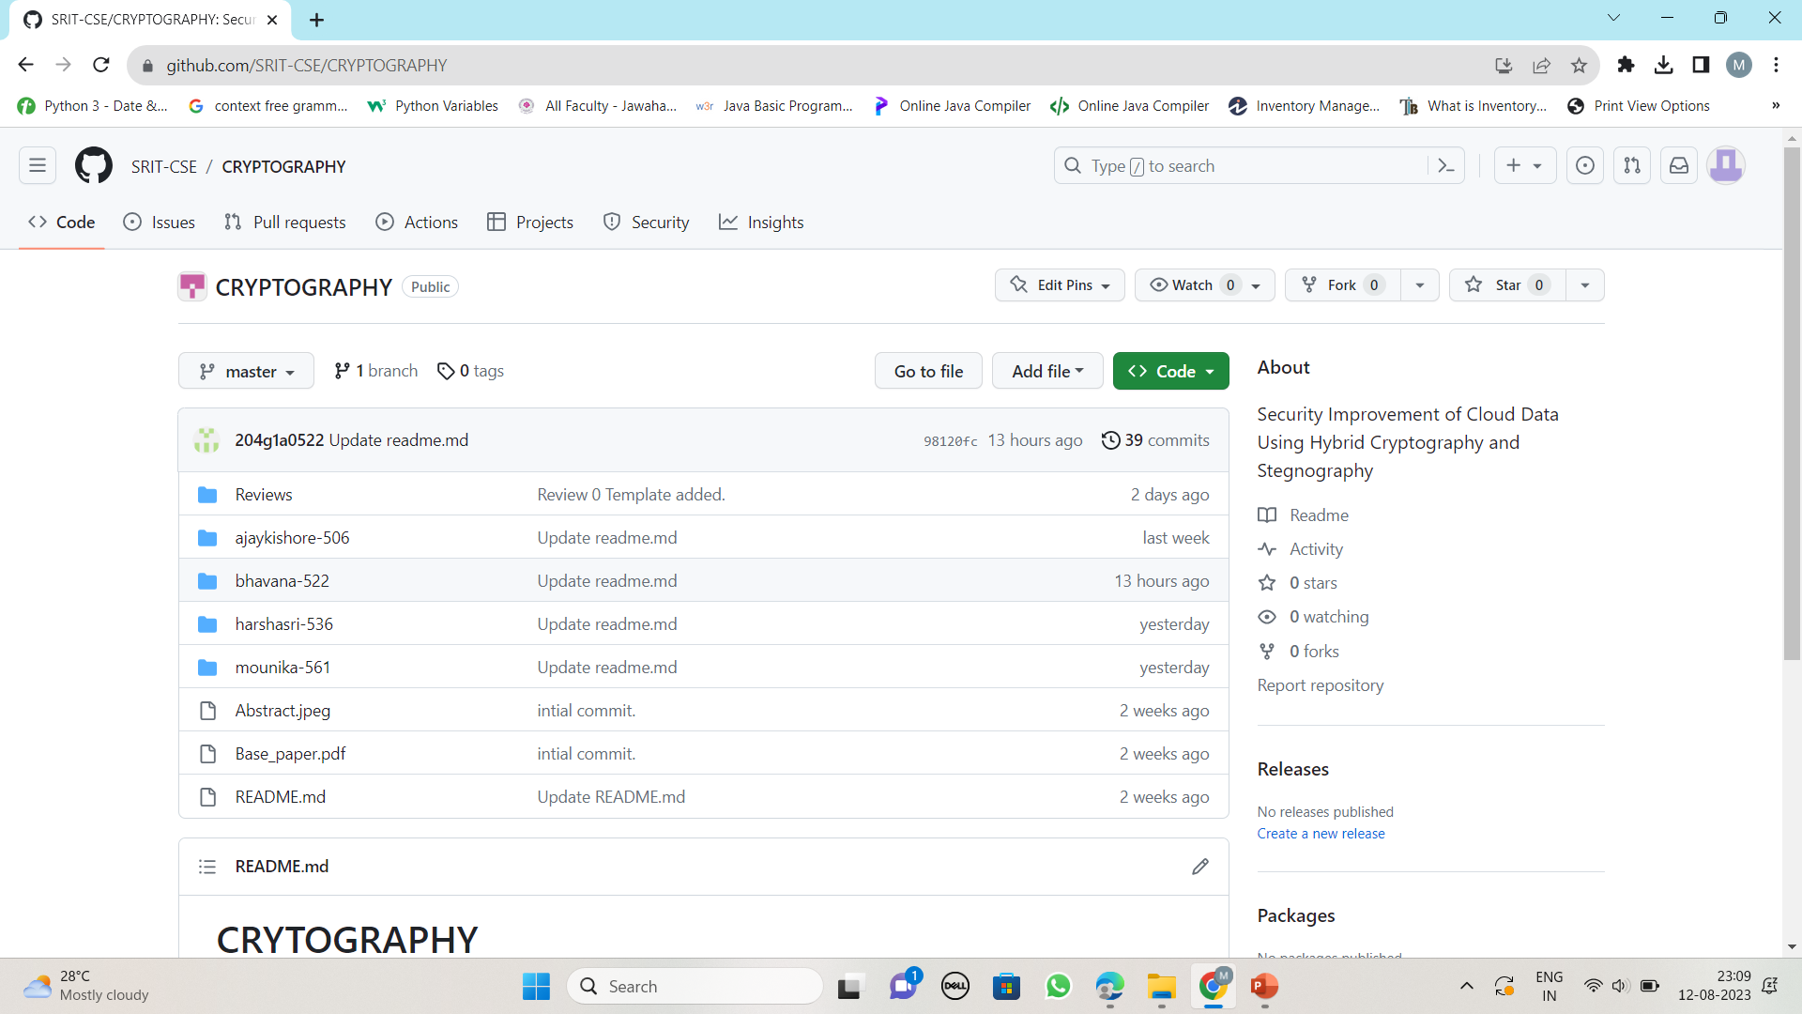
Git Hub Dashboards of each student
https://github.com/SRIT-CSE/CRYPTOGRAPHY.git

Slide 12
Any Queries?

