Slide 1

Google Android Developer Virtual Internship
by
G. Ajay Kishore
Roll No : 204G1A0506
Department of Computer Science and Engineering
Srinivasa Ramanujan Institute of Technology
Autonomous
Rotarypuram Village, B K Samudram Mandal, Ananthapuramu – 515701.
2023-2024

Slide 2

Contents
Introduction
Modules
Modules Explanation
Conclusion
References

Slide 3
Introduction
Launched by Google in 2008, Android is an open-source operating system based on the Linux kernel that encourages community collaboration for continuous improvement. The Google Play Store serves as the official app distribution platform, granting users access to millions of applications. The user interface of Android is tailored for touch gestures, featuring a customizable home screen and support for widgets, ensuring an interactive and intuitive experience.
From Eduskills Foundation, AICTE launches a Virtual Internship on Google Android Virtual Internship.
The main aim of this is to gain insights into cutting-edge cloud and AI technologies.

Slide 4
Modules
Your first Android app
Building App UI
Display lists and use Material Design
Navigation and app architecture
Connect to Internet
Data Persistence
Work Manager
Views and Compose

Slide 5
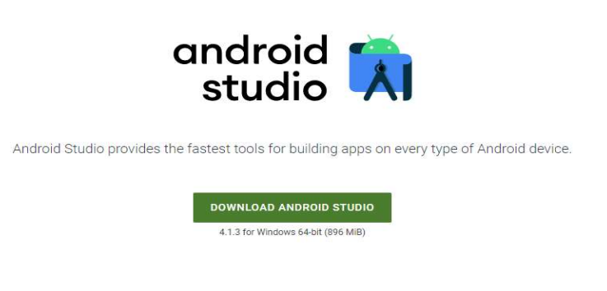
Your first Android app
Android Studio Installation

Slide 6
Your first Android app
The module describes about the android and requirements of android. The requirements Kotlin programming language, setting up the android studio and describes building a basic layout.
Kotlin, a modern and concise programming language, has emerged as a preferred choice for Android app development. Endorsed by Google, Kotlin offers a seamless integration with existing Java code and brings a host of features like null safety, concise syntax, and improved code readability. Its expressive and pragmatic nature accelerates development, making it an excellent fit for Android projects.
Android applications Configuration of JDK & IDE
https://www.oracle.com/java/technologies/downloads/#jdk17-windows
https://developer.android.com/studioOperations Perspective

Slide 7
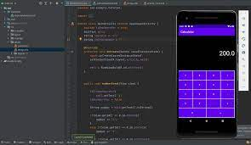
Building App UI
This module offers an overview of fundamentals of Kotlin, widgets in android studio, and interacting with UI.
Throughout the development process, we explore techniques for capturing user input, dynamically updating the UI, and managing the application's state to ensure a seamless and responsive user experience.
By the end of this module, learners will have gained valuable insights into creating interactive UIs and handling states, providing a solid foundation for developing user-friendly applications.

Slide 8
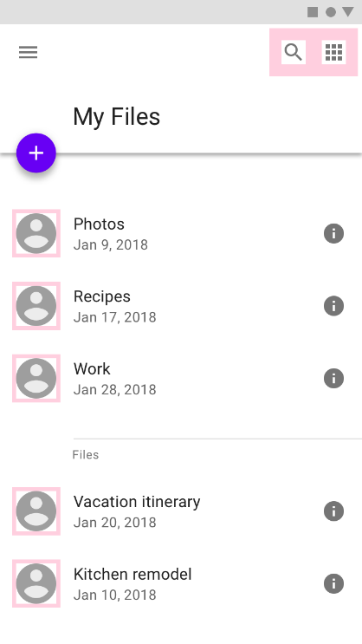
Display lists and use Material Design
In this module, we explore the creation of an app using Compose that showcases a scrollable list containing both text and images.
The app's functionality includes the seamless integration of text and images within a scrollable layout, demonstrating essential techniques for creating engaging and visually appealing user experiences.
This documentation serves as a valuable resource for developers seeking insights into building versatile and interactive applications through Compose.

Slide 9
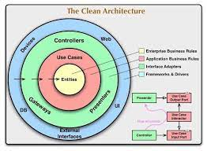
Navigation and app architecture
This module gives knowledge about developers in harnessing the power of the Navigation component to construct intricate Android applications with multiple screens.
Additionally, developers will gain profound knowledge on the effective passing and management of data between screens, emphasizing efficiency and maintaining a resilient architecture.
This resource is tailored to help developers enabling the creation of dynamic, interconnected applications that respond dynamically to user interactions.

Slide 10
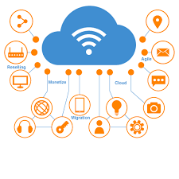
Connect to Internet
Connecting to the internet is a fundamental aspect of modern application development, enabling communication between devices and servers. Here's a concise overview of key concepts when establishing internet connections:
Network Permission: Declare the necessary network permissions in the AndroidManifest.xml file. You can use <uses-permission android:name="android.permission.INTERNET"/>. This permission allows app to create network sockets for sending and receiving data from internet.
Network Requests: Use either HTTP or HTTPS protocols to initiate network requests from your application to remote servers. This is typically done using the following methods:
HttpURLConnection, HttpClient.
Get data from internet
To fetch data from the internet in an Android application, you need to ensure that your app has the necessary network permissions declared in the AndroidManifest.xml file. This is crucial for the app to access the internet. Once permissions are set, you can initiate network requests using HTTP or HTTPS protocols.

Slide 11
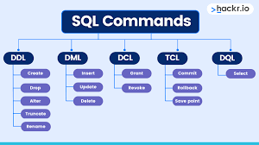
Data Persistence
Data persistence in software development refers to the process of storing and retrieving data to and from a persistent storage medium, such as a database or file system. It is a crucial aspect of creating robust and user-friendly applications. There are several methods for achieving data persistence in Android applications:
Shared Preferences: This is the simplest way to store small amounts of primitive data in key- value pairs. Shared Preferences are ideal for storing user preferences or settings.
Internal Storage: You can store private data files directly on the device's internal storage. These files are accessible only by your application and are not shared with other applications.
External Storage: This method allows you to save files on the device's external storage, such as an SD card.
Structured Query Language): SQL, or Structured Query Language, is a powerful domain-specific language designed for managing and manipulating relational databases. It provides a standardized way to interact with databases, allowing users to perform operations such as querying, updating, inserting and deleting data.

Slide 12
WorkManager
Google's Android WorkManager is a powerful API within the Android Jetpack library designed to simplify and manage background tasks in Android applications. It addresses the need for executing tasks that continue running even when the app is not in the foreground or if the device restarts. Here's a brief summary of WorkManager's key features.
Background Task Management:
WorkManager allows developers to schedule and manage tasks that run in the background, such as data syncing, periodic updates, or content downloads.
Persistent Execution:
Tasks scheduled with WorkManager persist across device reboots and app closures, ensuring reliable execution even in challenging conditions.
Constraints Management:
WorkManager allows the specification of constraints, such as network availability or battery status, to control when a task should be executed, optimizing resources and improving efficiency.

Slide 13
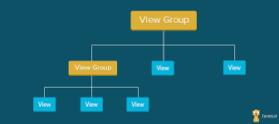
Views and Compose
A View is a fundamental element for any user interface (or design) in android. The View is a base class for all UI components in android. For example, the EditText class is used to accept the input from users in android apps, which is a subclass of View. Following are the some of common View subclasses that will be used in android applications.
TextView
EditText
Button
CheckBox
RadioButton
ImageButton

Slide 14
Real-time Examples
Ride-Sharing Apps (e.g., Uber, Lyft)
Instant Messaging Apps (e.g., WhatsApp, Telegram)
Live Event Streaming Apps (e.g., Facebook Live, Instagram Live)
Weather Apps with Real-Time Updates (e.g., AccuWeather)
Emergency Services Apps (e.g., SOS Apps)
Real-Time Language Translation Apps (e.g., Google Translate)

Slide 15
Conclusion
Enrolling in Google's Android development course provides a concise yet comprehensive journey into the world of mobile app creation.
With Google's expertise in developing the Android platform, learners can expect a focused curriculum covering essential topics like programming languages, the Android SDK, and API integration.
The course's hands-on approach ensures a practical understanding of building robust applications, aligning with industry standards.
Completing this course not only equips individuals with the skills necessary for app creation but also stands as a valuable endorsement from a leading authority in the mobile technology landscape

Slide 16
References
[1] https://developer.android.com/courses/android-basics-compose/course
[2]https://internship.aicte-india.org

Slide 17
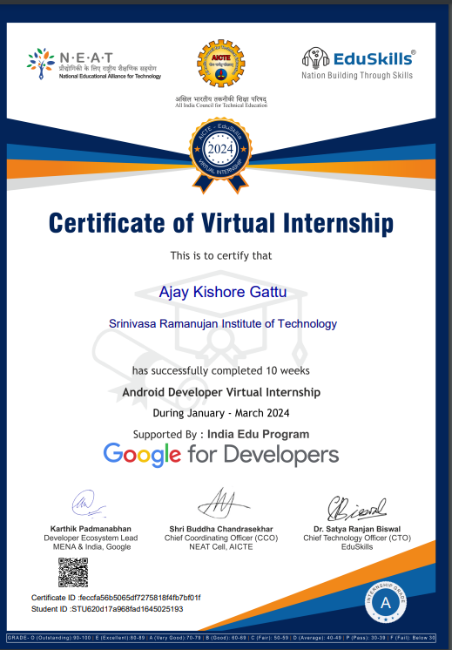
Internship Certificate

Slide 18
Thank You!!!

