Slide 1


URGENT UNITY: BRIDGING IN CRISIS
SRIVISHWA P 2021115109
SURYA NARAYANAAN K C 2021115113
SANTHOSH R 2021115311
Department of Information Science and Technology
Anna University, Chennai.

Slide 2
OVERVIEW
Agenda (PPT)
Problem Statement
Existing System
Proposed System
Implementation Details
Results
Conclusion and Future Works
References

Slide 3
AGENDA
This disaster management app was developed to provide real-time alerts, emergency resources, and communication tools to assist both the general public and emergency responders during natural disasters and crisis situations. It aims to enhance preparedness, coordination, and response efforts, ultimately saving lives and minimizing the impact of disasters on communities. Through its intuitive interface and robust features, the app empowers users to access critical information, report incidents, and coordinate rescue efforts effectively.

Slide 4
PROBLEM STATEMENT
During natural disasters, the lack of a centralized platform with internet connectivity hampers effective relief coordination, resource distribution, and identification of safe areas. This fragmentation leads to inefficiencies in relief efforts, hindering timely assistance and potentially endangering lives. Addressing these challenges necessitates innovative solutions to streamline coordination and improve resource allocation among relief organizations and affected communities.

Slide 5
EXISTING SYSTEM
FEMA App: Provides real-time alerts, safety tips, and information on emergency shelters and disaster recovery centers.
Red Cross Emergency App: Offers real-time alerts, emergency preparedness plans, and a "Safe and Well" feature for checking in during disasters.
Zello: A walkie-talkie app used for real-time communication during emergencies.
Disaster Alert (by Pacific Disaster Center): Provides real-time alerts and updates on natural disasters worldwide, including earthquakes, tsunamis, and severe weather events.
Emergency: Alerts & Notifications: Offers real-time alerts for various types of emergencies, personalized emergency preparedness plans, and safety tips for users.

Slide 6
PROPOSED SYSTEM
Our project seamlessly integrates key features from existing disaster management apps like FEMA and Red Cross Emergency, providing users with real-time alerts, personalized emergency plans, safety tips, and a locator for shelters and resources. Additionally, users can report incidents, request aid, and access helpline numbers for quick assistance, streamlining communication during crises. By combining these functionalities, our app offers a comprehensive solution for preparing for, responding to, and recovering from emergencies effectively

Slide 7
IMPLEMENTATION
The methodology behind our project encapsulates the meticulous design and development process that forms the backbone of Urgent Unity's functionality and user experience.
User-Centric Design Principles:
Our methodology begins with a deep understanding of user needs and preferences, guiding the seamless fusion of user-centric design principles into the architectural blueprint.
We prioritize intuitive user interactions and interfaces, ensuring accessibility and ease of use for all stakeholders.

Slide 8
Robust Backend Infrastructure:
The architecture is built upon a robust backend infrastructure, incorporating technologies like Firebase to ensure scalability, reliability, and security.
Authentication mechanisms guarantee secure access, establishing trust and confidence among users.
Seamless Integration of Features:
Each component of the system is meticulously integrated to provide a cohesive user journey, from assistance requests to donation facilitation.
Integration of powerful technologies such as the Google Maps API enriches user experiences with real-time routing assistance and navigation services.

Slide 9
Monitoring and Alert Mechanisms:
The architecture incorporates mechanisms for monitoring alerts, empowering users and admin personnel with timely updates and actionable insights.
This ensures that stakeholders remain informed and equipped to respond effectively to evolving situations.
Foundational Pillars:
In essence, our methodology elucidates the foundational pillars upon which Urgent Unity stands, poised to deliver a seamless and impactful solution in the realm of disaster management and community support.
It embodies a holistic approach to design and development, prioritizing resilience, accessibility, and user empowerment.

Slide 10
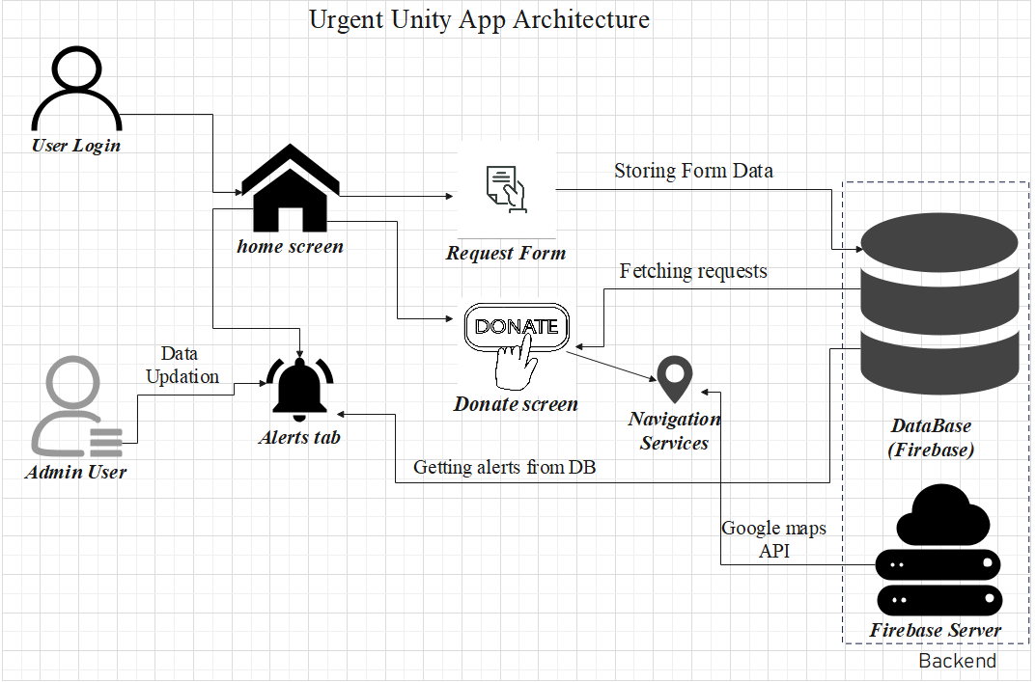
ARCHITECTURE OF the system

Slide 11
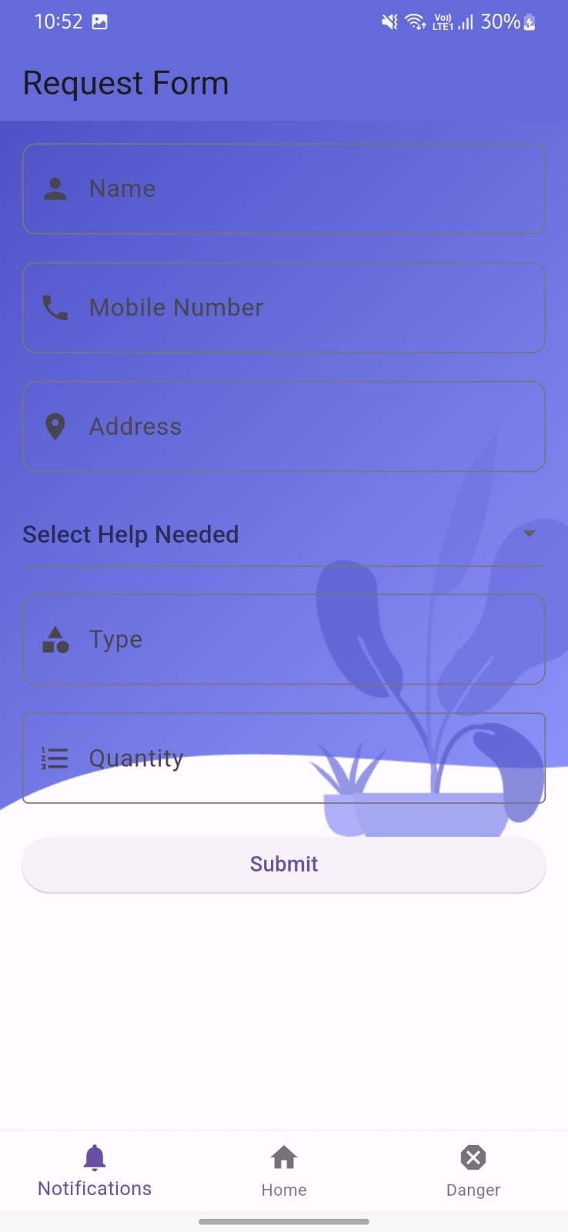
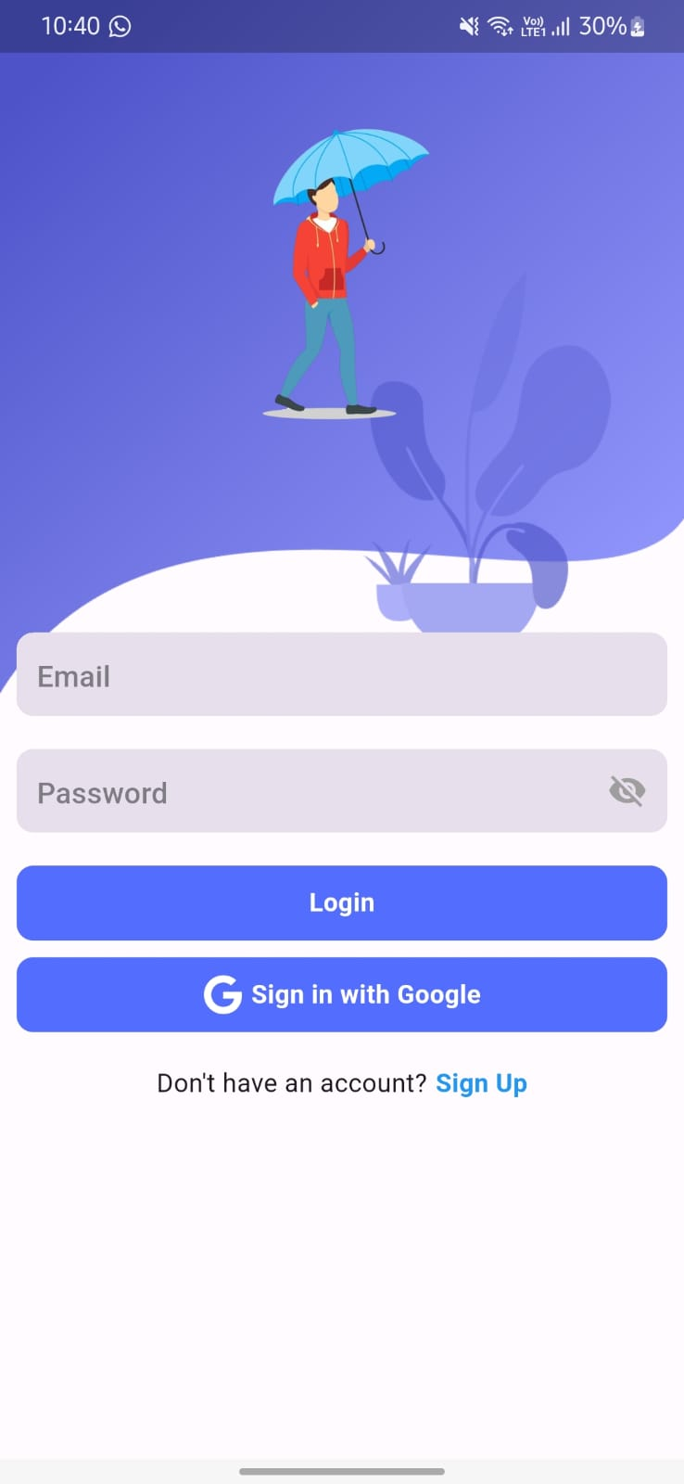
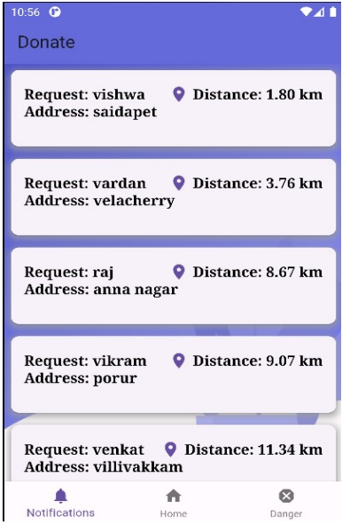
RESULTS

Slide 12
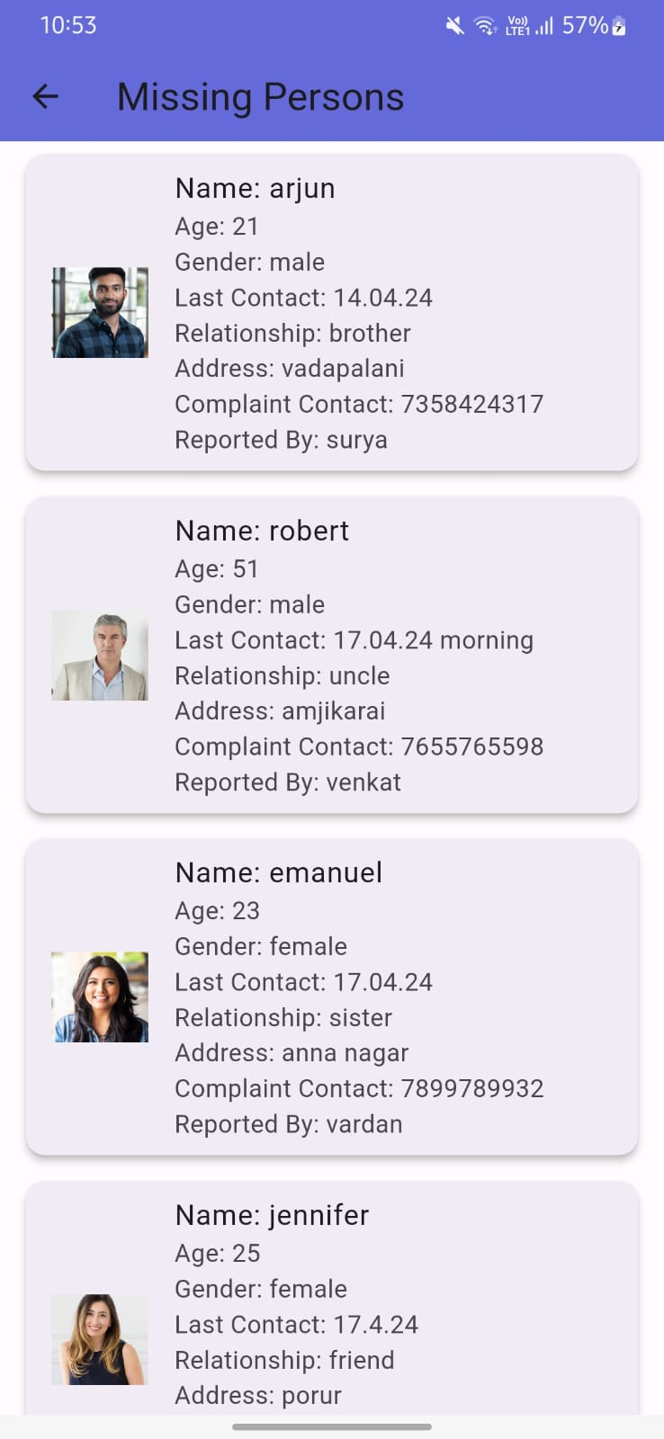
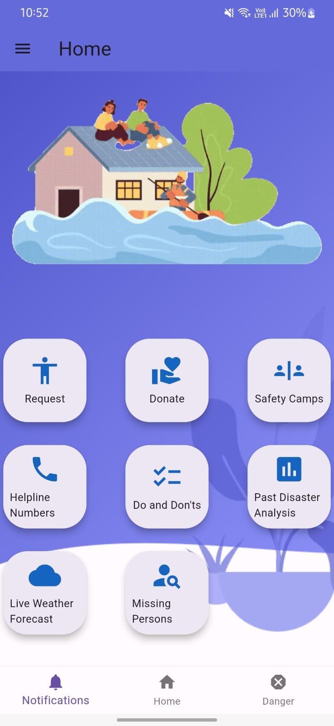
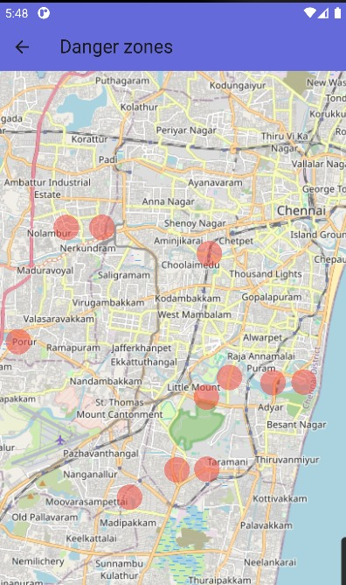

Slide 13
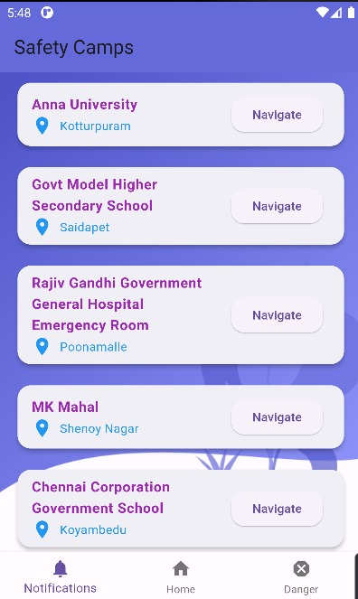
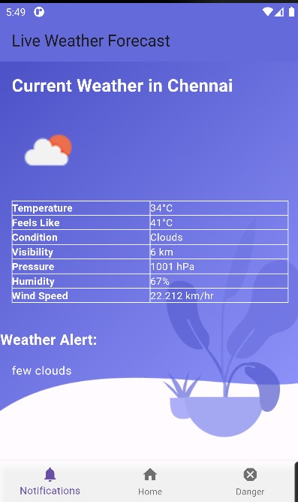
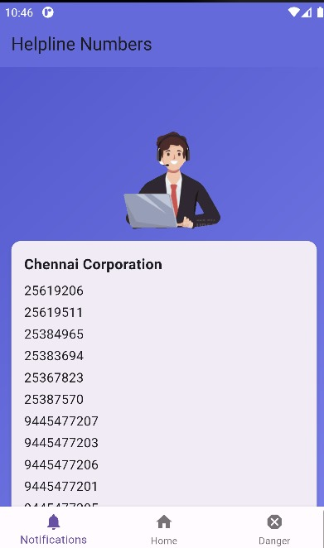

Slide 14
Conclusion anD FUTURE WORKS
Conclusion:
The disaster management project offers efficient and coordinated response efforts during emergencies, with user-friendly features such as assistance request forms and donation portals. Real-time alert monitoring and administrative functionalities ensure timely communication and effective crisis management.
Future Work:
Future enhancements include introducing offline functionality for accessibility in areas with limited network connectivity, enhancing community engagement features, improving predictive analytics, and integrating emerging technologies like AI and IoT. Ongoing collaboration ensures the system's alignment with community needs, reinforcing its role in disaster preparedness and response efforts.

Slide 15
REFERENCES
Gabriel Murariu, Silviu Epure, Dan Munteanu, Ciprian Vlad, “Disaster manage- ment system”, proceedings of 2019 6th International Symposium on Electrical and Electronics Engineering (ISEEE) 18-20 October 2019, Galati, Romania
Jason Widagdo, Dicky Dwi Putra, Budi Syihabuddin, Tutun Juhana, “Android- based Disaster Management Application for After-Disaster Rapid Mobile Assess- ment”, proceedings of 2020 IEEE International Conference on Internet of Things and Intelligence System (IoTaIS) 27-28 January 2021 BALI, Indonesia
Vidhi Mody, Vrushti Mody, Soham Parekh, “Distress – An Application for Emer- gency Response and Disaster Management”, Proceedings of the International Conference on Smart Electronics and Communication (ICOSEC 2020) 10-12 September 2020 Trichy, India
Prabodh Sakhardande, Sumeet Hanagal, Savita Kulkarni, “Design of Disaster Management System using IoT Based Interconnected Network with Smart City Monitoring”, proceedings of the 2016 International Conference on Internet of Things and Applications (IOTA) 22-24 January 2016 Pune, India
Himadri Nath Saha; Supratim Auddy; Subrata Pal; Shubham Kumar; Shivesh Pandey, “Disaster management using Internet of Things”, proceedings of 2017 8th Annual Industrial Automation and Electromechanical Engineering Confer- ence (IEMECON) 23 October 2017 Bangkok, Thailand

Slide 16
6. Mei Xiang, Yanan Wu, Ming Zhao, ”Intelligent Flood Monitoring and Manage- ment System Using Satellite Imagery and Community Engagement,” Proceed- ings of the International Conference on Environmental Science and Technology (ICOEST 2021), 15-17 June 2021, Beijing, China.
7. Alessandro Russo, Luca Rossi, Giuseppe Marino, ”Wildfire Detection and Re- sponse Platform: Integrating Satellite Imagery, Weather Data, and Machine Learning,” Proceedings of the IEEE International Conference on Computational Intelligence and Applications (ICCIA 2020), 10-12 December 2020, Milan, Italy.
8. Maria Lopez, Juan Rodriguez, Ana Garcia, ”Community-Based Hurricane Pre- paredness and Response Application: Integrating Storm Tracking, Evacuation Routes, and Emergency Shelters,” Proceedings of the International Conference on Human-Computer Interaction (HCI 2021), 5-7 September 2021, Portugal.
9. Rajesh Sharma, Neetu Gupta, Prakash Singh, ”Landslide Risk Assessment and Mitigation System: Geospatial Data Analysis, Rainfall Monitoring, and Com- munity Engagement Strategies,” Proceedings of the International Conference on Geotechnical Engineering and Disaster Management (ICGEDM 2020), 20-22 November 2020, Mumbai, India.
10. Sara Alves, Pedro Costa, Joao Rodrigues, ”Integrated Tsunami Early Warning System: Leveraging Seismic Sensors, Ocean Buoys, and Communication Net- works,” Proceedings of the International Conference on Disaster Management and Risk Reduction (ICDMRR 2021), 10-12 October 2021, Tokyo, Japan.

