Slide 1
Complexity Analysis
~ SRI YAMUNA DEVI

Slide 2
Time Complexity
Time complexity measures how the runtime of an algorithm increases as the input size grows. It is expressed using Big-O notation (e.g., 𝑂(𝑛)O(n), 𝑂(𝑛2)O(n2)).
Common Time Complexities
Complexity | Name | Example
𝑂(1) | Constant Time | Accessing an array element
𝑂(log⁡𝑛) | Logarithmic | Binary search
𝑂(𝑛) | Linear | Looping through an array
𝑂(𝑛log⁡𝑛) | Linearithmic | Merge sort, Quick sort
𝑂(𝑛2) | Quadratic | Bubble sort, Nested loops
𝑂(2𝑛) | Exponential | Recursive Fibonacci (naive)
𝑂(𝑛!) | Factorial | Permutations of a list

Slide 3
Space Complexity
Space complexity measures the extra memory an algorithm uses relative to input size. It also uses Big-O notation.
Common Space Complexities
Complexity | Name | Example
𝑂(1) | Constant | Swapping two variables
𝑂(𝑛) | Linear | Storing an array of size n
𝑂(𝑛2) | Quadratic | 2D matrix

Slide 4
Key Points
Time Complexity: How fast an algorithm runs.
Space Complexity: How much extra memory it uses.
Big-O Notation: Describes worst-case growth rate.

Slide 5
Ω (Omega) and Θ (Theta) Notations Explained
1. Ω (Omega) Notation: Lower Bound
When to Use:
To describe the best-case scenario of an algorithm.
Example:
Linear Search:
Best case: Target is the first element → Ω(1)Ω(1).
Worst case: Target is last → 𝑂(𝑛)O(n).
2. Θ (Theta) Notation: Tight Bound
When to Use:
When an algorithm’s best and worst cases are identical.
Example:
Merge Sort: Always Θ(𝑛log⁡𝑛)Θ(nlogn) (split + merge steps are fixed).
Binary Search: Always Θ(log⁡𝑛)Θ(logn) (halving is consistent).

Slide 6
Comparison with Big-O
Notation | Meaning | Example (Sorting Algorithms)
𝑂 | Upper bound (worst-case) | Bubble Sort: 𝑂(𝑛2)O(n2)
Ω | Lower bound (best-case) | Bubble Sort: Ω(𝑛)Ω(n) (if already sorted)
Θ | Tight bound (exact rate) | Merge Sort: Θ(𝑛log⁡𝑛)Θ(nlogn)

Slide 7
Algorithm | Best Case (Ω) | Average Case (Θ) | Worst Case (O) | Notes
Quick Sort | Ω(𝑛log⁡𝑛) | Θ(𝑛log⁡𝑛) | 𝑂(𝑛2) | Worst case: unbalanced partitions.
Merge Sort | Ω(𝑛log⁡𝑛) | Θ(𝑛log⁡𝑛) | 𝑂(𝑛log⁡𝑛) | Consistent, stable, 𝑂(𝑛) space.
Heap Sort | Ω(𝑛log⁡𝑛) | Θ(𝑛log⁡𝑛) | 𝑂(𝑛log⁡𝑛) | In-place, unstable.
Bubble Sort | Ω(𝑛) | Θ(𝑛2) | 𝑂(𝑛2) | Best case: already sorted.
Insertion Sort | Ω(𝑛) | Θ(𝑛2) | 𝑂(𝑛2) | Best case: nearly sorted.
Selection Sort | Ω(𝑛2) | Θ(𝑛2) | 𝑂(𝑛2) | Always scans entire unsorted part.
Bucket Sort | Ω(𝑛+𝑘) | Θ(𝑛+𝑘) | 𝑂(𝑛2) | 𝑘 = number of buckets.
Radix Sort | Ω(𝑛𝑘) | Θ(𝑛𝑘) | 𝑂(𝑛𝑘) | 𝑘 = digit length.
Counting Sort | Ω(𝑛+𝑘) | Θ(𝑛+𝑘) | 𝑂(𝑛+𝑘) | 𝑘 = range of input values.

Slide 8
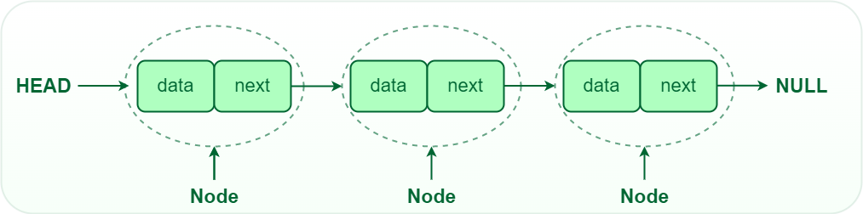
Linked list
Singly linked list

Slide 9
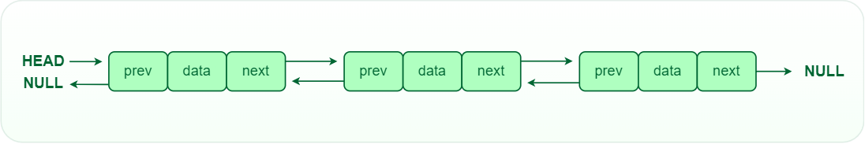
Doubly linked list

Slide 10
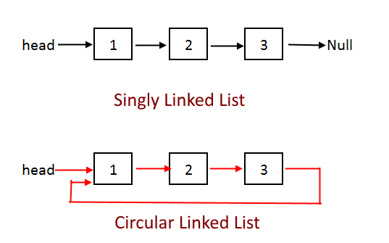
Circular singly linked list

Slide 11
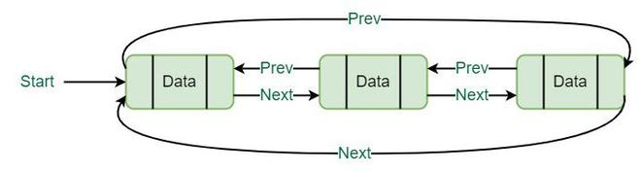
Circular doubly linked list

