Slide 1

Application of scan statistics in implementation and modeling of hotspot of total cognization IPC crimes in India: An inferential perspective
Sriya S Pillai(23MDT0008)
Gopika K.V.(23MDT0009)
Yash Mishra(23MDT0081) MSc Data Science Department of Mathematics School of Advanced Studies VIT Vellore
Under the guidance of
Dr. Jitendra Kumar
Associate professor
Department of Mathematics
School of Advanced Studies
VIT Vellore
SET ID: 224105

Slide 2
CONTENT
Motivation and relevance
Introduction
Objectives
Literature survey
Methodology
Results and discussions
Conclusion

Slide 3
MOTIVATION AND RELEVANCE
Public Safety: Identifying crime hotspots ensures targeted law enforcement efforts for public safety.
Policy Focus: Informs evidence-based policies to prevent crime and enhance community safety.
Resource Optimization: Directs resources efficiently by prioritizing high-risk areas for intervention.
Data-Driven Decisions: Utilizes statistical methods for proactive crime prevention strategies.
Economic Impact: Mitigates economic losses by targeting crime prevention measures effectively.

Slide 4

INTRODUCTION
Crime analysis is important in law enforcement and policy
creation to prevent the crime.
In India the criminal code in categorized into two: Cognizable and Non-cognizable crimes. The cognizable cases are subdivided into IPC and SLL.
The IPC is a comprehensive criminal code that defines various offenses and prescribes penalties for them,whereas SLL are enacted by local governments, such as city councils or county commissions, to address specific issues or circumstances within their jurisdiction.
The aim of this research paper is to detect Total IPC crime hotspots across India using the Spatial Scan Statistics (SaTScan) software.

Slide 5
OBJECTIVES
To do exploratory data analysis.
To find the outliers using the z score.
To design a model using linear regression .
To identify and analyze spatial clusters of total cognizable IPC crimes in India using Scan Statistics.
To find the hotspots using Satscan.
To provide law enforcement agencies, policymakers, and researchers with a robust inferential tool for understanding crime distribution

Slide 6
LITERATURE SURVEY
Study on Crime Rate in India
This research provides a thorough examination of the trends and factors that influence crime in the various areas of the nation.
The authors present an empirical analysis that highlights the frequency of different sorts of crime, such as violent crimes, property crimes, and Non-violent crimes.
The geographic distribution of hotspots for crime and the variations in crime rates between states and union territories are clarified
This study offers a useful basis for comprehending the fundamental causes of crime in India and developing efficient policy responses by clarifying the complexity of the country's criminal justice system.

Slide 7
2. Does higher educational attainment imply less crime? Evidence from the Indian states.
In this research, the correlation between crime rates and educational attainment is examined in several Indian states.
The authors investigate the possibility that having more education will lead to less criminal activity by using a thorough statistical analysis.
Regression analysis and empirical modelling are used in the study to provide new information on the negative relationship between crime rates and education levels.
This phenomenon is explained by increased socioeconomic options, better decision-making abilities, and increased social integration.
The study also emphasizes how education is important to prevent crime and increase safety.

Slide 8
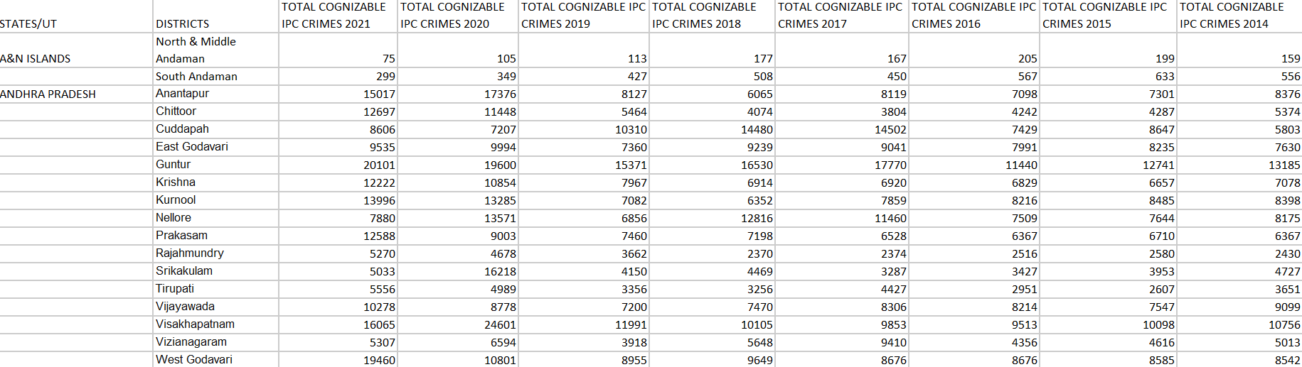
METHODOLOGY
DATASET
The data has been collected from National criminal Records Bureau(NCRB) for every district in India from 2014-2021.
Among the gathered data, the Total Cognizable IPC crimes was prioritized.
The geographical data, the estimated population and the Total Cognizable IPC crimes in each district of India has been collected for scan statistics.

Slide 9
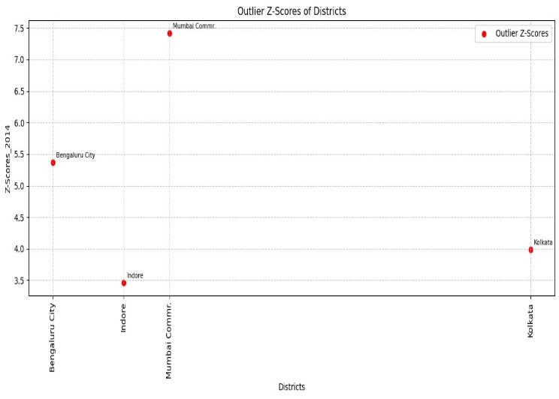
To understand the crime patterns in each district, the average, the standard deviation, the covariance, and the ranking based on the covariance were calculated over the year 2014-2021.
Average Crime Rate: This is the basic picture - it shows the typical level of crime in each district over the studied period (2014-2021).
Standard Deviation: This tells you how much the crime rates fluctuated within each district over the years. A high standard deviation indicates large year-to-year variations, while a low standard deviation suggests crime rates were more consistent.
Coefficient of Variation: It takes the standard deviation and expresses it as a percentage of the average crime rate. This allows you to compare the variability across different districts, even if their average crime rates are different.
Benefits of Ranking Districts: To identify the high crime districts, districts with volatile crime rates, Districts with consistently low crime rates.

Slide 10
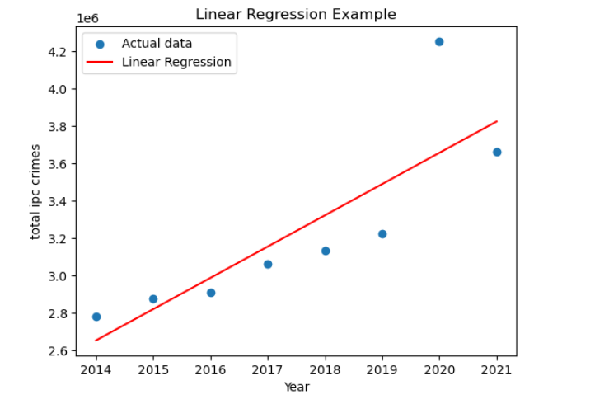
Further, Z score was also calculated that helps in finding the outliers which gives the districts that has values other than -3 to 3 Also, regression line is plotted between the time period and total cognizable crime of each year from 2014-2021.
Linear regression between year and total IPC crimes
Indicates Outliers for the year 2014

Slide 11
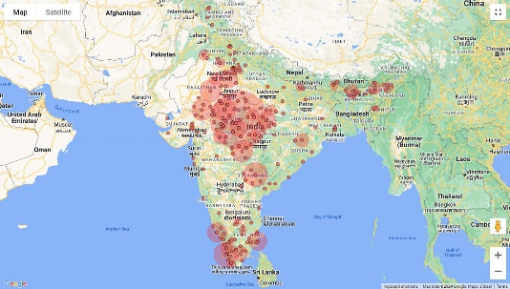
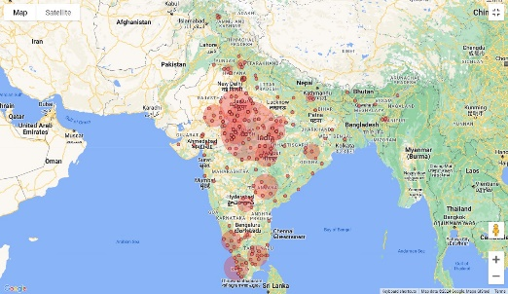
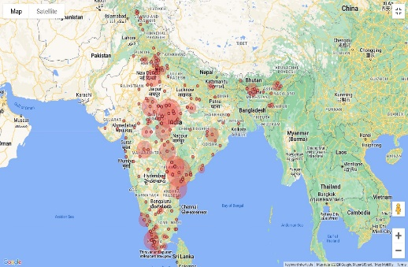
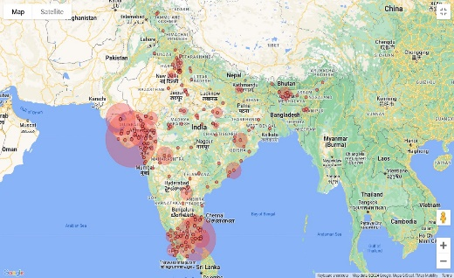
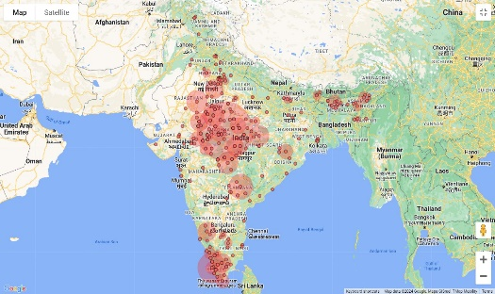
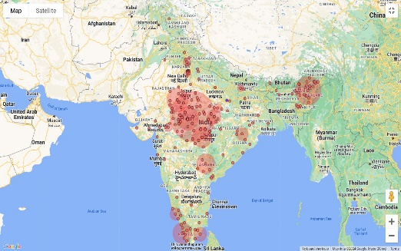
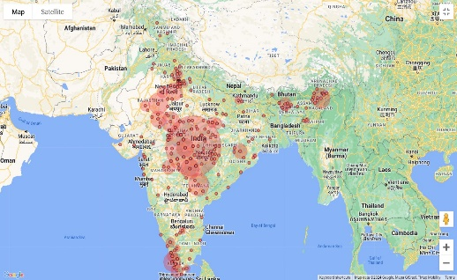
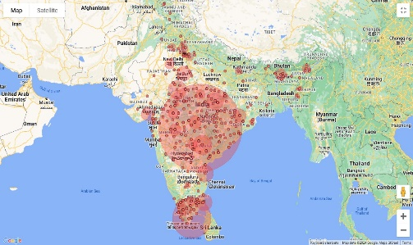
SCAN STATISTICS
The excel data has been used as input into SatScan application which is created after particular district data was merged with that of the neighbouring districts. Also, some of the districts with least value is also dropped.
Hence the dataset was reduced from 875 to 645. Case file comprises of the number of crime cases of each district, taken separately, coordinate file contains the latitude and longitude, and population file contains the estimated population of each district in India.
Discrete Poisson based model is used to identify the hotspots.
Satscan image for the year 2014
Satscan image for the year 2015
Satscan image for the year 2016
Satscan image for the year 2017
Satscan image for the year 2021
Satscan image for the year 2020
Satscan image for the year 2019
Satscan image for the year 2018

Slide 12
RESULTS AND DISCUSSIONS
We obtained a regression line which indicates that the crime rate is increasing almost linearly for those years.
Z-score analysis was used to identify outliers in crime data from 2014 to 2021. The results showed that Bangalore, Indore, and Kolkata frequently appeared as outliers.
However, it's important to recognize that these outliers can be the result of some other reasons in addition to high crime rates in these areas. Hence, we used another technique to find the hotspots of cognizable crime.
On comparing the hotspots obtained by Z-score and SatScan, it can be summarized that SatScan is more accurate because it uses LLR and RR to see how strong is the evidence for a district to be under hotspot and how likely the person in that hotspot is involved in the crime respectively.

Slide 13
Whereas, z-score only focuses on identifying the hotspots on the basis of average crime rate in that district. The main objective of this research is to evaluate the statistical significance of crime cluster alarms and find the hotspots.
Here, Discrete Poisson based model is used to identify the hotspots.
After the completion of the calculations, a standard text-based results file is automatically generated, containing information about the clusters detected, computing time and the analysis parameters chosen.
Prominent clusters on the basis of IPC crime cases are as follows: North West, New Delhi, Central, Gurugram, North East. These districts have the highest crime cases over the 2014-2021.

Slide 14
CONCLUSION
This project involves examining IPC Crime data from every district of India.
The first five hotspots of India are observed to be North West, New Delhi, Central, Gurugram , North East.
By this it can be concluded that these districts are in higher chance of risk, in these districts the observed cases are more than the expected cases as per the total population.
These districts need maximum optimization of resources, like installing cameras, increasing Police presence in those districts especially as night, educating the people and many more. In these ways the resources can be allocated to decrease the crimes and increase safety.
This helps the policymakers in India to prevent the crimes taking place.
Policymakers can maximise the effectiveness and impact of crime prevention initiatives by focusing resources and actions on regions that require the greatest attention by identifying hotspots using scan statistics.
The policymakers should also find out how what are the reasons for crime in those districts, like lack of education or poverty.

Slide 15
REFERENCES
Akçomak, İ.S. and Ter Weel, B, “The impact of social capital on crime: evidence from The Netherlands”, Regional Science and Urban Economics, Vol. 42 Nos 1-2, pp. 323-340, 2012
Doe, J. "Trends and Patterns of Crime in Urban India": 2018
Gupta, U., & Sharma, R. “Analysis of criminal spatial events in India using exploratory data analysis and regression”.(2023)
Mandal, B.”Differences in conviction rates across violent crimes in India”. Version of Record 18 June 2019.

Slide 16
THANK YOU

