Slide 1
Covid 19 analysis
Team Members
P S Yeshwanth(2010030122)
T S S Subramanyam(2010030167)
P Venkata Sai Adithya Reddy(2010030434)
Y Sai Bhargav(2010030535)

Slide 2
Table of contains
Project Area
Literature Survey
Problem Statement
Our Approach
Conclusion

Slide 3
Project Area
Our data set statical data
We are performing predictive analysis. As Predictive analytics seeks to predict what is likely to happen in the future. Based on past patterns and trends, data analysts can devise predictive models which estimate the likelihood of a future event or outcome.
We will perform data analysis on covid data set which contains country name, number of covid cases,death,recoveries and predict new positive cases Using regression

Slide 4
Literature Survey
SNO | Authors | Title | Year | Descrpition
1 | R. Wang, | Data Analytics for the COVID-19 Epidemic | 2020
2 | G. Wolfe, | COVID-19 Candidate Treatments, a Data Analytics Approach, | 2020
3 | Deepak Gupta | COVID-19 data | 2021
4 | Alex Lima | Predictive COVID-19 models | 2021
5 | Zoabi | prediction of COVID-19 diagnosis based on symptoms | 2021

Slide 5
Problem Statement
The Pandemic has changed many people lives. Since the start of the pandemic, some countries witnessed exponential hike in positive cases.
This has become very difficult for countries to track and Control covid cases. In this project we are going to analyze data.
Through the data analysis of cases one can analyze how countries all over the world are doing in terms of controlling the pandemic.
Predictions are made with the dataset available to the individual/country thus helping them to decide how far they are able to control the pandemic or up to how much extent they should guide preventive measures.
To build a model that will predict the next day’s number of coronavirus cases based on the last n day’s number of coronavirus cases and deaths.

Slide 6
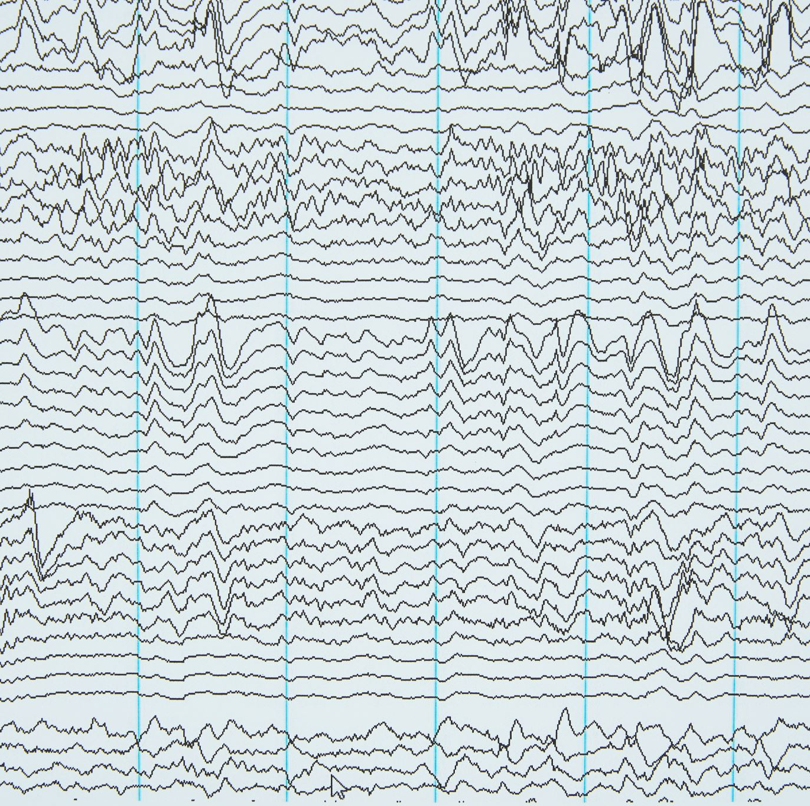
Our Approach
Linear regression:-It mainly concentrates on individual regression simulation characteristics. It may also be used to define and model the relationship between independent variables and dependent
Support Vector Machine:-The SVM is a type of ML managed algorithm for reverse and regression classification. The SVM regression depends on a variety of statistical functions as a non parametric technician. The set of the kernel function converts data input into the form you like. In order to overcome regression problems using a linear function, SVM maps the vector(x) input(s) in the n-dimensional space called the function space(z) when dealing with non-linear regression problems. After linear regression is implemented in the space, non-linear mapping techniques are used for this mapping.

Slide 7
PROPOSED WORK
In our project we are going to analyze covid data and use different colors toshow confirmed and recovered cases. We have used red for confirmed cases and green forrecovered cases and show top 15 recovered countries and confirmed countries. Also we have build an interactive dashboard using powerbi to show confirmed casesrecovered cases, recovery rate of that country and deaths. We have also used some previous data to predict new cases using linear regression and decision tree to make our model more efficient.

Slide 8
SOFTWERE HARDWER REQUIRMENTS DATASETS NEEDED
Component Minimum requirement
Processor 64-bit, four-core, 2.5 GHz minimum per core (If your dataset size is significantly larger than the medium dataset, we recommend 8 cores.)
RAM 4 GB
Hard disk 80 GB
Windows 10 (recommended)
Software Requirements
PyCharm (latest version),google colab ,power bi
Data Sets Needed
covid_19_clean_complete.csv
Times_series_recoverd.csv
Times_series_deaths.csv
Times_series_confirmed

Slide 9
Work Allocation
P.S Yeshwanth-:Integrating python with power bi
T.S.S Subramanyam-:data cleaning and predicting
P.Venkata Sai Adithya Reddy-:Collecting data set and ppt preparation
Y.Sai Bhargav-:Plotting various graphs

Slide 10
Conclusion
In this project we are going to analyze dataset and show total number positive cases, deaths, recovered cases country wise
. Also we are going show red color for countries havingVery high positivity rate on world map. And green for people in the country for people who recovered from covid 19.
We also build interactive dash boards in power bi to show covid data.
Finally we have predicted new cases from previous data
We have used linear regression and decision tree for predicting new cases

