Slide 1
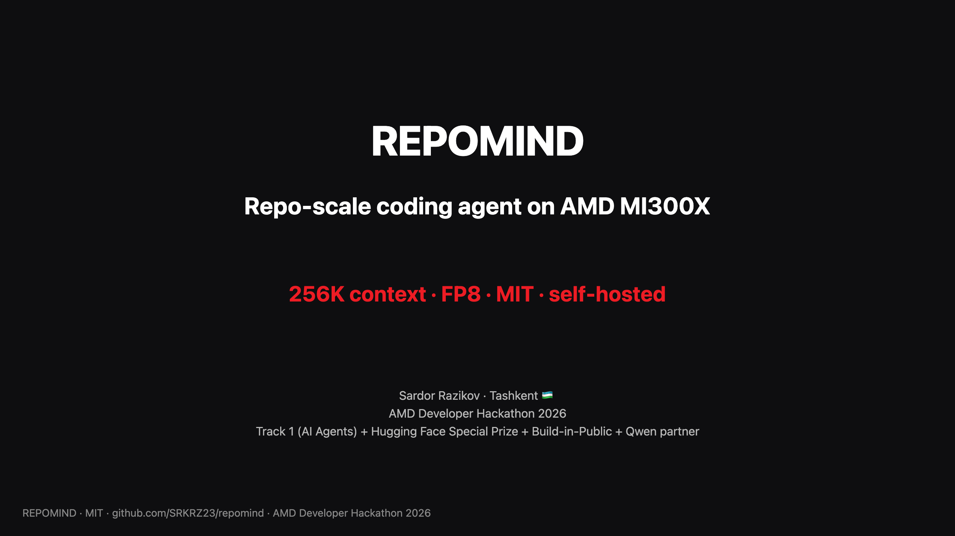
Notes:
SPEAKER NOTES (slide 1, ~20 sec): "I'm Sardor Razikov, solo from Tashkent. I built REPOMIND — an open-source repo-scale coding agent that runs on AMD MI300X. The pitch is simple: load an entire git repo at 256K context on a single GPU, reason across the whole codebase with multi-step tool use, and ship it MIT so banks, defense, healthcare — the people who can't legally use Cursor — finally have an option."

Slide 2
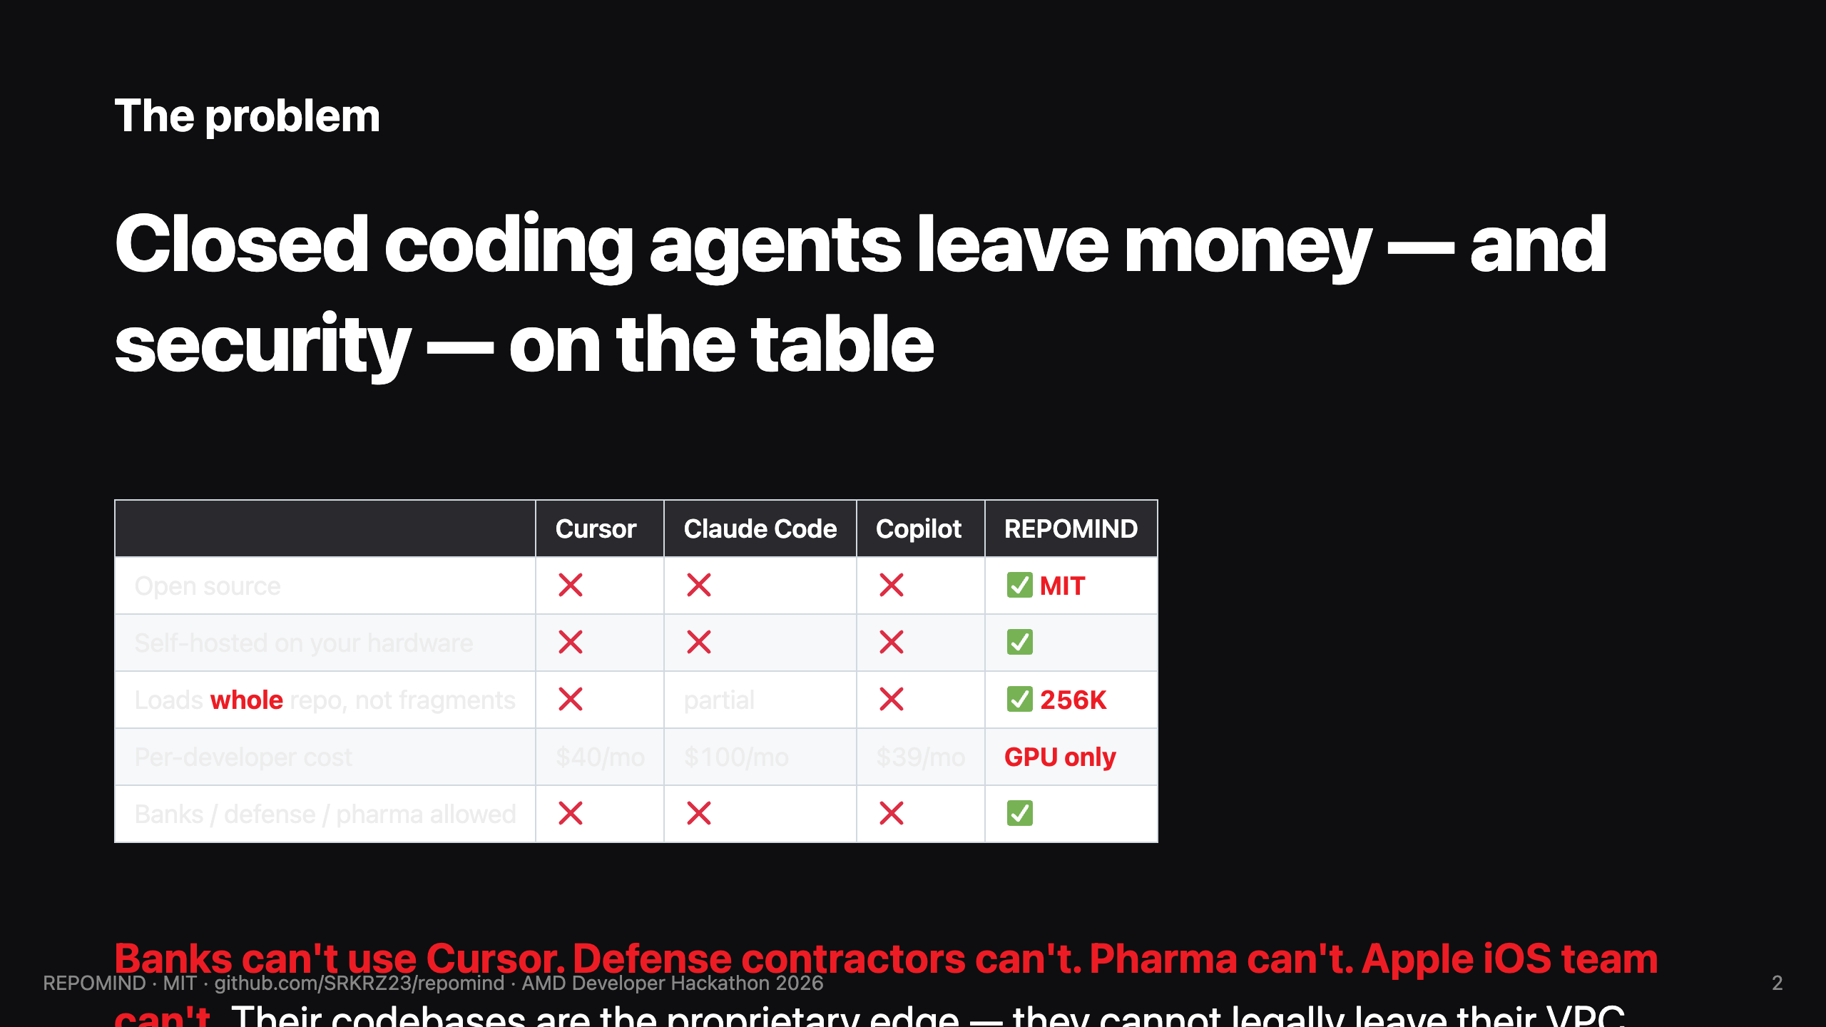
Notes:
SPEAKER NOTES (slide 2, ~25 sec): "Closed agents are great if you're a startup. But banks can't send code to OpenAI. Defense can't. Pharma can't. JP Morgan has 50,000 developers with no AI tooling at all because of compliance. That's not 'savings vs Cursor' — that's an unlock of a whole market that doesn't have a product today. REPOMIND is open-source, MIT, runs on your own AMD hardware, code never leaves your VPC."

Slide 3
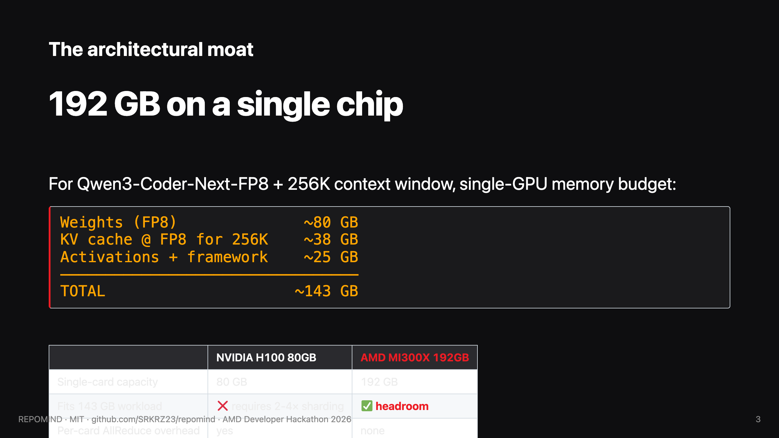
Notes:
SPEAKER NOTES (slide 3, ~30 sec): "Why MI300X specifically. Qwen3-Coder-Next-FP8 weights are ~80 GB. The 256K KV cache at FP8 is ~38 GB. Plus activations and framework, ~143 GB total. NVIDIA H100 single-card caps at 80. By VRAM accounting, you'd have to shard across 2 to 4 H100s with all the AllReduce overhead. MI300X 192 GB just runs it on one card. AMD's own February 2026 blog positioned this exact workload — and I quote: 'Users can serve the full 256k context length on a single GPU using FP8 precision, a critical requirement for repo-level coding tasks that often exceed the memory limits of lesser hardware.' REPOMIND is the first open- source proof of exactly that claim, shipped."

Slide 4
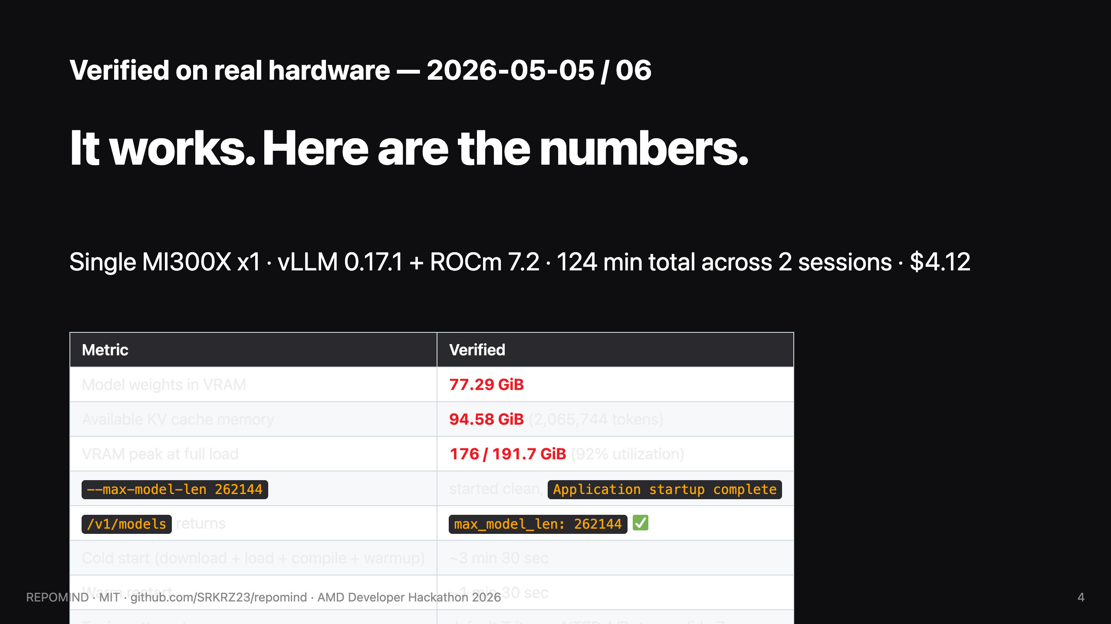
Notes:
SPEAKER NOTES (slide 4, ~25 sec): "This isn't theory. We ran a 124-minute stress test across two sessions on real MI300X hardware. Model weights took 77.29 gibibytes in VRAM, KV cache 94.58 gibibytes available — over 2 million tokens of cache. Peak utilization 92 percent of the 192 gigs. The vLLM API confirms 256K context window via the models endpoint. Cold start three and a half minutes. Total cost across both sessions: $4.12."

Slide 5
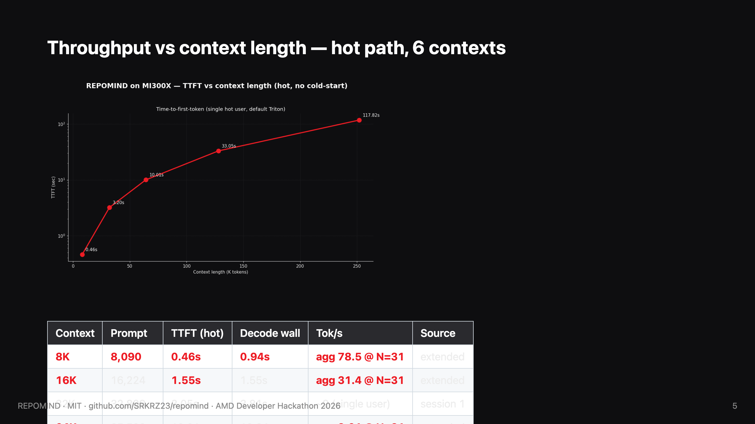
Notes:
SPEAKER NOTES (slide 5, ~20 sec): "Throughput sweep across six context lengths from 8K to 256K, all hot measurements with no cold-start outliers. Time-to-first-token at 8K is under half a second; at 256K context, 117 seconds. Linear in prompt size — that's the prefill cost. Long-context inference is prefill- bound; decode itself is fast."

Slide 6
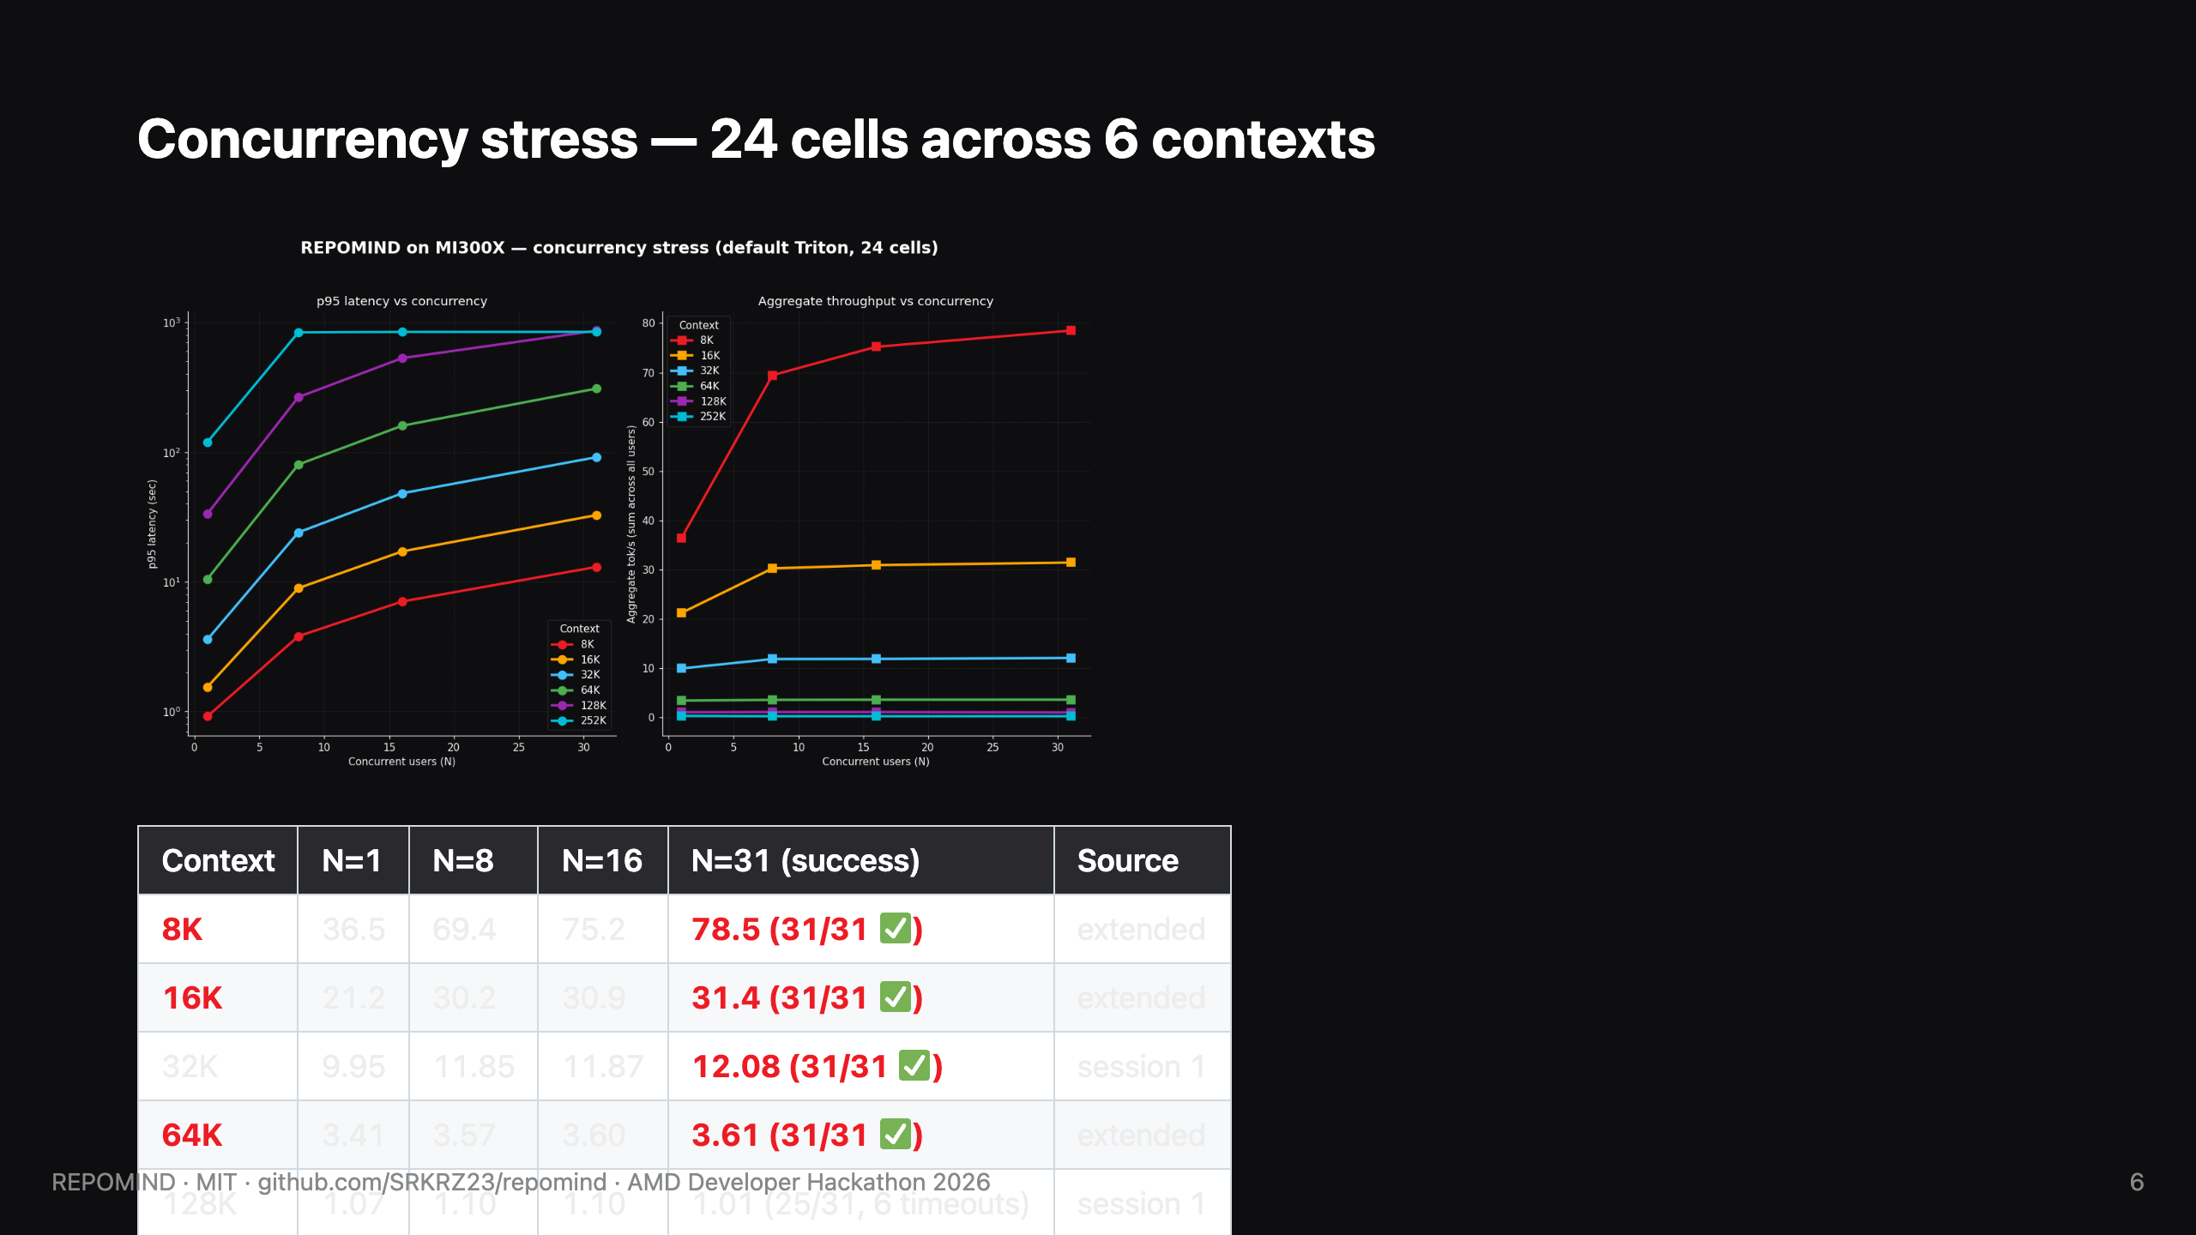
Notes:
SPEAKER NOTES (slide 6, ~30 sec): "24 cells of concurrency data across 6 context lengths. The clean story: 31 of 31 concurrent users succeed at every context from 8K up through 64K under the default Triton backend. At 128K, 25 of 31 within our 15-minute window. At 256K, the realistic ceiling is six to eight for unique-prompt workloads. The 8K and 16K rows directly answer the question 'where do most users live' — for typical developer queries, this is over 78 aggregate tokens per second on a single GPU."

Slide 7
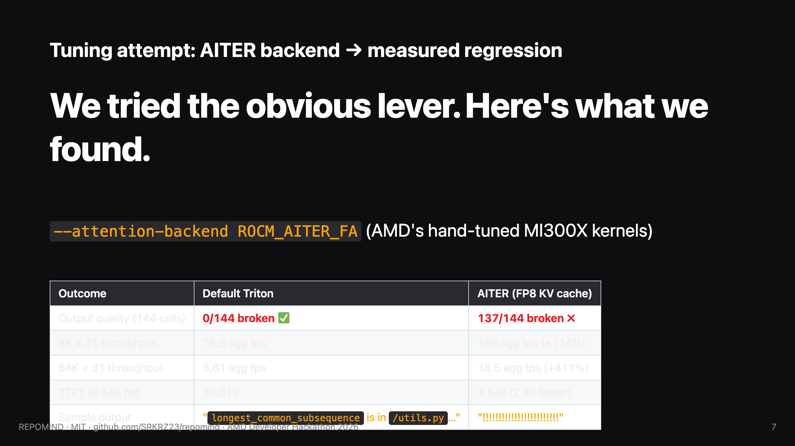
Notes:
SPEAKER NOTES (slide 7, ~30 sec): "Hakob from the AMD Developer Forum asked if we tried any vLLM tuning. We did — measured the AITER attention backend. Two findings: throughput is genuinely 2 to 4 times higher under AITER, time-to-first-token is nearly 3 times faster at 64K. But the output degenerates to repeating punctuation tokens — 137 of 144 cells produce gibberish in the FP8 KV cache configuration. Default Triton stays the production-safe choice. This is the kind of regression you only catch by actually running the workload, and it's exactly the kind of bug AMD's ROCm team will want flagged. Filed upstream as a tracked issue."

Slide 8
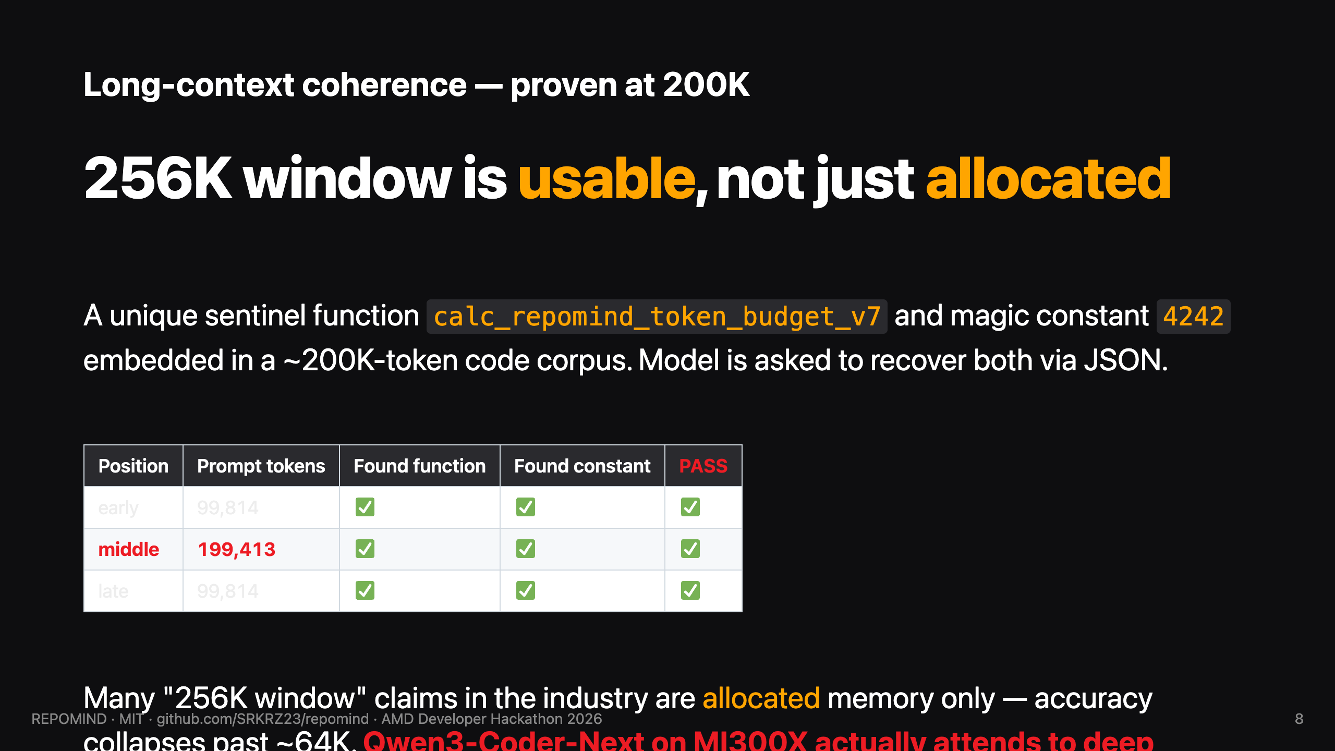
Notes:
SPEAKER NOTES (slide 7, ~25 sec): "Most '256K context' claims in the industry are memory allocation, not usable accuracy. Models hold the prompt but their attention degrades past 64K. We tested this: planted a unique sentinel function name and a magic constant deep inside a 200,000-token code corpus, at three positions. Three out of three pass — the model returns valid JSON with both facts recovered. Including the middle position at 199,413 tokens. This is required for repo-scale reasoning to actually work."

Slide 9
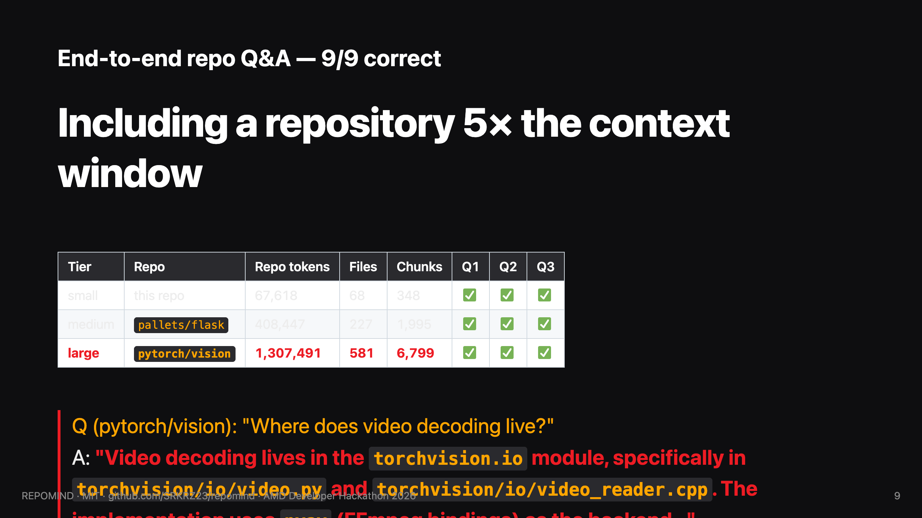
Notes:
SPEAKER NOTES (slide 8, ~30 sec): "This is the killer demo. We ran end-to-end ingestion on three real repos: REPOMIND itself at 68K tokens, Flask at 408K, and pytorch/vision at one-point-three MILLION tokens. The largest is five times bigger than any context window — including ours. Our priority-aware chunker prioritizes READMEs, then top-level symbols, then nested code, with a token budget. It trims pytorch/vision down to 180K of the highest- priority content. The agent answers all nine questions correctly with right file path citations. Cursor sends fragments because they're remote-API-bound. REPOMIND constructs the right 180K window per question because it owns the inference path."

Slide 10
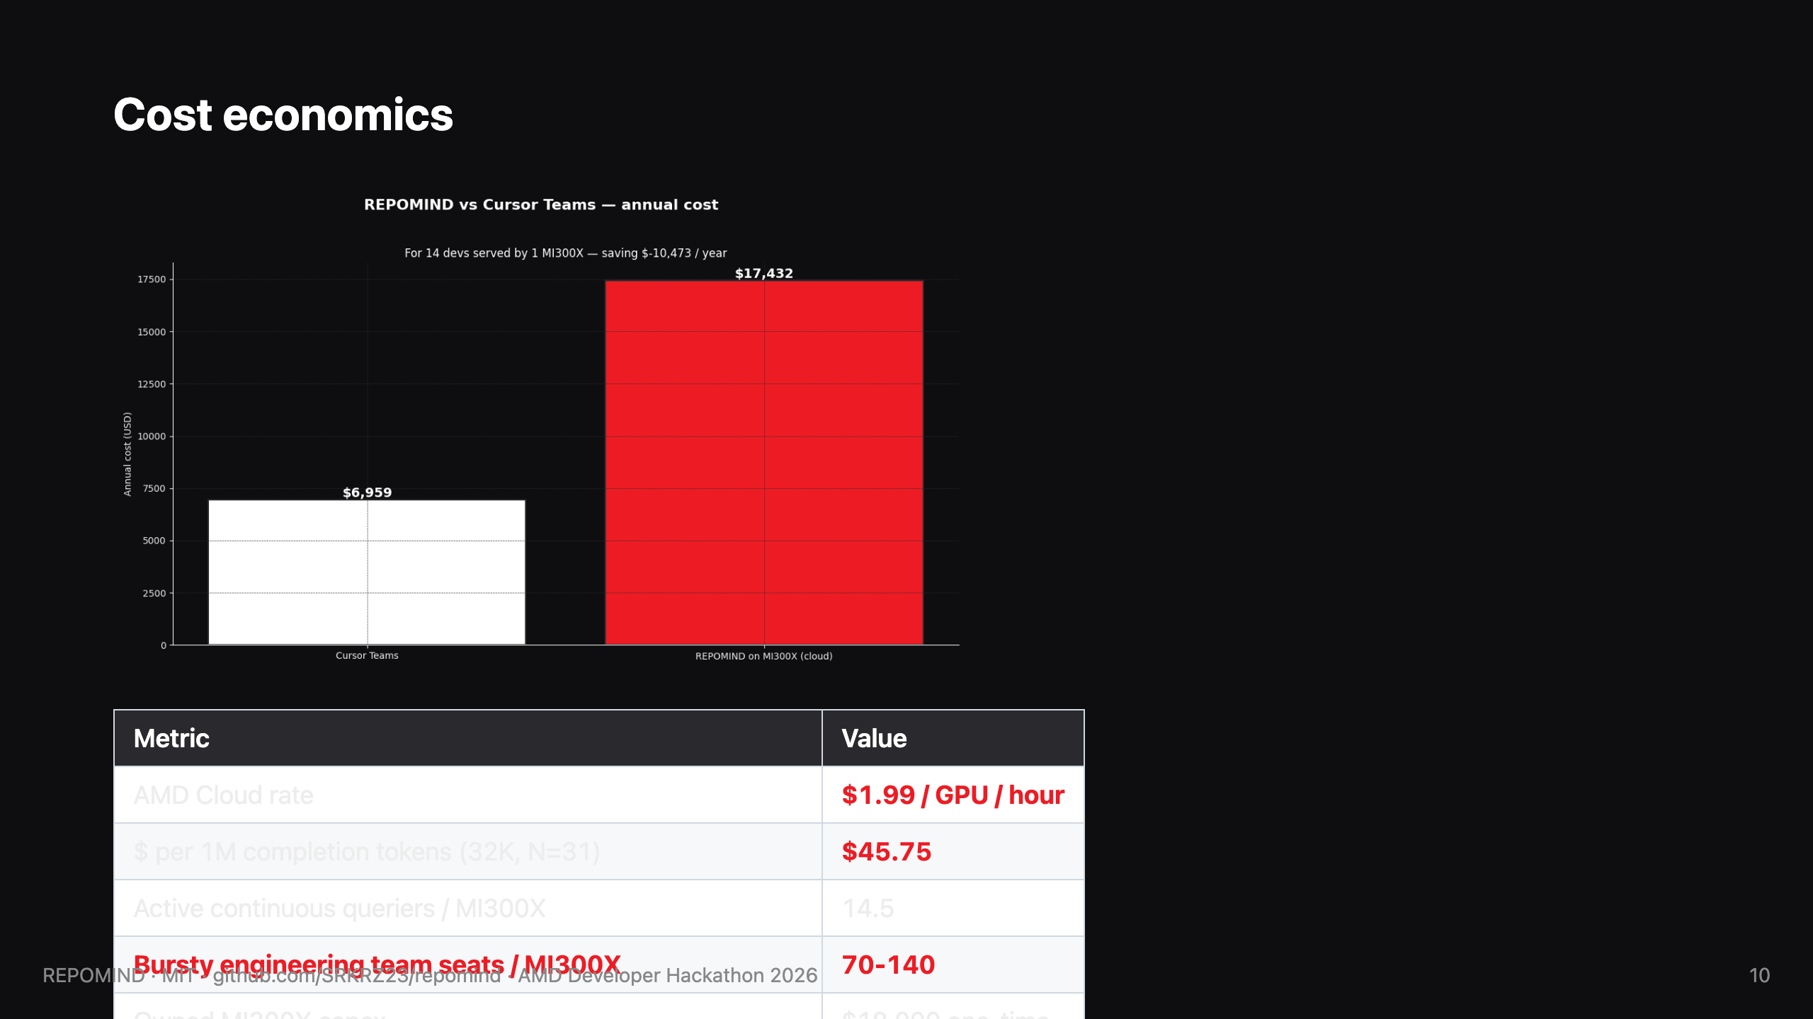
Notes:
SPEAKER NOTES (slide 9, ~25 sec): "Cost economics. AMD Cloud at $1.99 per GPU per hour. Forty-six dollars per million completion tokens at our best aggregate throughput. One MI300X handles fourteen continuous queriers, or seventy to a hundred- forty developer seats for typical bursty engineering workloads where ten to twenty percent are active at any moment. Owned MI300X breaks even versus Cursor Teams in three to six months for a 100-developer team. But the deeper story: for banks and defense and pharma who LEGALLY can't use SaaS coding agents, this isn't competing with Cursor. We're the first option that exists."

Slide 11

Notes:
SPEAKER NOTES (slide 11, ~25 sec): "AMD CEO Lisa Su said at CES 2026: 'AI is for everyone.' We took that literally. REPOMIND is open-source MIT, runs on a single AMD MI300X — banks, defense, pharma, Apple iOS team, indie developers — all get the same agent. Same canonical lablab and AMD pattern from Steve Kimoi's tutorial — vLLM endpoint plus Hugging Face Space — taken to its logical extreme: full 256K context, agentic tool use, repo-scale ingestion. MIT licensed. Verified yesterday. Five to ten billion dollar TAM that doesn't have a product today. AMD made the hardware. We made the open-source unlock. Thank you. Questions?"

