Slide 1
Team
Tech-Prove

Slide 2

Theme
Idea
Aim to change

Slide 3
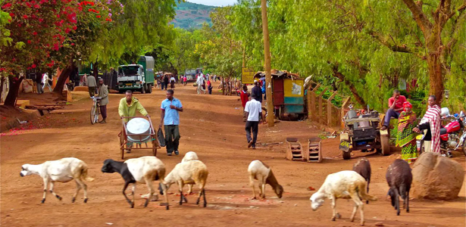
Problem Definition
Lack of knowledge
Lack of Awareness

Slide 4
1-Maintain database(Scheme collection)
what we did?
Govt. schemes
+
private schemes

Slide 5
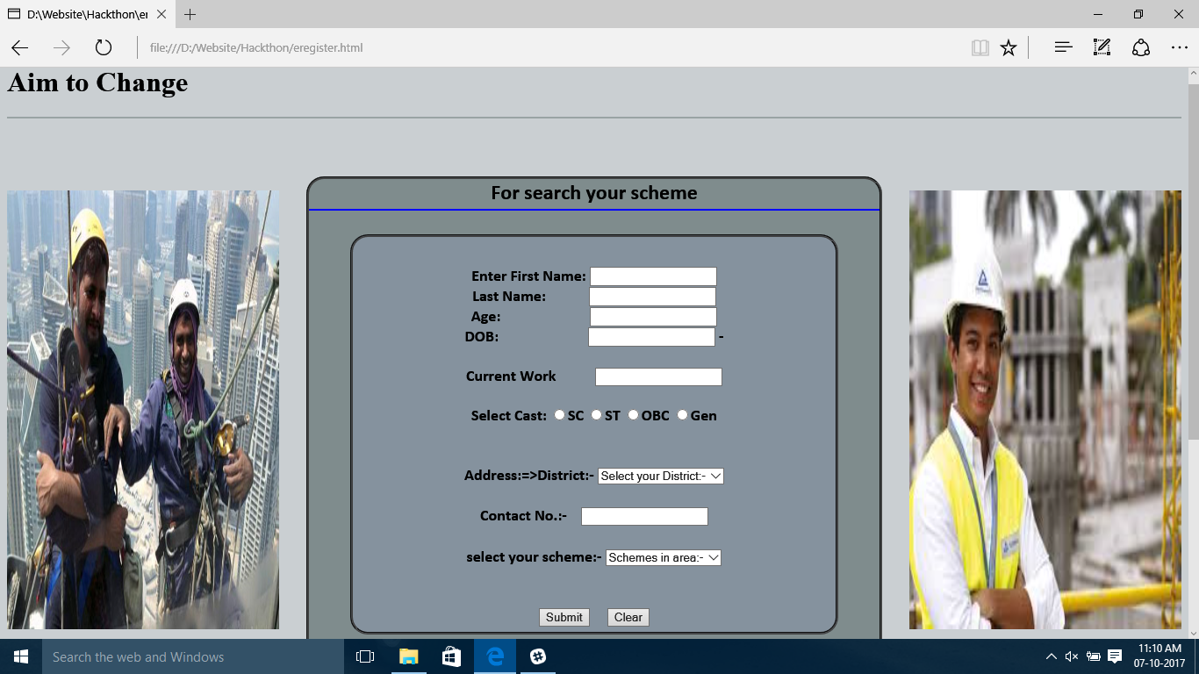
2-Make a categorize Page
what we did?

Slide 6
3-define eligibility Criteria
Like – who can apply
what is the requirement
Future advantages
Easy to search scheme

Slide 7
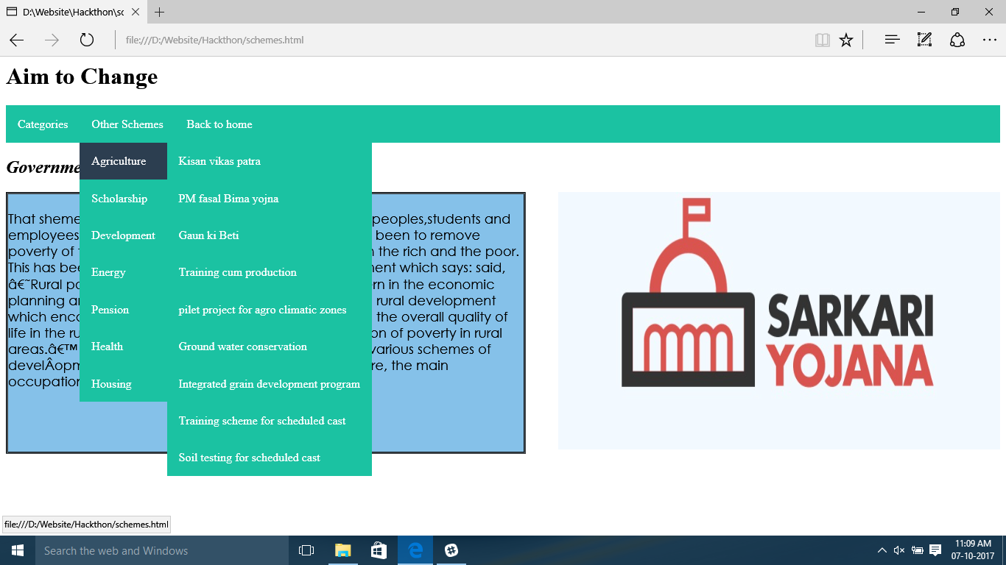

Slide 8
Thank you

