Slide 1
IPv6
Sarmistha Neogy
Professor
Department of Computer Science and Engineering
Jadavpur University

Slide 2
What is IPv6?
IPv6 is the newest version of internet protocol formulated by the IETF, which helps identify and local endpoint systems on a computer network and route online traffic while addressing the problem of IPv4 address depletion due to prolonged internet use worldwide.

Slide 3
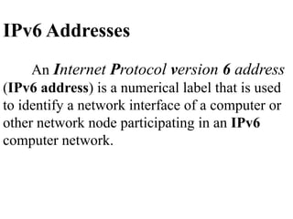

Slide 4
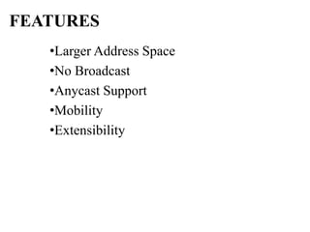

Slide 5
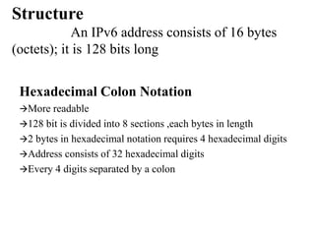

Slide 6
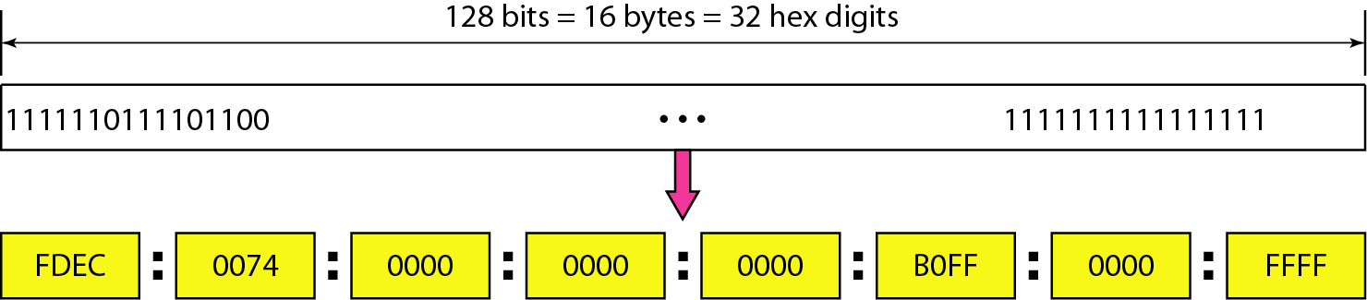
IPv6: Binary and Hexadecimal notations

Slide 7
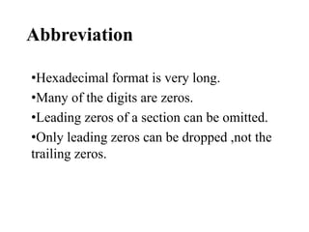

Slide 8
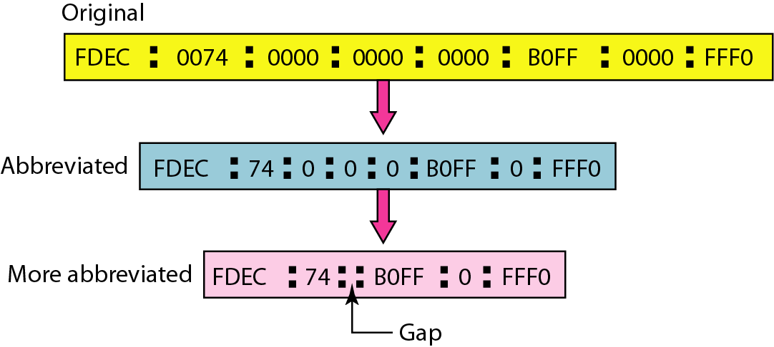
Abbreviation

Slide 9
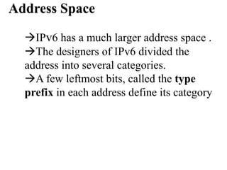

Slide 10
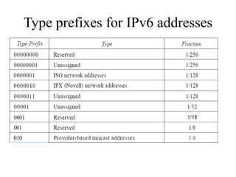

Slide 11
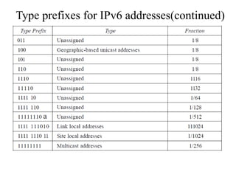

Slide 12
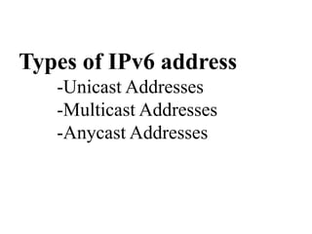

Slide 13
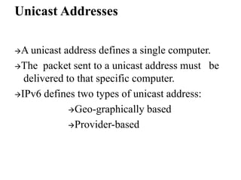

Slide 14
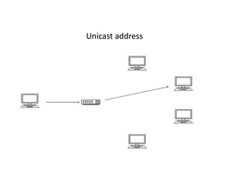

Slide 15
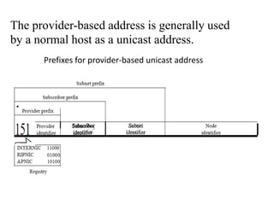

Slide 16
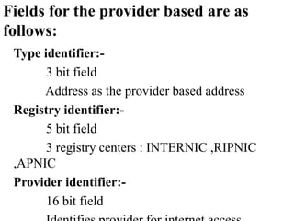

Slide 17
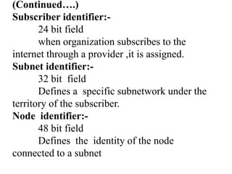

Slide 18
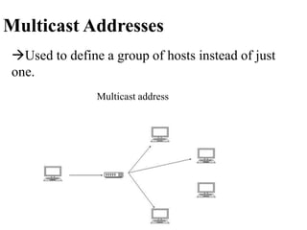

Slide 19
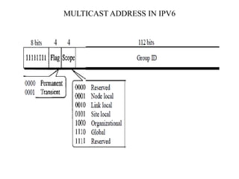

Slide 20
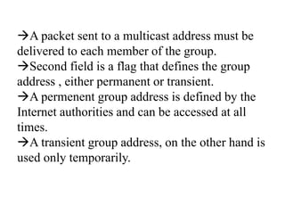

Slide 21
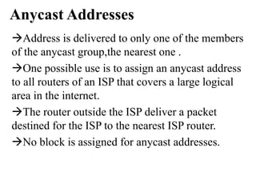

Slide 22
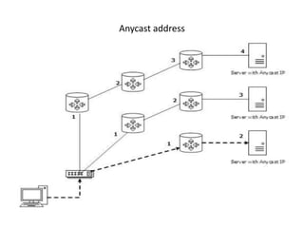

Slide 23
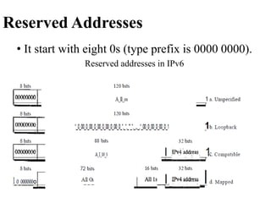

Slide 24
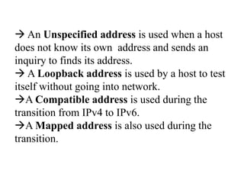

Slide 25
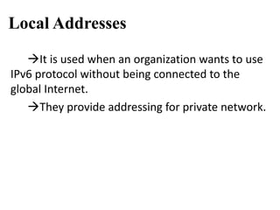

Slide 26
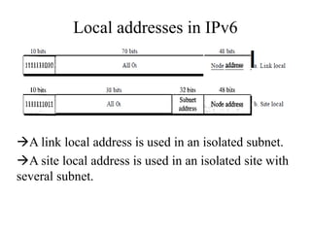

Slide 27
IPv4 vs IPv6
IPv4 | IPv6
Address Length – 32 bits | Address Length - 128 bits
Internet address classes | Not applicable
Multicast addresses (224.0.0.0/4) | Multicast addresses (FF00::/8)
Broadcast addresses | Not applicable
Unspecified address is 0.0.0.0 | Unspecified address is ::
Loopback address is 127.0.0.1 | Loopback address is ::1
Public IP addresses | Global unicast addresses
Private IP addresses (10.0.0.0/8, 172.16.0.0/12, and 192.168.0.0/16) | Site-local addresses (FEC0::/10)
Autoconfigured addresses (169.254.0.0/16) | Link-local addresses (FE80::/64)

Slide 28
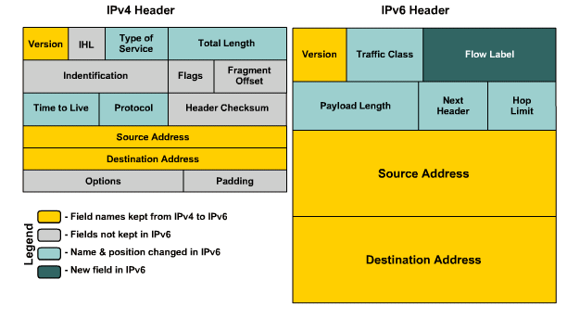

Slide 29
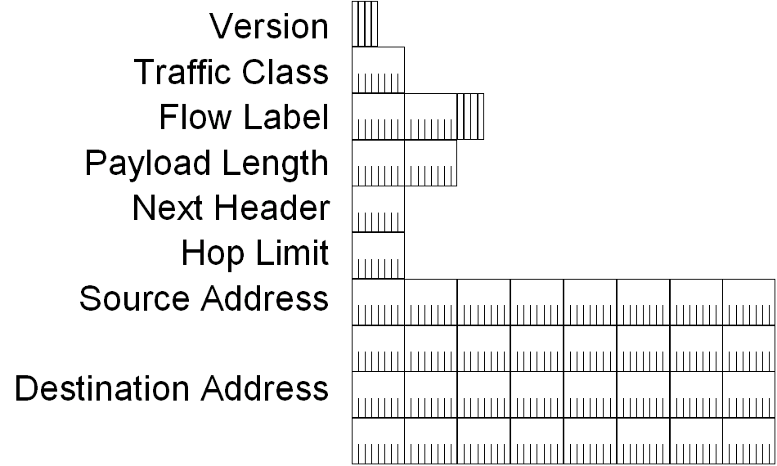
IPv6 Header

Slide 30
Header Fields:IPv6
RFC 2460 defines the following IPv6 header fields:
Version (4 bits)
4 bits are used to indicate the version of IP and is set to 6
Traffic Class (8 bits)
same function as the Type of Service field in the IPv4 header.
Flow Label (20 bits)
identifies a flow and it is intended to enable the router to identify packets that should be treated in a similar way without the need for deep lookups within those packets.
set by the source and should not be changed by routers along the path to destination.

Slide 31
Traffic Class
The Traffic Class field in an IPv6 header identifies the priority or class of an IPv6 packet. It is similar to the Type of Service (ToS) field in an IPv4 packet. It is an 8-bit field in the IPv6 header.
How is it used?
The field is used by originating nodes and forwarding routers to identify and distinguish between different classes or priorities of IPv6 packets.
The field helps routers handle traffic based on the packet's priority. If congestion occurs on the router, packets with the least priority will be discarded.
Why?
The Traffic Class field can be used to set specific precedence or differentiated services code point (DSCP) values.

Slide 32
Header Fields:IPv6 (contd.)
Payload Length (16 bits)
With the header length fixed at 40 bytes, it is enough to indicate the length of the payload to determine the length of the entire packet.
Next Header (8 bits)
Indicates either the first extension header (if present) or the protocol in the upper layer PDU (such as TCP, UDP, or ICMPv6).
Hop Limit (8 bits)
In IPv6, the IPv4 TTL was appropriately renamed Hop Limit because it is a variable that is decremented at each hop, and it does not have a temporal dimension.

Slide 33
Header Fields:IPv6 (contd.)
Source IPv6 Address (128 bits)
Stores the IPv6 address of the originating host.
Destination IPv6 Address (128 bits)
Stores the IPv6 address of the current destination host.

Slide 34
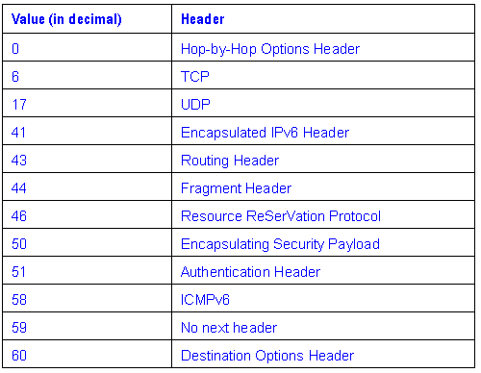
Next Header field

