Slide 1
Mobile TCP
Sarmistha Neogy
Dept. of Computer Science and Engineering
Jadavpur University

Slide 2
Wireless : What Breaks?
Packet loss in wired networks very low, so assumption that
packet loss == network congestion is valid
Not necessarily valid in wireless networks, where error rates are higher
packet loss can occur even when the network is only lightly loaded
resetting size of ewnd on packet loss seriously affects throughput
high latency makes this worse--even more time to ramp up (because cwnd size changes only on an ACK)!

Slide 3
Wireless : What Breaks (2)
Problems with header compression techniques
Idea: Header compression allows sending only changes in, e.g., a TCP header
Less overhead than transmitting full header
Problems with wireless, tho:
Error rates higher—more likely to lose packets
Lost packet means differential header info in subsequent packets is unusable...
This causes many packets to be discarded, requires resynchronization of sender/receiver
Reduces the usefulness of header compression
Some recent work on fixing this problem

Slide 4
Classification of Schemes
End-to-End protocols
loss recovery handled by sender
Link-layer solutions
hide link-related losses from sender
TCP sender may not be fully shielded
Split-connection approaches
hide any non-congestion related losses from TCP sender
since the problem is local, solve it locally

Slide 5
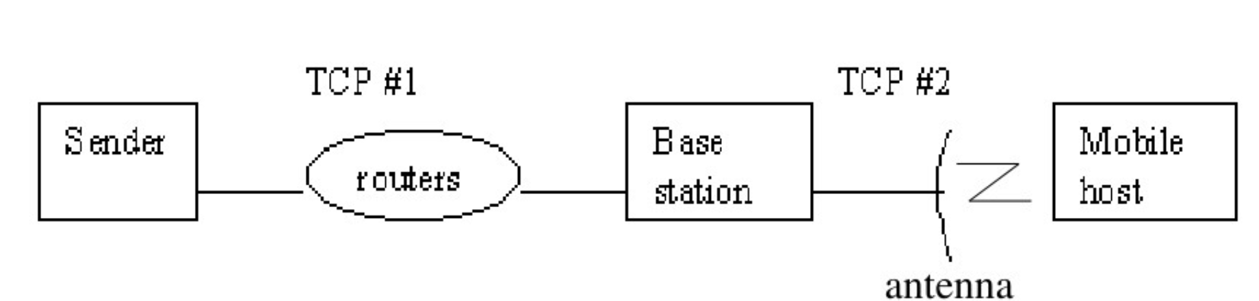
Split Connection Protocols
Split the TCP connection into two separate connections.
1st connection: sender to base station
2nd connection: base station to receiver
The base station simply copies packets between the connections in both directions

Slide 6
Link Layer Protocols
Hides the characteristics of the wireless link from the transport layer and tries to solve the problem at the link layer
Uses technique like forward error correction (FEC)
Snoop, AIRMAIL(Asymmetric Reliable Mobile Access In Link-layer)

Slide 7
End to End Protocols
Tahoe: Original TCP
Slow start, Congestion avoidance, Fast retransmit
Reno: TCP Tahoe + Fast Recovery
can manage a loss of at most one packet from a single window of data
New-Reno: Reno + Stay in Fast Recovery
can manage a loss of more than one packet without changing the TCP message structure
SACK: Reno + SACK option
enables to cope with a loss of more than one packet by changing message structure (using TCP options)

Slide 8
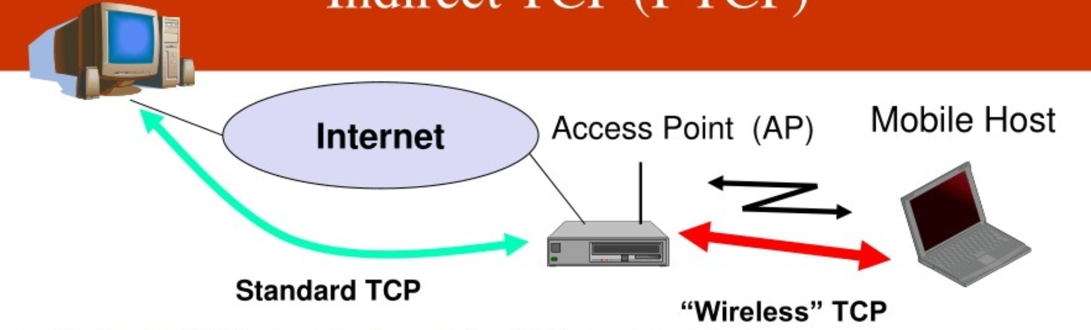
Indirect TCP (I-TCP)
Split the TCP connection at the AP into two parts
AP buffers and retransmits received segments
AP sends ACKs for the received segments
Standard T C P on the wire-line link
On the wireless link:
TCP optimized for wireless
Even standard T C P benefits from shorter RTT
Shorter timeout
Faster retransmissions

Slide 9
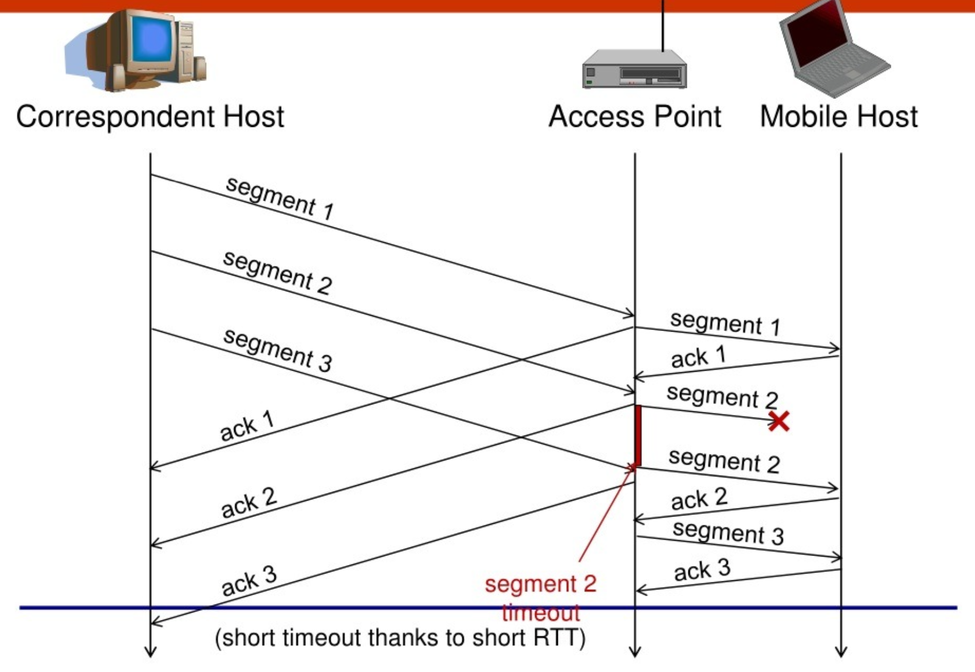
Indirect TCP (I-TCP)

Slide 10
I-TCP Summary
I-TCP Advantages
No changes in the fixed network or hosts (TCP protocol), all current TCP optimizations still work
Potentially no changes in mobile hosts
Wireless transmission errors do not "propagate" to the wire-line network
I-TCP Disadvantages
Loss o f end-to-end semantics
An ACK does not imply that the receiver got the segment
For mobility support, all FAs need to be I-TCP compatible, and the state needs to be transferred to maintain end-to-end semantics
Higher end-to-end delays due to buffering and forwarding to a new agent
Problem with security mechanisms, e.g. IPsec
FA needs to spoof ACKs

Slide 11
Acknowledgemnet
Prepared from
https://www.slideserve.com/poissonj/unit-4-mobile-tcp-powerpoint-ppt-presentation

Slide 12
Thank you

