Slide 1
Motor Data Report
Speaker: Eric
Professor: Hsiao-Ping Tsai
Date: 2024/05/22

Slide 2
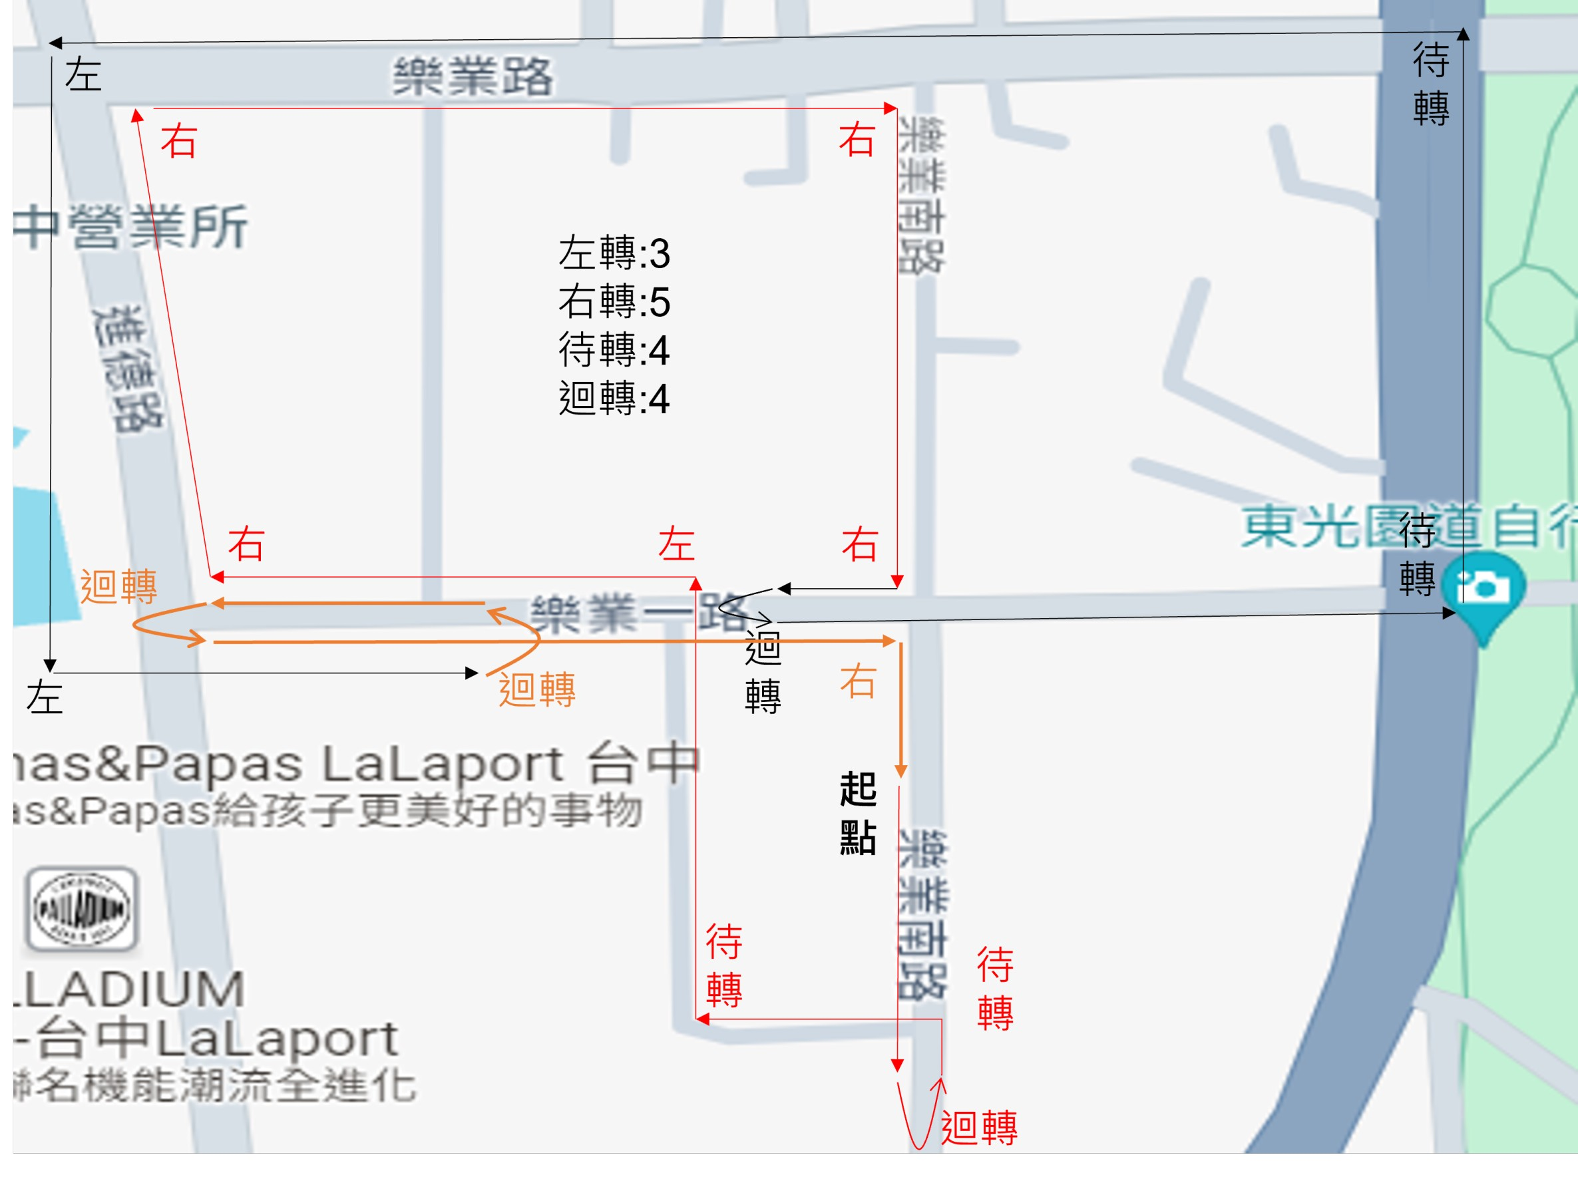
Route
The Number of Snapshot
Idle: 5838
Go Straight: 3558
Turn Left: 208
Turn Right: 240
Two-Stage Left: 208
U-turn: 278

Slide 3
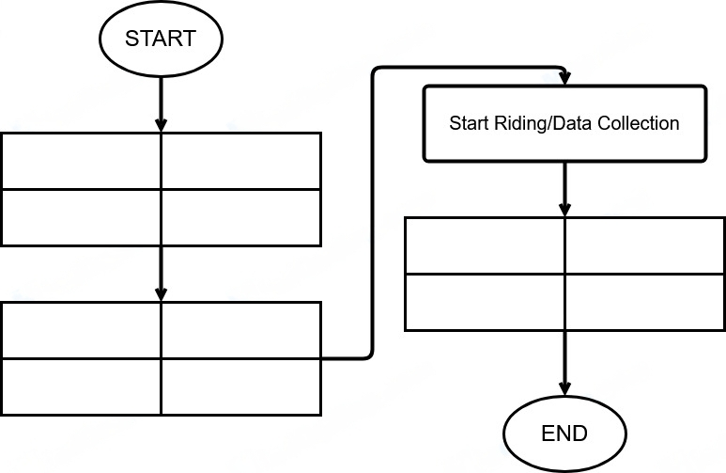
Data Collection Method
ECU Receiver Setting
Gopro Setting
Phone Setting
Tablet Setting
Stop ECU App
Stop GPS Recording
Stop Video Recording
Stop IMU
Start Video Recording
Start IMU (30Hz)
Start GPS Rrcording
Start ECU App (2Hz)

Slide 4
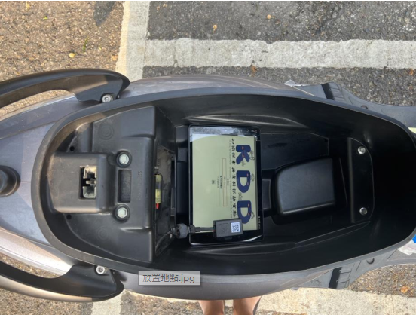
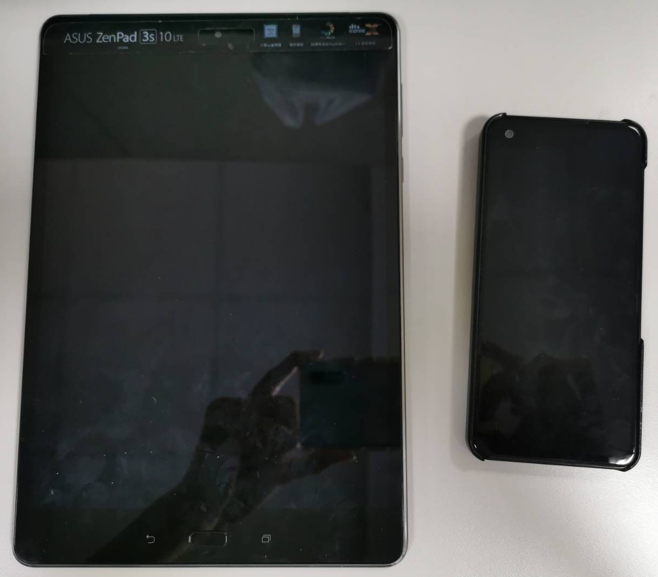
IMU Direction
Y
Z
X

Slide 5
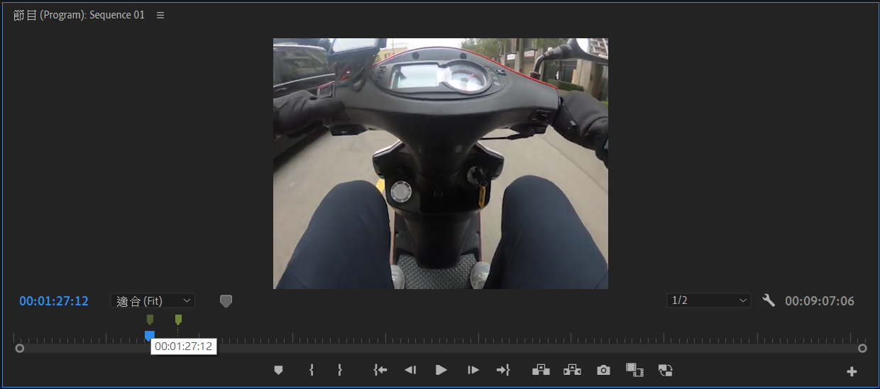
Data Collection Method
Using Adobe Premiere Pro video editing software to mark the timestamps of High-level driving behaviors, and converting them into corresponding real-time using Python program.

Slide 6
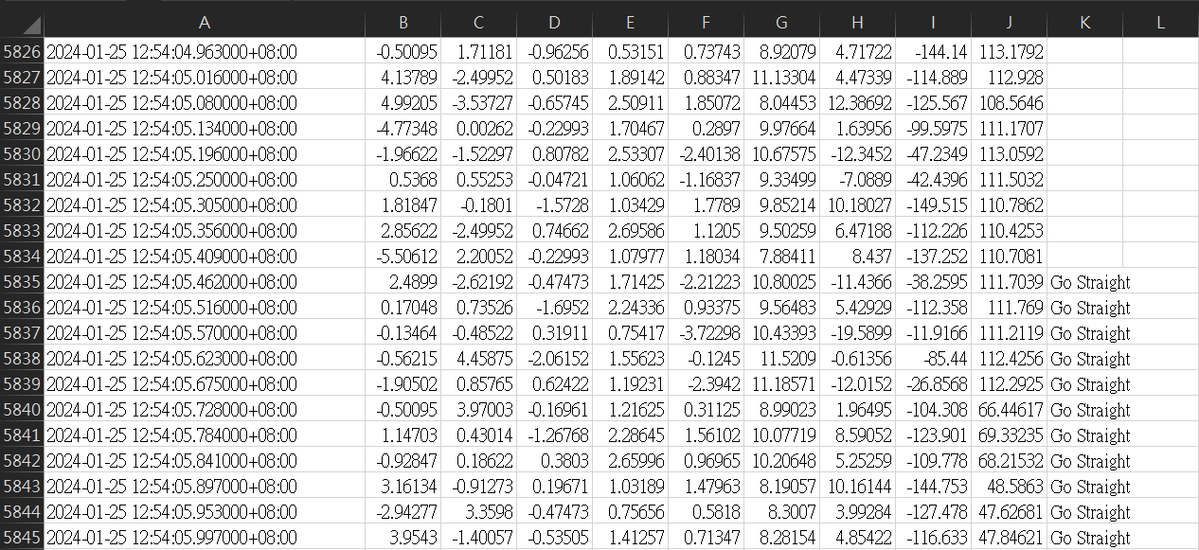
Data Collection Method
According to the real time after converted, then we can search the most recent timestamp and mark into the “Action” column with the corresponding drive behavior.

Slide 7
Data Collection Method
Ground truth
train
test
Left
Left
Left
Left
Left
Left
Left
Left
Left
Left

Slide 8
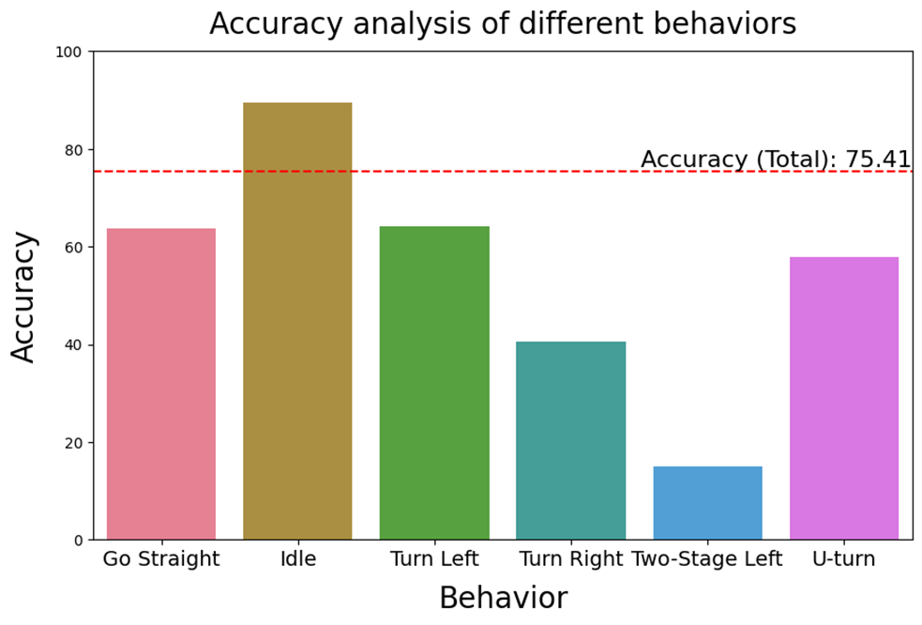
Result
The Number of Action
Idle: 8
Go Straight: 26
Turn Left: 2
Turn Right: 3
Two-Stage Left: 2
U-turn: 2

Slide 9
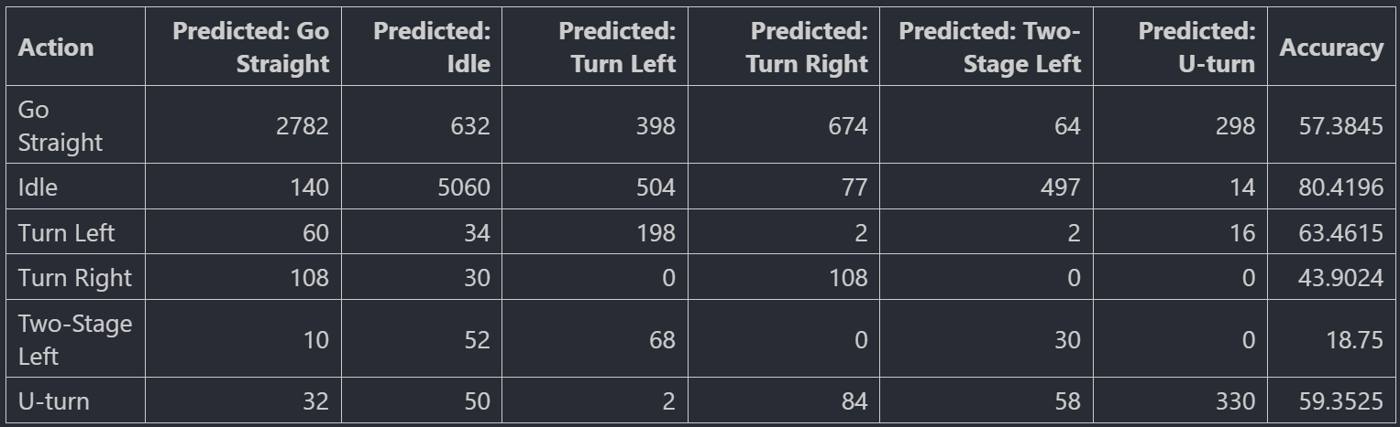
Result
$$\frac{the num of snapshot of Idle predicted}{the num of snapshot of Idle Gound turth}=\frac{5060}{140+5060+504+77+497+14}=0.8042$$

Slide 10
The SOP of Collecting Data
Motorcycle Setting
Ensure that the motorcycle's center stand is deployed.
IMU Setting
Fix the phone on the left phone stand.
Ensure that the tilt angle of the phone remains consistent for each experiment.
Set the sampling rate to 30 Hz, and then start IMU recording.
Gopro Start Recording
ECU Setting
Set the bluetooth device connected.
Ensure that the GoPro recording includes the phone's absolute time and the moment the ECU APP start button is pressed.

Slide 11
The SOP of Collecting Data
Start Collecting Data…
Turn off the ECU and then turn off the IMU.
Stop Gopro recording.

Slide 12
Future Work
Update IMU processing code
Collect Data again
Survey papers about deep learning model
Survey open datasets

