Slide 1
Motor Data Report
Speaker: Eric
Professor: Hsiao-Ping Tsai
Date: 2024/06/12

Slide 2
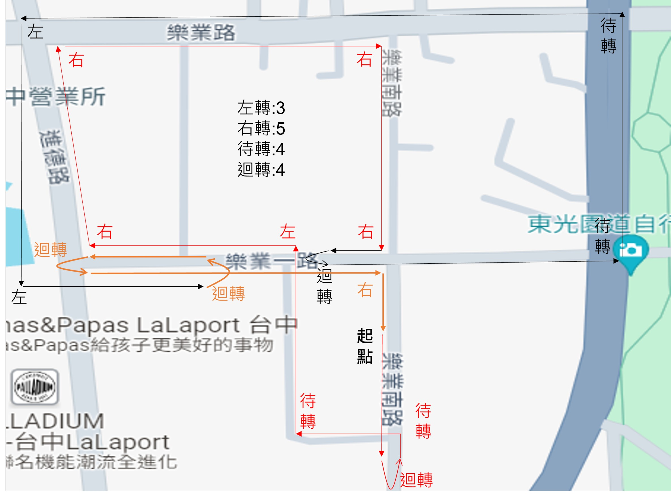
Route
The Number of Snapshot
Idle: 5838
Go Straight: 3558
Turn Left: 208
Turn Right: 240
Two-Stage Left: 208
U-turn: 278

Slide 3
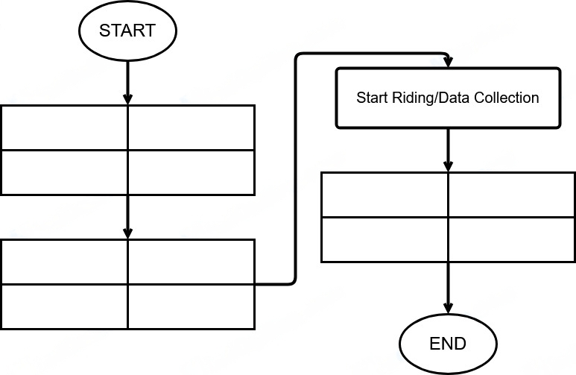
Data Collection Method
ECU Receiver Setting
Gopro Setting
Phone Setting
Tablet Setting
Stop ECU App
Stop GPS Recording
Stop Video Recording
Stop IMU
Start Video Recording
Start IMU (30Hz)
Start GPS Rrcording
Start ECU App (2Hz)

Slide 4
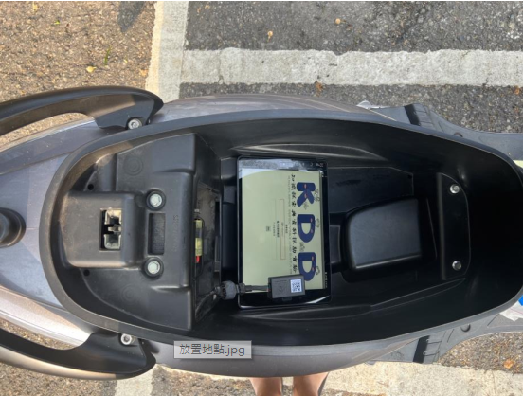
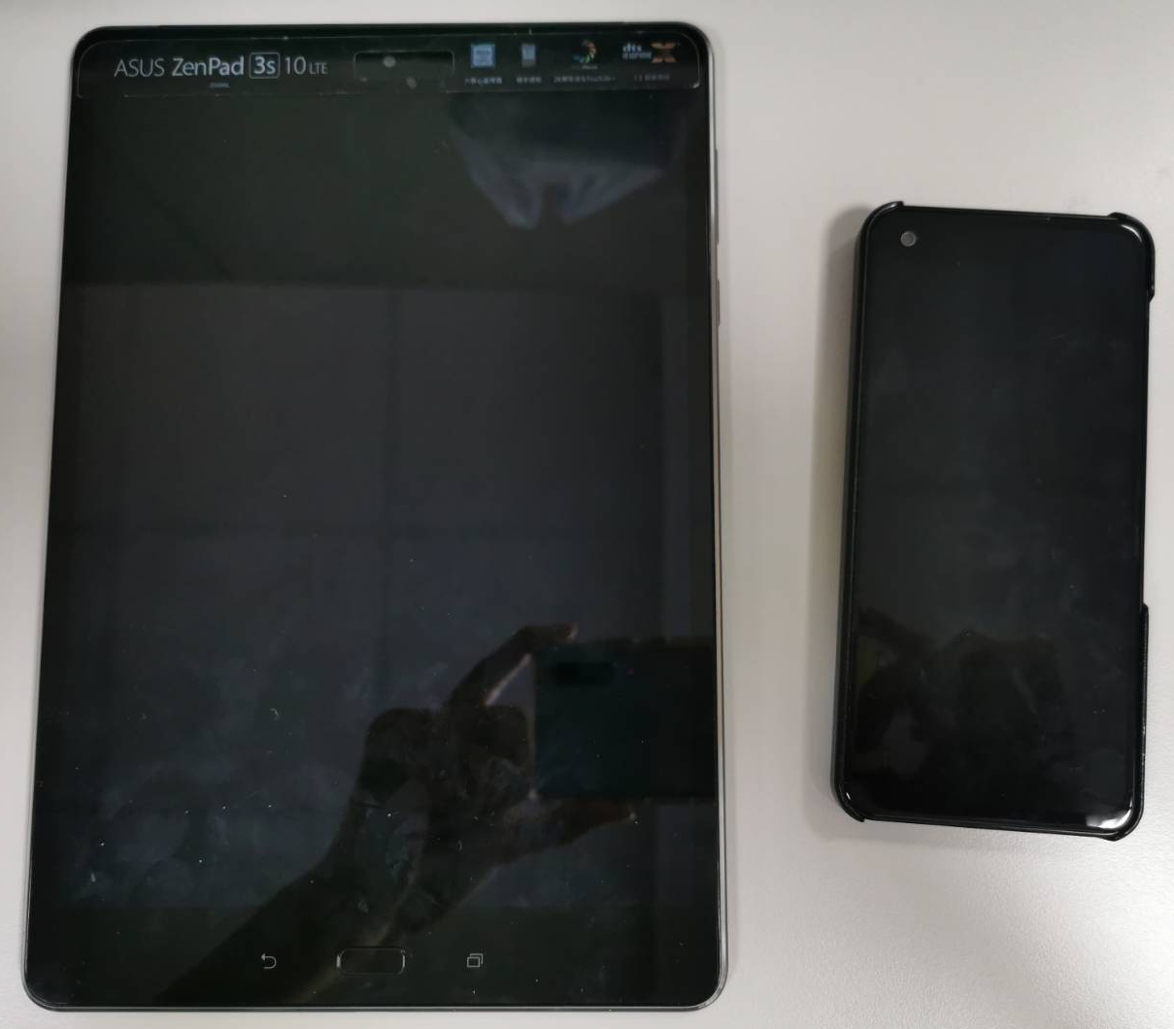
IMU Direction
Y
Z
X

Slide 5
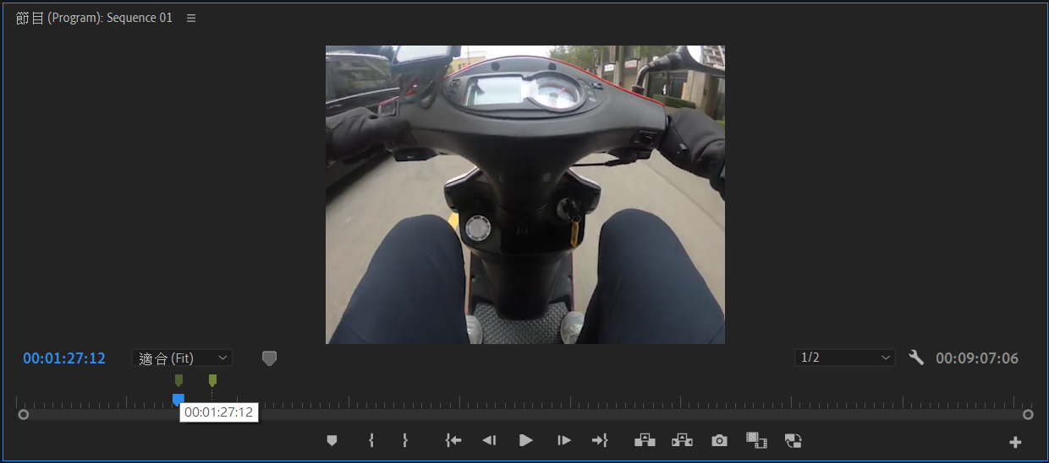
Data Collection Method
Using Adobe Premiere Pro video editing software to mark the timestamps of High-level driving behaviors, and converting them into corresponding real-time using Python program.

Slide 6
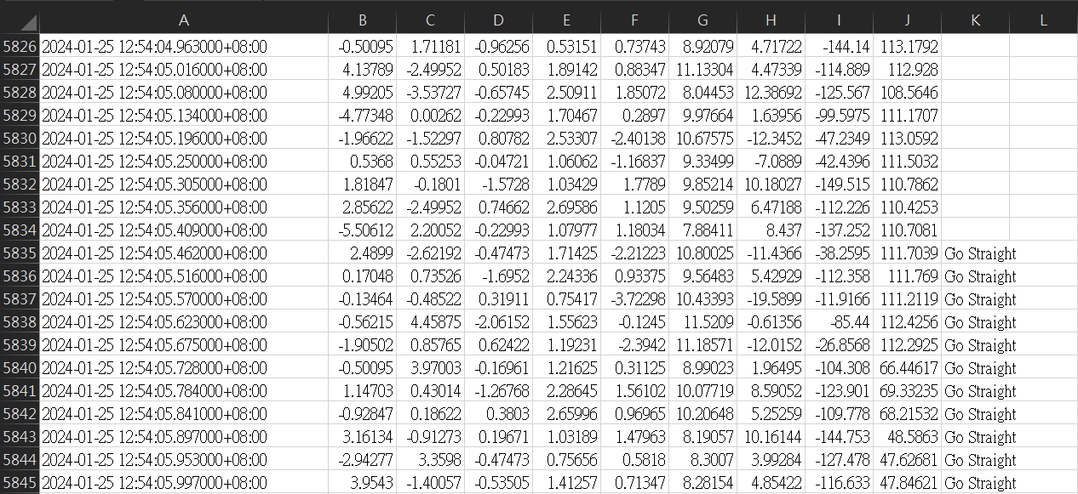
Data Collection Method
According to the real time after converted, then we can search the most recent timestamp and mark into the “Action” column with the corresponding drive behavior.

Slide 7
Data Collection Method
Ground truth
train
test
Left
Left
Left
Left
Left
Left
Left
Left
Left
Left

Slide 8
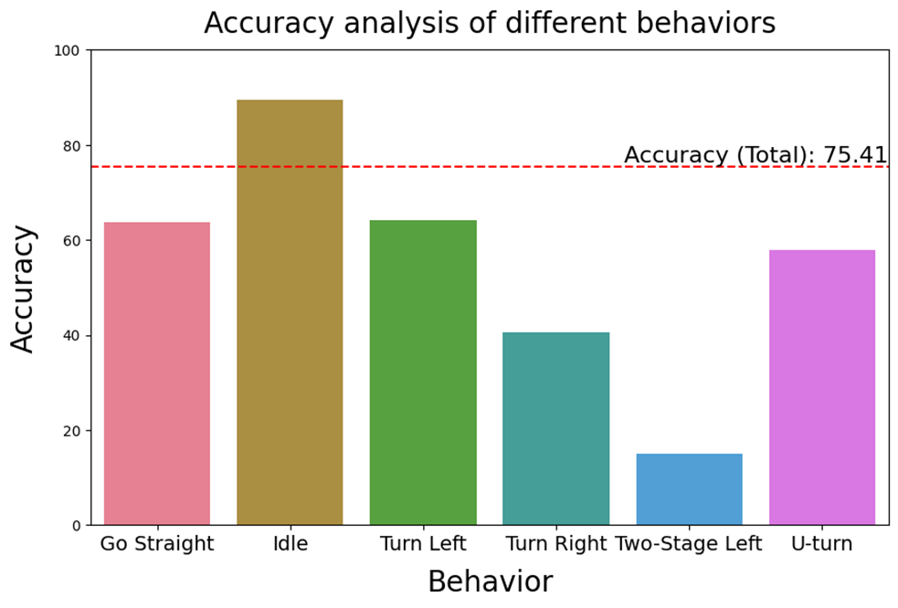
Result
The Number of Action
Idle: 8
Go Straight: 26
Turn Left: 2
Turn Right: 3
Two-Stage Left: 2
U-turn: 2

Slide 9
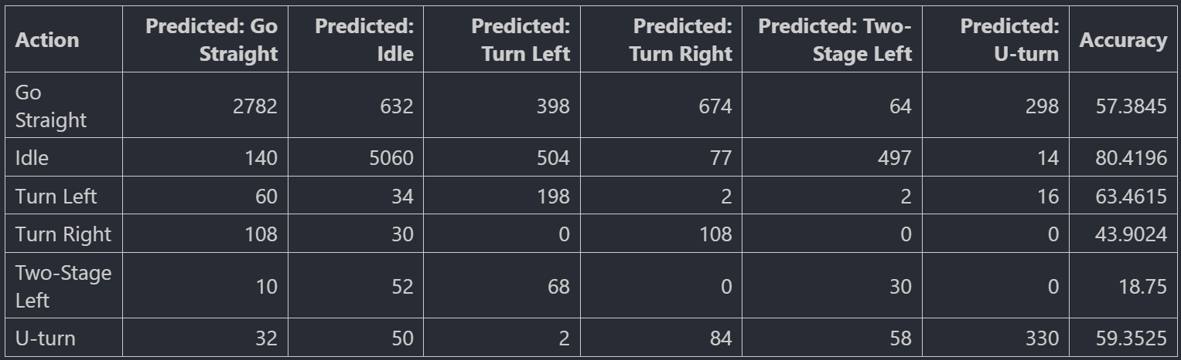
Result
$$\frac{the num of snapshot of Idle predicted}{the num of snapshot of Idle Gound turth}=\frac{5060}{140+5060+504+77+497+14}=0.8042$$

Slide 10

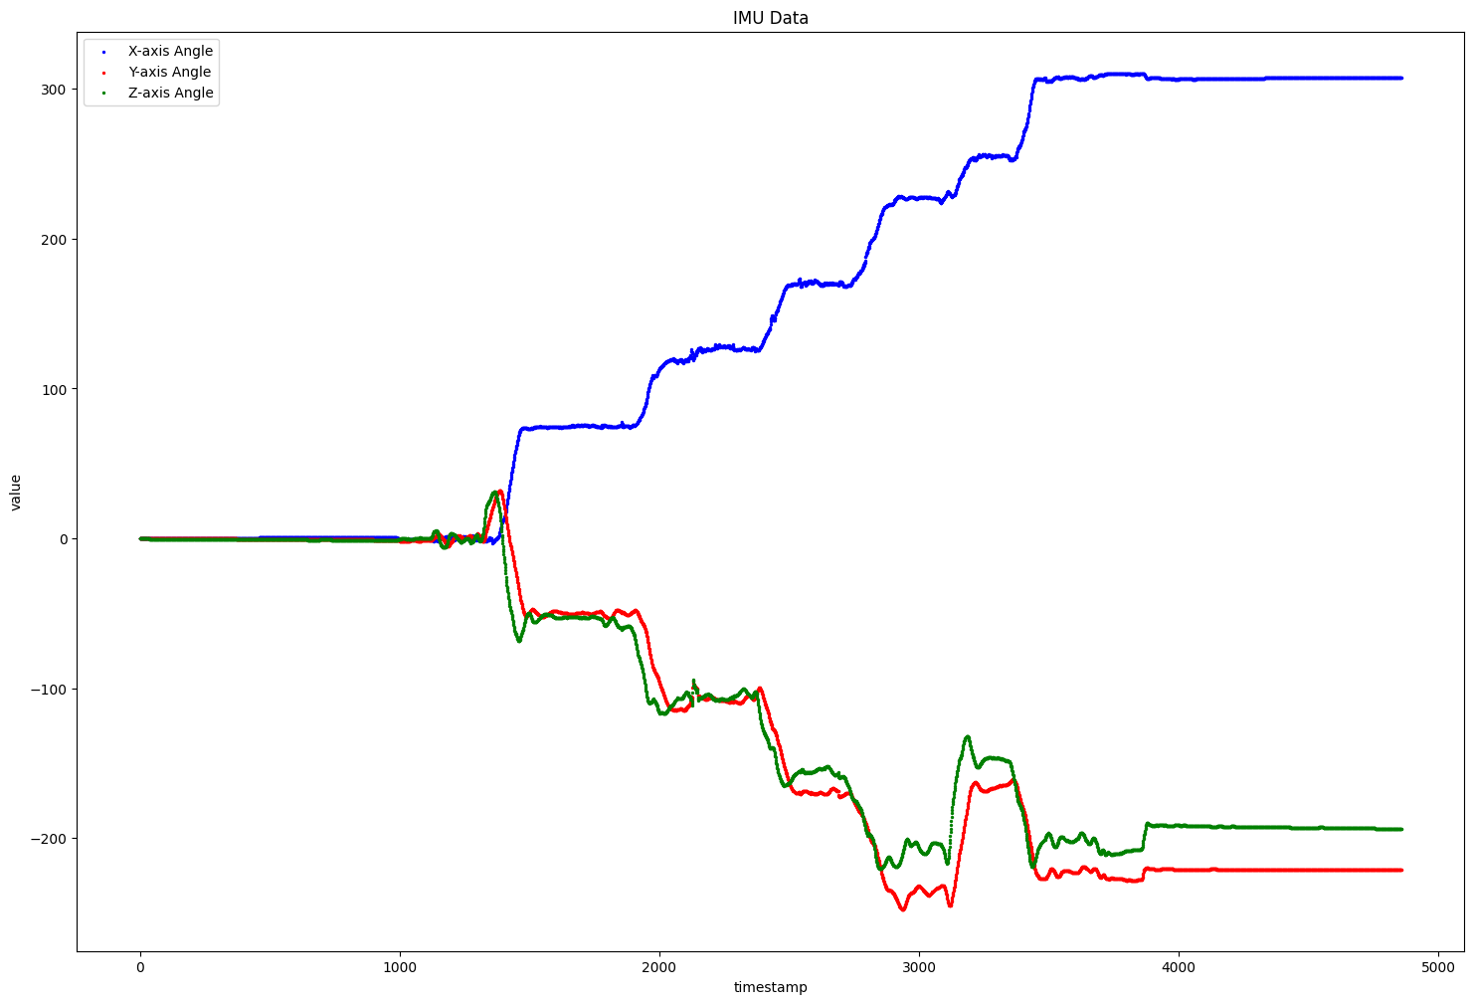
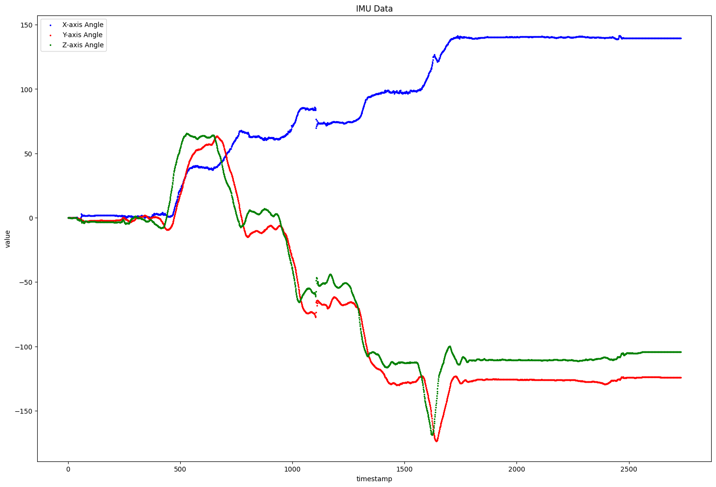
The Scooter Stand & Foot Test Comparison
Stand
Foot

Slide 11
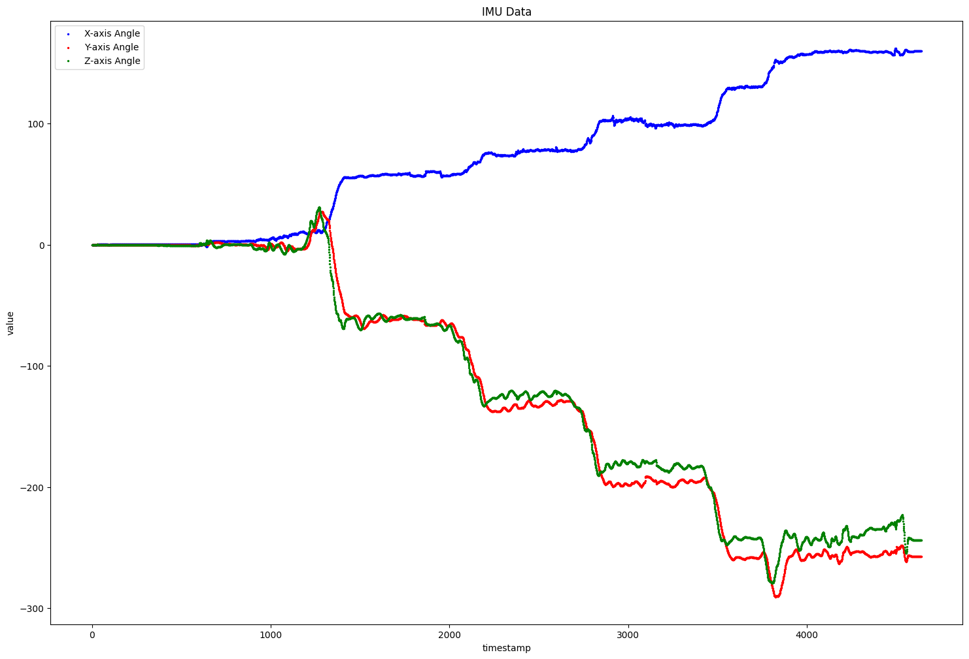
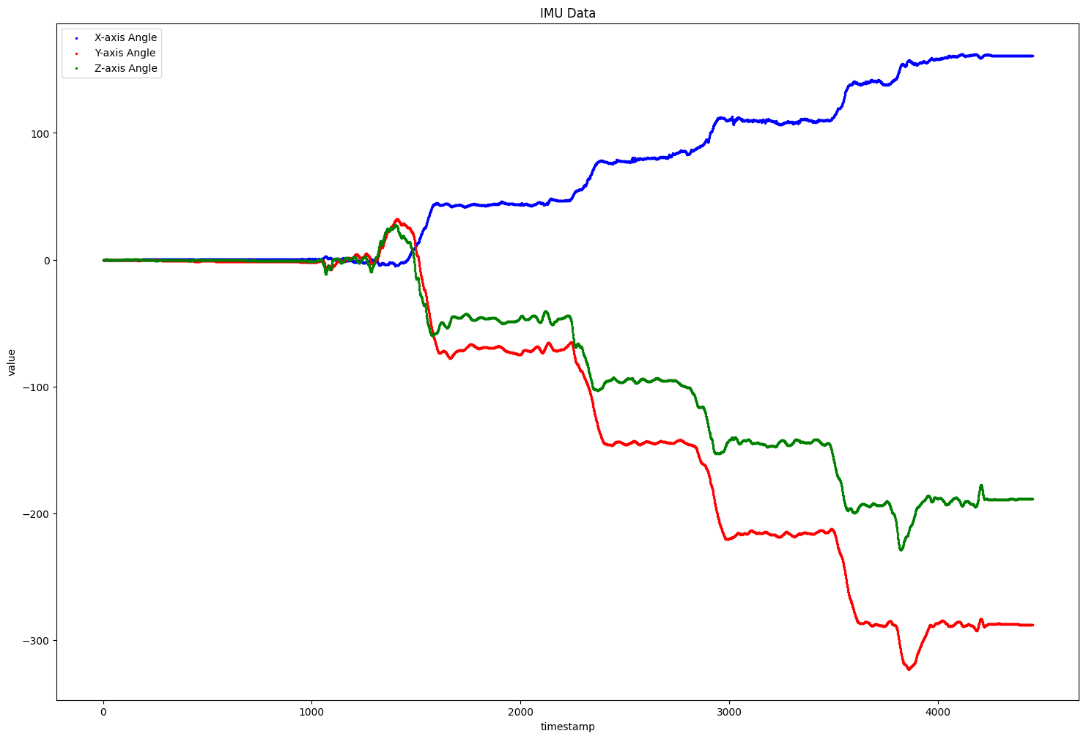
The Scooter Stand & Foot Test Comparison
Stand
Foot

Slide 12
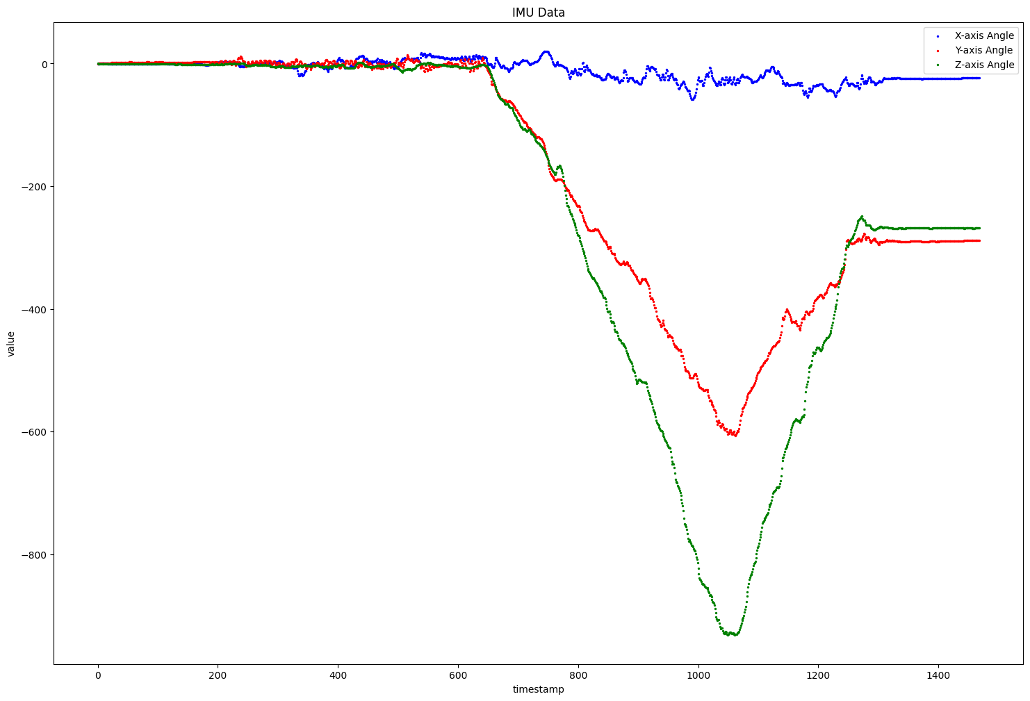
The angle value explosion problem

Slide 13

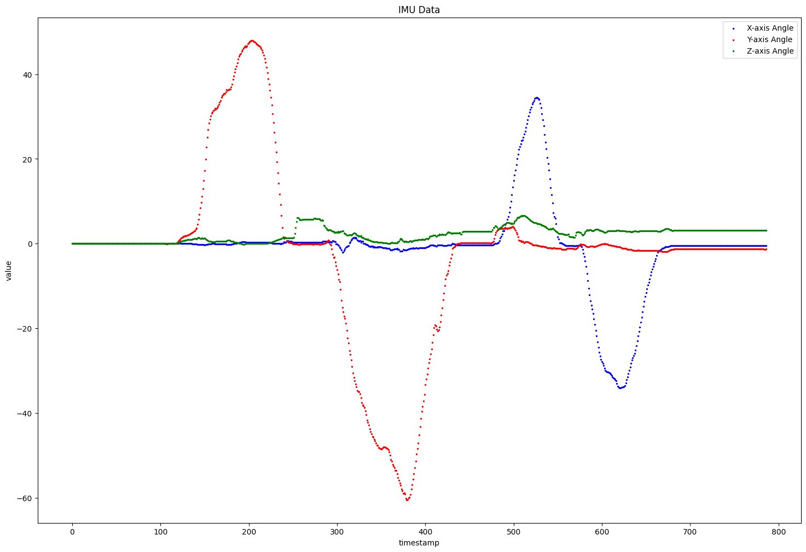
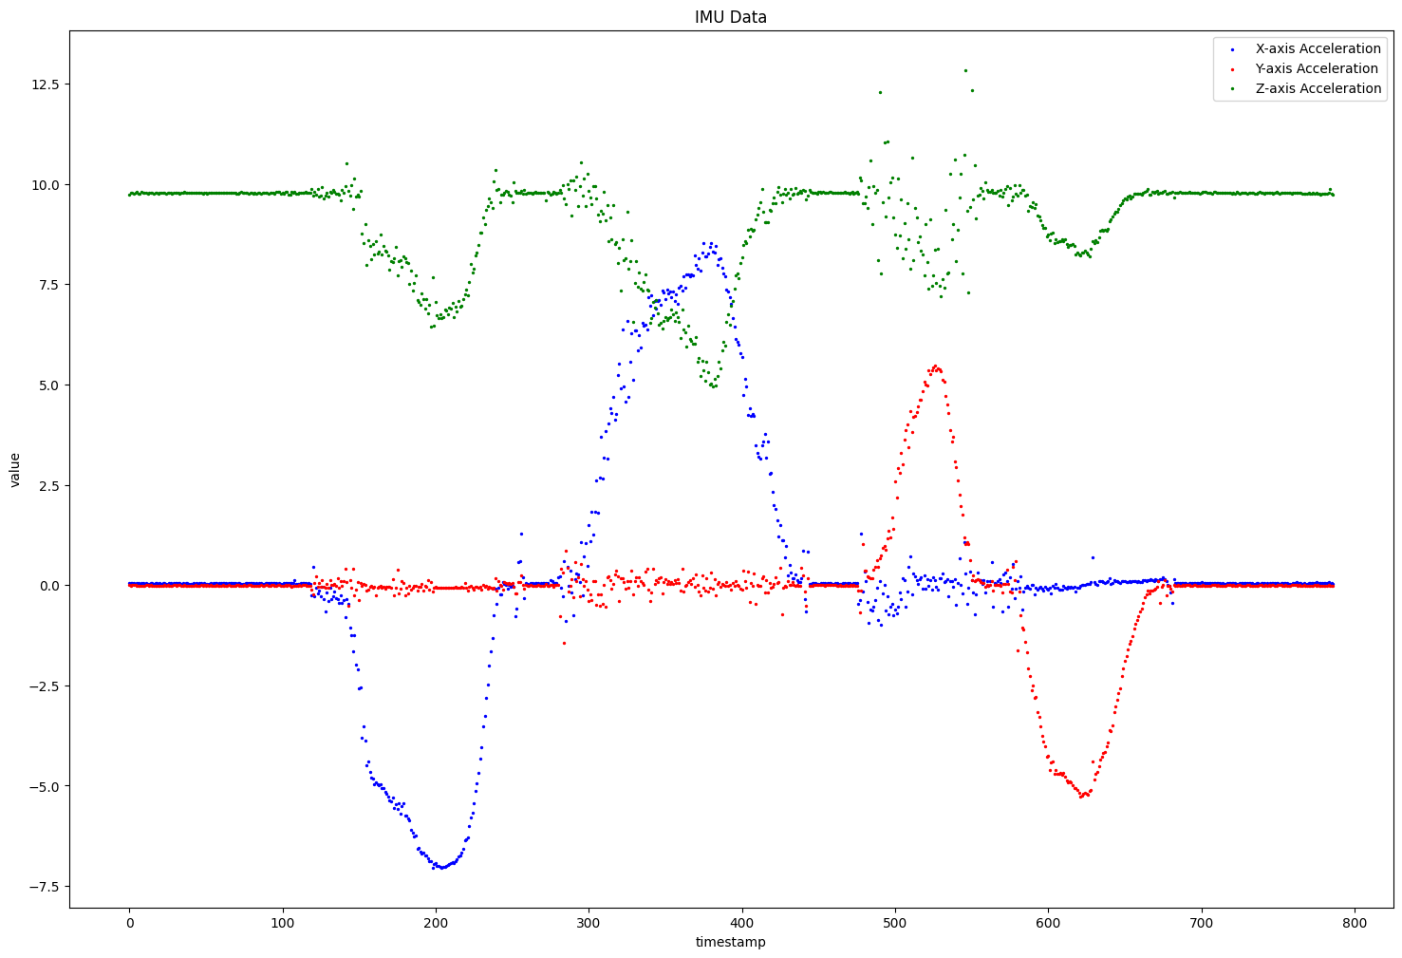
The angle value explosion problem – discard angle data
Notes:
若正在右轉，雖然角速度沒變，但是含重力加速度也可辨別是左傾還是右傾。
角度可用來當作標記的依據，之後就棄用。

Slide 14
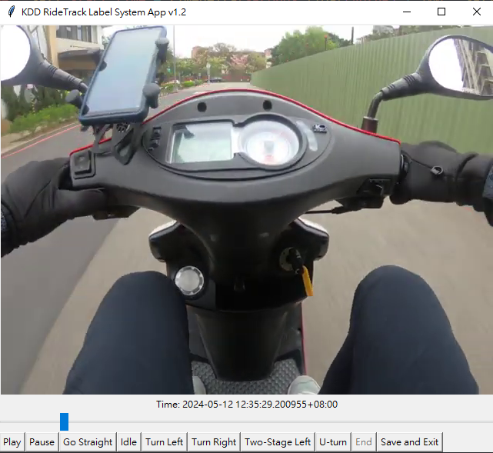
KDD RideTrack Label System App

Slide 15
Future Work
Document the SOP for collecting data
Data Labeling App 2.0 is currently under development
Survey papers about deep learning model
Survey open datasets

