Slide 1
Motor Data Report
Speaker: Eric
Professor: Hsiao-Ping Tsai
Date: 2024/06/26

Slide 2
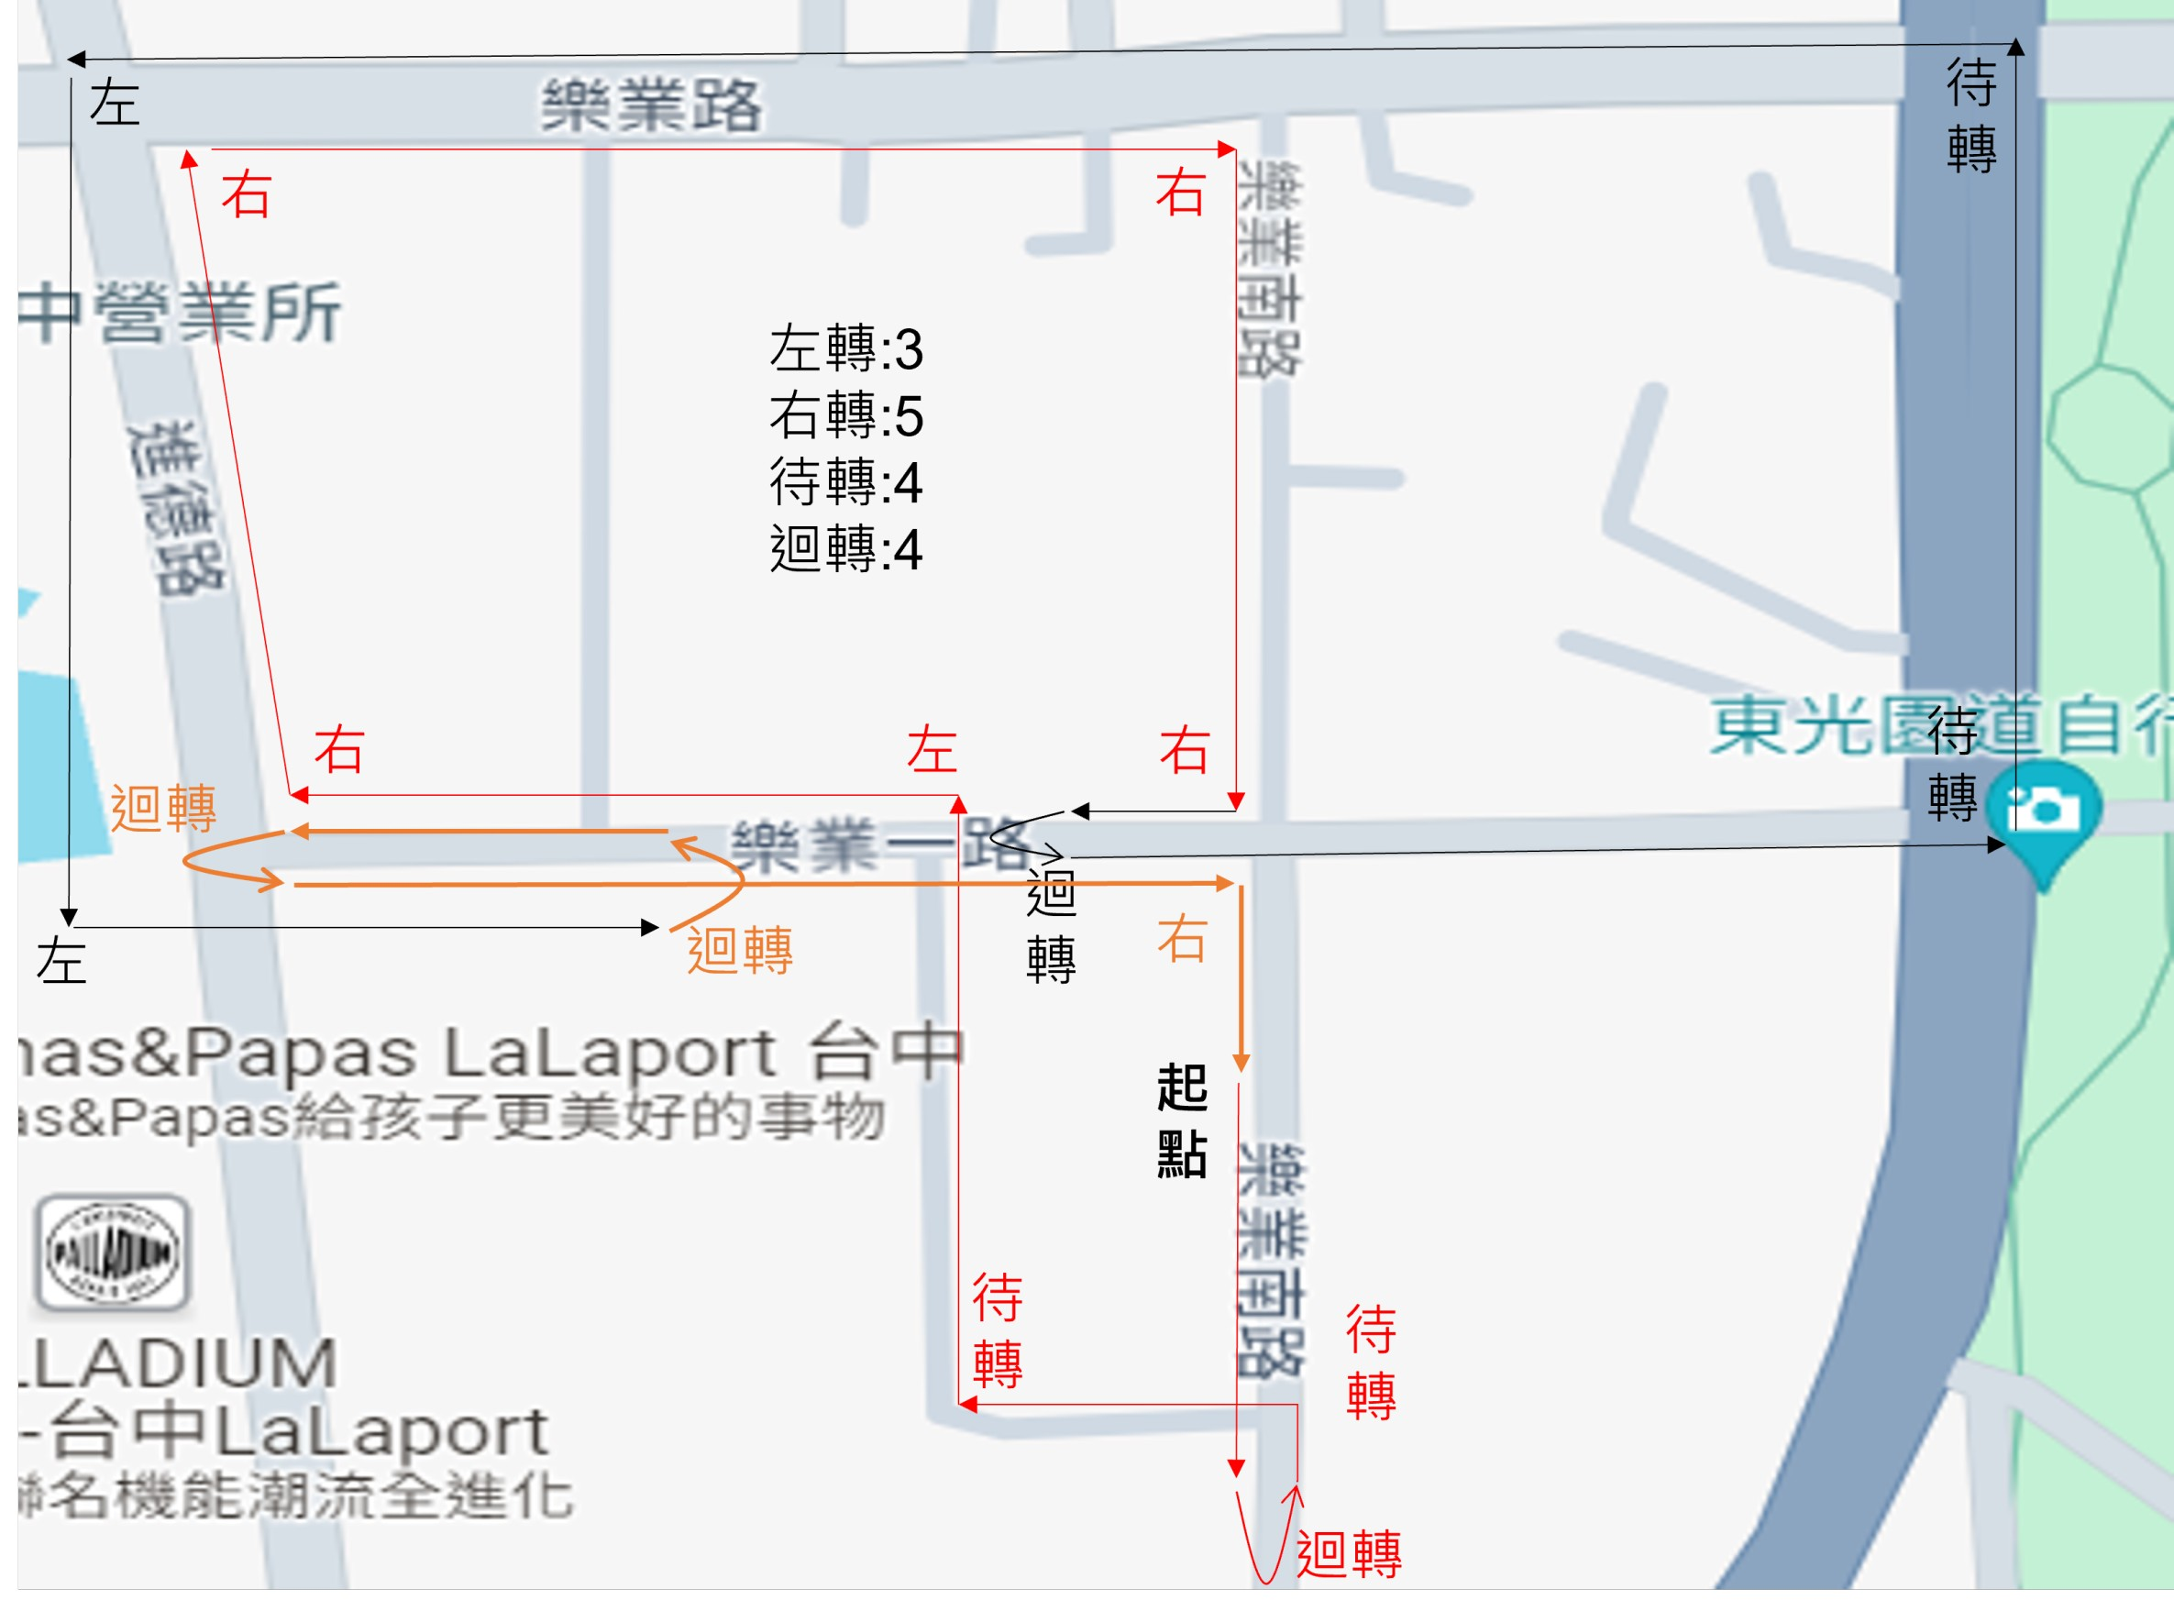
Route
The Number of Snapshot
Idle: 5838
Go Straight: 3558
Turn Left: 208
Turn Right: 240
Two-Stage Left: 208
U-turn: 278

Slide 3
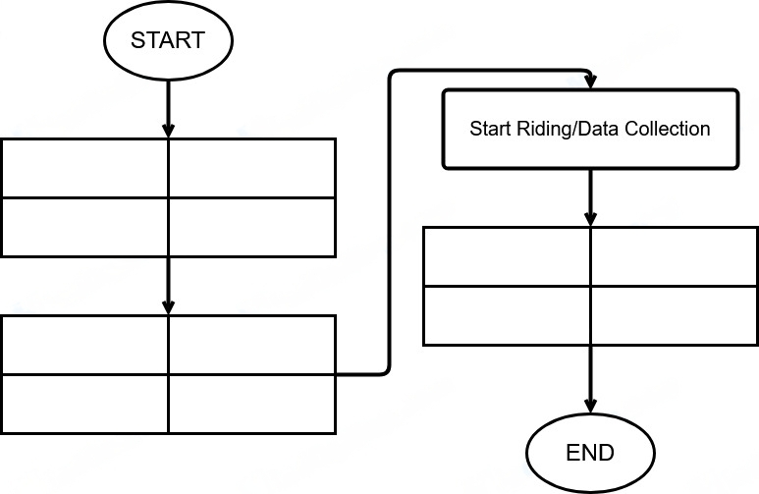
Data Collection Method
ECU Receiver Setting
Gopro Setting
Phone Setting
Tablet Setting
Stop ECU App
Stop GPS Recording
Stop Video Recording
Stop IMU
Start Video Recording
Start IMU (30Hz)
Start GPS Rrcording
Start ECU App (2Hz)

Slide 4
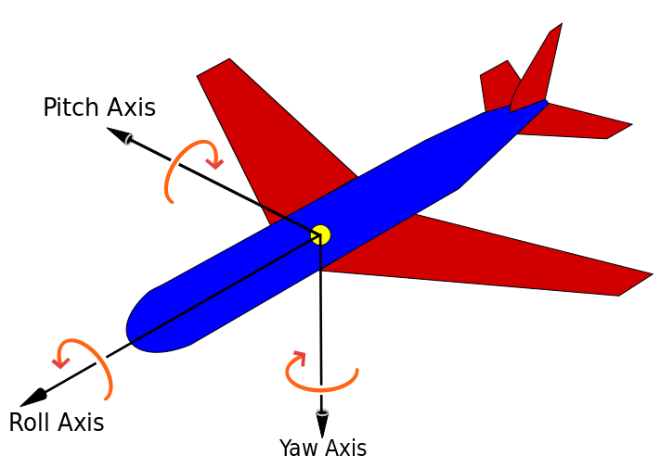
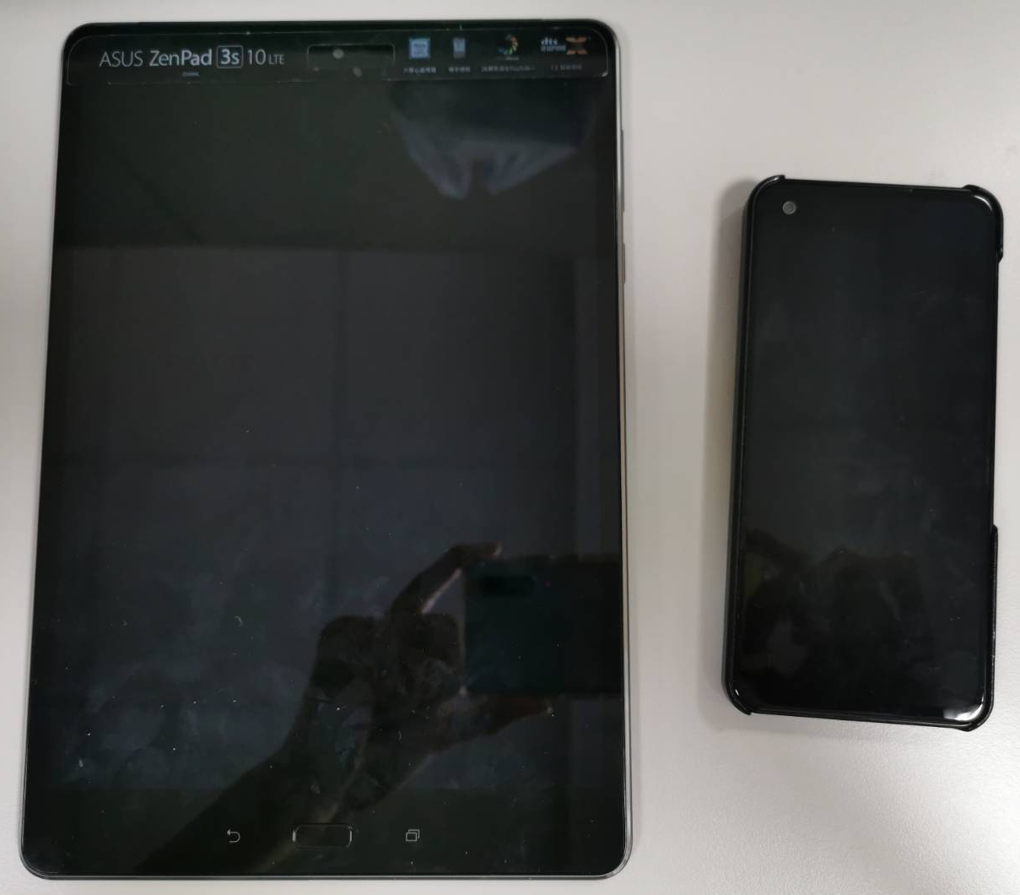
IMU Direction
Y
Roll
Pitch
Z
X
Yaw

Slide 5
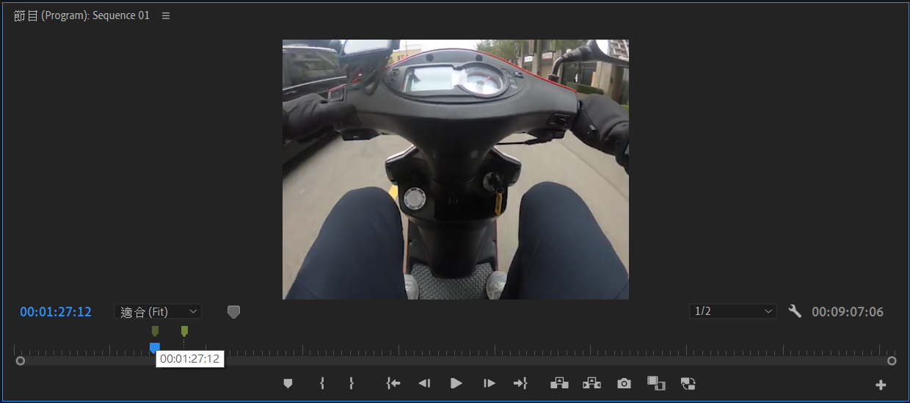
Data Collection Method
Using Adobe Premiere Pro video editing software to mark the timestamps of High-level driving behaviors, and converting them into corresponding real-time using Python program.

Slide 6
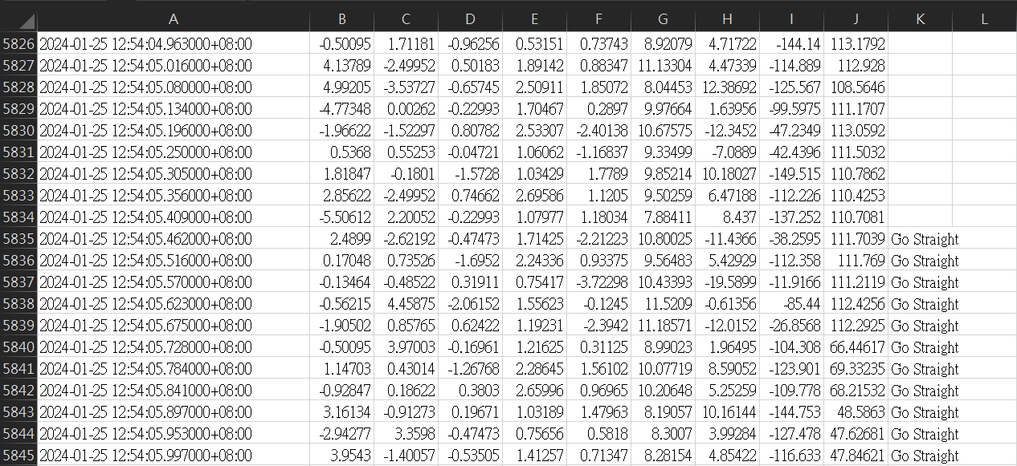
Data Collection Method
According to the real time after converted, then we can search the most recent timestamp and mark into the “Action” column with the corresponding drive behavior.

Slide 7
Data Collection Method
Ground truth
train
test
Left
Left
Left
Left
Left
Left
Left
Left
Left
Left

Slide 8
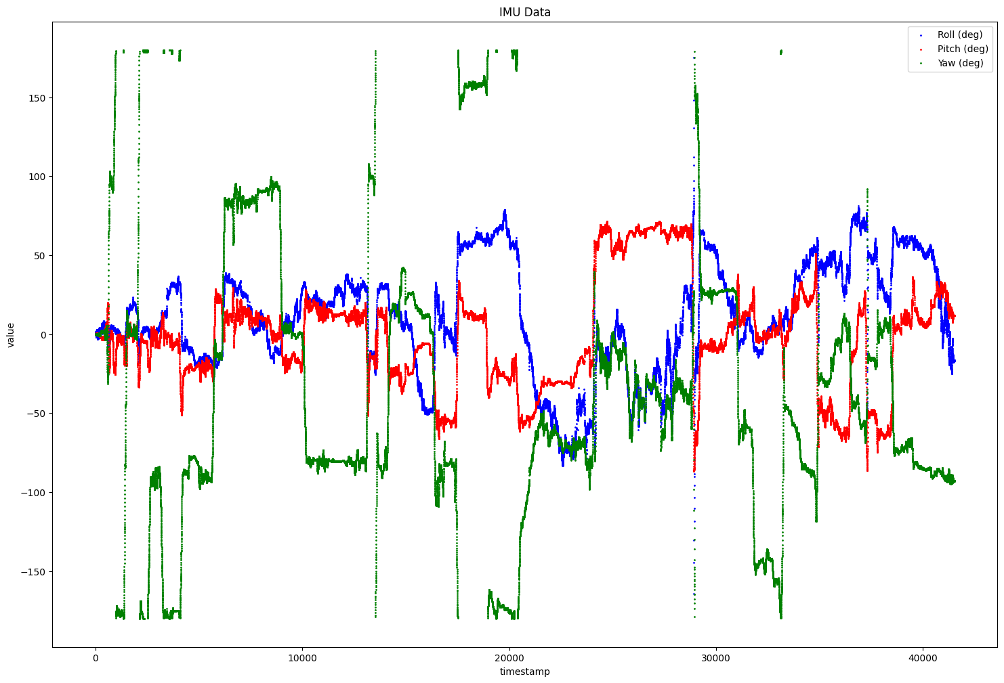
Euler Engle

Slide 9
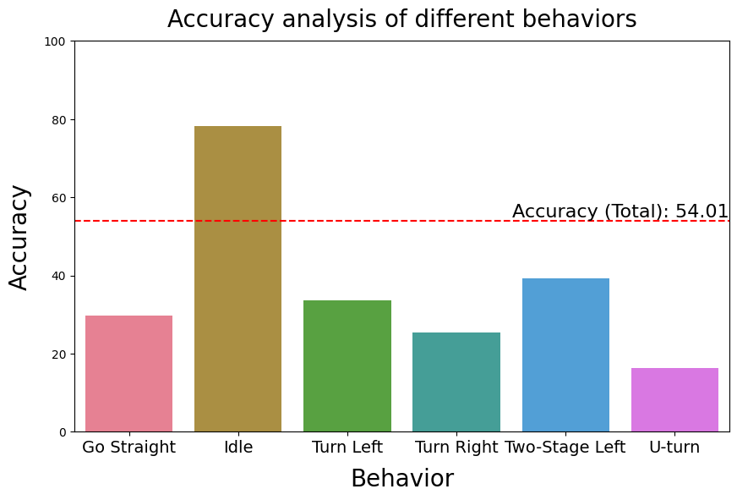
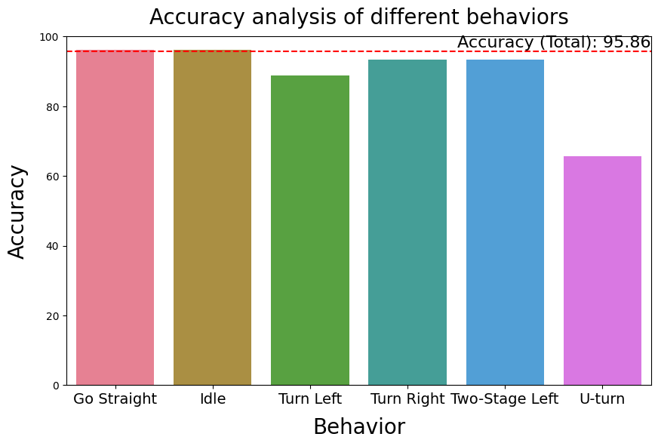
Result (Train & test are the same)
With angle data
Without angle data

Slide 10
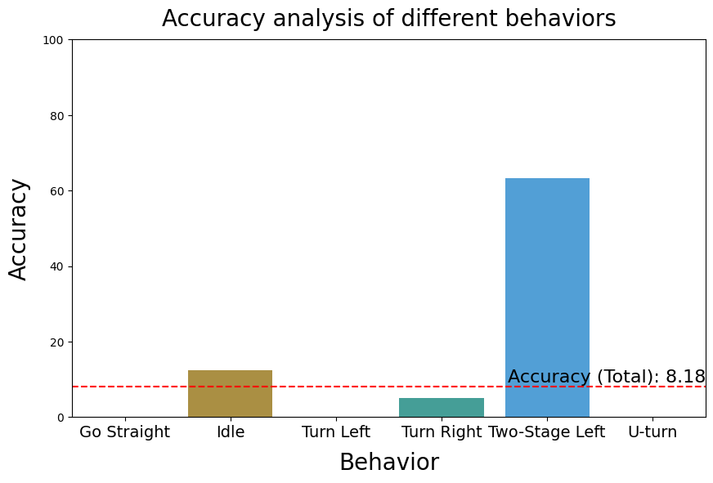
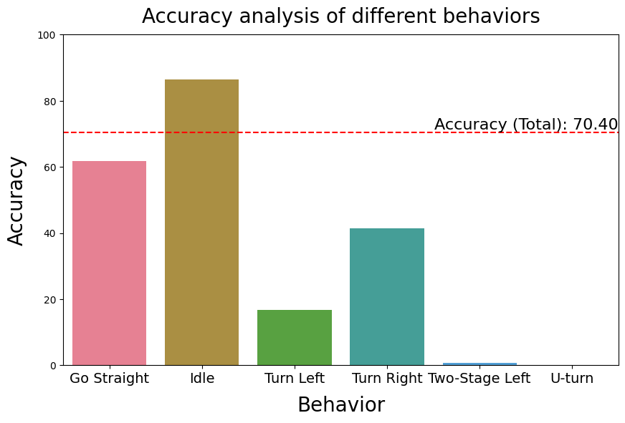
Result (First 50% train, second 50% test)
With angle data
Without angle data

Slide 11
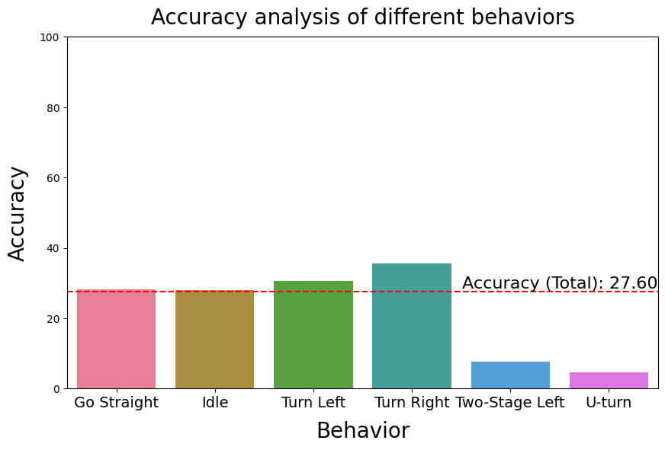
Result (Eric train, Kino test)
Without angle data

Slide 12
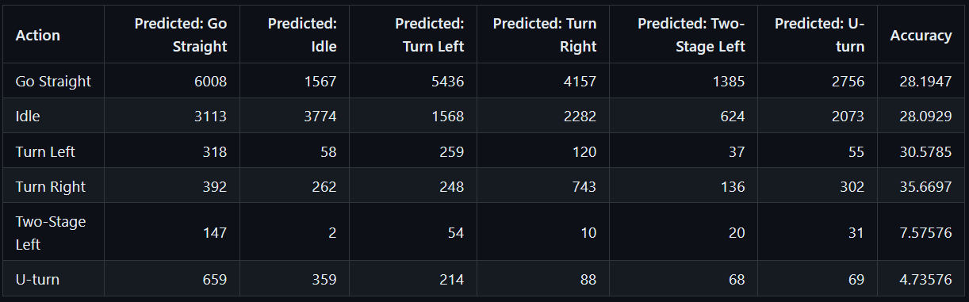
Result (Eric train, Kino test)
$$\frac{the num of snapshot of Idle predicted}{the num of snapshot of Idle Gound turth}=\frac{3774}{3113+3774+1568+2282+624+2073}=0.2809$$

Slide 13
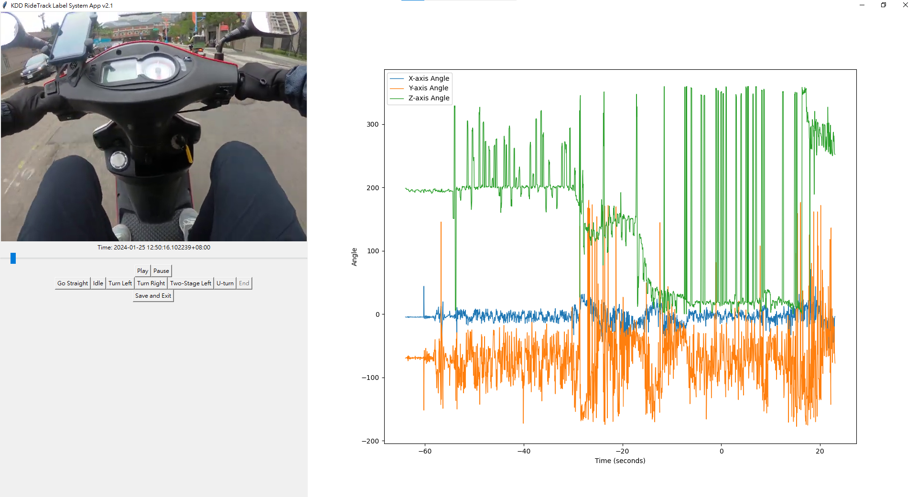
KDD RideTrack Label System App v2.0

Slide 14
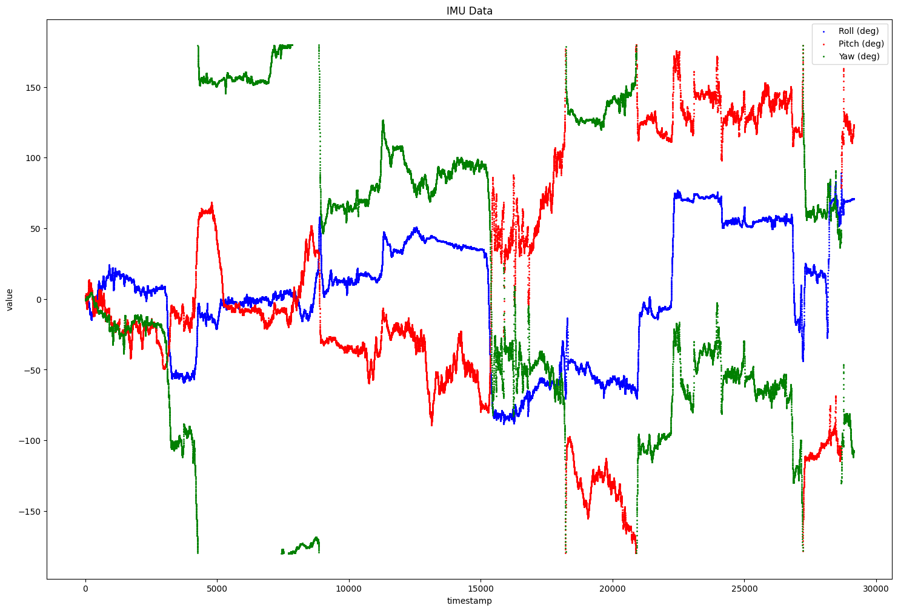
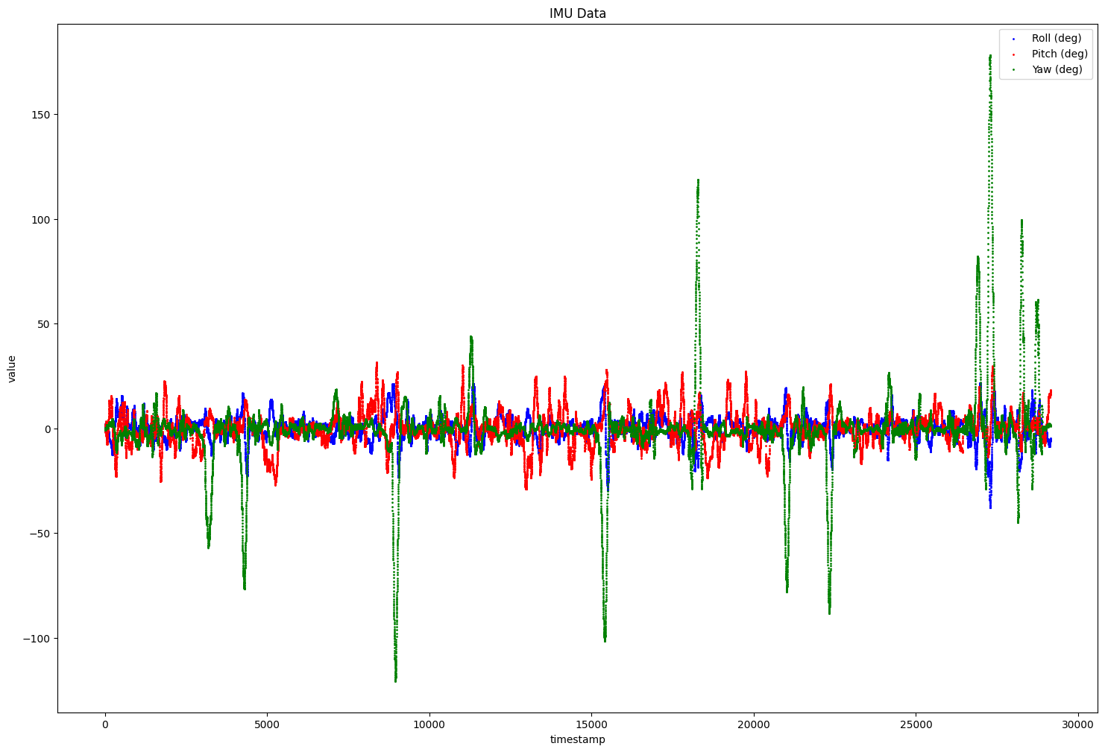
Euler Engle (normal v.s. 4s window size)
Normal
4s window size

Slide 15
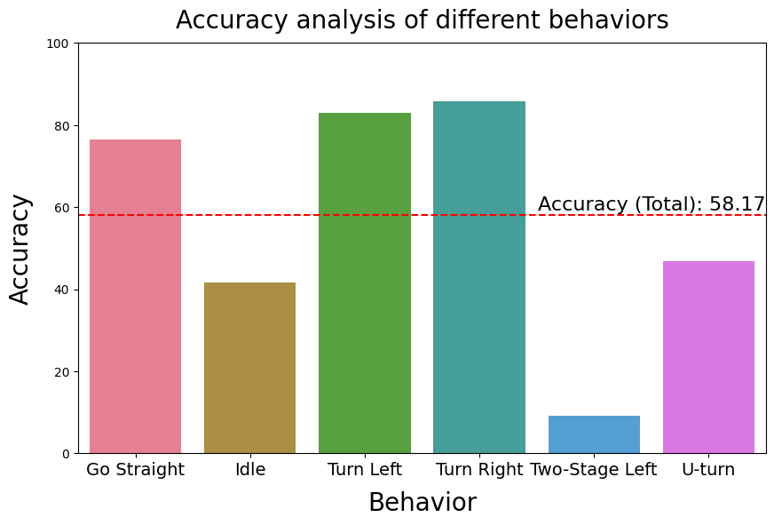
Result (Train & test are the same)
Normal
4s window size

Slide 16
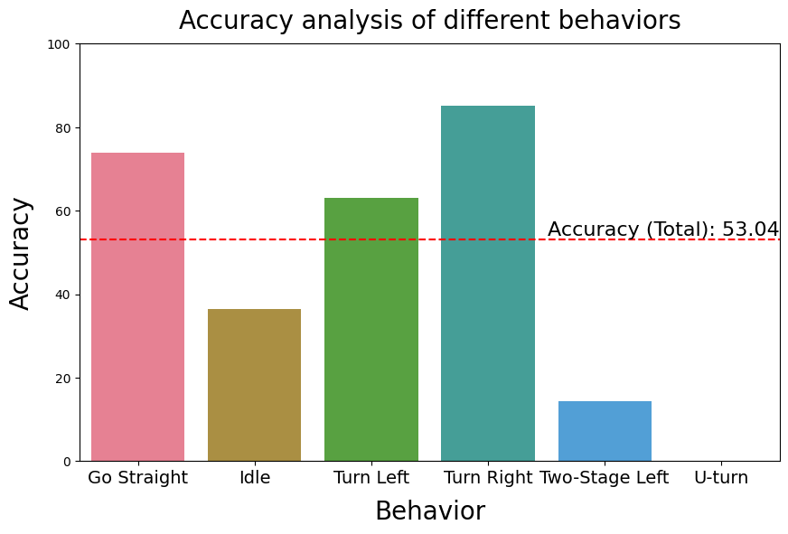
Result (First 50% train, second 50% test)
Normal
4s window size

Slide 17
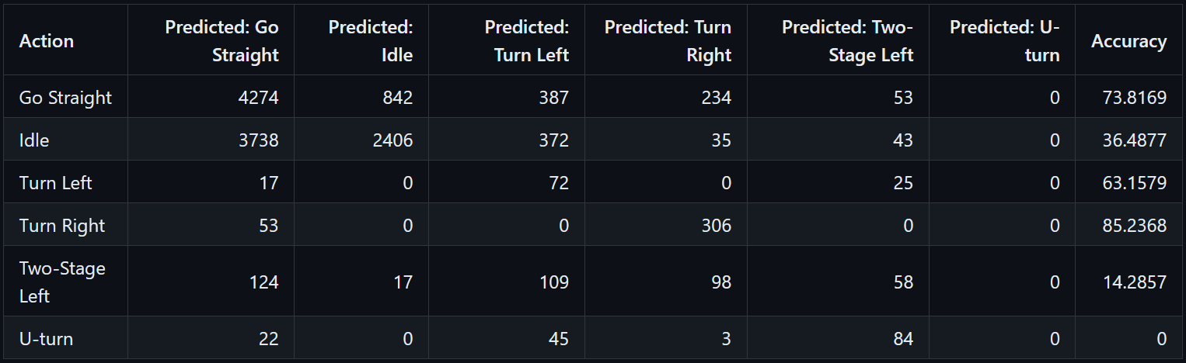
Result (First 50% train, second 50% test)

Slide 18
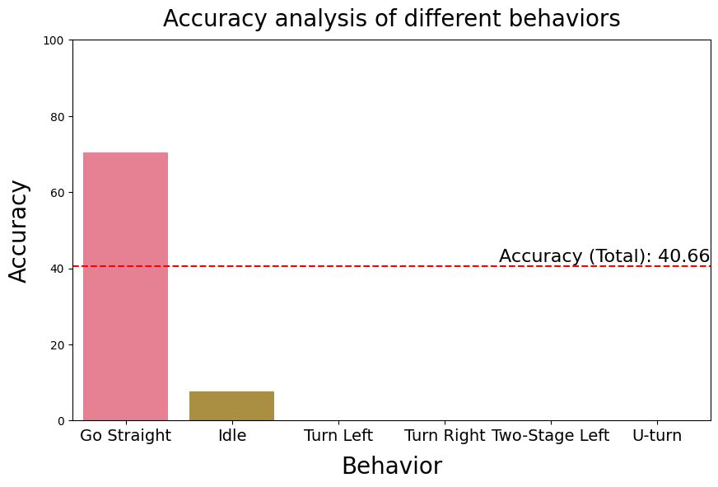
Result (Eric train, Kino test)
4s window size

Slide 19
Future Work
Document the SOP for collecting data
Data Labeling App 2.1 is currently under development
Survey papers about deep learning model
Survey open datasets

