Slide 1
Motor Data Report
Speaker: Eric
Professor: Hsiao-Ping Tsai
Date: 2024/03/13

Slide 2
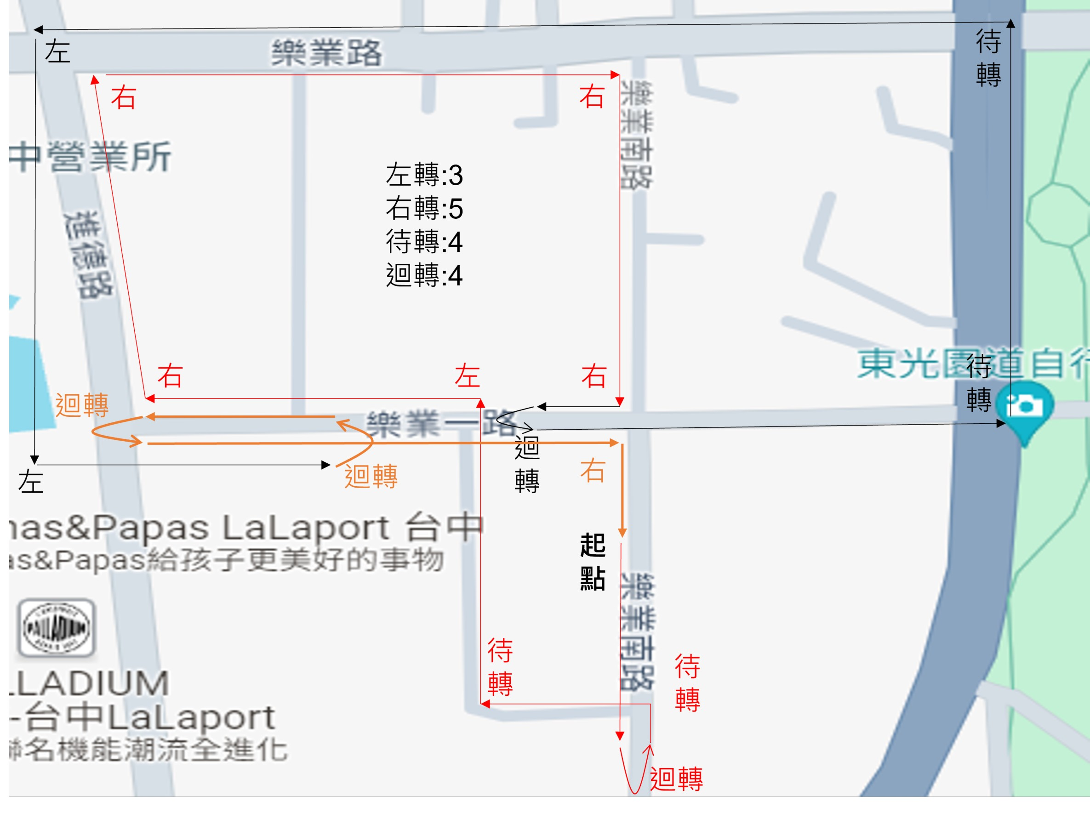
Route
The Number of Snapshot
Idle: 5838
Go Straight: 3558
Turn Left: 208
Turn Right: 240
Two-Stage Left: 208
U-turn: 278

Slide 3
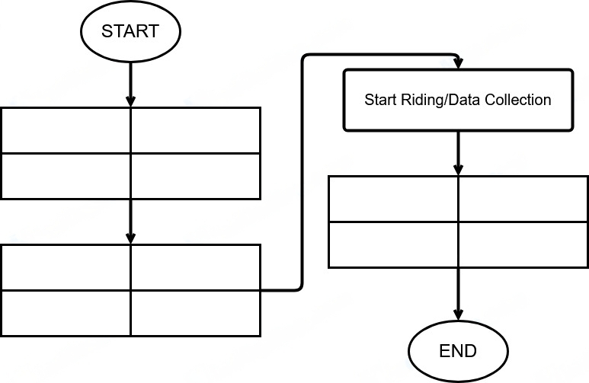
Data Collection Method
ECU Receiver Setting
Gopro Setting
Phone Setting
Tablet Setting
Stop ECU App
Stop GPS Recording
Stop Video Recording
Stop IMU
Start Video Recording
Start IMU (30Hz)
Start GPS Rrcording
Start ECU App (2Hz)

Slide 4
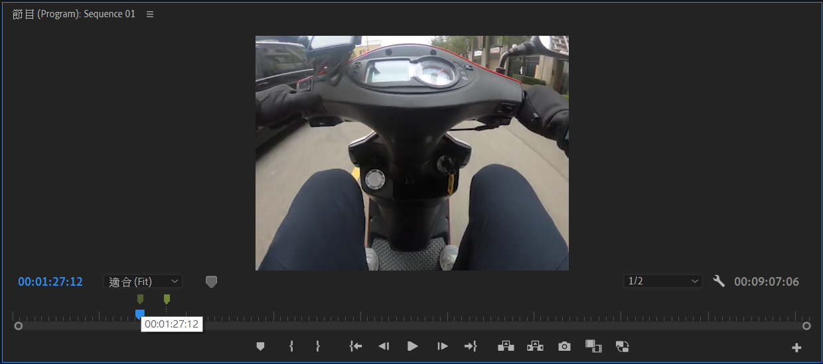
Data Collection Method
Using Adobe Premiere Pro video editing software to mark the timestamps of High-level driving behaviors, and converting them into corresponding real-time using Python program.

Slide 5
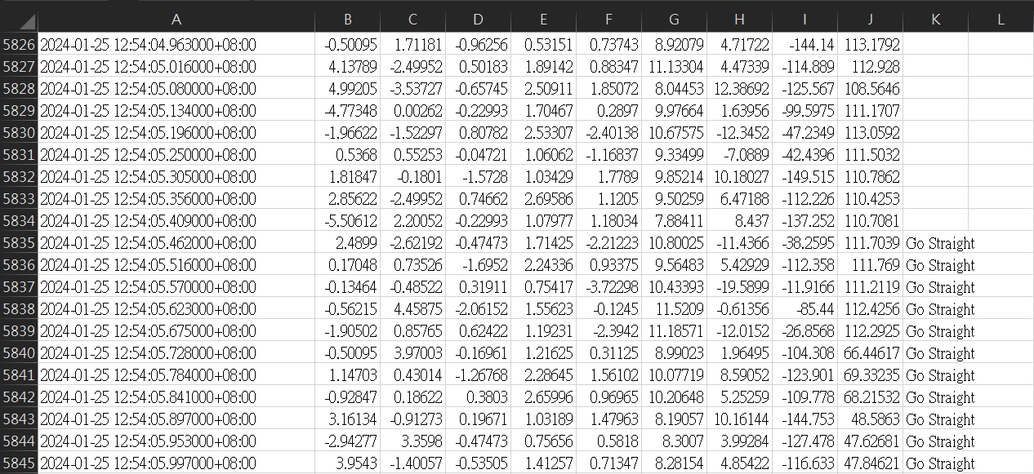
Data Collection Method
According to the real time after converted, then we can search the most recent timestamp and mark into the “Action” column with the corresponding drive behavior.

Slide 6
Data Collection Method
Ground truth
train
test
Left
Left
Left
Left
Left
Left
Left
Left
Left
Left

Slide 7
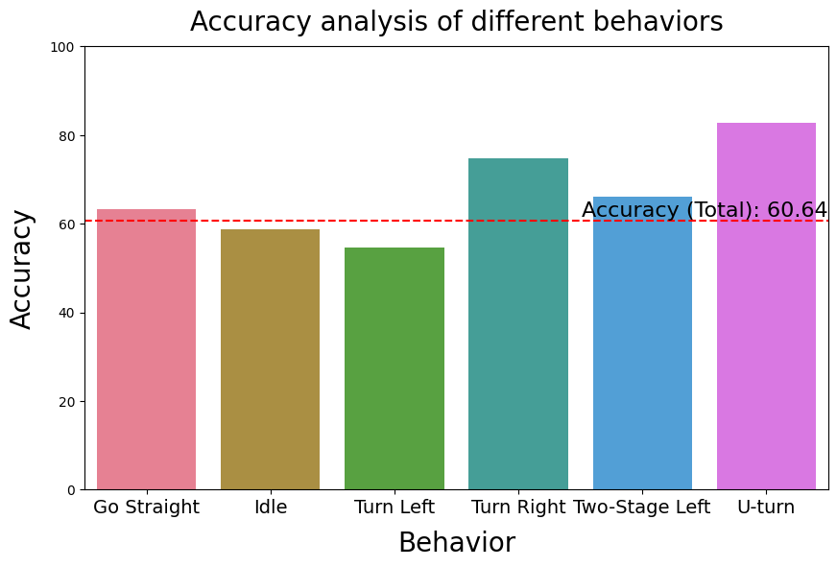
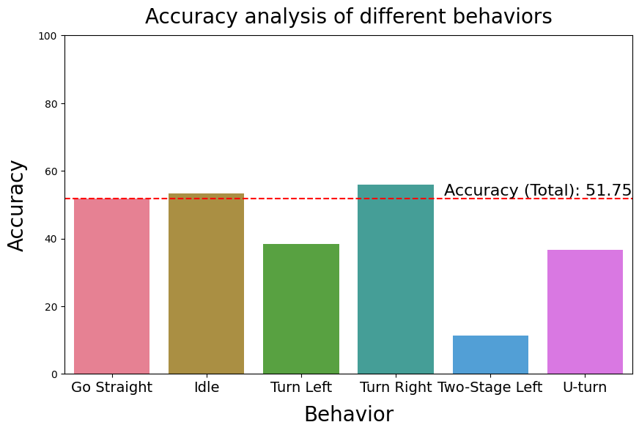
Result

Slide 8
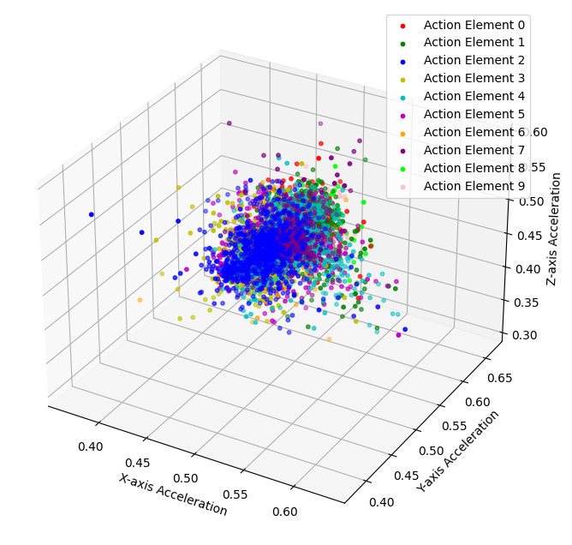
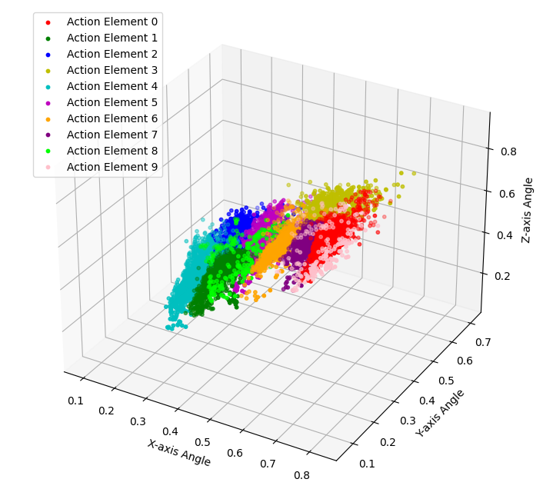
Result

Slide 9
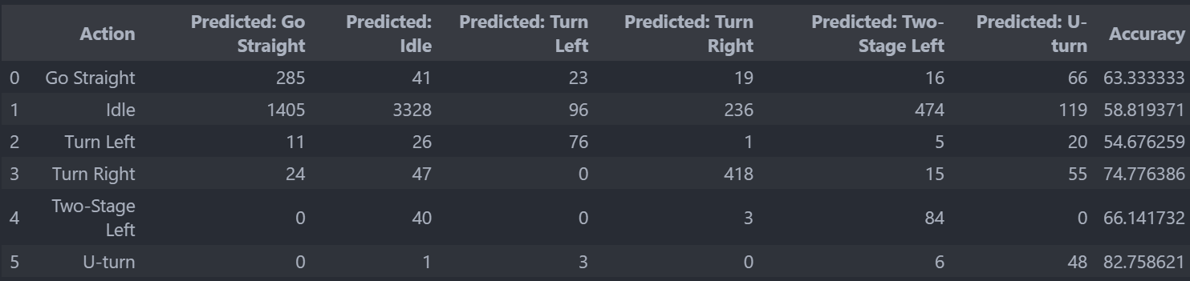
Result
$$\frac{the num of snapshot of Idle predicted}{the num of snapshot of Idle Gound turth}=\frac{3328}{1405+3328+96+236+474+119}=0.5882$$

Slide 10
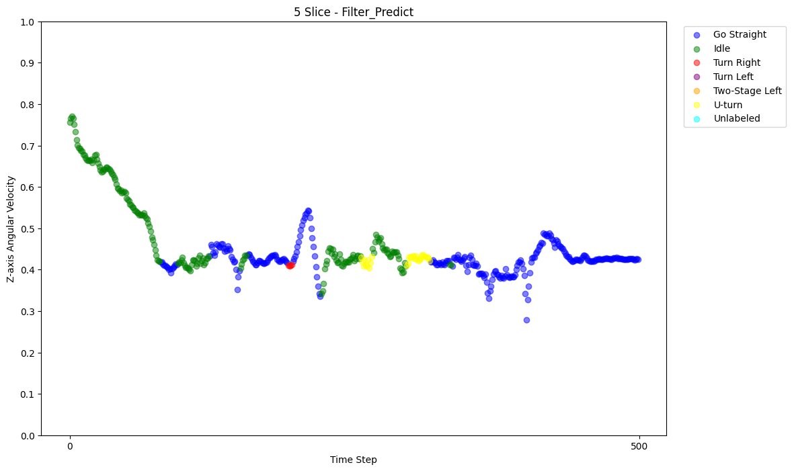
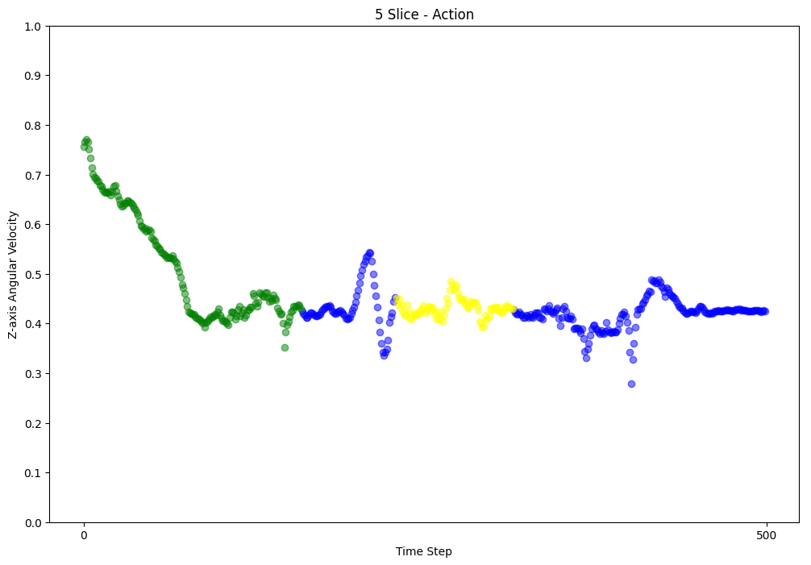
Result
Real Action
Action Predicted

