Slide 1
Challenge Information Packet
On
Residual Stress Measurement Results
Last updated: 07/08/2020
UC Davis Team
ORNL Team
Nicholas A. Bachus (nabachus@ucdavis.edu)
Christopher R. D’Elia (crdelia@ucdavis.edu)
Professor Michael R. Hill (mrhill@ucdavis.edu)
Sougata Roy (roys1@ornl.gov)
Jason Allen (allenjp@ornl.gov)
Yan Chen (cheny1@ornl.gov)
Ke An (kean@ornl.gov)
Andrzej Nycz (nycza@ornl.gov)
Luke Meyer (meyerlt@ornl.gov)

Slide 2
Introduction
These charts contain a summary of residual stress measurement data for Metal Big Area Additive Manufacturing (MBAAM) calibration builds
Residual stress data are available in a separate file
\SRP\SRPCALLPackage\ResidualStress\CalTask\Residual Stress _calibration sample.xlsx
A companion document provides a summary of the procedures used to gather residual stress data
ORNL_MBAAM_Challenge_Residual_Stress_Measurement_Procedures_V0.pptx

Slide 3

Measurement tracking scheme
Distance to cut/measurement plane
Along the $Y$ direction from origin of the build
Measurement identifier
Sample - stress component direction - location of measurement as a length (millimeters) along $Y$ direction - measurement type
Example: CAL1-SYY-Neg125mm-CM
Translation: Calibration Sample 1, measurement of YY stress, at $−125 millimeters$ from the origin using contour method (CM: contour method, ND: neutron diffraction)
L_{B}
_{L}
Build
_{W}
W_{B}
s_{y}
Y
Measurement plane
X
Baseplate

Slide 4
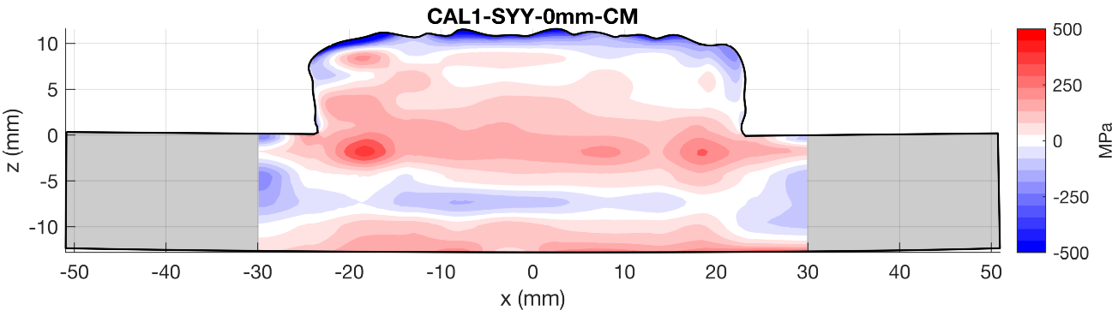

CAL1-SYY-0mm-CM (mid-plane)
Bisecting cut on CAL1 at at $Y=0 mm$
Voids and inclusions within the build caused issues when cutting the part which subsequently introduced cutting artifacts on the deformed surface
Stress computed with possible plasticity artifacts excluded from figure
At the center of the sample, moving along the $z$ direction and starting at $z=8 mm$, the stress varies from $90 MPa$ to $200 MPa$ ($z=−2 mm)$, down to $−90 MPa$ at roughly the center of the baseplate ($z=−7 mm)$, back to $90 MPa$ at the bottom surface ($z=−9 mm)$
Cut 2
Cut 1
Potential plasticity artifact
Potential plasticity artifact
Cutting artifacts

Slide 5
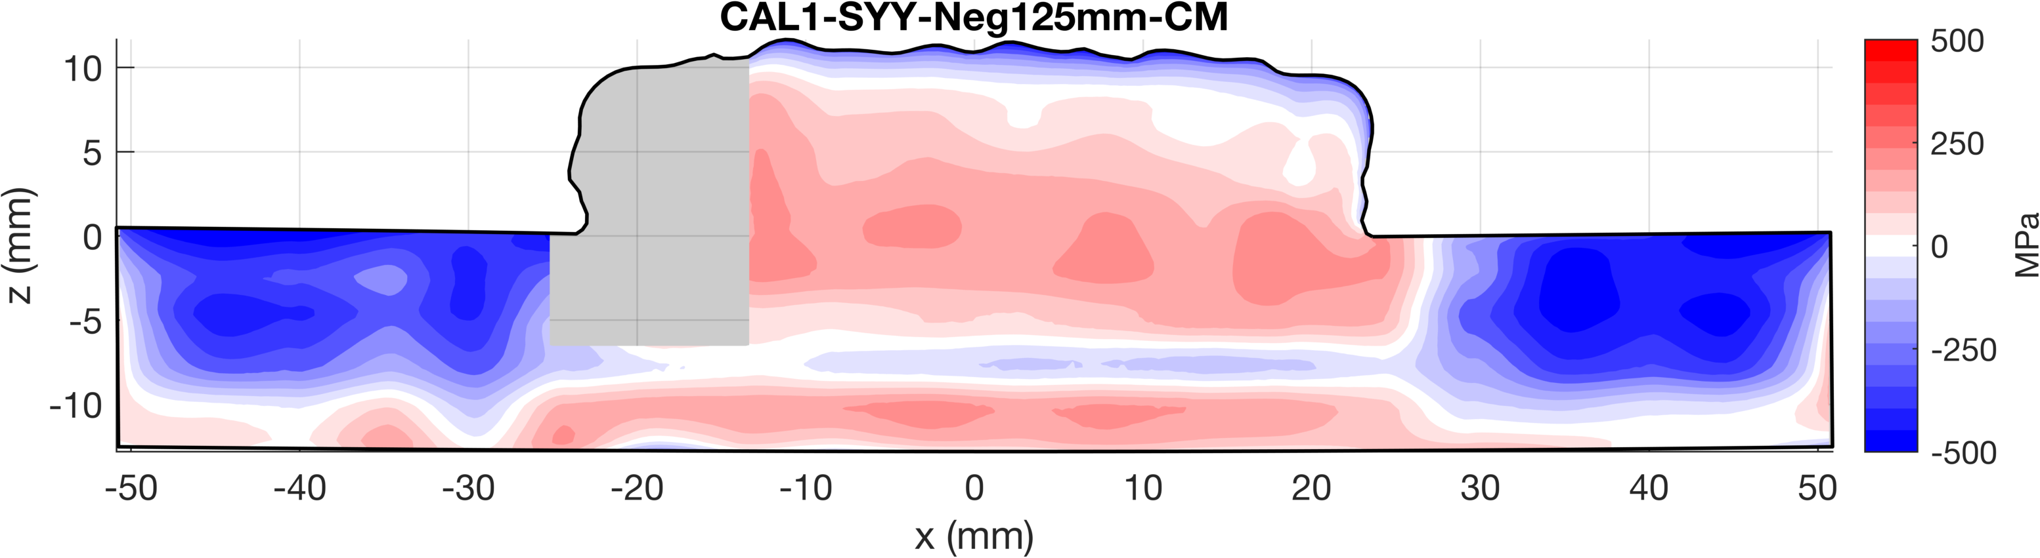

CAL1-SYY-Neg125mm-CM (quarter-plane)
Quarter-plane cut on CAL1 at $Y=−125 mm$
Slag on surface of sample caused the cut to be interrupted and created the cutting artifact
Stress computed with possible plasticity artifact excluded from figure
Along the center of the sample, moving from the top of the build ($z=8 mm$) to the bottom of the baseplate, the stress varies from $90 MPa$ to $200 MPa$ ($z=0 mm$), down to $−60 MPa$ at roughly the center of the baseplate ($z=−7.5 mm)$, back to $220 MPa$ at the bottom surface ($z=−11 mm)$
Cut 2
Cut 1
Cut 3
Potential plasticity artifact
Cut stopped due to surface slag
Self-constraint holes
Notes:
Add picture of as cut surface state

Slide 6
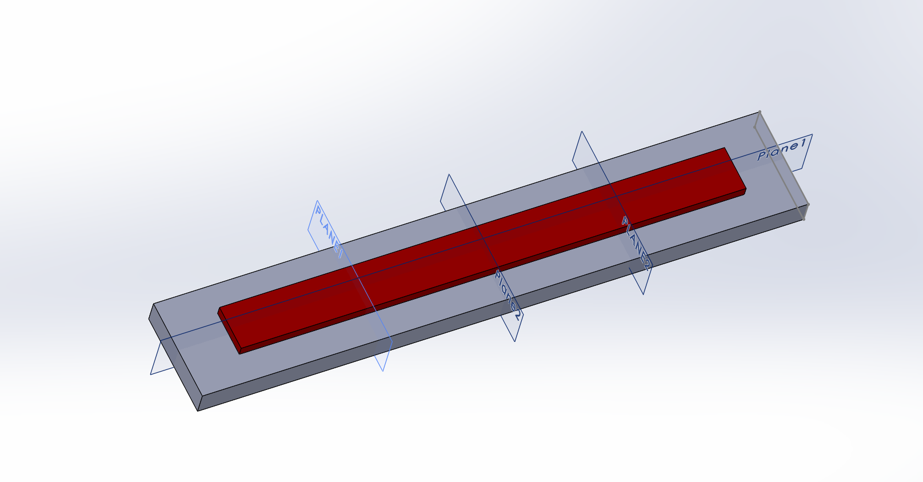
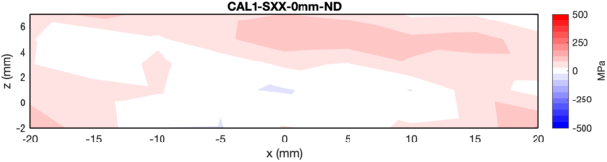
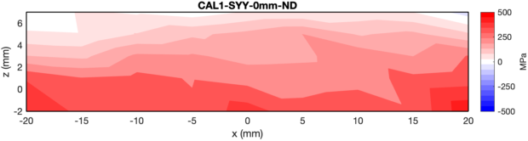
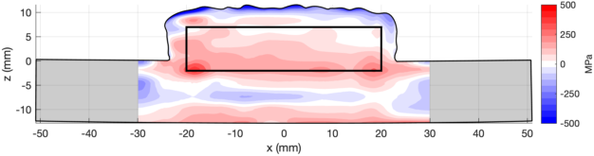
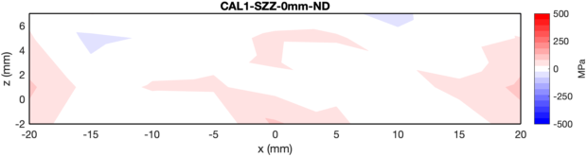


CAL1-SXYZ-0mm-ND (mid-plane)
Y
X
Measured three components of residual stress via neutron diffraction on the plane bisecting the origin ($Y=0 mm$): Transverse (X), Longitudinal (Y), and Build (Z)
$σ_{XX}:120 MPa$ to $60 MPa$ variation from top to bottom
$σ_{YY}:$ $65 MPa$ to $380 MPa$ variation from top to bottom
$σ_{ZZ}$: $40 MPa$ to $120 MPa$ variation from top to bottom
Neutron diffraction measurement region

Slide 7
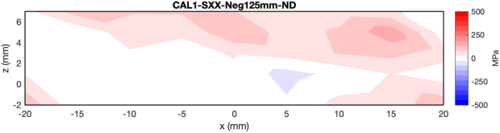
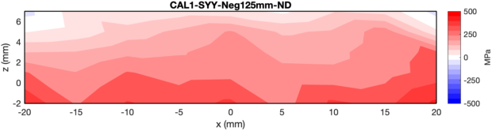
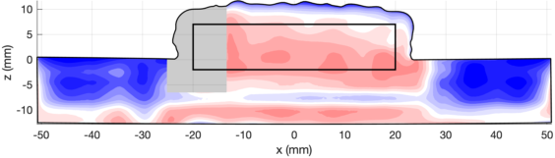
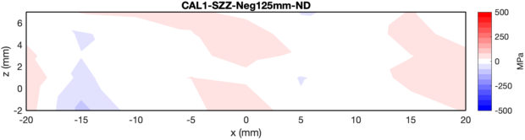


CAL1-SXYZ-Neg125mm-ND (quarter-plane)
Y
Neutron diffraction measurements in the negative Y region at $Y=−125 mm$ from the sample origin
X
$σ_{XX}:110 MPa$ to $50 MPa$ variation from top to bottom
$σ_{YY}:$ $75 MPa$ to $360 MPa$ variation from top to bottom
$σ_{ZZ}$: $30 MPa$ to $100 MPa$ variation from top to bottom
Neutron diffraction measurement region

Slide 8
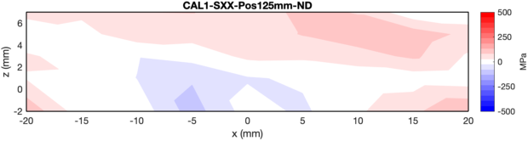
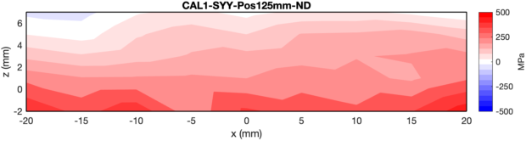
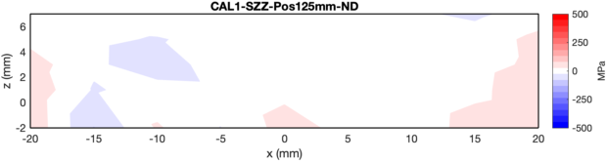


CAL1-SXYZ-Pos125mm ND (opposing quarter-plane)
Neutron diffraction measurements in the positive Y region at $Y=+125 mm$ from the sample origin
Y
X
$σ_{XX}:85 MPa$ to $25 MPa$ variation from top to bottom
$σ_{YY}:$ $40 MPa$ to $360 MPa$ variation from top to bottom
$σ_{ZZ}$: $20 MPa$ to $80 MPa$ variation from top to bottom
Neutron diffraction measurement region

Slide 9
CAL1 residual stress measurements
Neutron diffraction area is a subset of the contour measurement area
Contour method (CM) magnitudes are generally lower than the neutron diffraction (ND) magnitudes
CAL1-SYY-0mm max stress: Contour = 380 MPa, Neutron = 500 MPa
CAL1-SYY-Neg125mm max stress: Contour = 280 MPa, Neutron = 425 MPa
Similar trends
High tension at the top of the baseplate, then approaches 0 MPa as you move towards the top of the build
Contour
Neutron Diffraction
Mid-plane
Plasticity artifact removed
Quarter-plane

Slide 10
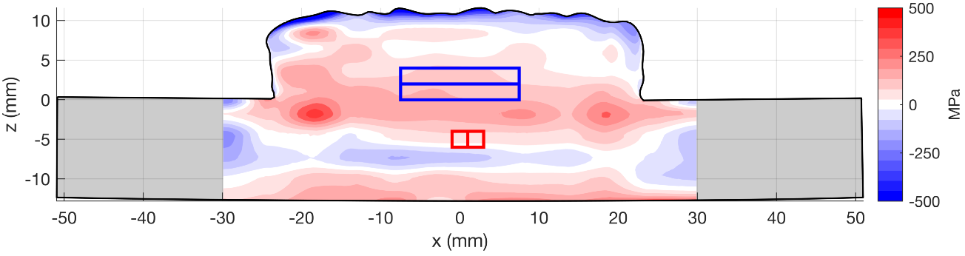

Lineouts using boxcar averaging volume
Using boxcar averaging routine for CM and ND measurements, with the error bars representing the standard deviation of points within the boxcar volume
Horizontal Lineouts
Boxcar volume 2 mm ($X$ dimension) x 2 mm ($Z$ dimension) – 2 mm was chosen since the largest variations are seen along the height of the sample and we did not want to obscure the horizontal lineouts with this variation
2 mm spacing along X direction
Vertical lineouts
Boxcar volume 15 mm ($X$ dimension) x 2 mm ($Z$ dimension) - 15 mm was chosen to provide a representation of residual stress averaged across several of the beads in the weld deposit, near the build center
2 mm spacing along Z direction
Boxcars for vertical lineouts
(15 mm x 2 mm)
Boxcars for horizontal lineouts
(2 mm x 2 mm)

Slide 11
CAL1 lineouts
Horizontal lineout boxcar volumes 2 mm x 2 mm
Vertical boxcar volumes 15 mm x 2 mm
Discontinuities in contour method lineouts represent removed potential plasticity error regions
See similar trends in the vertical lineouts between the contour method and neutron diffraction residual stress measurements with the neutron diffraction magnitudes being roughly 2x as large as the contour method

