Slide 1
Netflix Global Content Analysis & Visualization
Using Python (Pandas) and Power BI

Slide 2
Agenda
Project Overview
Problem Statement
Objectives
Dataset
Methodology
Analysis & Insights
Dashboard
Conclusion

Slide 3
Project Overview
Performed comprehensive data cleaning, preprocessing, and transformation using Python (Pandas) to improve data quality and consistency.
Conducted exploratory data analysis (EDA) to identify trends, patterns, and relationships within Netflix's content library.
Developed interactive Power BI dashboards to visualize country-wise, genre-wise, rating-wise, and yearly content distribution.
Generated key performance indicators (KPIs) and business insights to support data-driven decision-making.
Enabled users to explore Netflix content through dynamic filters, slicers, and navigation features for an enhanced analytical experience.

Slide 4
Problem Statement
Netflix hosts thousands of Movies and TV Shows across multiple countries, genres, ratings, and release years.
The raw dataset contains complex and multi-valued attributes that require extensive cleaning and transformation before analysis.
Identifying meaningful patterns and trends manually is time-consuming and inefficient.
Business stakeholders need a centralized and interactive solution to explore content distribution and audience preferences.
The challenge is to transform raw Netflix data into actionable insights through data analytics and interactive visualization.

Slide 5
Project Objectives
Clean, preprocess, and transform the raw Netflix dataset to ensure data quality and consistency.
Analyse content distribution across countries, genres, ratings, and content types.
Identify key trends and patterns in Netflix's content library through exploratory data analysis.
Develop interactive Power BI dashboards for effective visualization and user-driven exploration.
Generate actionable business insights to support data-driven decision-making.

Slide 6
Dataset Overview
The project uses the Netflix Titles Dataset, containing information on Movies and TV Shows available on Netflix.
The dataset consists of 8,804 unique titles collected from Netflix's global content library.
It contains 12+ attributes, including title, type, country, date added, release year, rating, duration, and genre.
The data is provided in CSV format(Netflix_Database) and serves as the primary source for analysis and visualization.
Data preprocessing techniques such as missing value handling, datatype conversion, and feature engineering were applied.
The cleaned dataset was used to perform country-wise, genre-wise, rating-wise, and yearly trend analysis.

Slide 7
MECE Framework
Dimension | Key Fields
Content | Title, Type, Description
Production | Country, Director, Cast
Time | Date Added, Release Year, Year Added
Classification | Genre, Rating
Duration | Duration, Duration Number

Slide 8
Technology Stack
Python and Pandas were used for data cleaning, preprocessing, transformation, and exploratory data analysis.
Google Collab served as the development environment for executing Python scripts and managing datasets.
Power BI was utilized to create interactive dashboards and visualize key business insights.
Excel was used for preliminary data inspection, validation, and result verification. Together, these tools enabled the complete analytics workflow from raw data processing to interactive reporting.

Slide 9
Project Methodology
Data Collection: Acquired the Netflix Titles dataset containing Movies and TV Shows metadata.
Data Cleaning: Handled missing values, standardized column names, and corrected data types.
Data Transformation: Applied feature engineering, extracted year information, and normalized multi-valued fields using explode operations.
Exploratory Data Analysis (EDA): Analysed content distribution across countries, genres, ratings, and release years.
KPI Development: Created key metrics such as Total Titles, Movies, TV Shows, Countries, and Genres.
Dashboard Development: Built interactive Power BI dashboards with filters, slicers, and navigation features.
Insight Generation: Derived actionable business insights and trends from the visualized data.

Slide 10
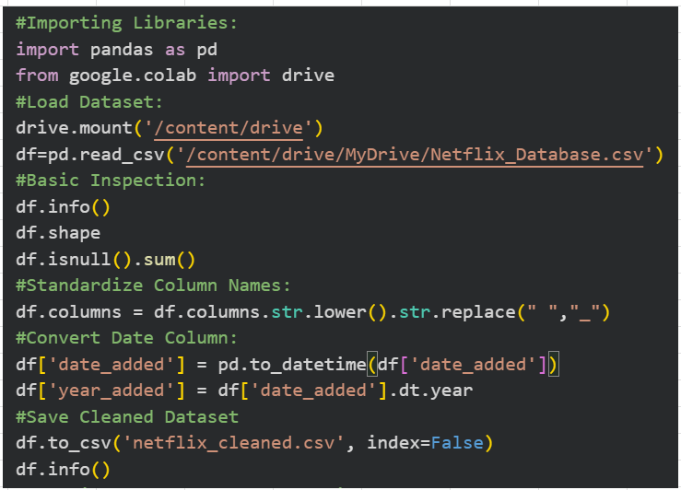
Data Cleaning & Transformation
Performed comprehensive data cleaning to ensure data accuracy and consistency.

Slide 11

Data Cleaning & Transformation
Addressed missing values and corrected invalid or inconsistent records
Column names were standardized for consistency and improved readability

Slide 12

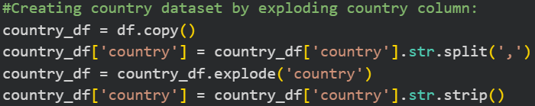
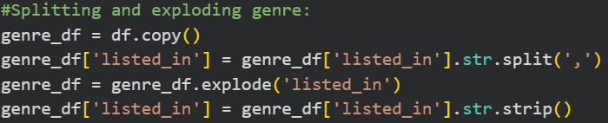
Data Cleaning & Transformation
Standardized data types and transformed date-related fields. Normalized multi-valued country and genre attributes using explode().

Slide 13
Data Cleaning & Transformation
Prepared an analysis-ready dataset for Power BI dashboard development.
Saving Cleaned Dataset as Netflix_df:
Saving Country_df:
Saving genre_df:

Slide 14
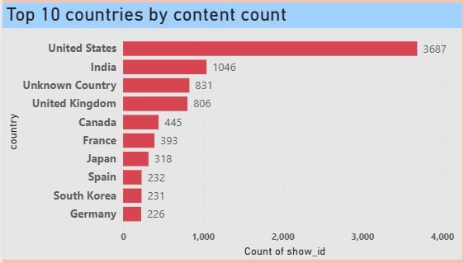
Country-wise Analysis
USA leads content production followed by India and UK.
Strong global and Asian content representation.

Slide 15
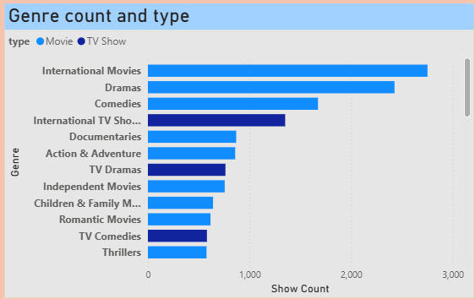
Genre Analysis
International Movies, Dramas and Comedies dominate.
Movies contribute more titles than TV Shows.

Slide 16
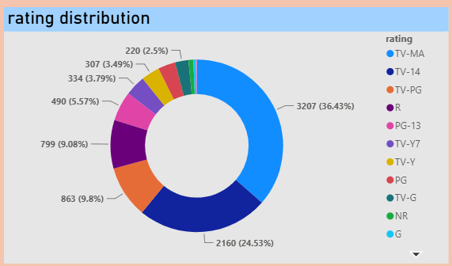
Audience Segmentation
TV-MA, TV-14 and TV-PG are dominant ratings.
Netflix primarily targets adults and young adults.

Slide 17
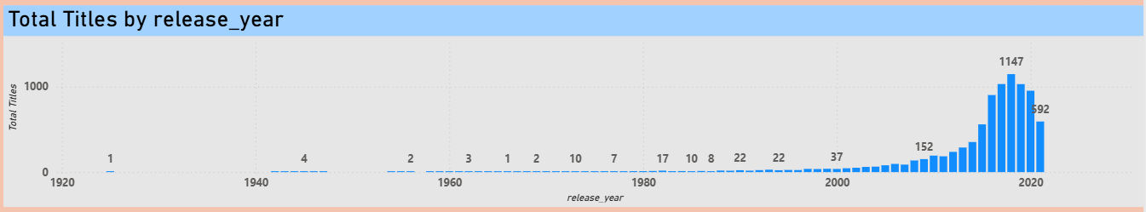
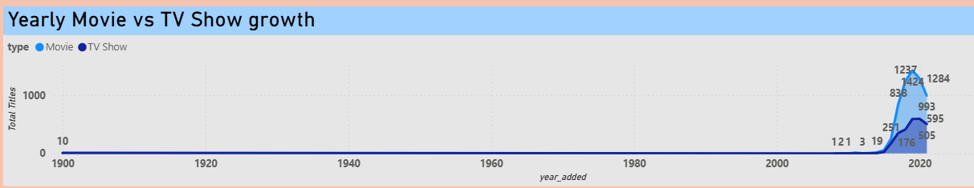
Content Growth Analysis
Major expansion after 2016.
Peak content additions observed around 2019.
Movies drive platform growth.

Slide 18

KPI Summary
The Netflix dataset contains 8,804 unique titles, including both movies and TV shows.
Movies dominate the library with 6,128 titles, while TV shows account for 2,676 titles.
Content is distributed across 124 countries, highlighting Netflix's global presence.
The platform offers content spanning 42 distinct genres, ensuring diverse viewer preferences.
These KPIs provide a high-level overview of the scale, diversity, and reach of Netflix's content catalogue.

Slide 19
Power BI Dashboard
Developed an interactive Power BI dashboard to visualize Netflix content insights.
The dashboard consists of five dedicated pages covering different analytical perspectives.
Key analyses include content overview, country-wise distribution, genre trends, and audience ratings.
A separate content growth page highlights yearly additions and platform expansion trends.
Interactive navigation enables users to explore insights efficiently and make data-driven observations

Slide 20
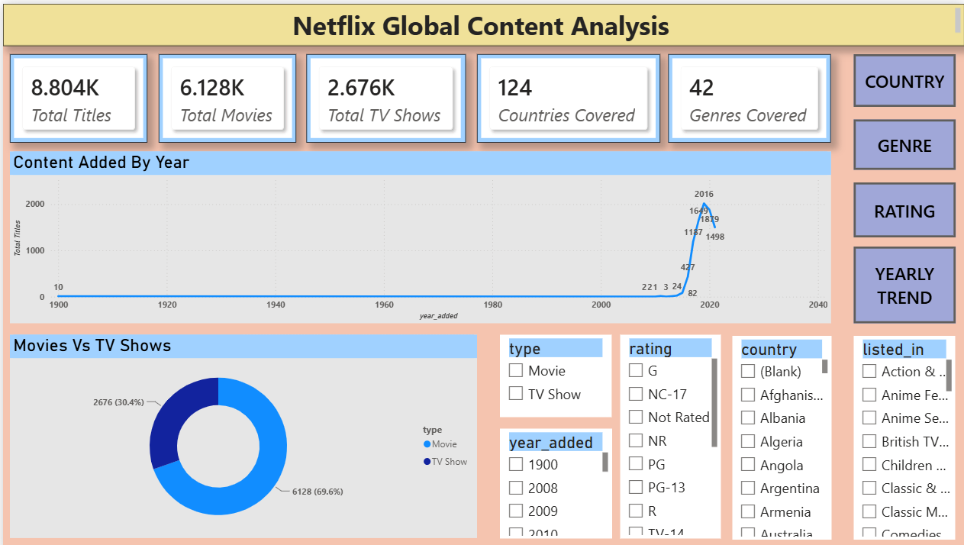
Power BI Dashboard
Netflix Overview Page:

Slide 21
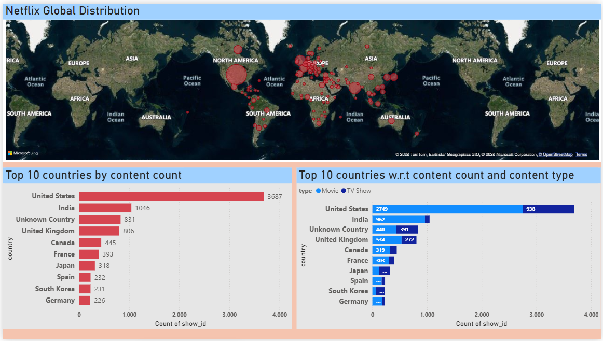
Power BI Dashboard
Country Overview Page:

Slide 22
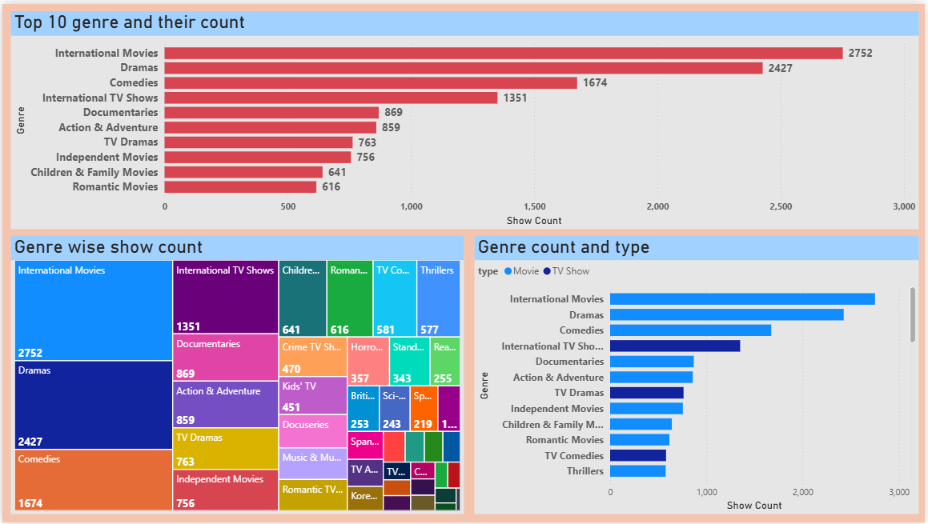
Power BI Dashboard
Genre Overview Page:

Slide 23
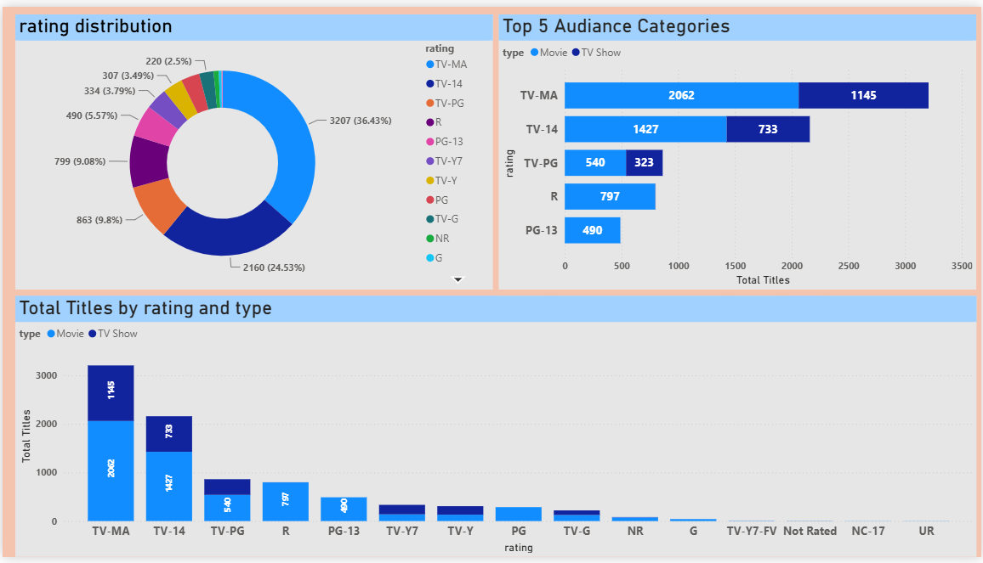
Power BI Dashboard
Audience Rating Overview Page:

Slide 24
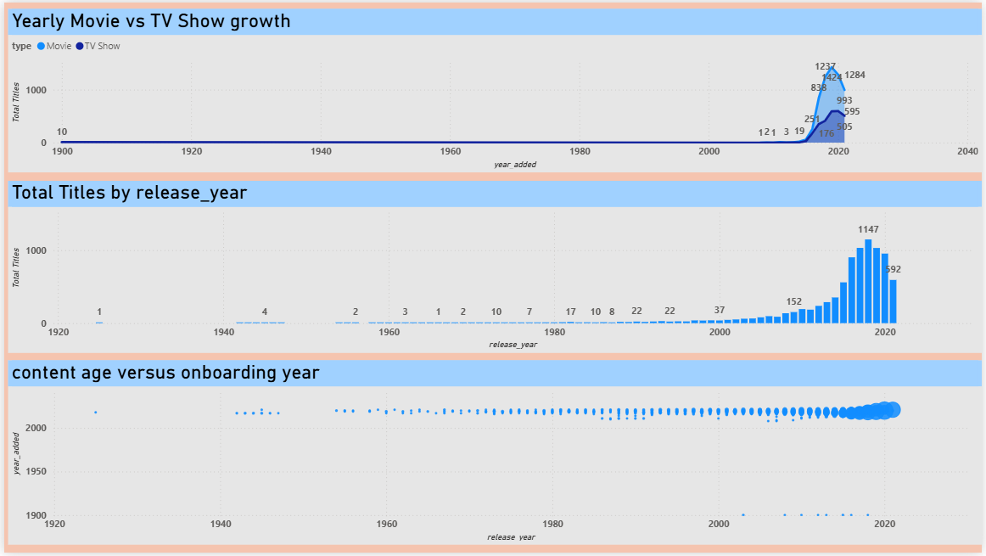
Power BI Dashboard
Yearly Content Trend Page:

Slide 25
Key Business Insights
Netflix maintains a highly diversified content library across multiple countries and genres.
The platform's catalogue is predominantly movie-focused, with movies significantly outnumbering TV shows.
International content has grown steadily, reflecting Netflix's expanding global strategy. Mature audience ratings account for a substantial share of the available content.
Content additions increased rapidly over recent years, demonstrating strong platform growth.
These insights highlight Netflix's focus on global reach, content diversity, and audience engagement

Slide 26
Key Business Insights
Business Insight | Recommendation | Future Scope
Global Diversification | Continue investing in localized and regional content to strengthen market penetration in emerging countries. | Expand analysis by studying country-wise viewer engagement and subscription growth.
Movie-Heavy Catalogue | Increase the production and acquisition of high-quality TV series to improve long-term audience retention. | Analyses watch-time and popularity metrics to determine the optimal Movie-to-TV Show ratio.
Growing International Focus | Prioritize multilingual content and strategic partnerships with international production houses. | Explore region-specific content performance and cultural preferences using audience data.
Strong Mature Audience Segment | Diversify offerings by introducing more family-friendly, children’s, and teen-oriented content. | Conduct audience segmentation analysis based on age groups and viewing patterns.
Rapid Content Growth | Maintain a balanced content acquisition strategy while ensuring quality and relevance. | Implement predictive analytics to forecast future content demand and optimize investments.

