Slide 1
The AI Advantage: Identifying Strategic Opportunities in a Transforming Landscape
By: Shrey Patel

Slide 2
Executive summary
Objective: To provide a clear, data-driven framework for making strategic AI investments by analyzing industry-wide trends in adoption, workforce impact, and revenue growth.
Key Insight: Simply increasing AI adoption does not guarantee success. Our analysis reveals that industries fall into four distinct strategic quadrants—Leaders, Upcoming, Saturated, and Underperformers—based on their ability to translate AI adoption into revenue.
Core Recommendation: Future investments should be targeted. We recommend prioritizing the high-potential "Upcoming" sector , learning from the efficiency of the "Leaders" , driving innovation in "Saturated" markets , and diagnosing the core issues in "Underperformers".

Slide 3
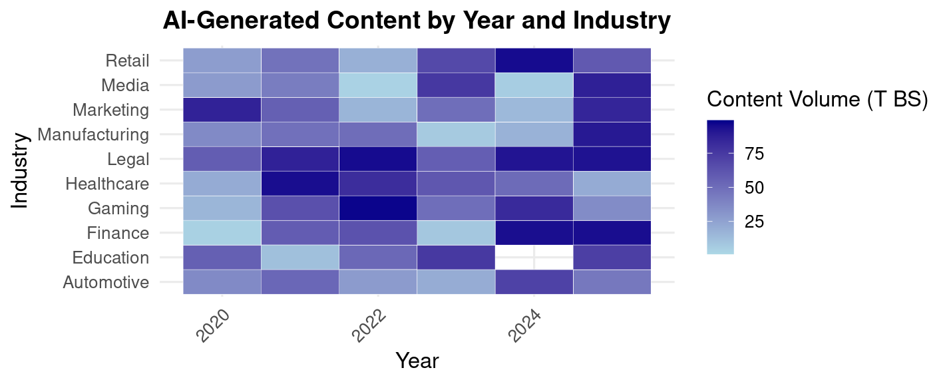
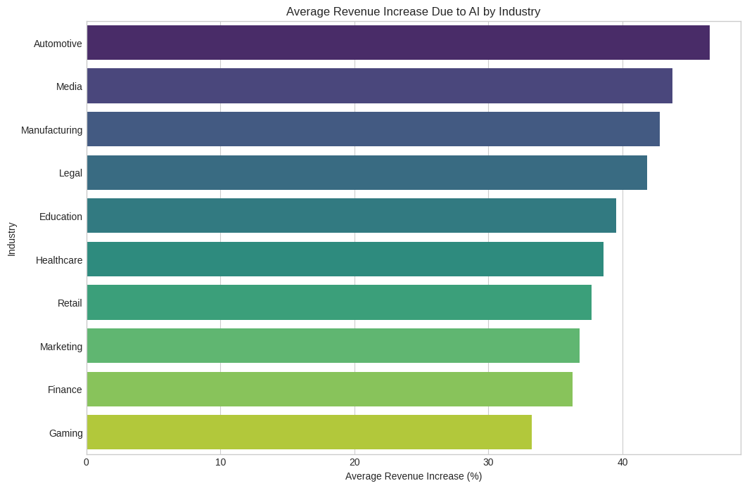
The Landscape: Who is Using AI-Generated Content?
Key Takeaway:
AI-generated content is now widespread, but adoption is not uniform. A few key industries are driving most of the volume, while others are just beginning to scale.
Analysis:
Clear Leaders in Volume: Since 2020, industries like Finance, Legal, and Marketing have consistently been the heaviest users of AI for content generation, showing early and mature adoption.
Recent Growth Surges: While some were early adopters, sectors like Manufacturing show a significant surge in content volume more recently (2023-2024), indicating a new wave of adoption.
Uneven Distribution: The heatmap clearly shows that the scale of AI implementation is highly varied, establishing the central theme that a "one-size-fits-all" view of AI adoption is misleading as the boxplot shows how revenue between industries is different.
(R visual 2)
(Python visual 1)

Slide 4
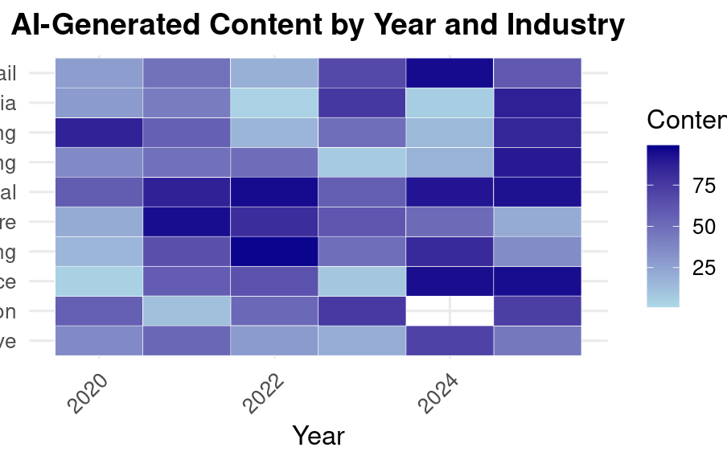
The Landscape: Who is Using AI-Generated Content?
Key Takeaway:
AI-generated content is now widespread, but adoption is not uniform. A few key industries are driving the majority of the volume, while others are just beginning to scale.
Analysis:
Clear Leaders in Volume: Since 2020, industries like Finance, Legal, and Marketing have consistently been the heaviest users of AI for content generation, showing early and mature adoption.
Recent Growth Surges: While some were early adopters, sectors like Manufacturing show a significant surge in content volume more recently (2023-2024), indicating a new wave of adoption.
Uneven Distribution: The heatmap clearly shows that the scale of AI implementation is highly varied, establishing the central theme that a "one-size-fits-all" view of AI adoption is misleading.
(R visual 2)

Slide 5
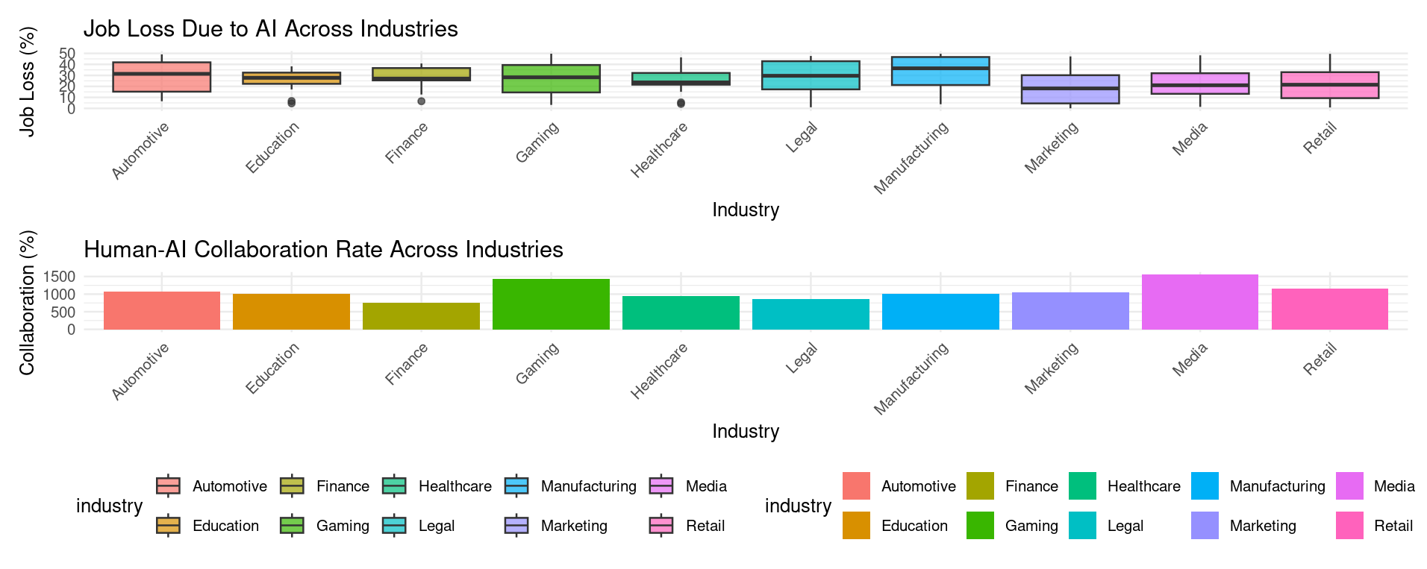
The Human Impact: How is AI Reshaping the Workforce?
Key Takeaway:
The impact of AI on the workforce is a double-edged sword. While certain industries face a significant risk of job displacement, others are demonstrating a remarkable capacity for human-AI collaboration, suggesting a fundamental transformation of roles rather than just elimination.
Analysis:
High-Risk Sectors: Industries like Automotive and Manufacturing show the highest potential for job loss due to AI. This is likely driven by automation in routine, physical, and procedural tasks.
High-Collaboration Sectors: In contrast, creative and dynamic fields like Media and Gaming are leading in human-AI collaboration. Here, AI is augmenting human capabilities, serving as a tool for creativity and productivity rather than a replacement.
The Narrative of Transformation: This data adds a crucial layer of complexity to our story. The impact of AI isn't just about business efficiency; it's about fundamentally reshaping roles and creating a new dynamic between people and technology.

Slide 6
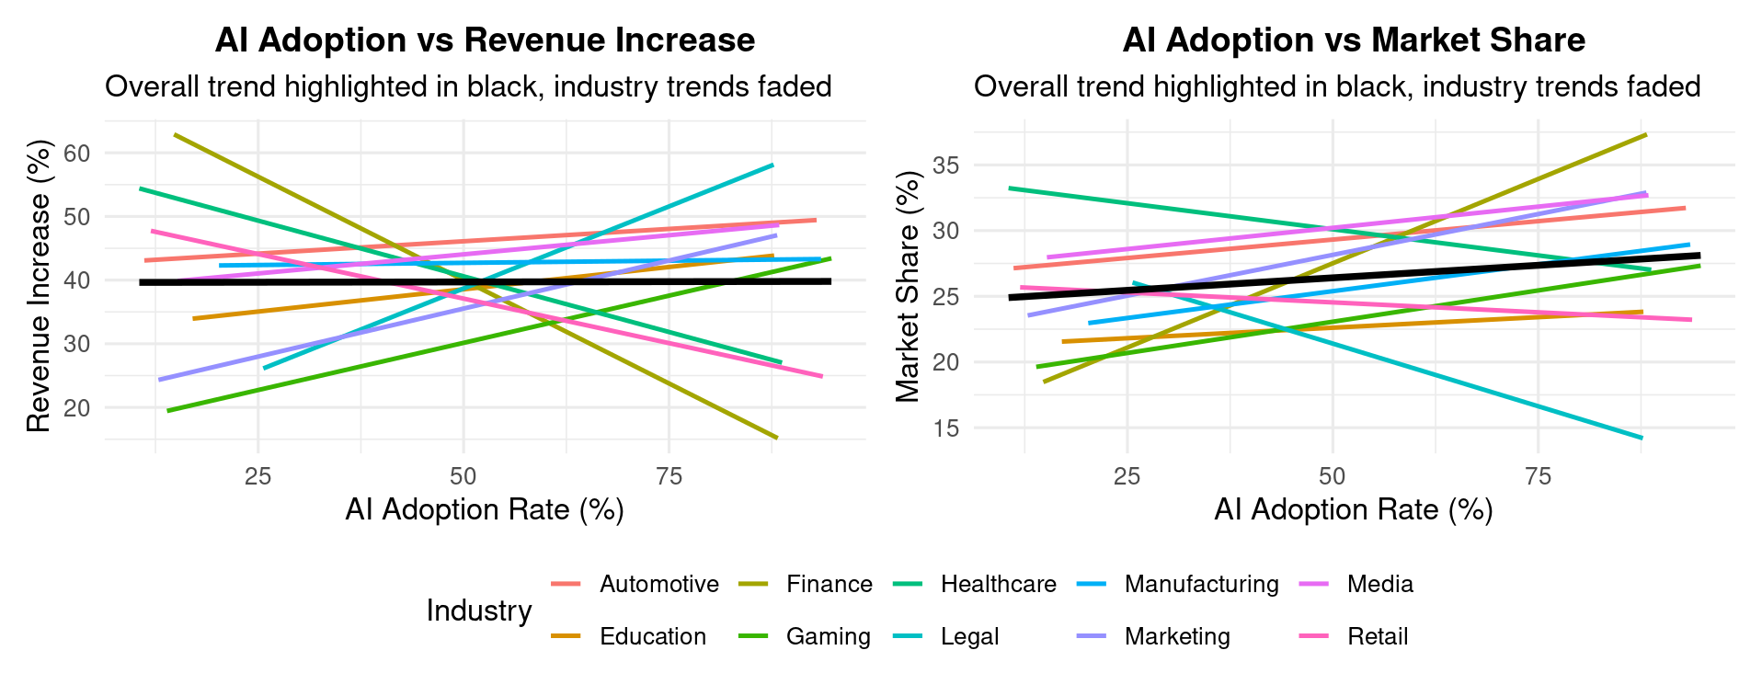
Does Higher Adoption Guarantee Success?
Key Takeaway: While there is a modest positive trend overall, the data clearly shows that higher AI adoption is not a universal guarantee of increased revenue or market share. The relationship is highly dependent on the industry.
Analysis:
The Overall Trend is Deceiving: The black trend line shows a slight positive correlation, suggesting that, on average, more AI is better. However, this average hides the real story.
Industry Variance:
The individual trend lines reveal a chaotic reality. For an industry like Finance, the correlation is strong and positive—more AI adoption directly translates to better performance.
For others like Gaming and Automotive, the trend is negative. In these sectors, increasing adoption beyond a certain point correlates with diminishing revenue, suggesting market saturation or ineffective implementation.

Slide 7
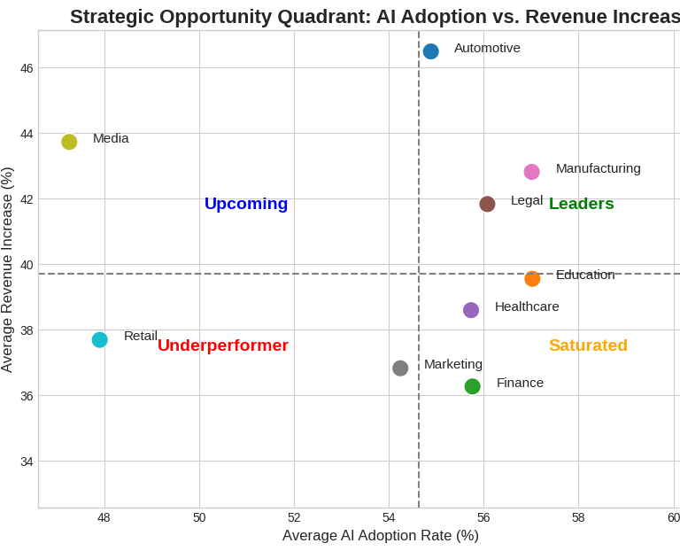
AI Adoption & Revenue: A Segmented View
Key Takeaway:
To make sense of the complex data, we can classify industries into four clear and actionable quadrants by plotting their AI adoption rate against the revenue it generates. This framework provides the clarity needed to guide our strategy
Leaders: Mature markets with high AI adoption and high revenue gains.
Strategy: To maintain their lead optimizing existing AI solutions, while actively exploring next-generation AI to prevent disruption.
Upcoming : High revenue impact from low adoption signals a major growth opportunity.
Strategy: Increase investment to scale proven use cases and accelerate adoption
Saturated: High adoption meets diminishing revenue returns, indicating a competitive market.
Strategy: The focus must shift to innovation, finding applications of AI that create new value and break away from the competition
Underperformer: Low adoption and low revenue impact show a nascent market.
Strategy: Find what the root problem is before investing more money
(Python visual 2)

Slide 8
Summary & Next Steps
Key Takeaways:
AI's Impact is Uneven: While AI adoption is growing across the board, its ability to drive revenue varies dramatically from one industry to the next.
Strategy Must Be Sophisticated: A simple strategy of "more adoption is better" is proven to be flawed. Without the right context, it can lead to wasted investment and diminishing returns.
A Clear Framework for Action: Our strategic quadrant model provides the clarity needed to move forward, allowing us to make targeted, data-driven decisions that align with each industry's unique position.
Recommended Next Steps:
Explore the "Upcoming" Sector: Initiate a deep-dive analysis into the Media industry to identify specific, high-ROI investment opportunities and capitalize on its growth potential.
Innovate in "Saturated" Markets: Propose and facilitate innovation workshops for key stakeholders in Finance, Gaming, and Marketing to brainstorm novel AI applications that can create new competitive advantages.

