Slide 1






TRENDS AND PREDICTIONS ON TECHNOLOGIES
POOJA
DECEMBER 2024

Slide 2



OUTLINE
Executive Summary
Introduction
Methodology
Results
Visualization – Charts
Dashboard
Discussion
Findings & Implications
Conclusion
Appendix

Slide 3

EXECUTIVE SUMMARY
Report on current and predicted trends among the programming languages, databases and other technologies.
It also analyses the demographics of the professionals in IT industry
Presenting the findings with the support of relevant charts and graphs
Data was collected, cleaned, analyzed and presented in dashboards

Slide 4

INTRODUCTION
The reports showcases that Javascript is currently the most popular programming language and continue to do so in future.
MySQL has the most database usage at present and is likely to be taken over by PostgreSQL.
Nearly 90000 people have contributed to the survey with a significant number of male respondents.
Predicting the future trends among developers.

Slide 5

METHODOLOGY
Data collection from various sources.
Web Scraping
APIs
Request Library
Data Exploration
Outliers
Distribution of Data
Correlations
Data Cleaning
Null Values
Errored Values
Data Visualization
Graphs
Charts etc.,
Dashboards
IBM Cognos

Slide 6
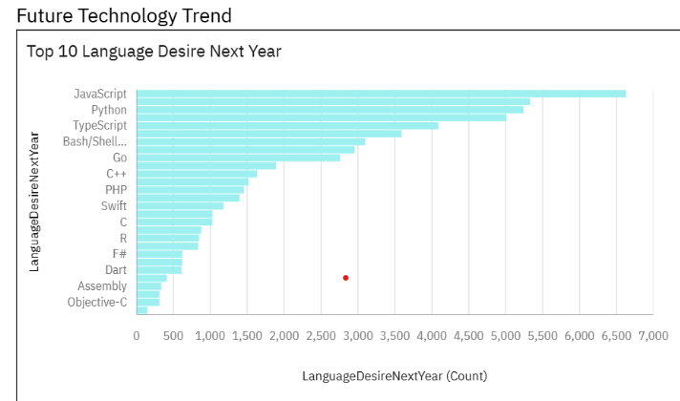
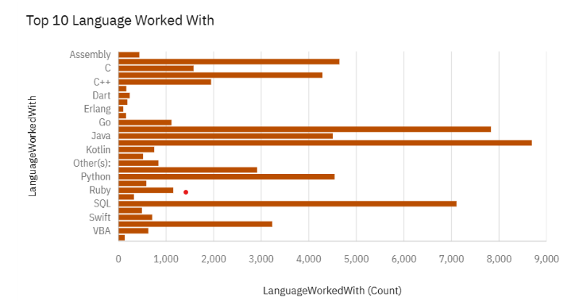
PROGRAMMING LANGUAGE TRENDS
Current Year
Next Year
<Bar chart of top 10 programming languages for the current year goes here.>
< Bar chart of top 10 programming languages for the next year goes here.>

Slide 7
PROGRAMMING LANGUAGE TRENDS - FINDINGS & IMPLICATIONS
Findings
Python overtake SQL in coming years.
Javascript, HTML/CSS, SQL, Shell languages and Python are widely used.
Typescript gaining popularity over Javascript.
Implications
Migration from Javascript to Typescript
Python gaining popularity

Slide 8
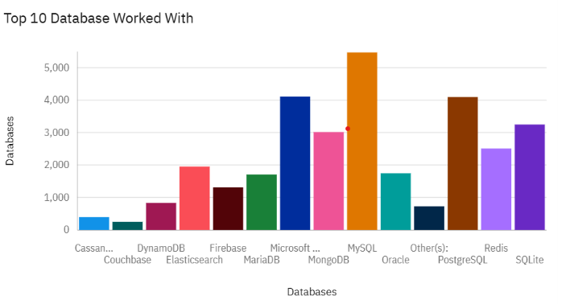
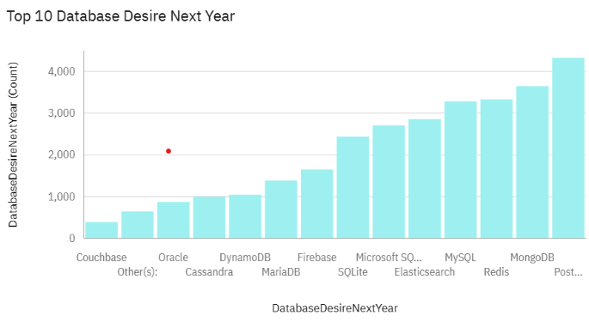
DATABASE TRENDS
Current Year
Next Year
< Bar chart of top 10 databases for the current year goes here >
< Bar chart of top 10 databases for the next year goes here.>

Slide 9
DATABASE TRENDS - FINDINGS & IMPLICATIONS
Findings
MySQL, PostgreSQL, SQLite, MongoDB are popular among developers currently
Redis and Elasticsearch are gaining more traction
MongoDB, Redis, Elasticsearch and MySQL are likely to be trending in future.
Implications
Redis support abstract datatypes.
Open source databases are widely preferred.
MySQL and SQLite might see significant decline.

Slide 10

DASHBOARD
https://github.com/SRPOOJA99/IBM-Data-Analyst-Capstone-Project/blob/main/Capstone_Cognos.pdf

Slide 11
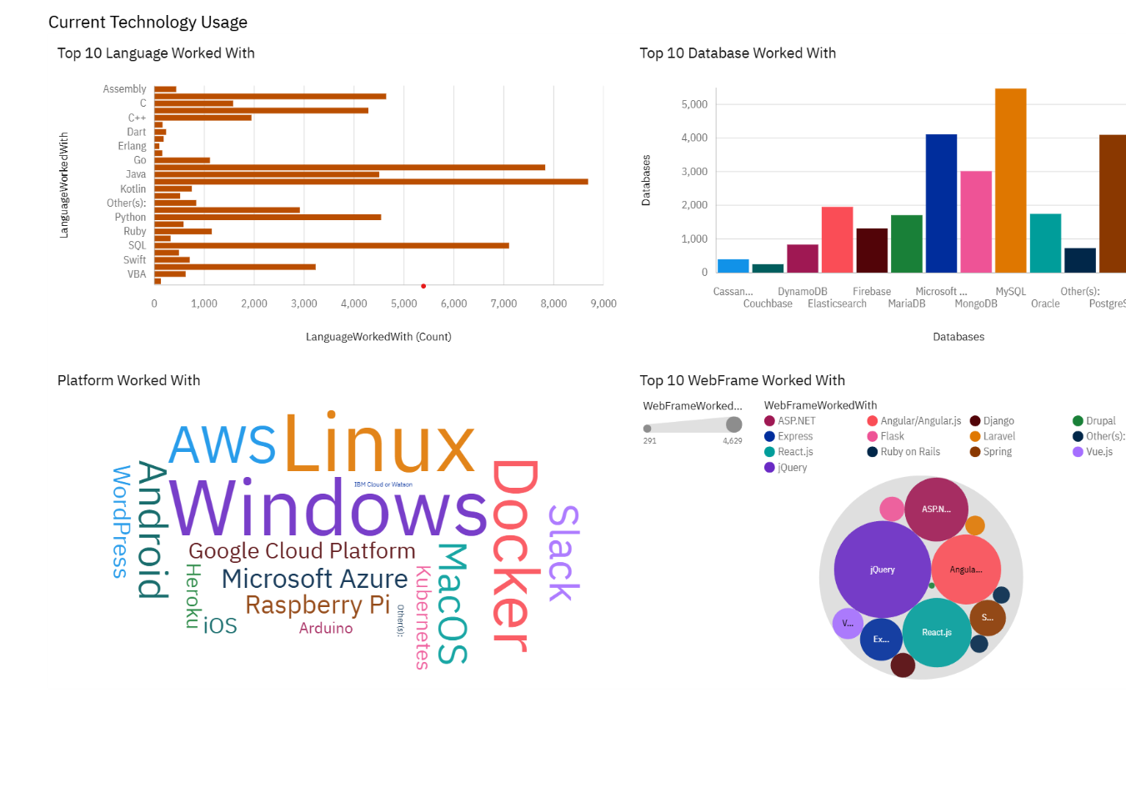
DASHBOARD TAB 1
Screenshot of dashboard tab 1 goes here

Slide 12
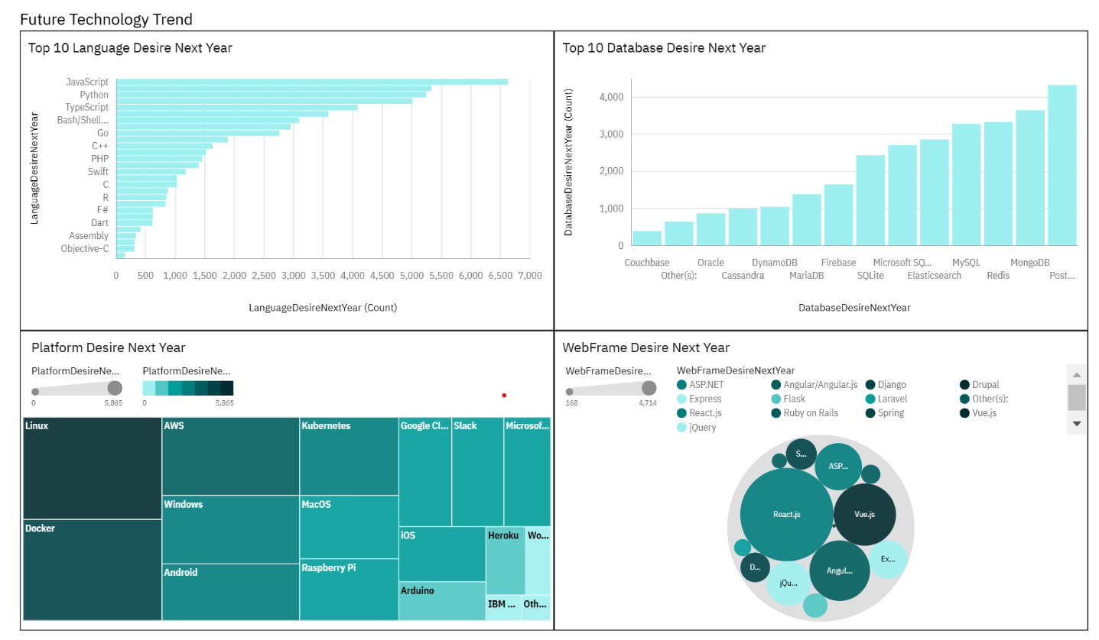
DASHBOARD TAB 2
Screenshot of dashboard tab 2 goes here

Slide 13
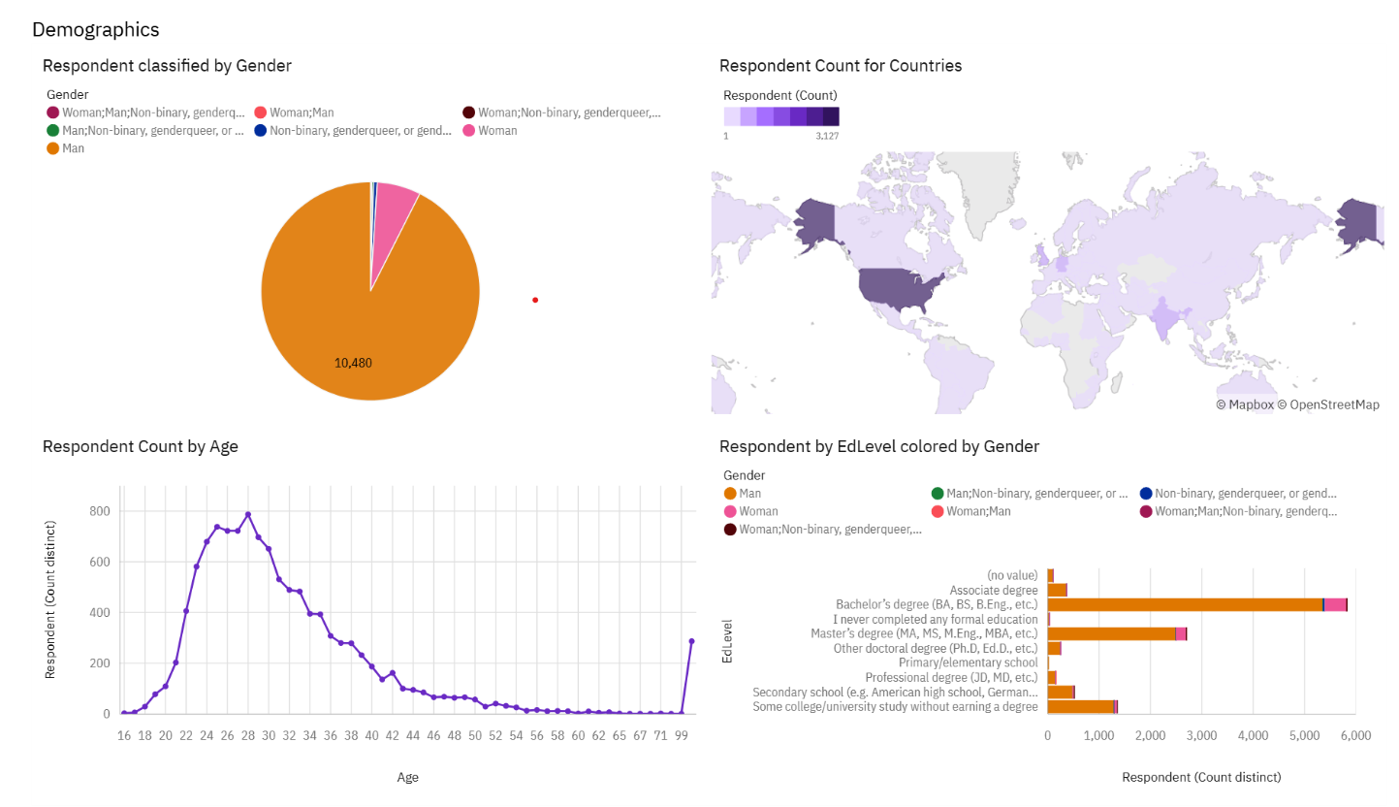
DASHBOARD TAB 3
Screenshot of dashboard tab 3 goes here

Slide 14
DISCUSSION
Widespread Technology development.
More women into workforce
Upskill to stay relevant
Bridge technology gaps among different parts of the world
Is Master and doctorate degree a must?

Slide 15
OVERALL FINDINGS & IMPLICATIONS
Findings
Most people only have a Bachelor's degree.
Technology changes in fast pace.
Tech sector consists mostly of young males.
Implications
Developing and less developed countries need more attention
Upskilling and postgraduates should be concentrated
Companies should keep up with the fast changing technologies.

Slide 16

CONCLUSION
ML, AI technologies are currently gaining traction and the languages supporting will become popular in future.
Developers are eager to learn new technologies which is good sign
Job markets should be expanded to developing countries
More women should be employed in Tech sector.

Slide 17

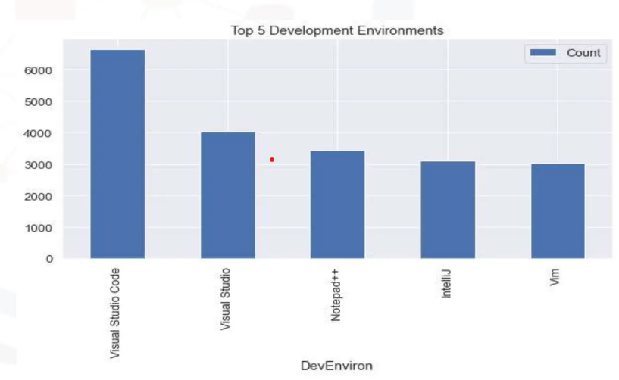
APPENDIX
Include any relevant additional charts, or tables that you may have created during the analysis phase.

Slide 18
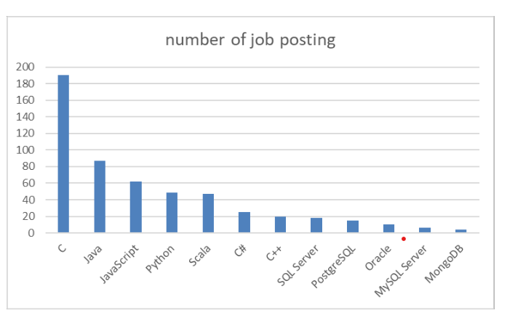
JOB POSTINGS
In Module 1 you have collected the job posting data using Job API in a file named “job-postings.xlsx”. Present that data using a bar chart here. Order the bar chart in the descending order of the number of job postings.

Slide 19
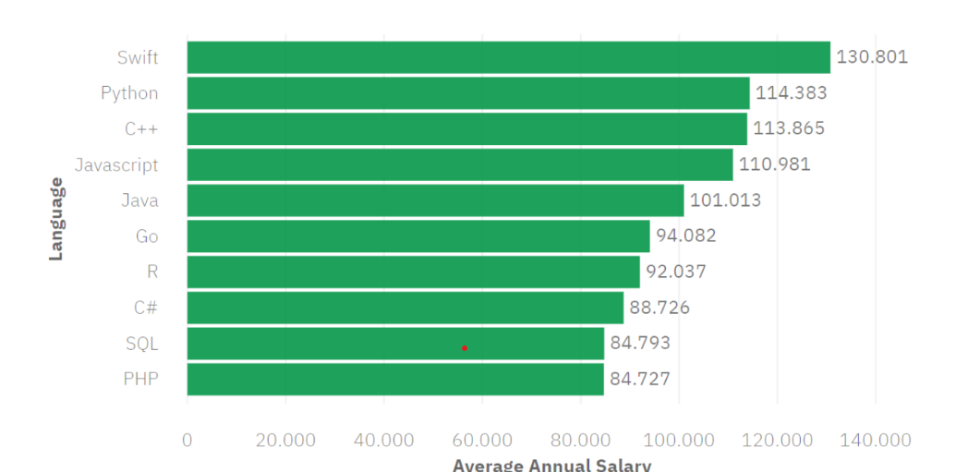
POPULAR LANGUAGES
In Module 1 you have collected the job postings data using web scraping in a file named “popular-languages.csv”. Present that data using a bar chart here. Order the bar chart in the descending order of salary.

