Slide 1




Ayyapa Best Price Supermarket: Empowering Retail Growth through Data-Driven Insights
BDM Capstone Project
Indian Institiute of Madras
Presented by : Sai Reshmitha Ponnaganti
Roll No:23F3004280

Slide 2


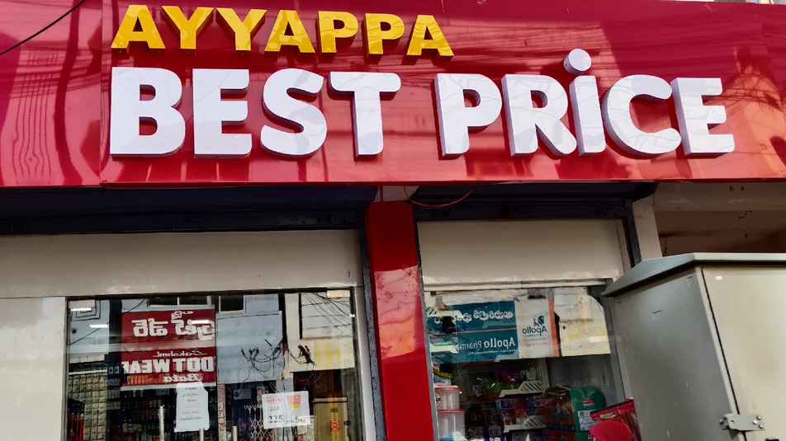

Overview
Ayyapa Best Price Supermarket, established on February 23rd, 2020, is a retail store committed to providing customers with quality products at competitive prices. The supermarket operates on a value-driven model, offering a standard 5% discount on MRP across essential categories such as groceries, household items, personal care, and medicines. Since its launch, the store has steadily built customer trust through affordability, reliable service, and consistent product availability. With growing footfall and expanding product lines, Ayyapa Best Price Supermarket aims to strengthen its market presence by adopting data-driven decision-making to optimize inventory, enhance customer satisfaction, and improve overall business efficiency.

Slide 3

Problem Statement
Despite offering competitive pricing and a consistent 5% discount on MRPs, Ayyapa Best Price Supermarket faces challenges in optimizing inventory, understanding customer purchasing patterns, and managing seasonal demand fluctuations. Limited data-driven decision-making has led to occasional stockouts, overstocking in slow-moving categories, and reduced profitability. To sustain growth and improve operational efficiency, the supermarket requires a comprehensive data analysis approach to identify sales trends, forecast demand, streamline inventory, and enhance customer satisfaction. The goal is to leverage data insights to support informed, strategic decisions that drive retail performance and long-term business sustainability.

Slide 4
Dataset Used
a
The dataset includes transaction records collected at the supermarket, containing fields such as:
Date of Purchase
Product Category (Staples, Beverages, Personal Care, Dairy, etc.)
Product Name
Quantity Purchased
Price per Unit
Total Price
Customer/Flat Number
This data reflects real sales patterns, enabling analysis of customer behavior, top-selling items, seasonal demand, and revenue trends.

Slide 5
Methodology
Collect and organize sales data from supermarket transactions.
Clean the data by removing errors, duplicates, and missing values.
Convert dates, quantities, and prices into proper analytical formats.
Perform exploratory data analysis (EDA) to identify sales trends and patterns.
Analyze product-wise and category-wise performance.
Visualize monthly, seasonal, and customer purchase trends using charts.
Interpret insights to understand demand fluctuations and inventory gaps.
Provide data-driven recommendations for improving stock management and sales.

Slide 6
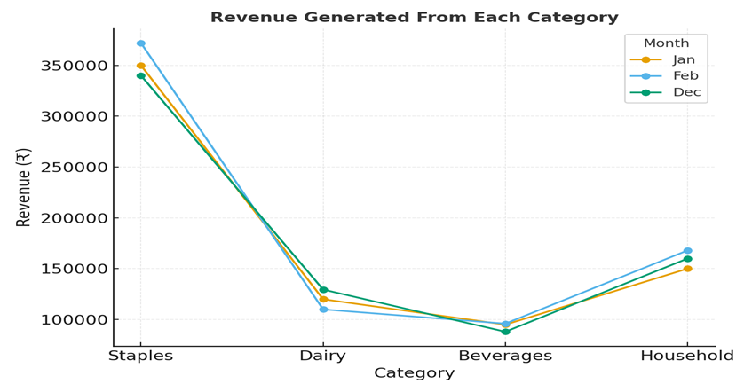
Analysis Method and Tools used
Analysis Methods
Data Cleaning & Preprocessing
Descriptive Analysis
Trend Analysis
Category-wise Analysis
Customer Purchase Analysis
Visualization
Inventory Analysis
Actionable Insight Generation
Tools Used:
Google Sheets – for data entry, cleaning, and basic analysis

Slide 7
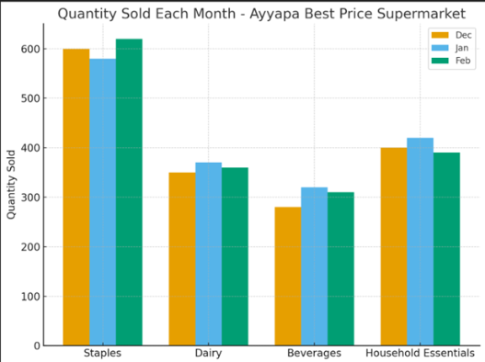
Results and Fidings
Staples and essentials generated the highest sales, with fast-moving items showing steady monthly demand.
Festival seasons caused clear spikes in sales, especially for beverages and personal care items.
Slow-moving products led to overstocking, showing the need for better inventory control.
Repeat purchases showed strong customer loyalty, but stockouts in key items highlight poor demand forecasting.

Slide 8
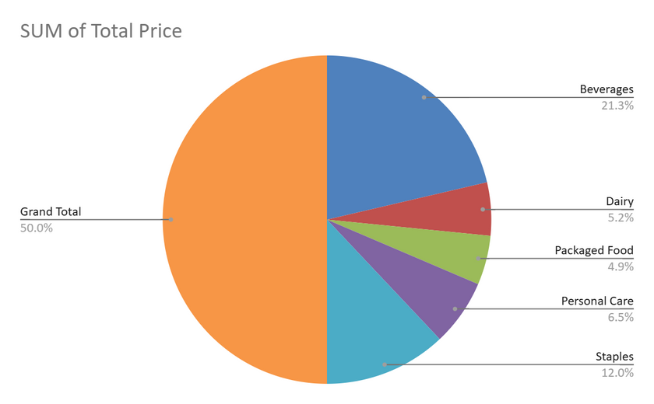
Insights and Recommendations
Analysis Methods
Staples generate the highest sales, while slow-moving items affect inventory efficiency.
Festival seasons increase demand, but essential items face stockouts.
Tools Used:
Keep higher stock of fast-moving items and limit slow-moving purchases.
Use demand forecasting and offer festival-based promotions to boost sales.

Slide 9
Conclusion
The analysis of Ayyapa Best Price Supermarket highlights the importance of data-driven decision-making for improving sales and inventory efficiency. Staples continue to dominate customer demand, while seasonal trends create predictable fluctuations. Addressing stockouts, reducing slow-moving items, and implementing simple forecasting methods can significantly enhance overall performance. With informed planning and targeted strategies, the supermarket can optimize operations, improve customer satisfaction, and support sustainable business growth.

Slide 10
Thank You
Sai Reshmitha Ponnaganti
Roll No:23F3004280
23f3004280@ds.study.iitm.ac.in

