Slide 1

Attune
Group Number : 3 (Panel - 4)
Members : Ayan Koche (111915022)
Parag Jaiswal (11916032)
Rohit Sonkusare (111916037)
Guided By : 1) Dr. Rahul Dixit
2) Dr. Sushant Kumar

Slide 2
Outline
Introduction
Motivation
Literature Survey
Research Gap
Objective
Methodology
Results and Discussion
Conclusion and Future works
References

Slide 3
Introduction
Attune is a music recognition app which can run on any operating system be it Android or IOS. It listens to an audio clip and recognises the song. Attune quickly turns your clip into an audio fingerprint and searches in the database, and if the song is recognised, it’s displayed.
Eureka!!!

Slide 4
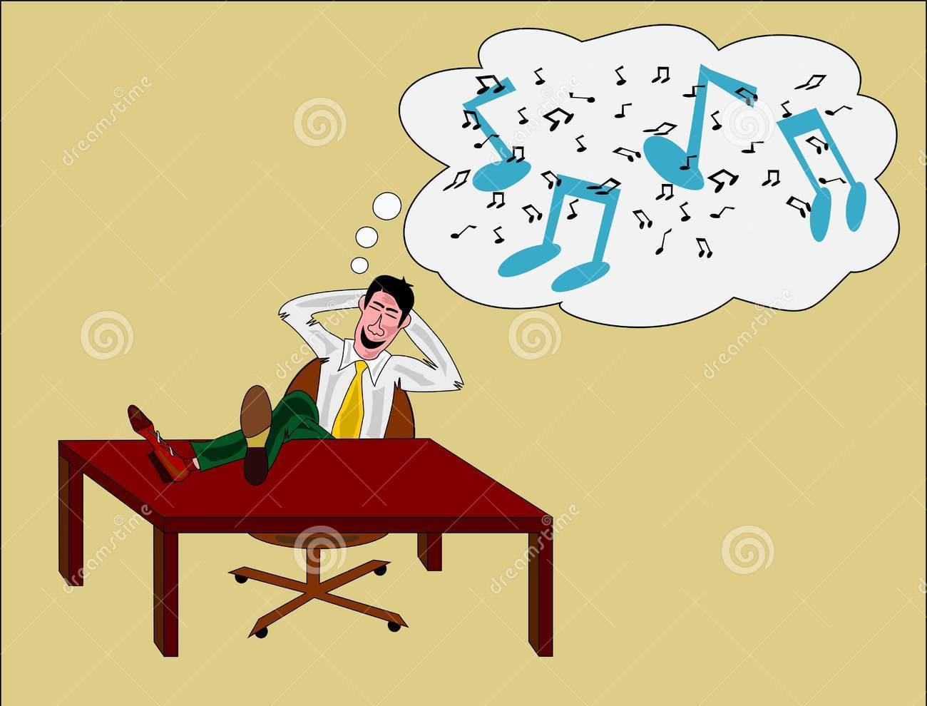
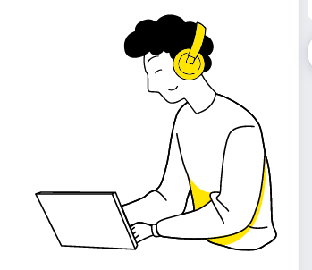
Motivation
Sometimes, a song stucks in our mind but we are not able to completely recognise the song even though we have heard it a lot many times. Or sometimes when we are at a party and a song plays . And we want to know what song it is.
So how are we supposed to find it?

Slide 5


Wouldn’t it be much better if we could make our phone recognise a song just by hearing a small verse of it??

Slide 6
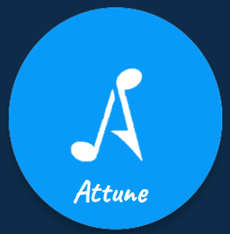

Slide 7
Literature Survey
Shazam Entertainment Ltd. developed an application that recognises music around you.
Snapchat also provides a music recognition service and uses shazam service for this purpose.
SoundHound is also a similar application and provides speech recognition service.

Slide 8
Research Gap
The Shazam algorithm was designed specifically to target recognition of sound files that are already present in the database. It is not expected to generalize to live recordings.
The algorithm is conversely very sensitive to which particular version of a track has been sampled.
There are many reports of false positives. Often times It is found that the algorithm was not actually wrong since it had picked up an example of “sampling,” or plagiarism.
Applications like Snapchat are not completely dedicated to music recognition.

Slide 9
Objective
The primary purpose of our project is to identify songs by the tune. All you have to do is to play the song and, the app will find it in couple of seconds.
As a user,if someone wants to listen to a song once heard without knowing the actual title just by playing some part of it.
If someone wants to identify a song playing around ,just by clicking a button.

Slide 10
Methodology
To start recognition process, Attune button will be pressed by user.
Attune listens to a song clip provided by the user.
The App generates an unique fingerprint for that clip .
The application uploads the fingerprint to Attune’s service that runs a search for a corresponding fingerprint in database.
If a match is found, a user gets the information on the song he is interested in; otherwise he will be informed that the song wasn’t found.

Slide 11
Analysis And Design
We have developed this application in a flutter environment that makes it compatible with Web, Android and even IOS.
Flutter provides the User Interface(UI) of the application.
We are using Deezer API for the songs. We have parsed the JSON type API into Dart which is the language we are using primarily.
The Deezer API provides us with the availability of songs from which our app will be searching for the desired song.
We have added our project at ACRCloud console. The ACRCloud console provides us with audio recognition features.

Slide 12
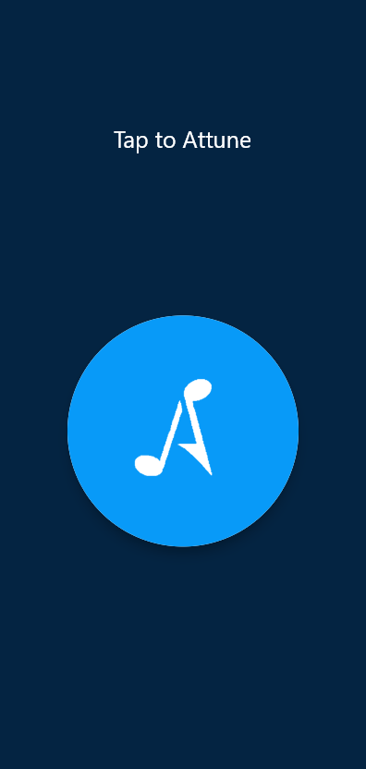
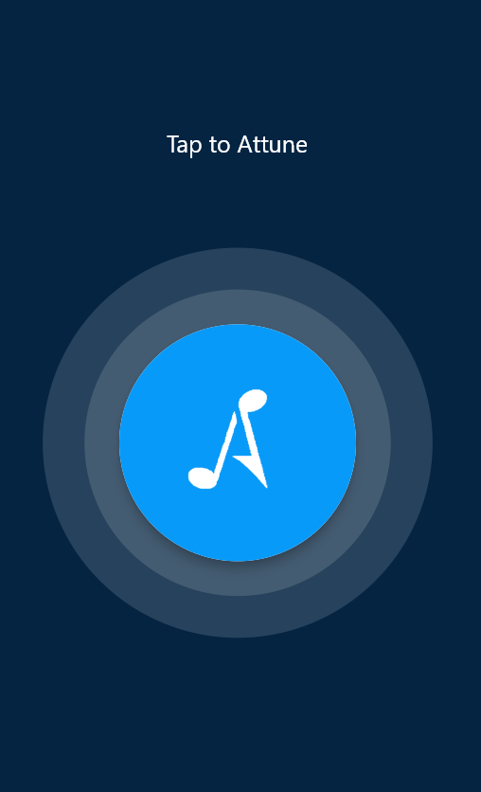

Slide 13
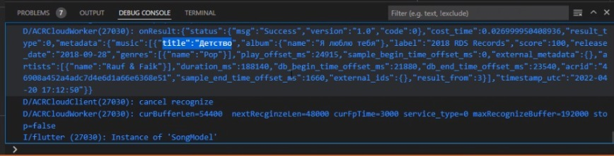
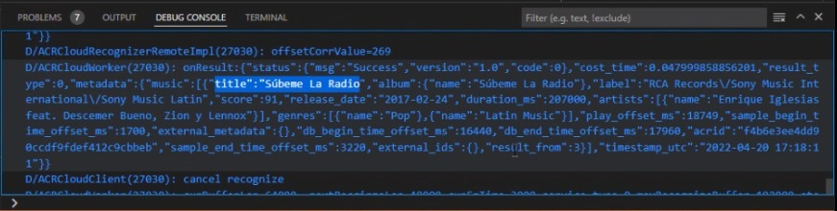

Slide 14
Conclusion
Thus, in this project we have successfully created an application which can recognize the music based on any external music as an input to the application.
Through Deezer API we have provided users with the wide availability of songs from which our app will be searching for the desired song.
Our application will be very handy in the situation described previously. It will be handy when we are in a cafe, restaurant, gym or any party house. Also it will help those reels lover to know the track title of trending reels.

Slide 15
References
An Industrial-Strength Audio Search Algorithm
Avery Li-Chun Wang and Julius O. Smith, III., WIPO publication WO 02/11123A2, 7 February 2002,
Cheng Yang, “MACS: Music Audio Characteristic Sequence Indexing For Similarity Retrieval”, in IEEE Workshop on Applications of Signal Processing to Audio and Acoustics, 2001
Erling Wold, Thom Blum, Douglas Keislar, James Wheaton, “Content-Based Classification, Search, and Retrieval of Audio”, in IEEE Multimedia, Vol. 3, No. 3: FALL 1996, pp. 27-36
Jaap Haitsma, Antonius Kalker, “A Highly Robust Audio Fingerprinting System”, International Symposium on Music Information Retrieval (ISMIR) 2002, pp. 107-115

Slide 16

THANK YOU!!!

