Slide 1
01
Introduction to create a 5 slide ppt on AI
Understanding create a 5 slide ppt on AI and its importance.

Slide 2
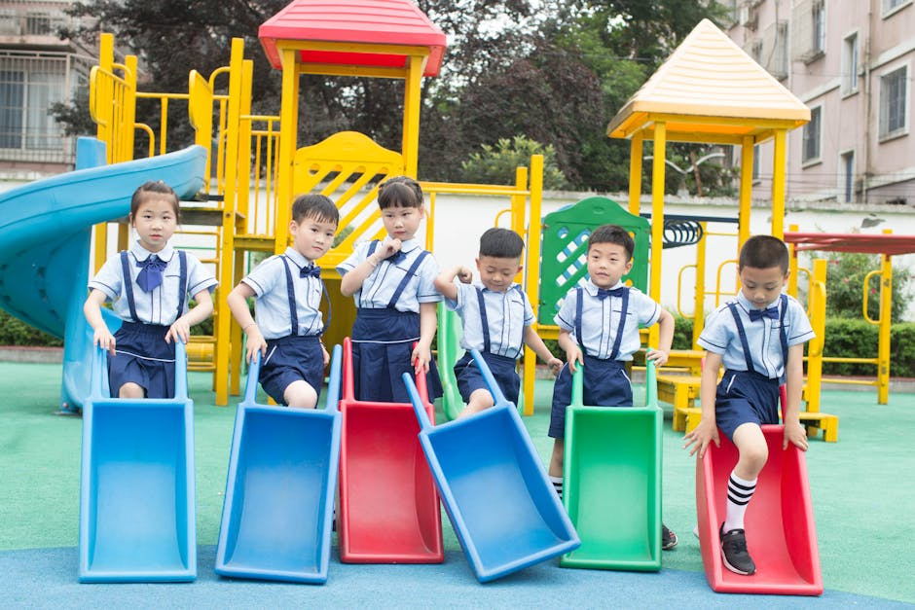
Background: What is create a 5 slide ppt on AI?
2/5
Defining create a 5 slide ppt on AI and key terminology.
Historical context of create a 5 slide ppt on AI.
Why create a 5 slide ppt on AI is important today.

Slide 3

Core Aspects of create a 5 slide ppt on AI
3/5
Main principles and concepts within create a 5 slide ppt on AI.
How different elements of create a 5 slide ppt on AI work together.
Building blocks and foundational ideas.

Slide 4

Practical Applications of create a 5 slide ppt on AI
4/5
Real-world examples of create a 5 slide ppt on AI in action.
How create a 5 slide ppt on AI impacts science, society, or technology.
Case studies and interesting discoveries.

Slide 5
05
Summary: Key Takeaways on create a 5 slide ppt on AI
Most important points about create a 5 slide ppt on AI.

