Slide 1
create a 5 slide ppt on solar system
An introduction to the topic. · Key concepts covered in this presentation. · What you will learn today.

Slide 2
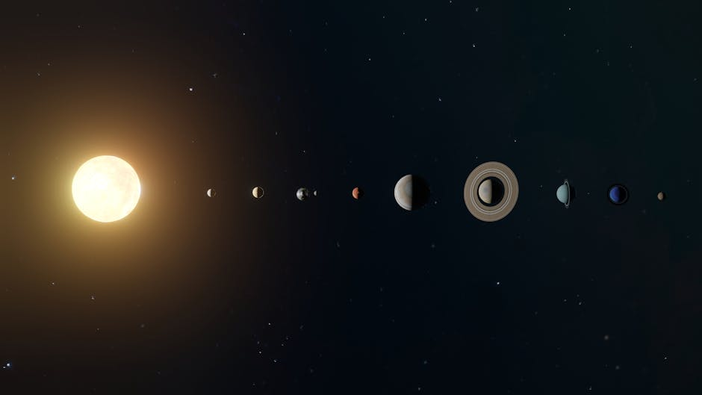
Background & Context
2
Understanding the foundations of this topic.
Historical development and key milestones.
Why this topic is important today.

Slide 3
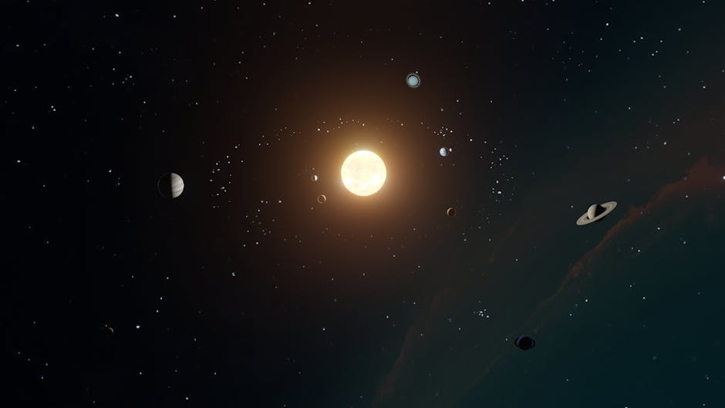
Core Concepts
3
The main ideas and principles involved.
Important terminology and definitions.
How the components interact with each other.

Slide 4
Real-World Applications
4
Practical examples from everyday life.
How this topic affects science and technology.
Case studies and interesting discoveries.

Slide 5
Summary & Key Takeaways
Review of the most important points covered. · Questions to think about going forward. · Thank you for your attention!

