Slide 1
create a 5 slide ppt on solar system
An introduction to the topic.

Slide 2

Background & Context
Understanding the foundations of this topic.
Historical development and key milestones.
Why this topic is important today.
02

Slide 3

Core Concepts
The main ideas and principles involved.
Important terminology and definitions.
How the components interact with each other.
03

Slide 4
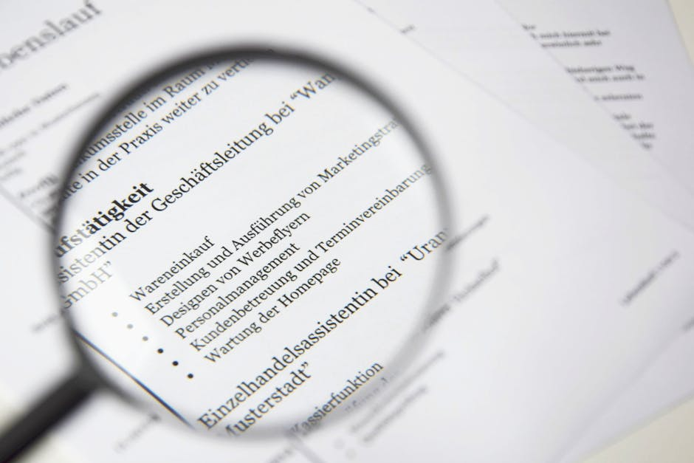
Real-World Applications
Practical examples from everyday life.
How this topic affects science and technology.
Case studies and interesting discoveries.
04

Slide 5

Summary & Key Takeaways
Review of the most important points covered.

