Slide 1
Introduction to plants
· Understanding plants and its importance. · Key concepts and core principles. · What you will learn in this presentation. ·

Slide 2

Background: What is plants?
2
Defining plants and key terminology.
Historical context of plants.
Why plants is important today.

Slide 3
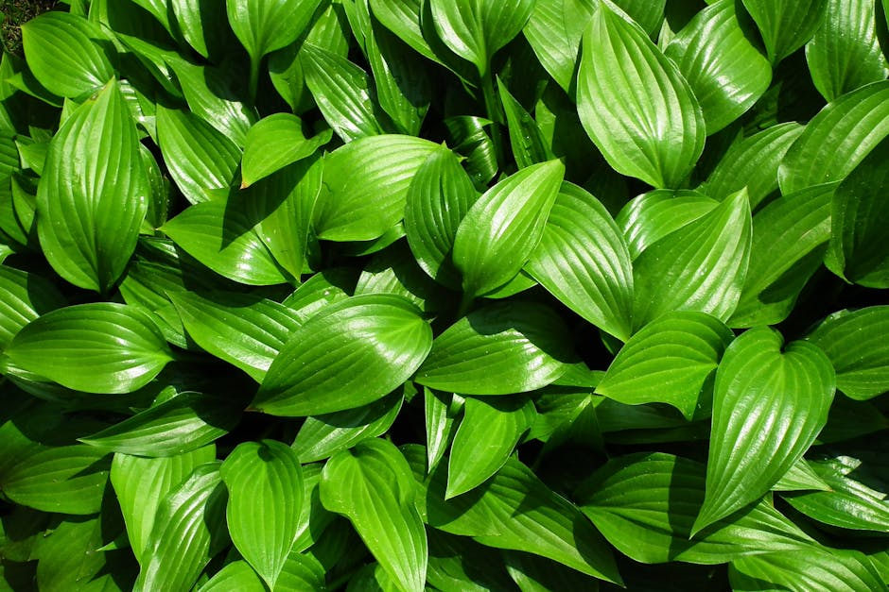
Core Aspects of plants
3
Main principles and concepts within plants.
How different elements of plants work together.
Building blocks and foundational ideas.

Slide 4
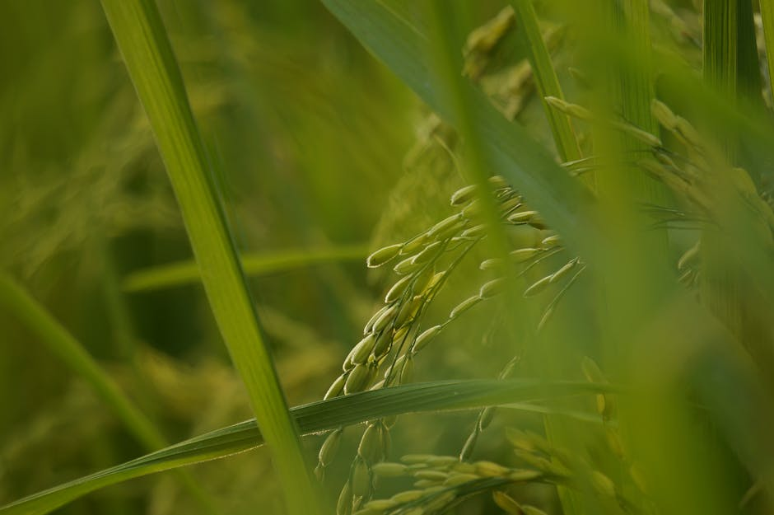
Practical Applications of plants
4
Real-world examples of plants in action.
How plants impacts science, society, or technology.
Case studies and interesting discoveries.

Slide 5

Summary: Key Takeaways on plants
· Most important points about plants. · Quick review of what plants means. · Thank you for learning about this topic! ·

