Slide 1

A Survey of Monte Carlo Tree Search Methods

Slide 2
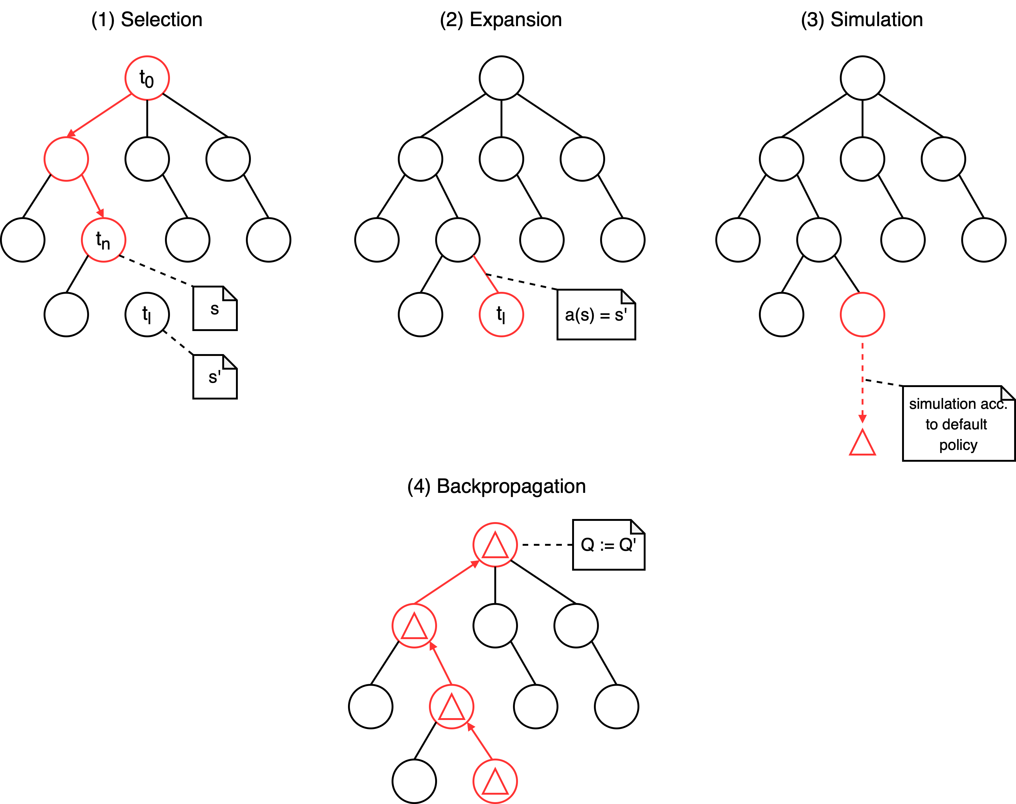
Monte Carlo Tree Search

Slide 3
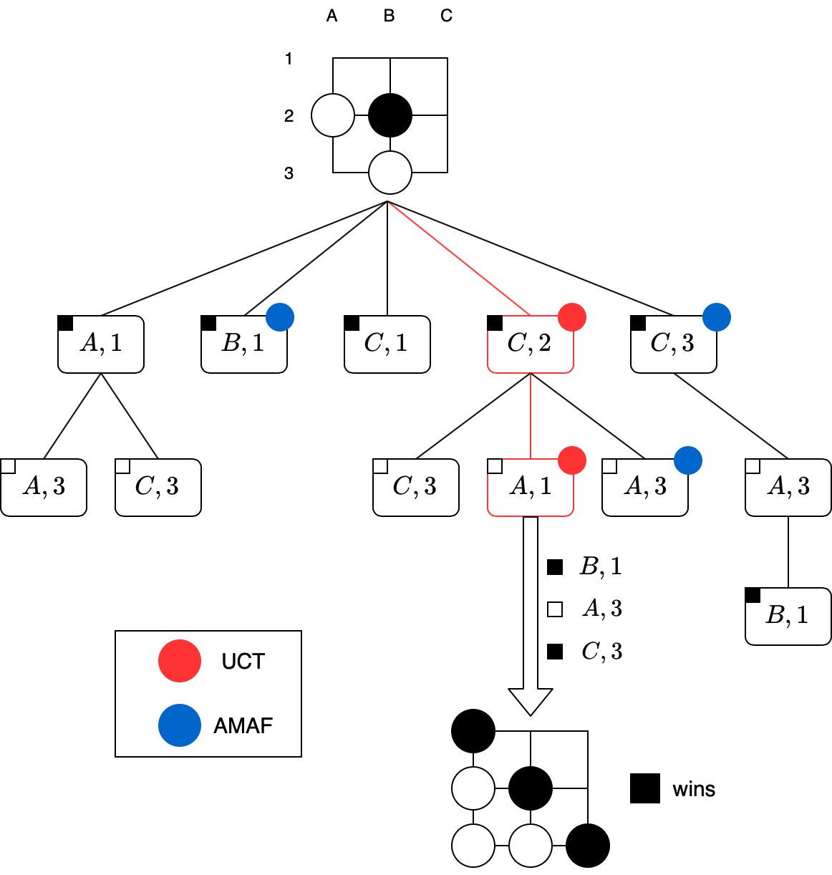
All Moves As First

Slide 4
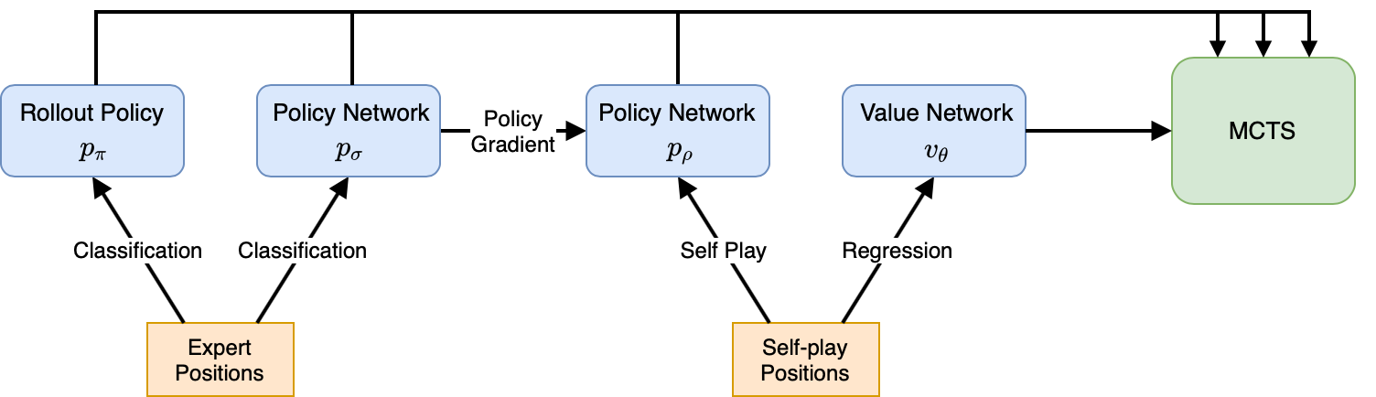
AlphaGo

Slide 5
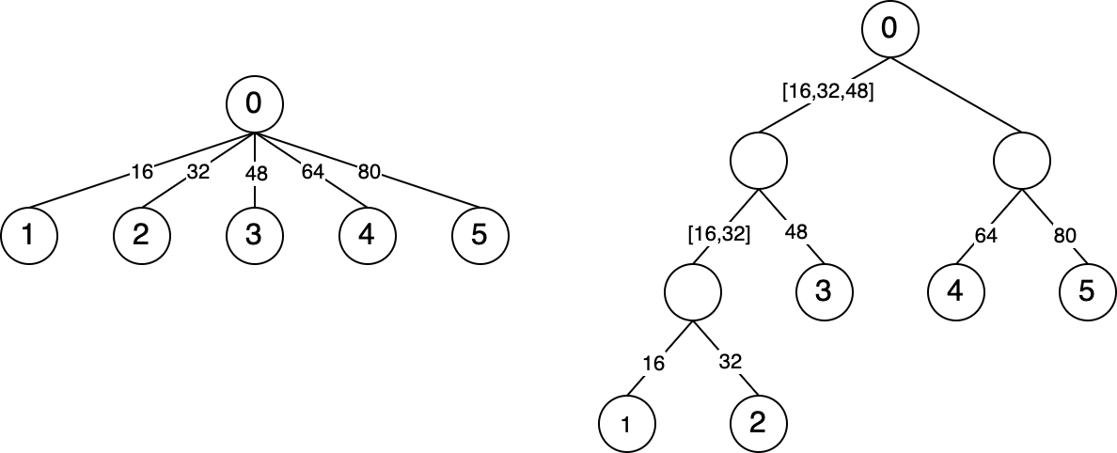
Deep Architect

Slide 6
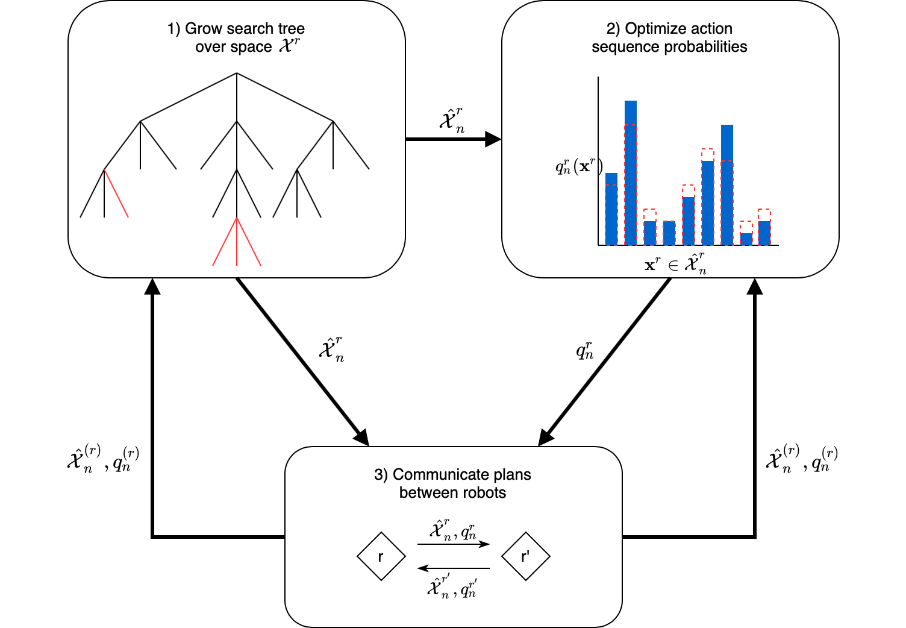
Dec-MCTS

Slide 7
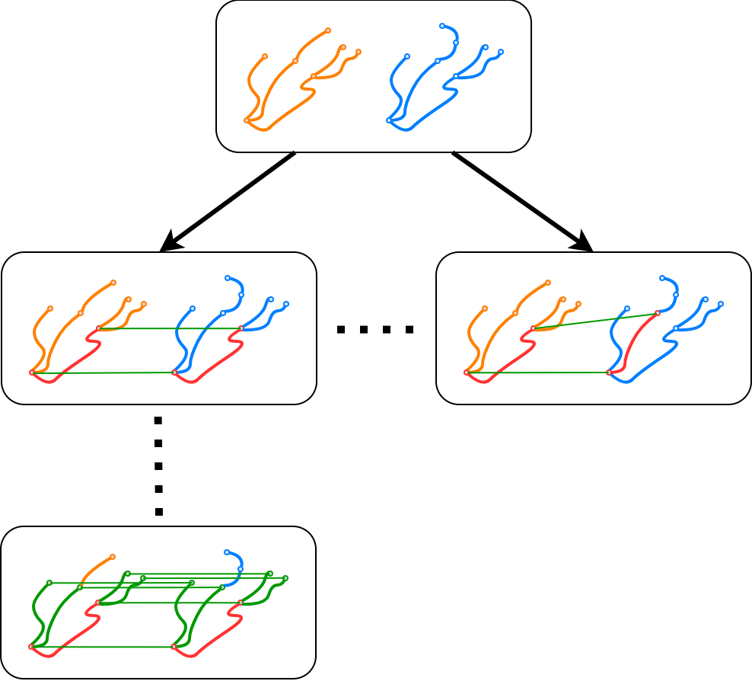
Geometrical Graph Matching

Slide 8
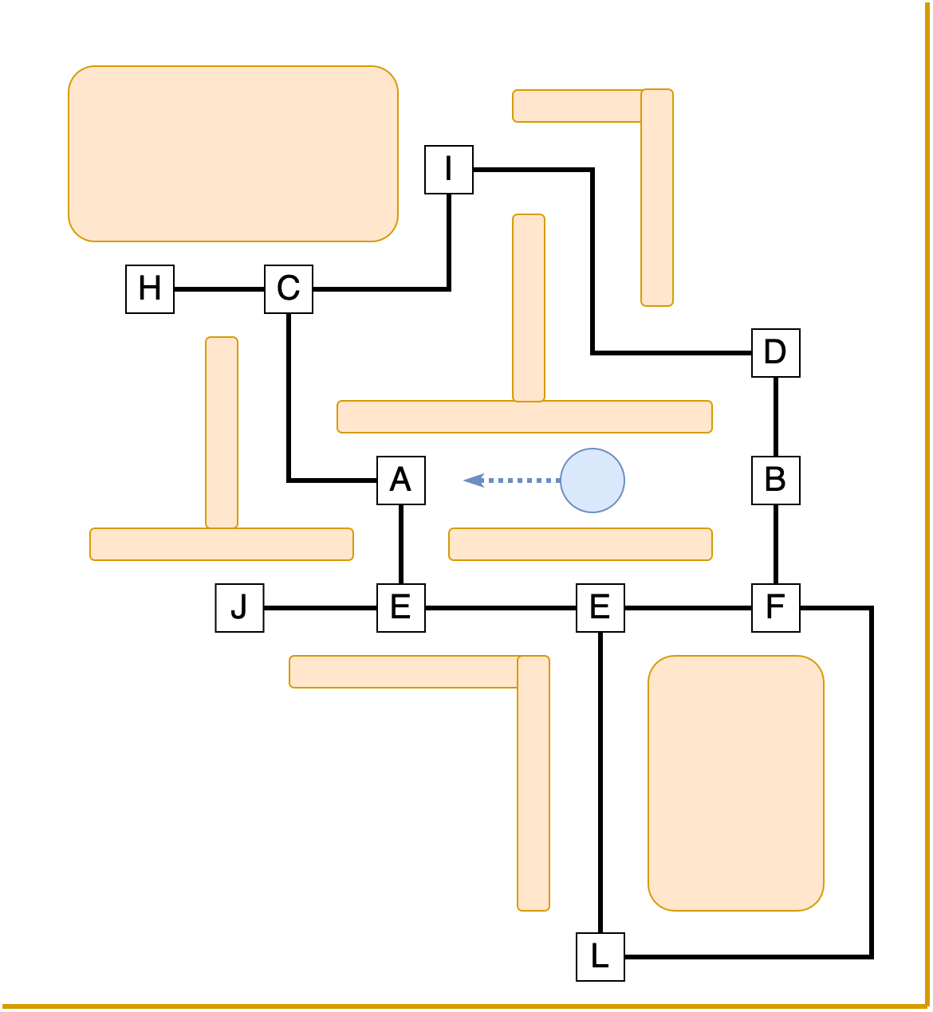
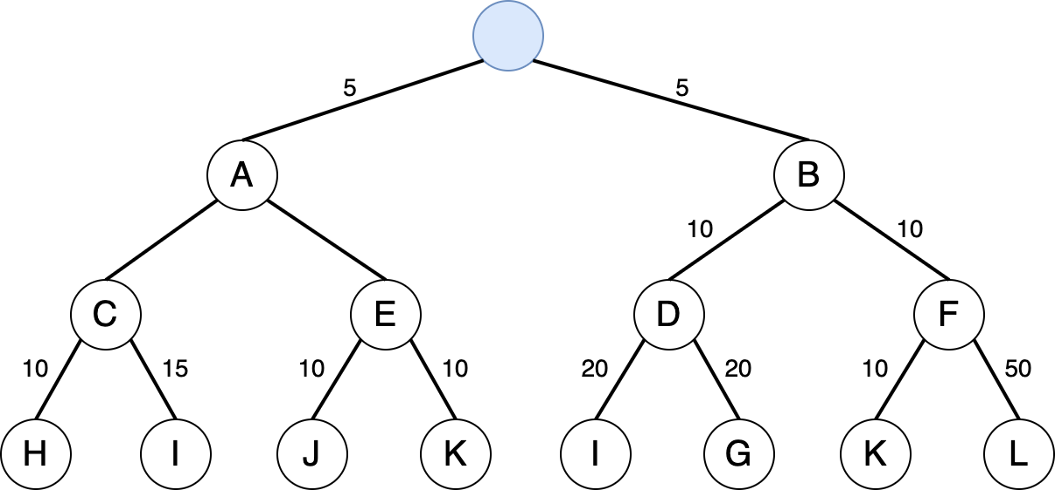
Ms Pacman

Slide 9
Zusammenfassung
Go…

