Slide 1
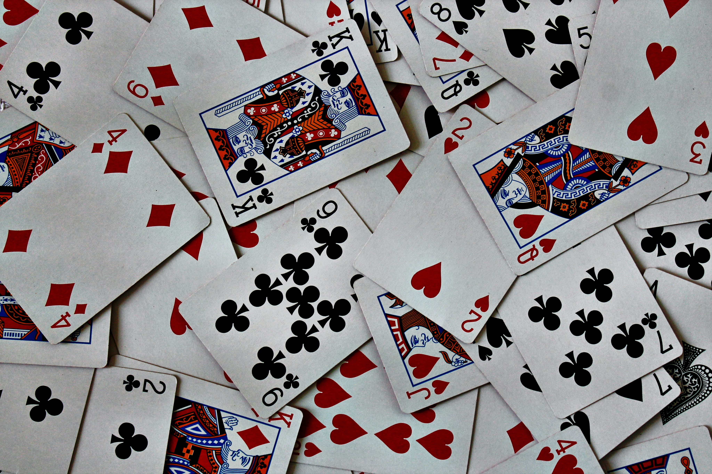
A Survey of Monte Carlo Tree Search Methods

Slide 2
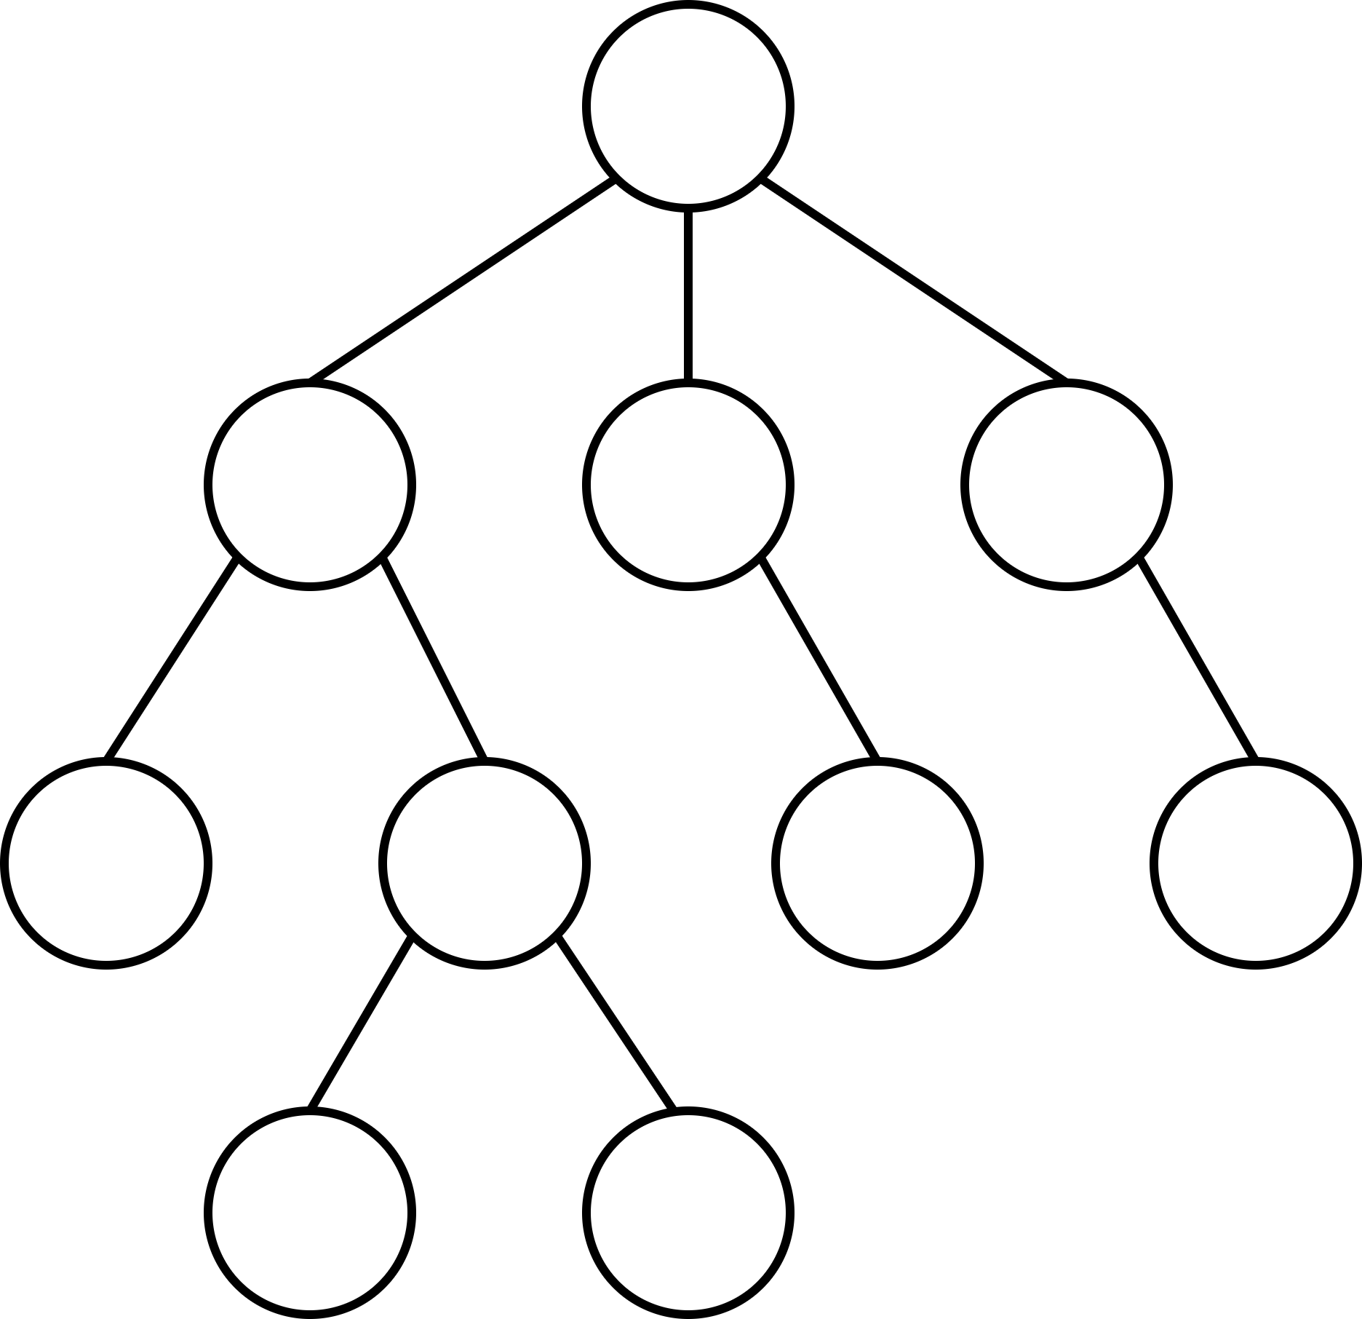
Introduction
Consider a game-playing agent
How to find good/best next move?
Game represented as a game tree
Nodes represent (subset of) states
Still too large to check all actions
TODO
Text
Don’t overthink the term “game”
Generally applicable search algorithm
state of game
(legal) action

Slide 3
Basics: Setting
s(v) – state s represented by node v
a(v) – incoming action a of node v
Q(v) – TODO of v
Formula for Q here
N(v) – number of times TODO of v
v
s(v)
a(v)
Q(v)
N(v)
v
a₀
a₁
a₂
v‘
v‘‘
v⁽³⁾

Slide 4
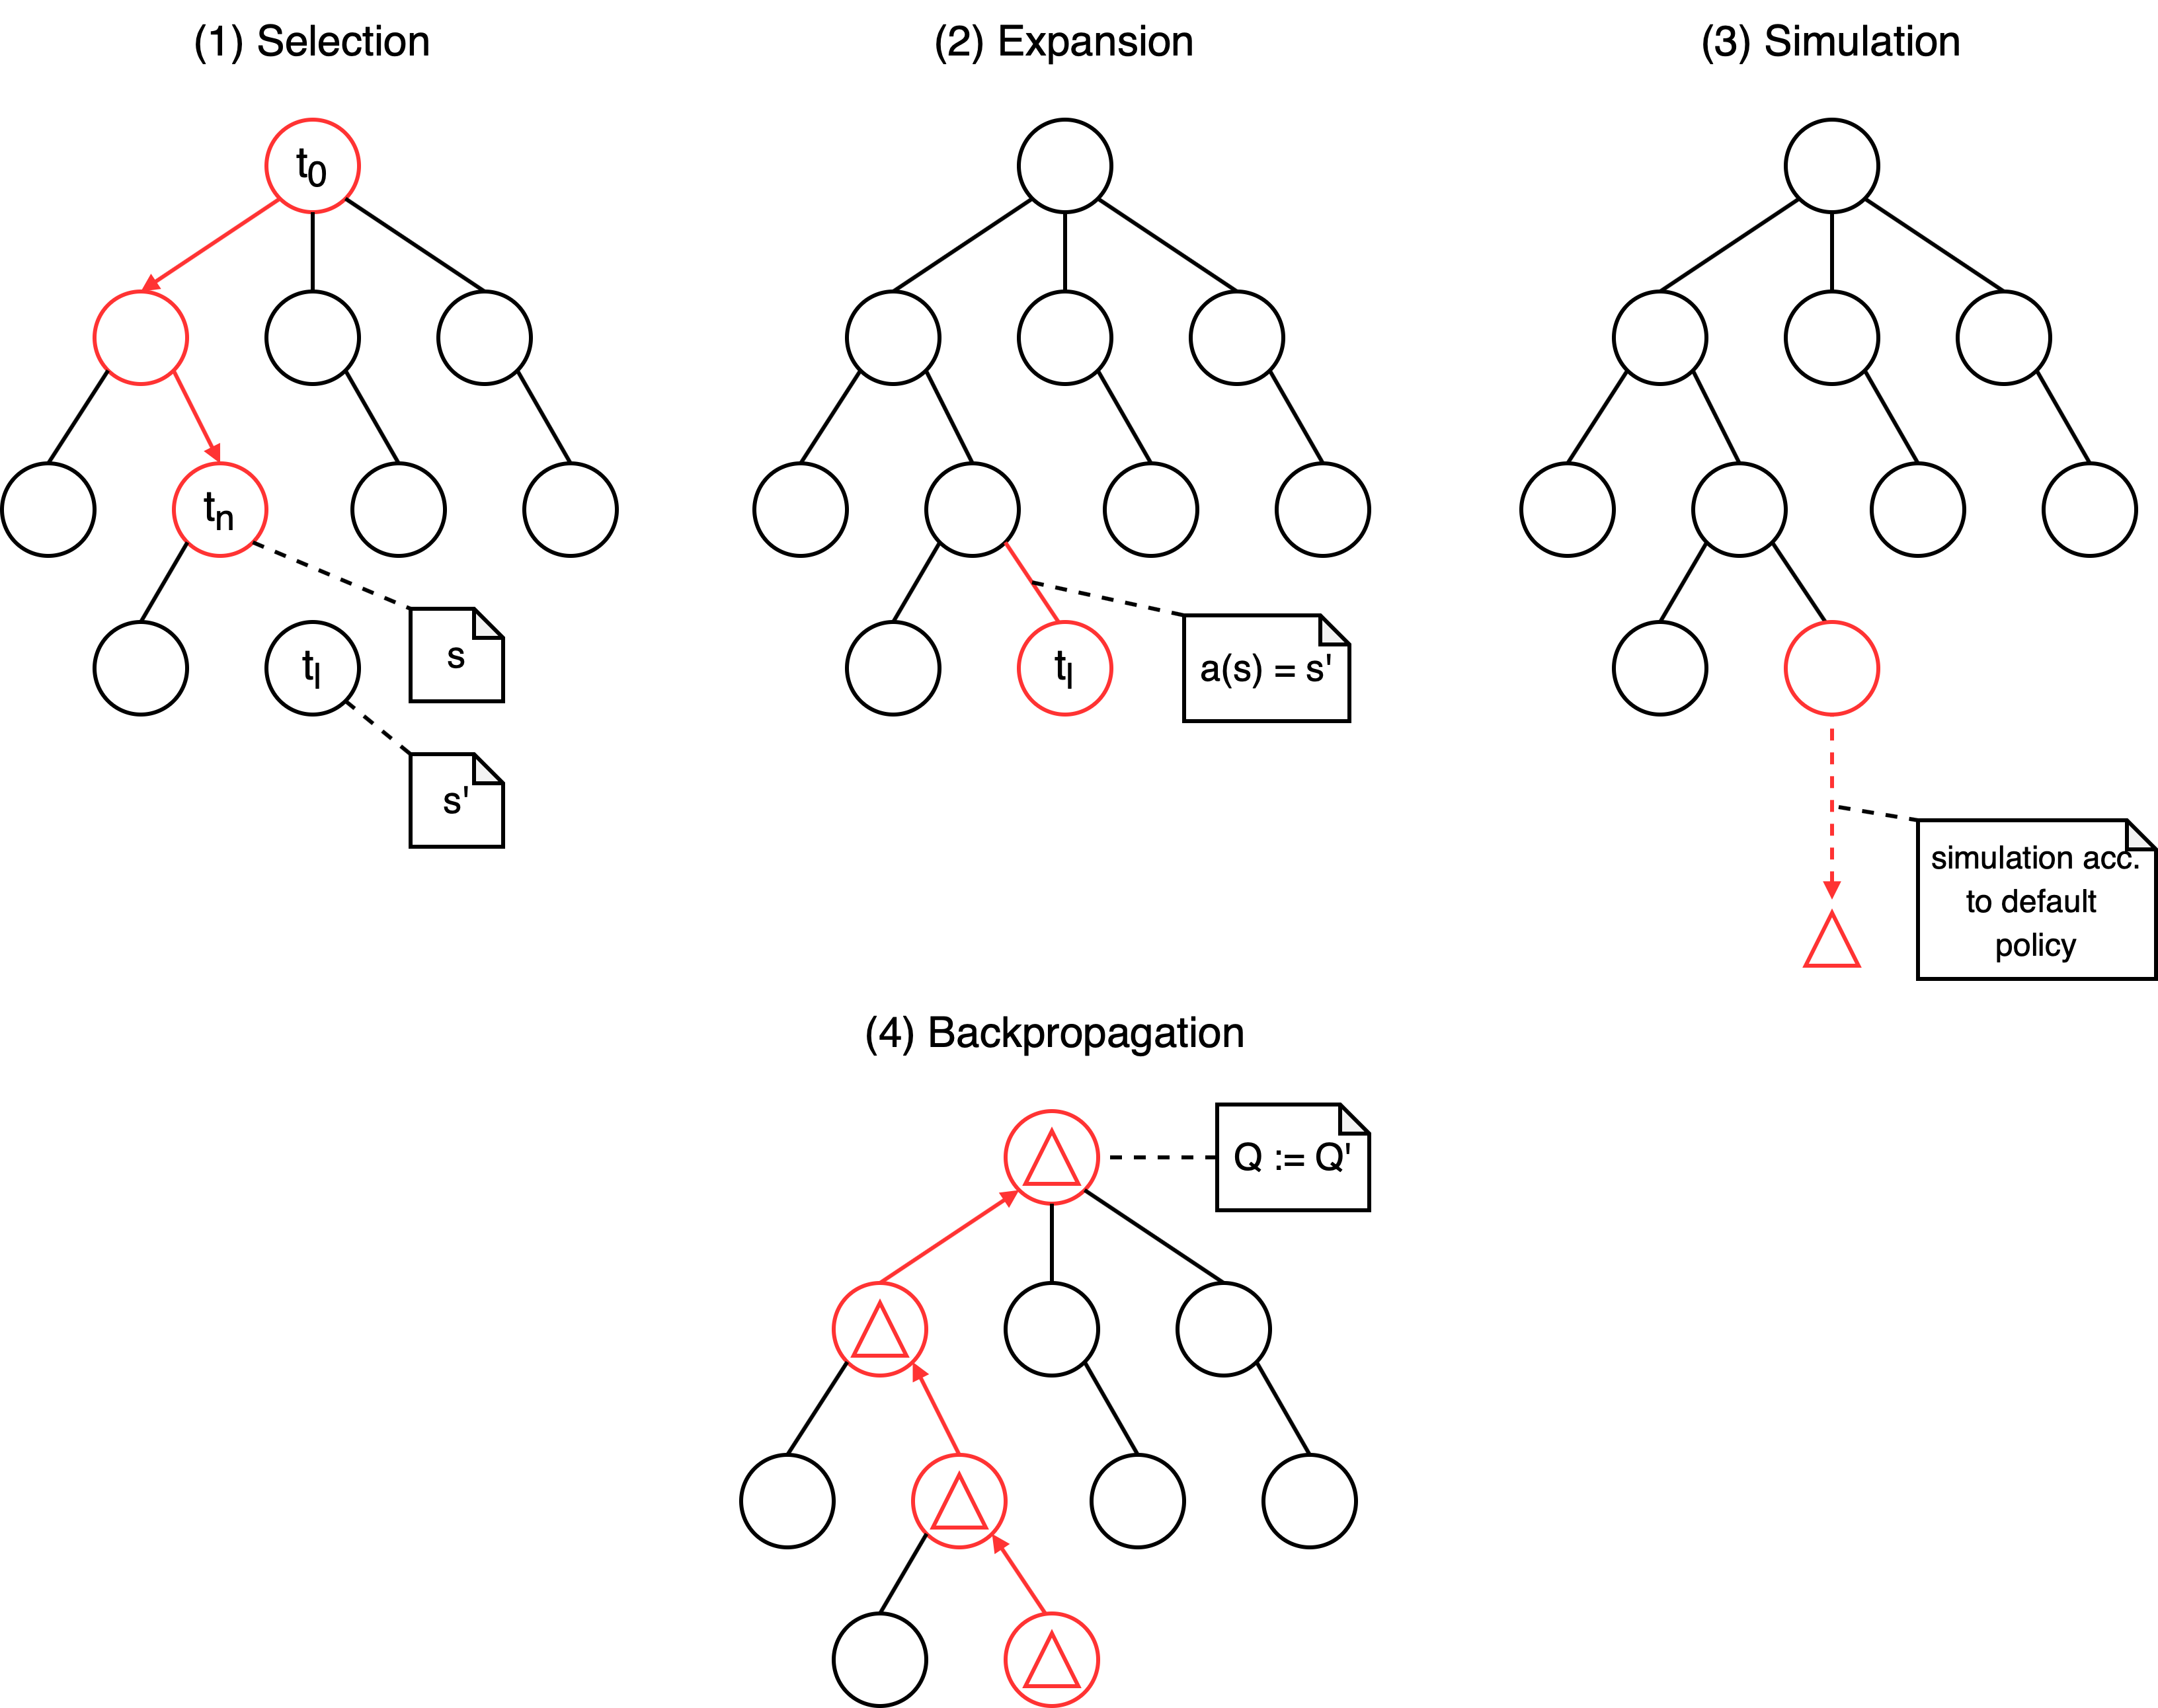
Basics: Monte Carlo Tree Search

Slide 5
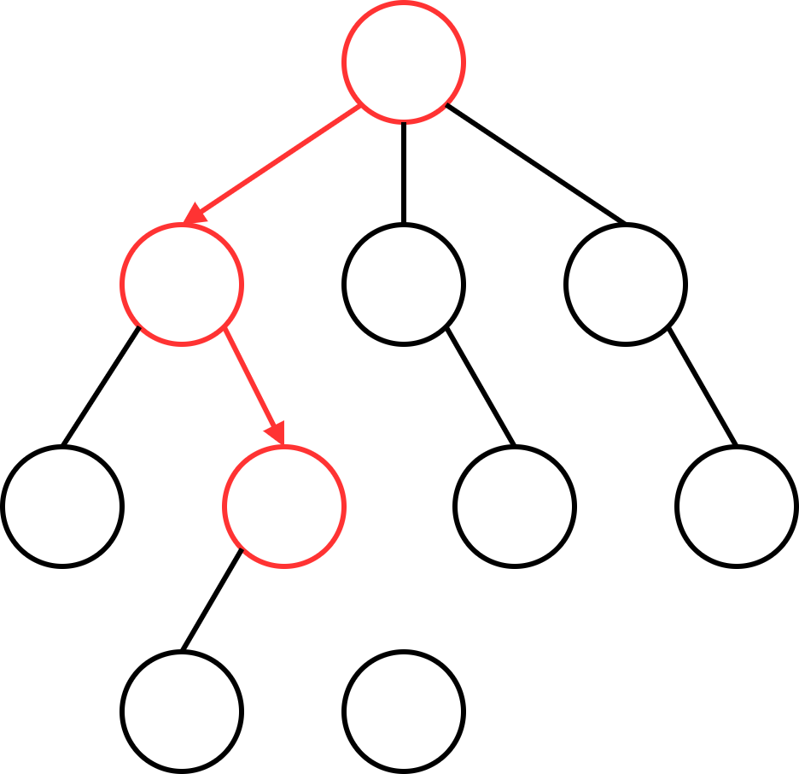
Basics: Monte Carlo Tree Search
First Step: Selection
Controlled by the Tree Policy
Transfer: Multi-Armed Bandit Problem
T-times: pick some action
collect associated reward
maximize total reward
Later: UCT

Slide 6
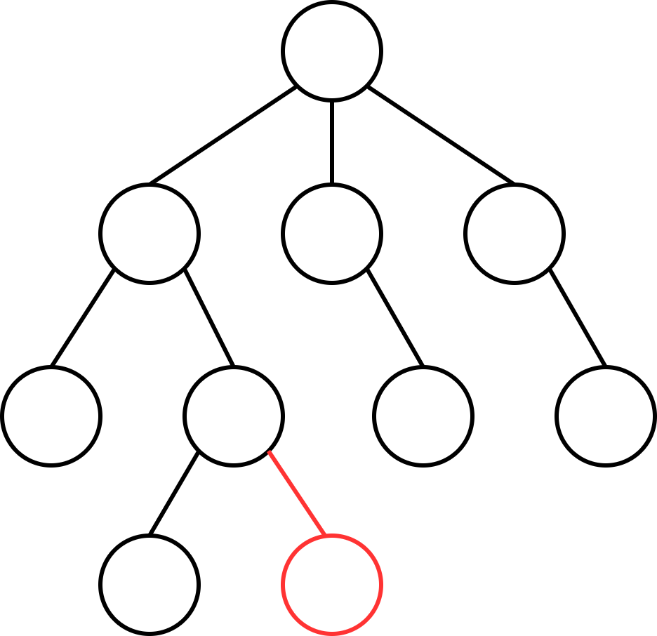
Basics: Monte Carlo Tree Search
Second Step: Expansion
Controlled by Tree Policy
Transfer: Multi-Armed Bandit Problem
T-times: pick some action
collect associated reward
maximize total reward
Later: UCT

Slide 7
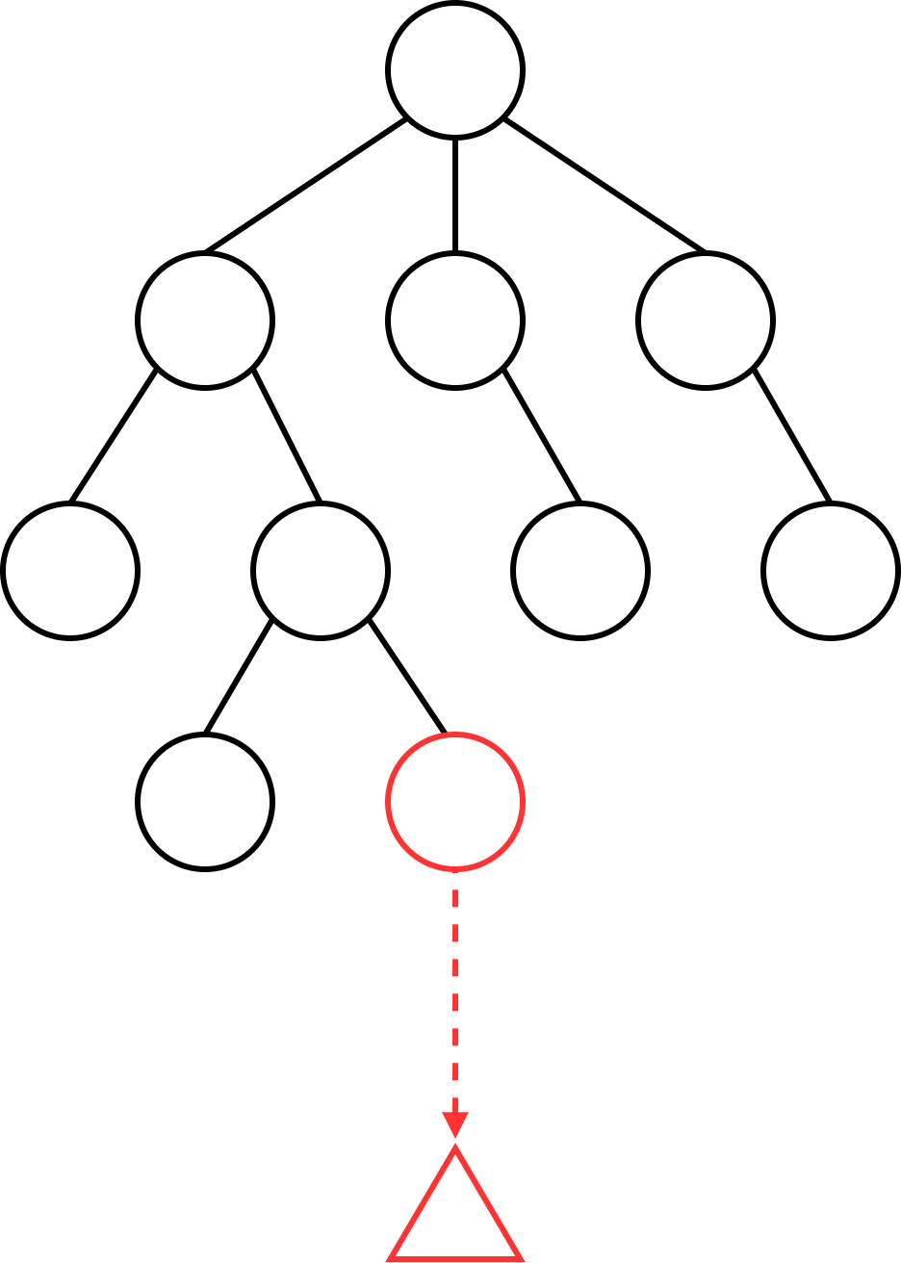
Basics: Monte Carlo Tree Search
Third Step: Simulation
Play out a game
i.e. execute actions until a terminal state is reached
evaluate result
Controlled by Default Policy
Details to consider:
speed vs. quality
complexity of evaluation function

Slide 8
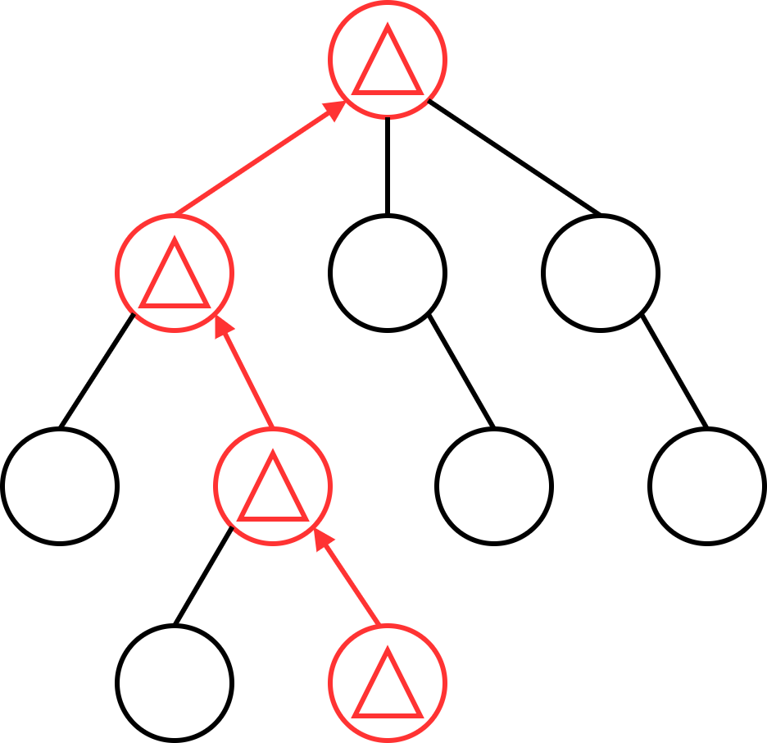
Basics: Monte Carlo Tree Search
Fourth Step: Backpropagation
Update values of
Q(v)
N(v)
Can be modified by heuristics
later - AMAF

Slide 9
Basics: Monte Carlo Tree Search
About iterations:
While the computation budget is not exhausted:
execute the four steps as many times as possible
Increase tree size and number of evaluated states
Finally, pick the best one
Time-constraints are crucial
real-time, turn-based games

Slide 10
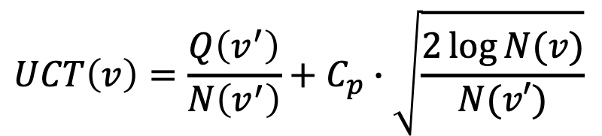
Basics: UCT
“Exploitation“
$$UCT\left(v\right)=\frac{Q\left(v^{′}\right)}{N\left(v^{′}\right)}+C_{p}∙\sqrt{\frac{2\log{N(v)}}{N(v′)}}$$
“Exploration“

Slide 11
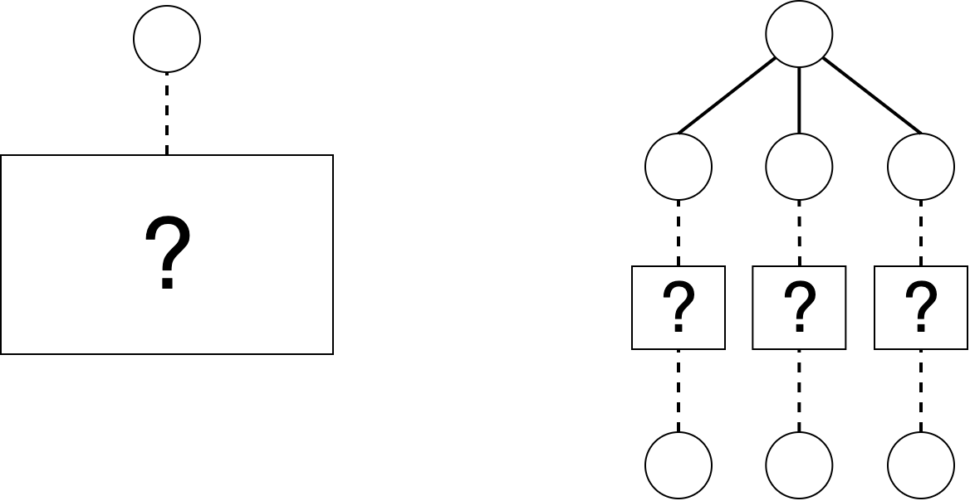

Heuristics: BFS-Tree Initialization
Before MCTS: execute each available root-action
Information gained can guide algorithm
$for a_{i}∈A_{0}: m × a_{i}$

Slide 12
Heuristics: Loss Avoidance
Ignore negative results when encountering new nodes

Slide 13
Heuristics: Novelty-based Pruning
Define a novelty measure nov(v), all nodes below a threshold are pruned

Slide 14
Heuristics: Knowledge-based Evaluations
Use A* and knowledge of the game to consider the distance to interesting objects

Slide 15
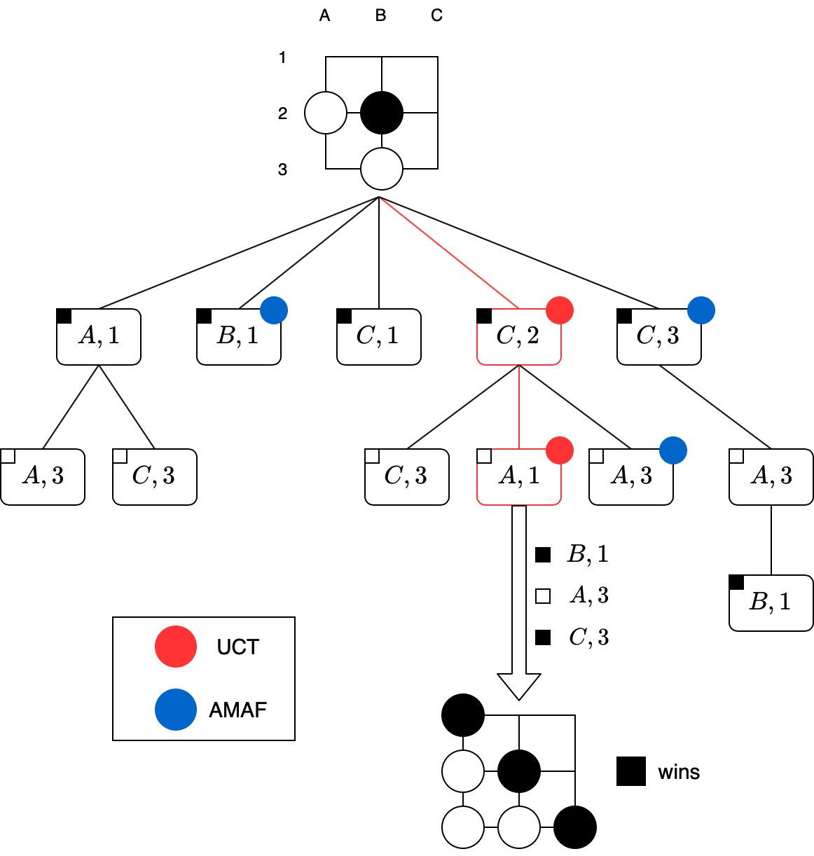
Heuristics: All Moves As First

Slide 16
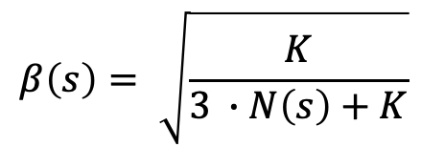
Heuristics: All Moves As First
$$AMAF\left(s,a\right)=β\left(s\right)∙Q\left(s,a\right)+\left(1−β\left(s\right)\right)∙AMAF(s^{′},a)$$
$$β\left(s\right)= \sqrt{\frac{K}{3 ∙N\left(s\right)+K}}$$
where

Slide 17
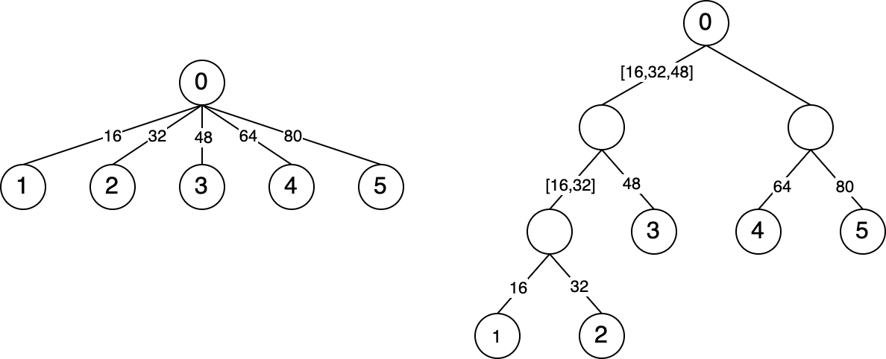
Extension: Tree Compression
Control size and width of tree when there are many paths
Binary-search
Inspired by: Deep Architect

Slide 18
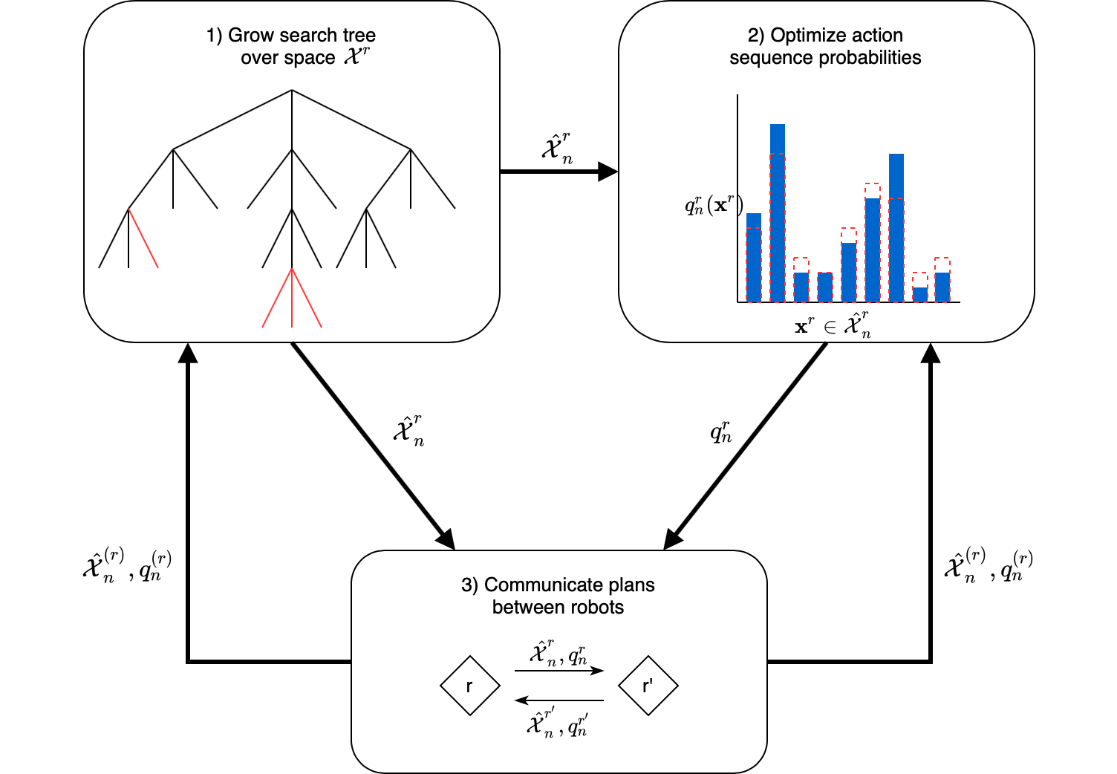
Applications: Dec-MCTS

Slide 19
Applications: Evolutionary Algorithms

Slide 20
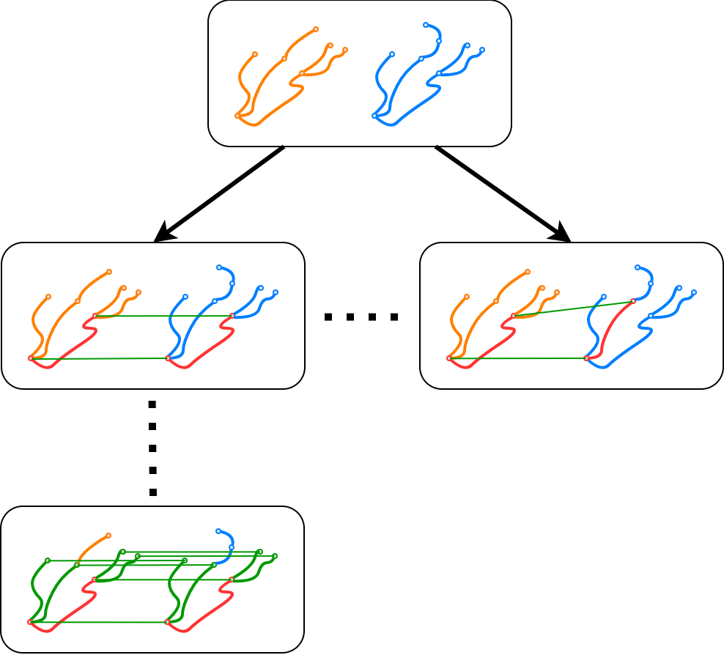
Applications: Geometrical Graph Matching

Slide 21
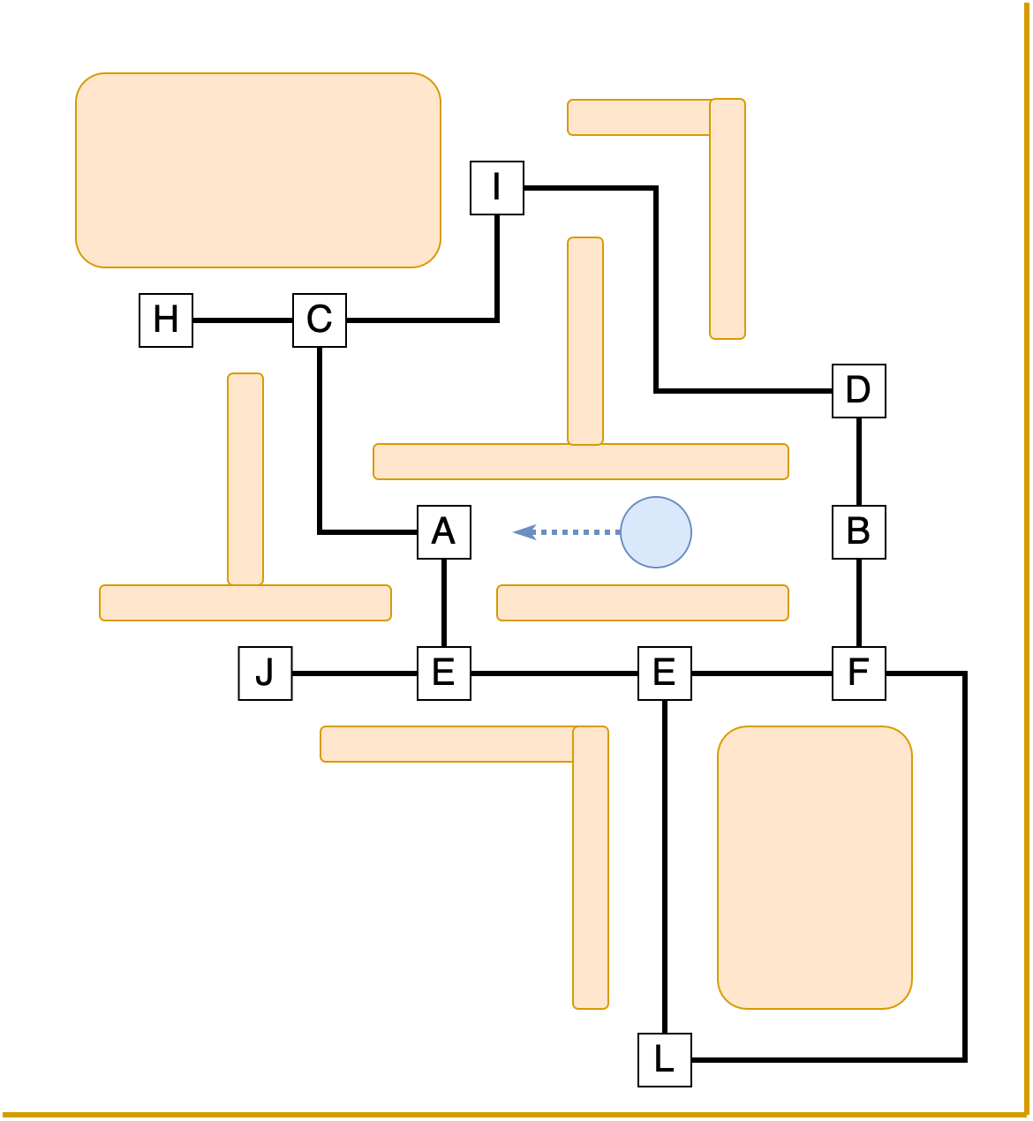
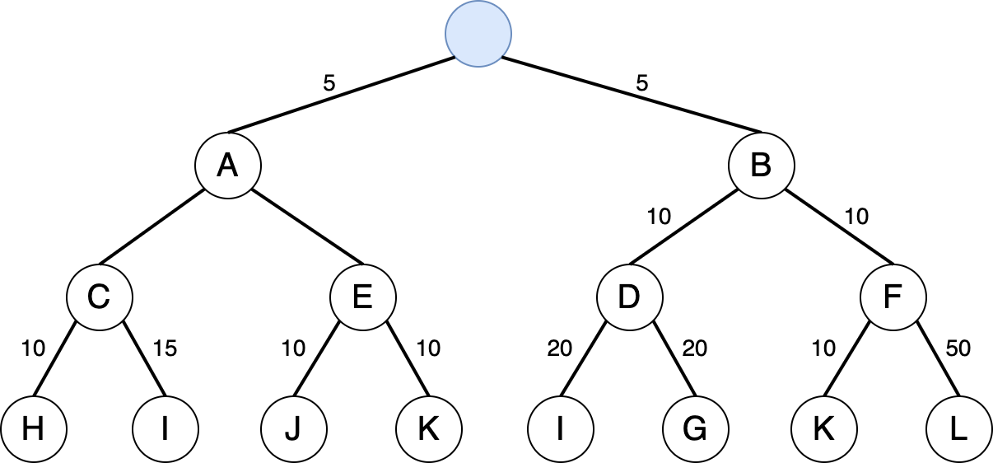
Applications: Ms Pacman

Slide 22
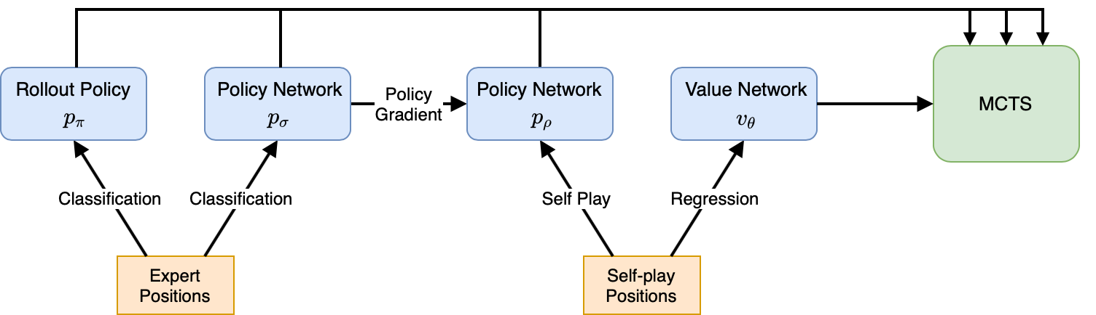
Applications: AlphaGo

Slide 23
Conclusion
Go…

