Slide 1

A Survey of Monte Carlo Tree Search Methods

Slide 2
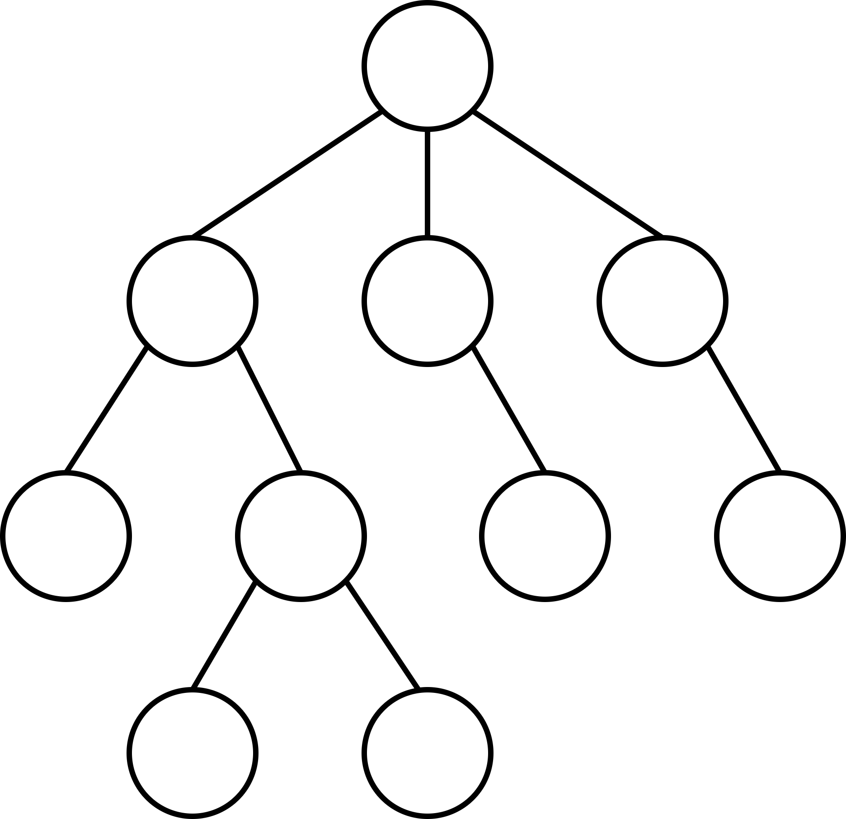
Basics: Setting
v
v
a₀
a₁
a₂
s(v)
a(v)
Q(v)
N(v)
v‘
v‘‘
v⁽³⁾

Slide 3
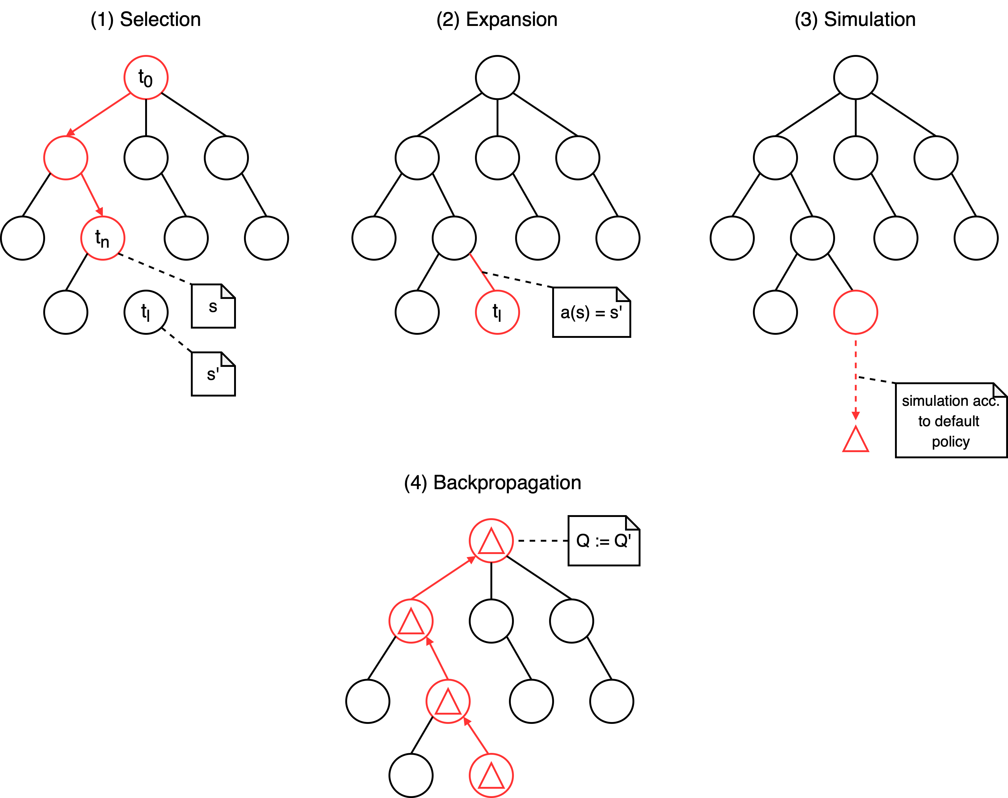
Basics: Monte Carlo Tree Search

Slide 4
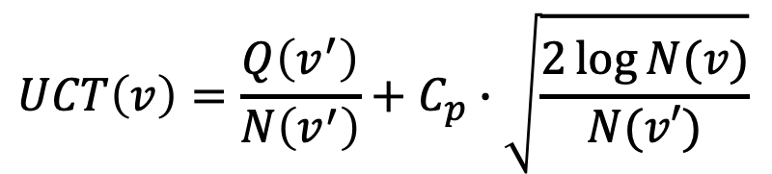
Basics: UCT
“Exploitation“
$$UCT\left(v\right)=\frac{Q\left(v^{′}\right)}{N\left(v^{′}\right)}+C_{p}∙\sqrt{\frac{2\log{N(v)}}{N(v′)}}$$
“Exploration“

Slide 5
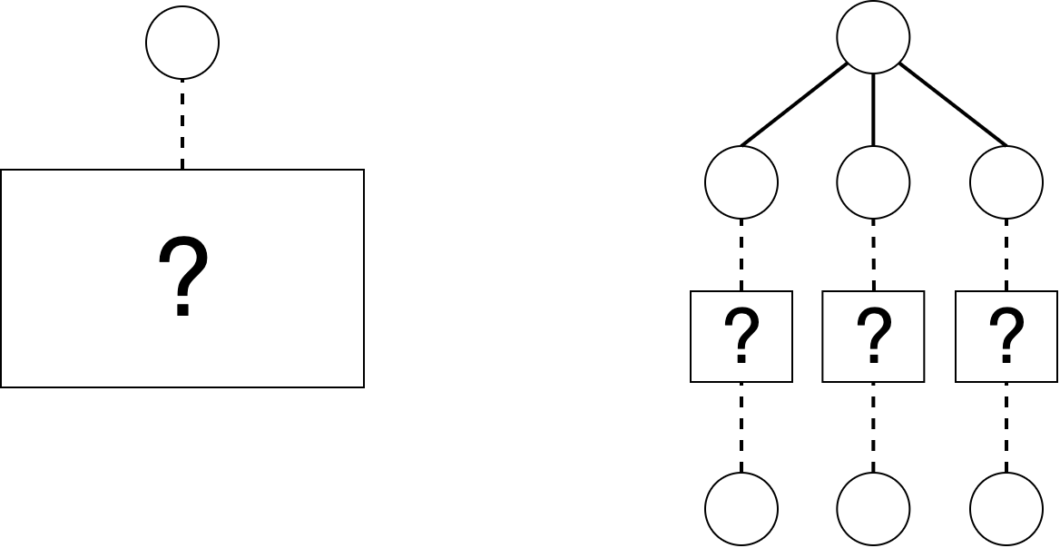

Heuristics: BFS-Tree Initialization
Before MCTS: execute each available root-action
Information gained can guide algorithm
$for a_{i}∈A_{0}: m × a_{i}$

Slide 6
Heuristics: Loss Avoidance
Ignore negative results when encountering new nodes

Slide 7
Heuristics: Novelty-based Pruning
Define a novelty measure nov(v), all nodes below a threshold are pruned

Slide 8
Heuristics: Knowledge-based Evaluations
Use A* and knowledge of the game to consider the distance to interesting objects

Slide 9
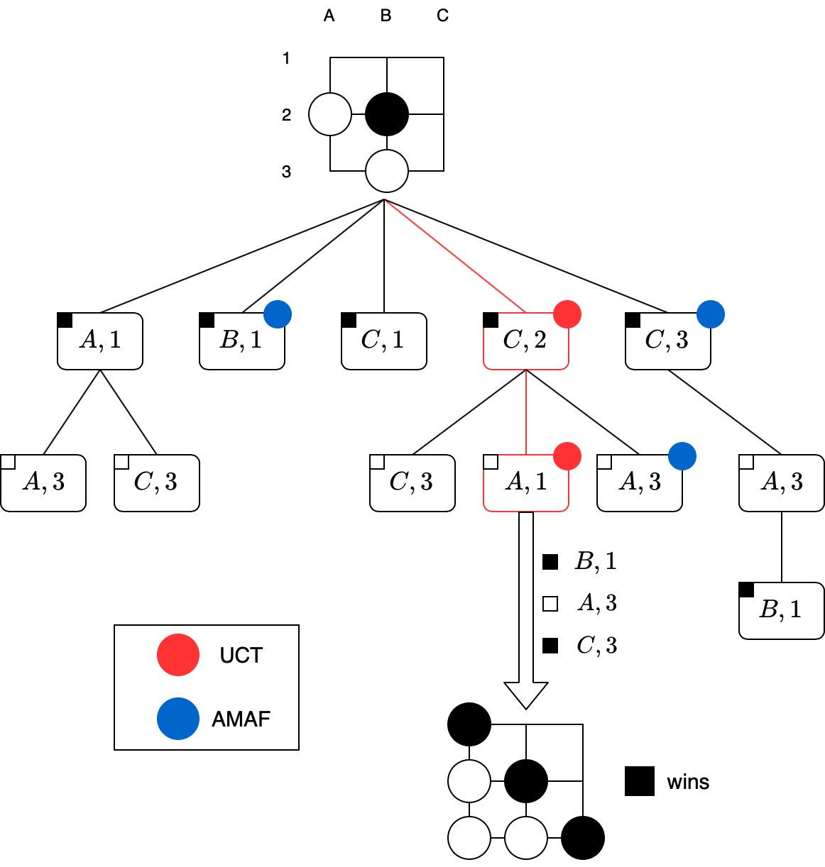
Heuristics: All Moves As First

Slide 10
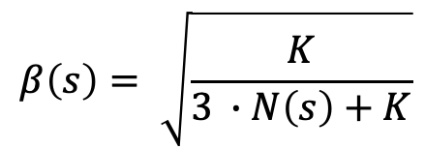
Heuristics: All Moves As First
$$AMAF\left(s,a\right)=β\left(s\right)∙Q\left(s,a\right)+\left(1−β\left(s\right)\right)∙AMAF(s^{′},a)$$
$$β\left(s\right)= \sqrt{\frac{K}{3 ∙N\left(s\right)+K}}$$
where

Slide 11
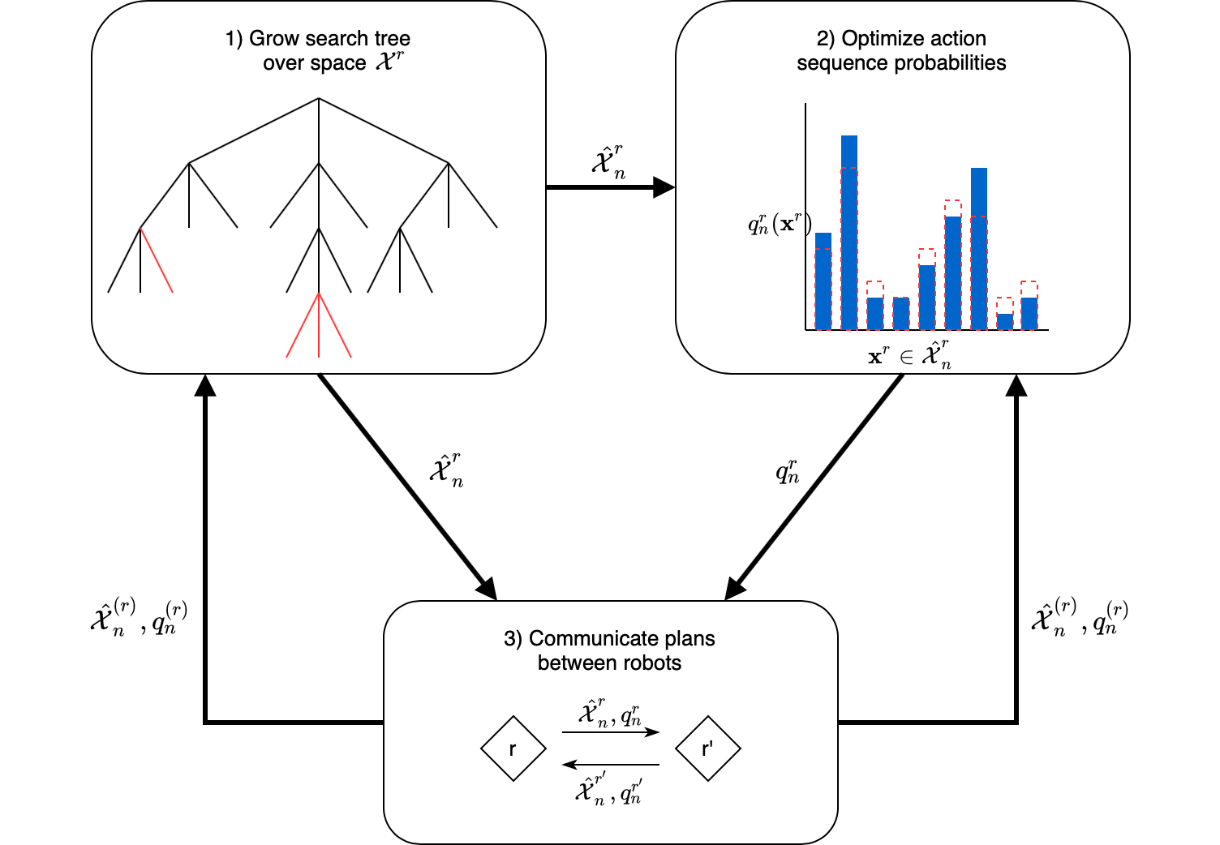
Applications: Dec-MCTS

Slide 12
Applications: Evolutionary Algorithms

Slide 13
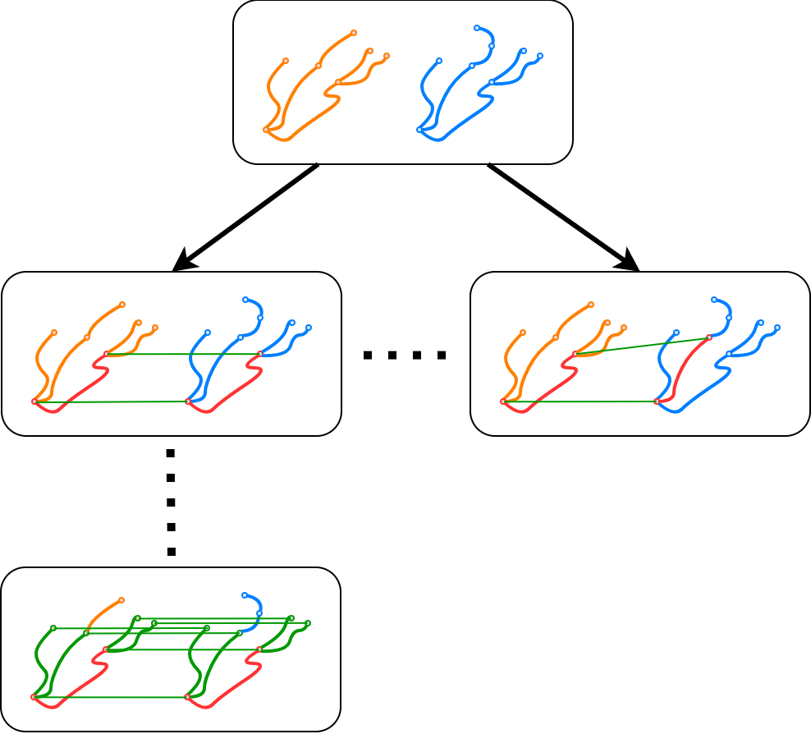
Applications: Geometrical Graph Matching

Slide 14
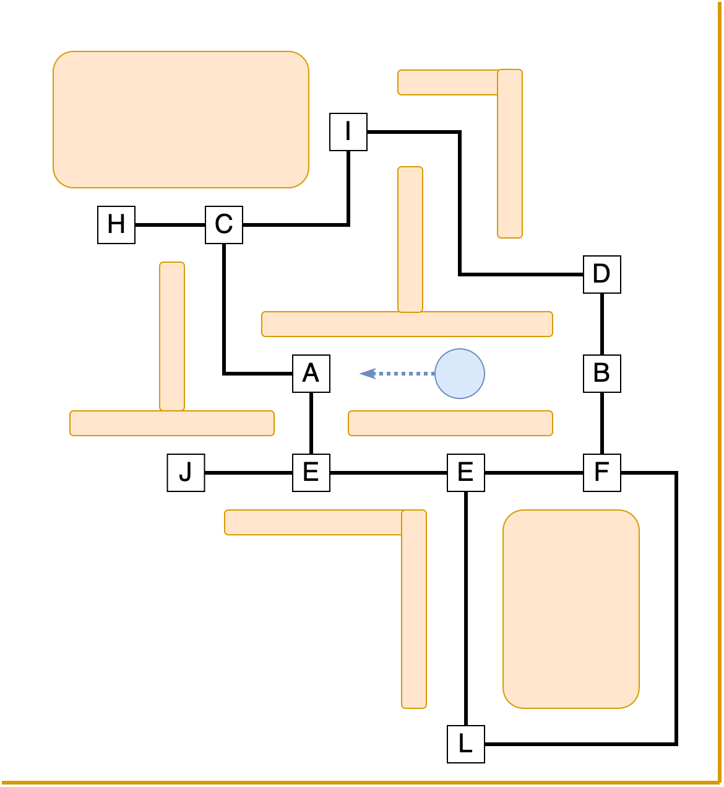
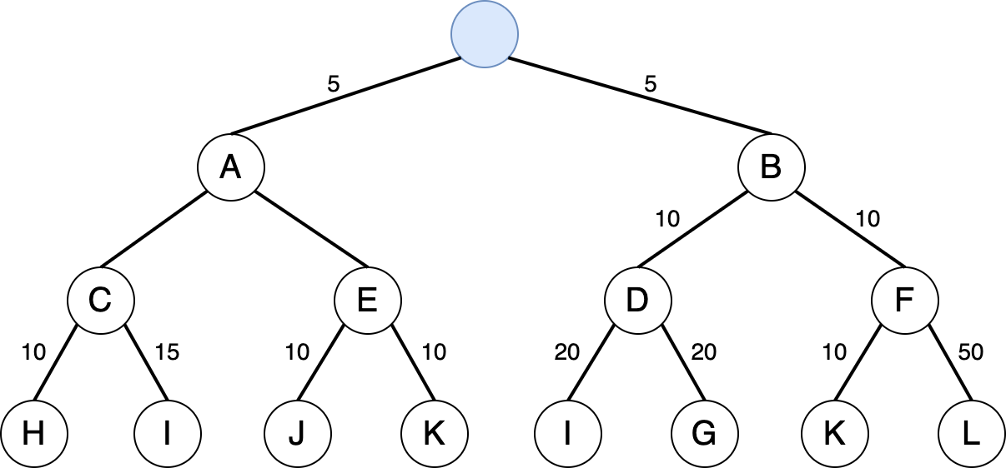
Applications: Ms Pacman

Slide 15
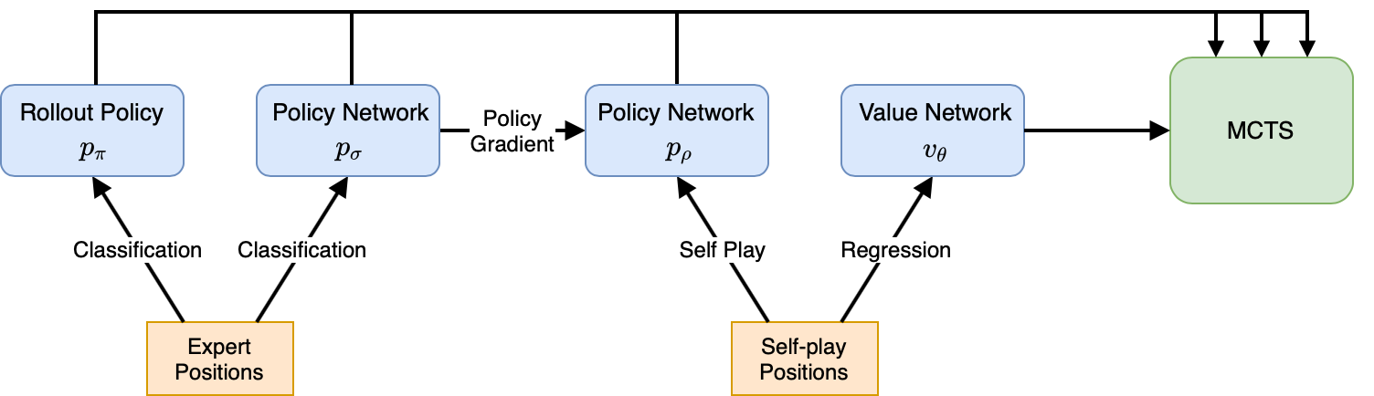
Applications: AlphaGo

Slide 16
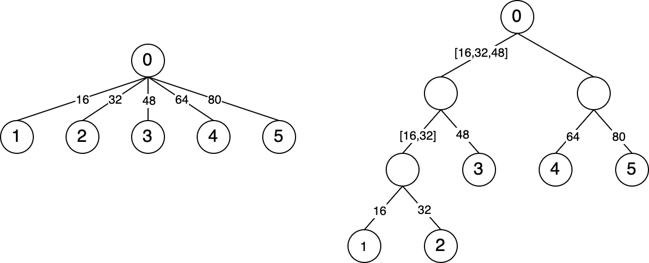
Applications: Deep Architect

Slide 17
Conclusion
Go…

