Slide 1
Multi-Modal Multi Environment Performance Comparison
Aman Chopra Nidhi Ranjan Shiv Ratan Sinha
05.05.22

Slide 2
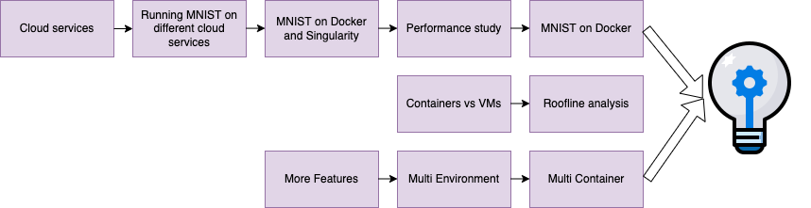
Motivation

Slide 3
Problem Description
To compare different models on different environments like Virtual Machine, Docker, and Singularity in Google Cloud Platform.
Gain insight on how factors like memory, FLOPS, communication overhead, throughput, etc, affect the performance.
Gain insight on which environment is better suited for a specific kind of workload.
Deep down in the GPU metrics of different workloads in different environments.

Slide 4
Agenda
Related works.
Methodology.
Models.
Environments.
Experimental setup.
Experiments.
Analysis and Results.
Lessons learned.
Demo1 - scripts.
Challenges.
Future works.
Demo2 - Cool UI.

Slide 5
Related Works
In [1], the authors trained two networks LCNN and SNN, on MNIST dataset, and compared its performance of Docker, Singularity and CharlieCloud.
The authors in [2] specifically compare the overhead caused in performance in containers complex ML/DL training and inference tasks, they used MLPerf benchmark
In [3], the authors compare the prediction and the accuracy of models trained on Docker, Singularity and Open Stack
[1] Minghui Sun et al 2021 J. Phys.: Conf. Ser. 1948 012005
[2] ARC Containers for AI Workload, Singularity vs Docker performance overhead : Newlin, Samthers
[3]Performance Comparison: Virtual Machines and Containers Running Artificial Intelligence Applications : Jack D. Marquez, Mario Castillo

Slide 6
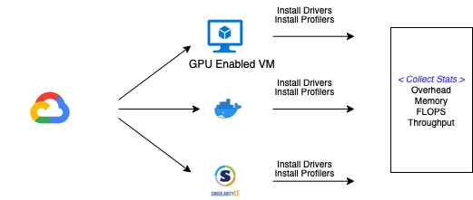
Methodology

Slide 7
Models
Image Classification
CNN
2 convolution layers
2 dropouts
2 fully connected layers
NLL loss
Dataset
MNIST dataset - 60k train, 10k test
Sentiment Analysis
RNN
1 Embedding layer
1 RNN layer
1 Fully connected layer
Binary Cross Entropy Loss
Dataset
IMDB dataset - 25k train, 10k test

Slide 8
Environments
Docker | Singularity
Not inbuilt support for OpenMPI | Built in support for OpenMPI
Starts with privileged access | Container started as normal user cannot use su or sudo to become root
Utilize Network Namespace. NAT is default | Transparent.
Bind and mount Host FS to access | Singularity app run as a user process
VM | Container
Spin-up time can take minutes | Spin-up time takes seconds
Hardware-level process isolation | OS level process isolation
VMs can move to new host easily | Containers are destroyed and re-created rather than moving
 | Container
dware-level process isolation
Boot in minutes | Boot in seconds

Slide 9
Experimental Setup
Bare VM
- GCE VM
- Debian 10
- 8 vcPUs @2.3Ghz
- RAM 30GB
Docker
- Docker version 20.10.14
Singularity
- Singularity version 3.6.3
1 x NVIDIA Tesla V100
Python 3.7
Cuda 11.3

Slide 10
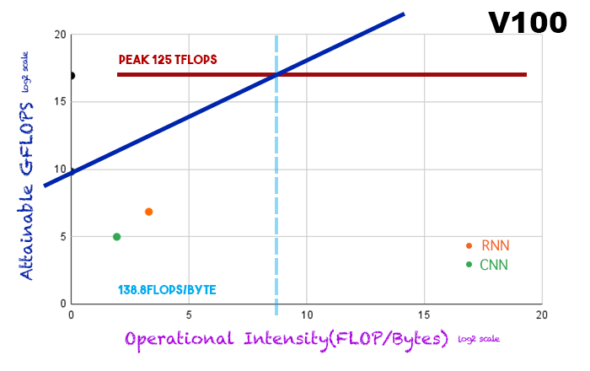
Roofline Model
We see that the both the models are memory bound.
We cannot compare between performance of 2 models per se as both are handling different workloads, but yes, can be said that the RNN model performs better in terms of the memory utilization.

Slide 11
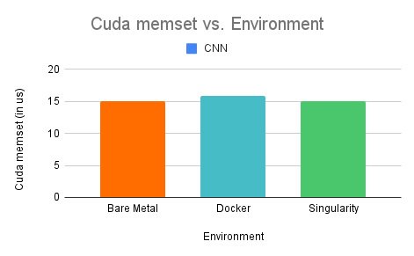
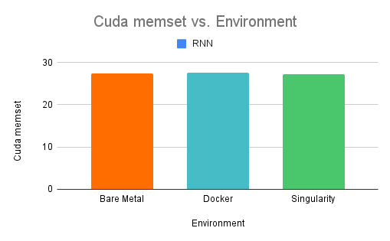
CUDA memset
We see that this is almost similar, with minor differences in the docker environment
This can be attributed to the factor of overhead introduced by NVIDIA Container Toolkit.

Slide 12
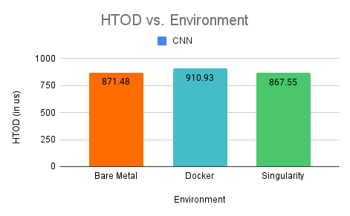
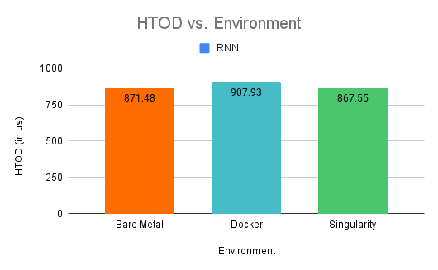
CUDA memcpy HTOD
Analyzed cudamemcpy calls as well.
Similar explanation as before.

Slide 13
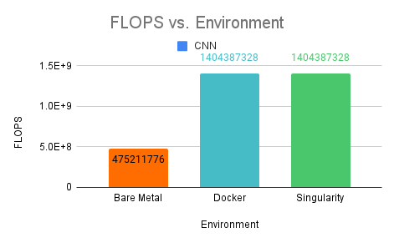
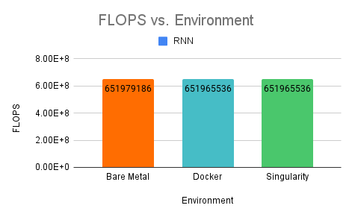
FLOPS - hmm, interesting!!
Can FLOPs be used as a universal proxy for efficiency?

Slide 14
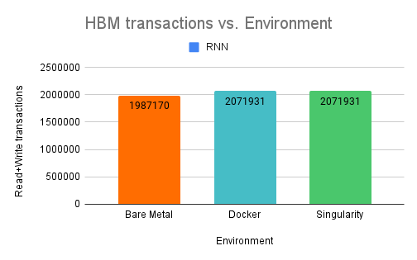
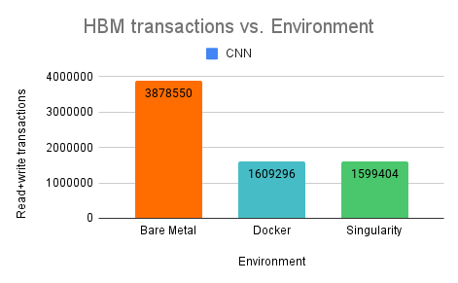
Transactions!!
HBM stands for high bandwidth memory and is a type of memory interface used in 3D-stacked DRAM.

Slide 15
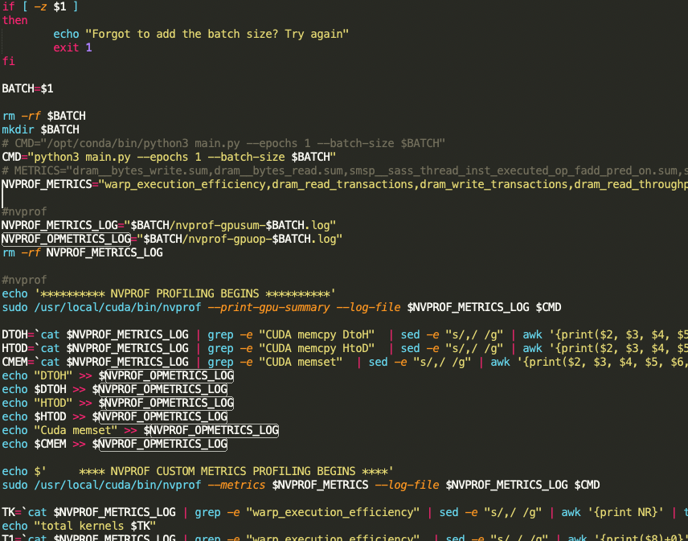
Time for some profiling

Slide 16
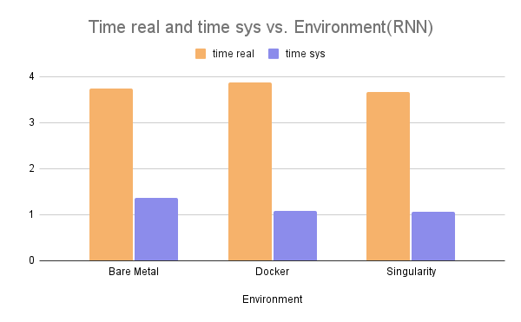
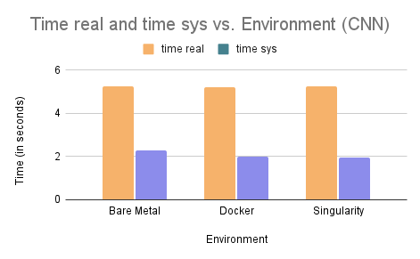
Time analysis
We achieved almost similar runtime based on multiple runs in the 3 environments.
However, most of the times, but we witnessed that docker was faster by very little margin :MTC:
Docker could have been slower due to runtime overhead, but we believe that it performed well.
Singularity - there is no daemon process. Instead, singularity is an executable.

Slide 17
Learnings
FLOPs for same model can differ on different environment.
FLOPs cannot be used as a universal proxy for efficiency, depends which type of MACs operations are being done.
Singularity has native support for GPUs.
Both the workloads performed similar in the 3 environment, but we believe for the containerization purposes, singularity wins - security, native GPU support, at par performance and can be used with K8s as well.

Slide 18
Challenges
Harder to get GPU in Google Cloud Platform.
Cuda Toolkit and driver installation version issues.
Issues with running GPU with Docker and Singularity.
Permission issues with the GPU Profiling.
ncu support is removed from cheaper GPU options like NVIDIA Tesla P4.

Slide 19
Future works
Profile the State of the Art models instead of the baseline models.
Profile more containers like Charlie cloud.
Profile other models like LSTM.
Experiment with unikernels.

Slide 20
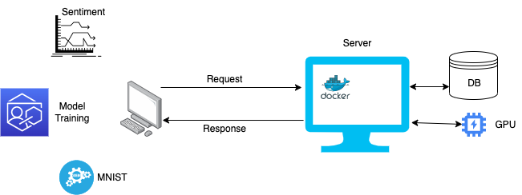
Demo2

Slide 21
Questions?

