Slide 1

Computer System Final Project X-Part Toy-OS
*College of computer science and technology Zhejiang University
June 2022
Computer System Final ProjectX-Part Toy-O
S
ZJU 2022
1 / 22

Slide 2



Table of Contents
1
Background
2 Buddy-system
3
System Call Table
4 File Loader
5
Shell
6 Conclusions and Thoughts
Computer System Final ProjectX-Part Toy-O
S
ZJU 2022
2 / 22

Slide 3



Table of Contents
1
Background
2 Buddy-system
3
System Call Table
4 File Loader
5
Shell
6 Conclusions and Thoughts
Computer System Final ProjectX-Part Toy-O
S
ZJU 2022
3 / 22

Slide 4
Background
Toy-OS
Buddy-System
Sys-call Table
File Loader
Shell
Computer System Final ProjectX-Part Toy-O
S
ZJU 2022
4 / 22
Notes:
构成，学习意义：了解kernel，对系统有一个简单的认知，并且能够较为底层理解一些编程的原理

Slide 5
Table of Contents
1
Background
2 Buddy-system
3
System Call Table
4 File Loader
5
Shell
6 Conclusions and Thoughts
Computer System Final ProjectX-Part Toy-O
S

Slide 6
Buddy-System
What’s Buddy-system?
Computer System Final ProjectX-Part Toy-O
S

Slide 7
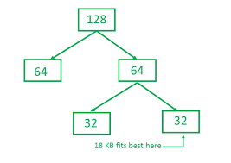
Buddy-System
Buddy-system
Computer System Final ProjectX-Part Toy-O
S

Slide 8
Buddy-System
How did I implement the buddy-system?
Computer System Final ProjectX-Part Toy-O
S

Slide 9
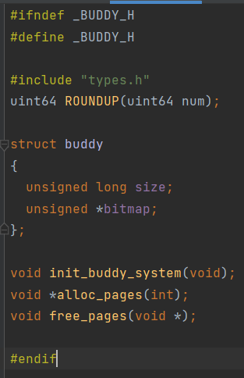
Buddy-System
How did I implement the buddy-system?
Computer System Final ProjectX-Part Toy-O
S

Slide 10
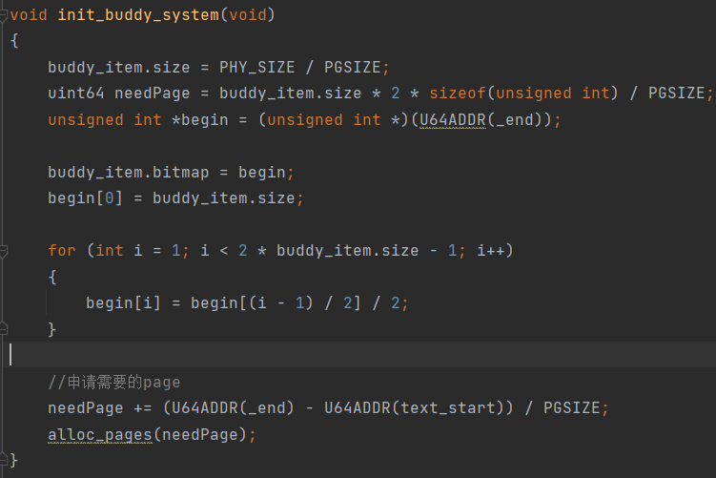
Buddy-System
Details
Computer System Final ProjectX-Part Toy-O
S

Slide 11
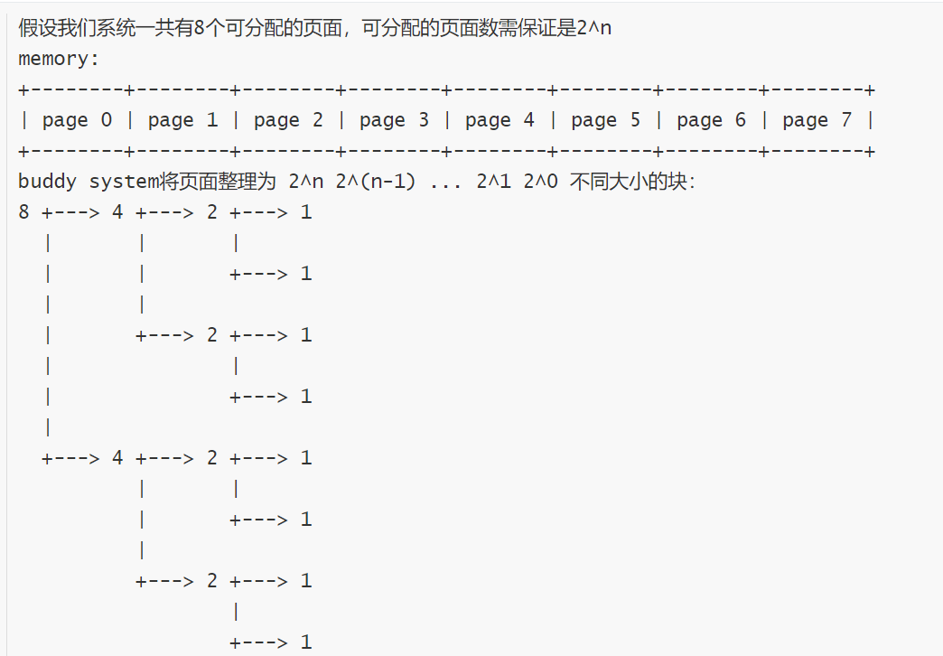
Buddy-System
Details
Computer System Final ProjectX-Part Toy-O
S

Slide 12
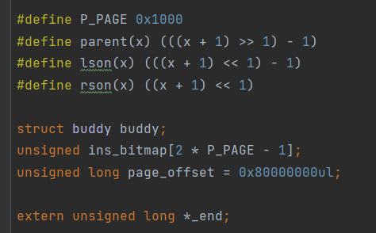
Buddy-System
Details
Computer System Final ProjectX-Part Toy-O
S

Slide 13
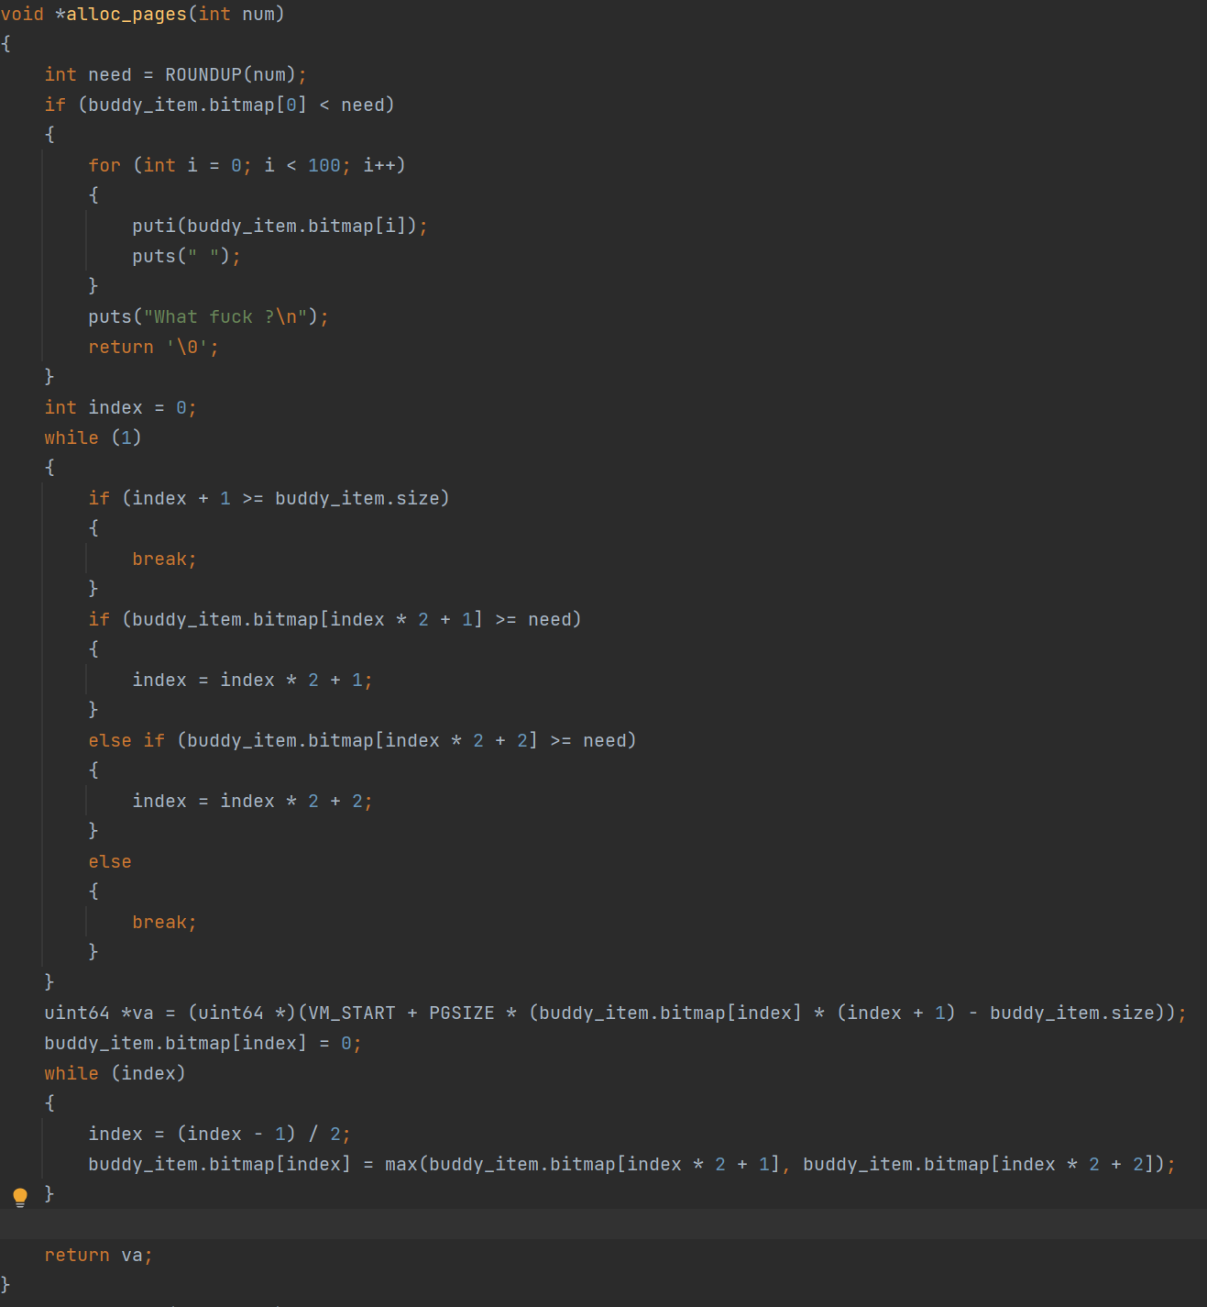
Buddy-System
alloc_pages
Computer System Final ProjectX-Part Toy-O
S

Slide 14
Buddy-System
alloc_pages
Computer System Final ProjectX-Part Toy-O
S

Slide 15
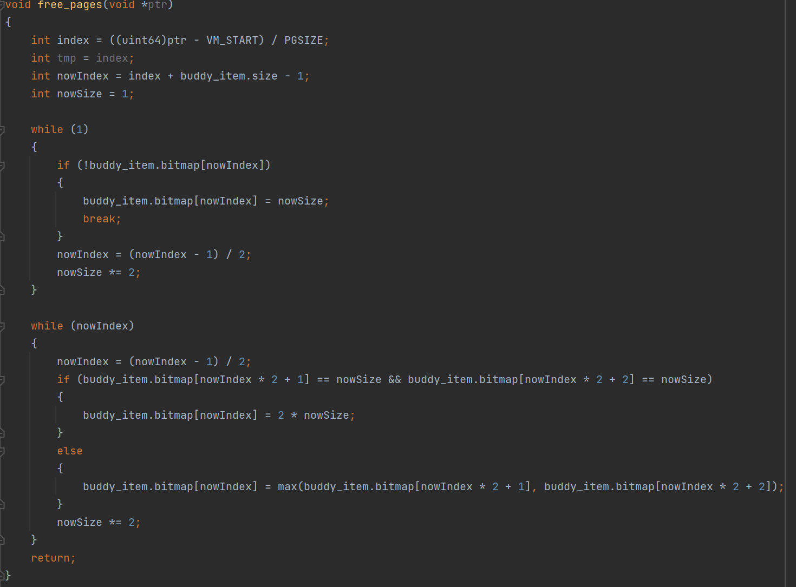
Buddy-System
free_pages
Computer System Final ProjectX-Part Toy-O
S

Slide 16
Buddy-System
free_pages
Computer System Final ProjectX-Part Toy-O
S

Slide 17
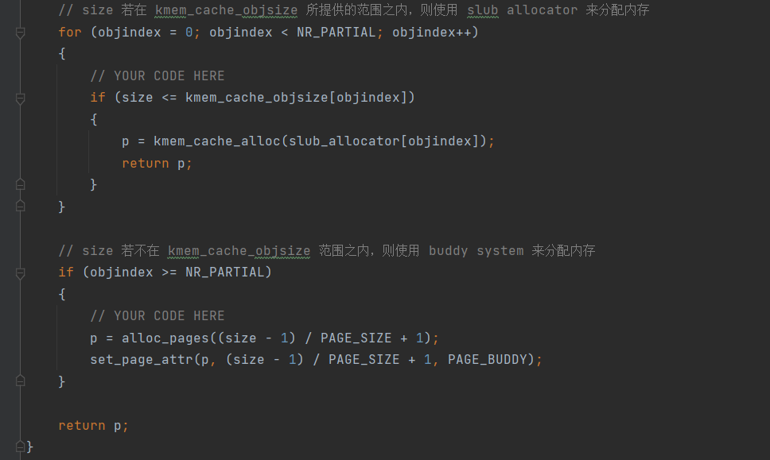
Buddy-System
void *kmalloc（size_t size)
Computer System Final ProjectX-Part Toy-O
S

Slide 18
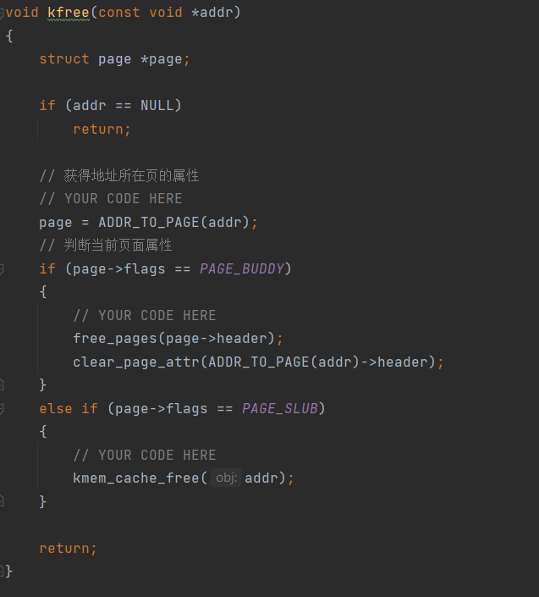
Buddy-System
void kfree(void *addr)
Computer System Final ProjectX-Part Toy-O
S

Slide 19
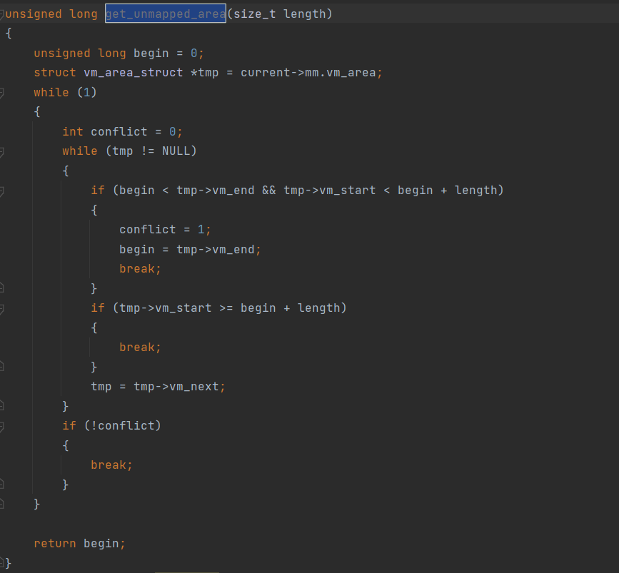
Buddy-System
get_unmapped_area
Computer System Final ProjectX-Part Toy-O
S

Slide 20
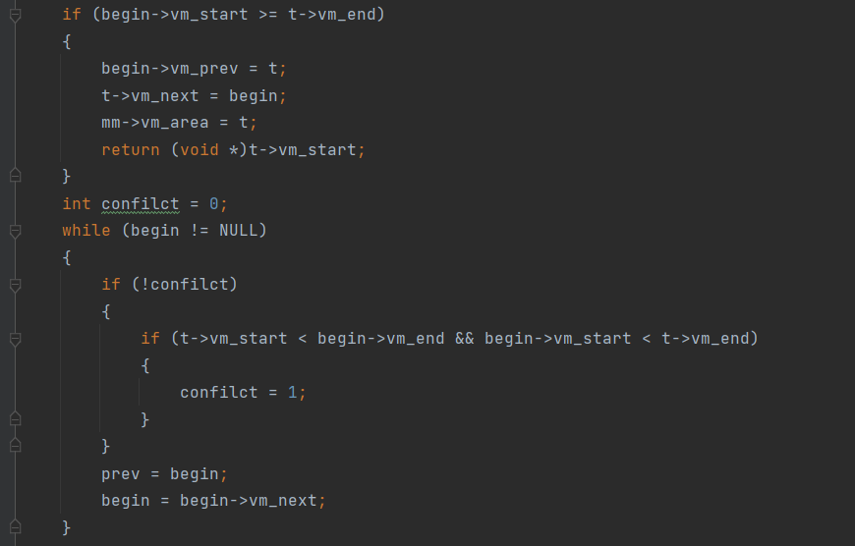
Buddy-System
Do_mmap
Computer System Final ProjectX-Part Toy-O
S

Slide 21
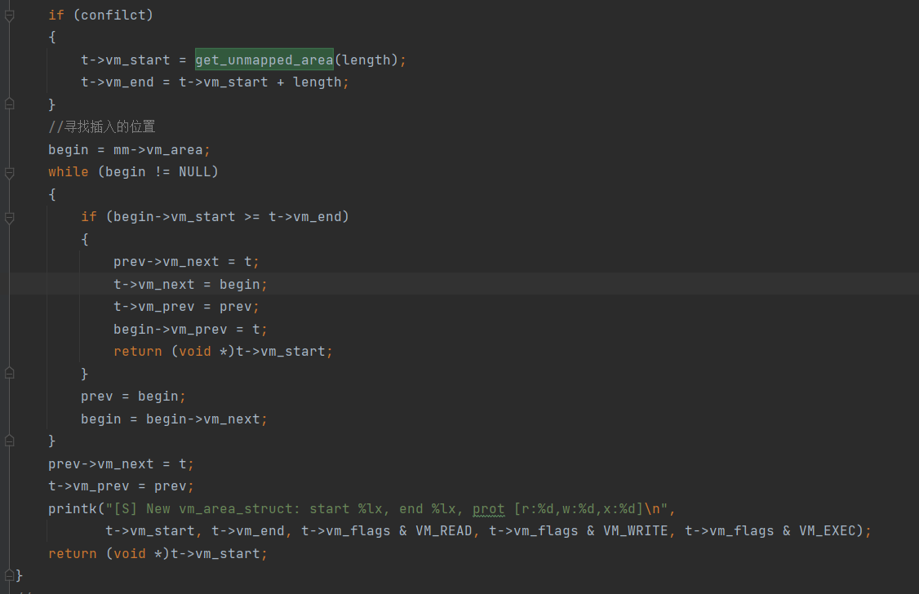
Buddy-System
Do_mmap
Computer System Final ProjectX-Part Toy-O
S

Slide 22
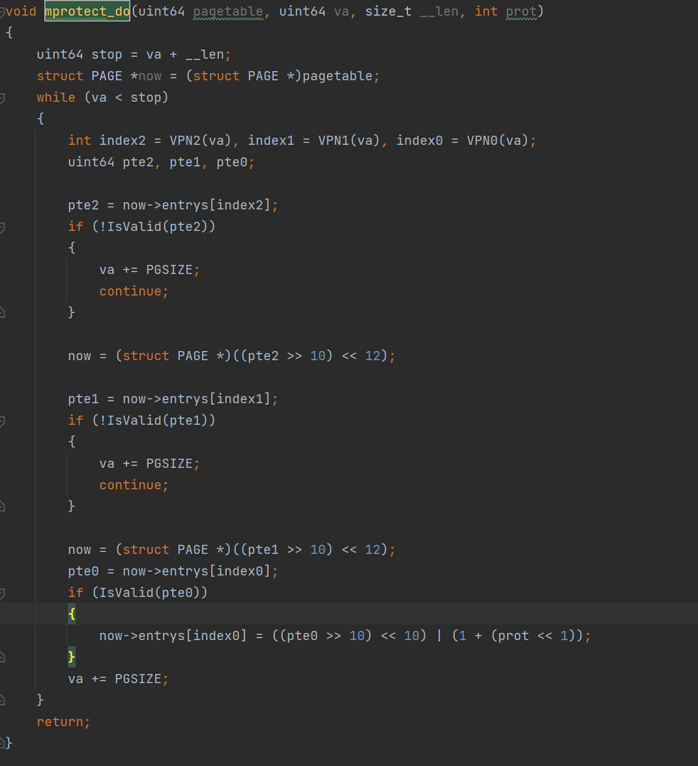
Buddy-System
mprotect
Computer System Final ProjectX-Part Toy-O
S

Slide 23
Buddy-System
Some conclusion
-fno-builtin
-gdwarf-2
-O2
Computer System Final ProjectX-Part Toy-O
S
Notes:
-fno-builtin ：禁止使用标准库函数，此次实验中的memset和标准库重名，导致自己的 memset函数编译出来的结果非常可笑，他直接call了标准库的memset，这个问题我也找了 非常久。。。
-gdwarf-2 使用 -g有些地方下 riscv64-unknown-elf-gdb 无法正确的查到符号表，导致部分 函数无法正常调试，搜索后使用了 -gdwarf-2
-O2 如果不开O优化，代码太长、无意义的太多，看的人很不舒服，开O3会导致各种函数内 联，调试复杂。

Slide 24
Buddy-System
Some conclusion
-fno-builtin
-gdwarf-2
-O2
Computer System Final ProjectX-Part Toy-O
S
Notes:
将各种段的定义写到 defs.h 内，类型定义写道 types.c 内，极大的方便了使用，也使整体代码结 构更加清晰，相应的slub代码部分很难理解，要是做为实验要求的话就会出很大问题。。

Slide 25
Table of Contents
1
Background
2 Buddy-system
3
System Call Table
4 File Loader
5
Shell
6 Conclusions and Thoughts
Computer System Final ProjectX-Part Toy-O
S
Notes:
在计算机系统三实验的lab4, lab5以及后来的Xpart中, 我们分批实现了一系列系统调用.

Slide 26
System Call Table
sys-call Implemented in finished course
sys-call 64: SYS_WRITE (Lab4)
- sys_write(unsigned int fd, const char* buf, size_t count)
- printout the string from user, is call by user-function printf
Computer System Final ProjectX-Part Toy-O
S
12 / 22
Notes:
经过之前的三个系统调用, 加上page fault和时钟中断的处理机制, 我们建立了简单的系统调用框架, 在添加新的系统调用的时候, 只要像其中加入选择判断的分支即可

Slide 27
System Call Table
sys-call Implemented in finished course
sys-call 174: SYS_GETPID (Lab4)
- sys_getpid
- pick the pid of current process, pass it to user program with register a0
Computer System Final ProjectX-Part Toy-O
S
12 / 22
Notes:
经过之前的三个系统调用, 加上page fault和时钟中断的处理机制, 我们建立了简单的系统调用框架, 在添加新的系统调用的时候, 只要像其中加入选择判断的分支即可

Slide 28
System Call Table
sys-call Implemented in finished course
sys-call 220: SYS_CLONE (Lab5)
- sys_clone(struct pt_regs *regs)
- execute the fork process of current running process
Computer System Final ProjectX-Part Toy-O
S
12 / 22
Notes:
经过之前的三个系统调用, 加上page fault和时钟中断的处理机制, 我们建立了简单的系统调用框架, 在添加新的系统调用的时候, 只要像其中加入选择判断的分支即可

Slide 29
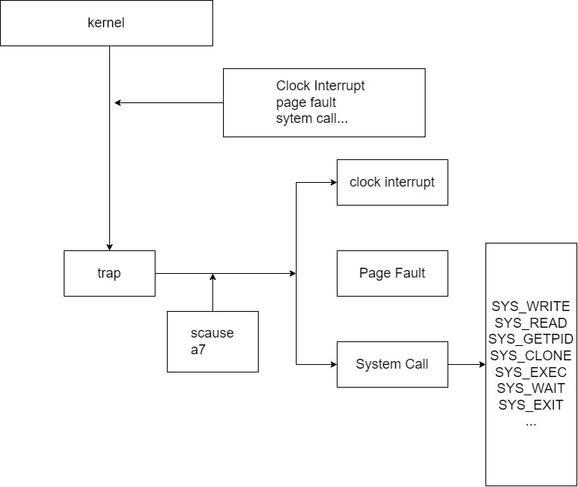
System Call Table
Computer System Final ProjectX-Part Toy-O
S
12 / 22
Notes:
进入trap进行系统调用的流程如图所示

Slide 30
System Call Table
sys-call Implemented in finished course
- The former implemented three sys-calls build the framework of sys-call schema of a kernel, we could extend the sys-call of the kernel with a unified schema
Computer System Final ProjectX-Part Toy-O
S
12 / 22

Slide 31
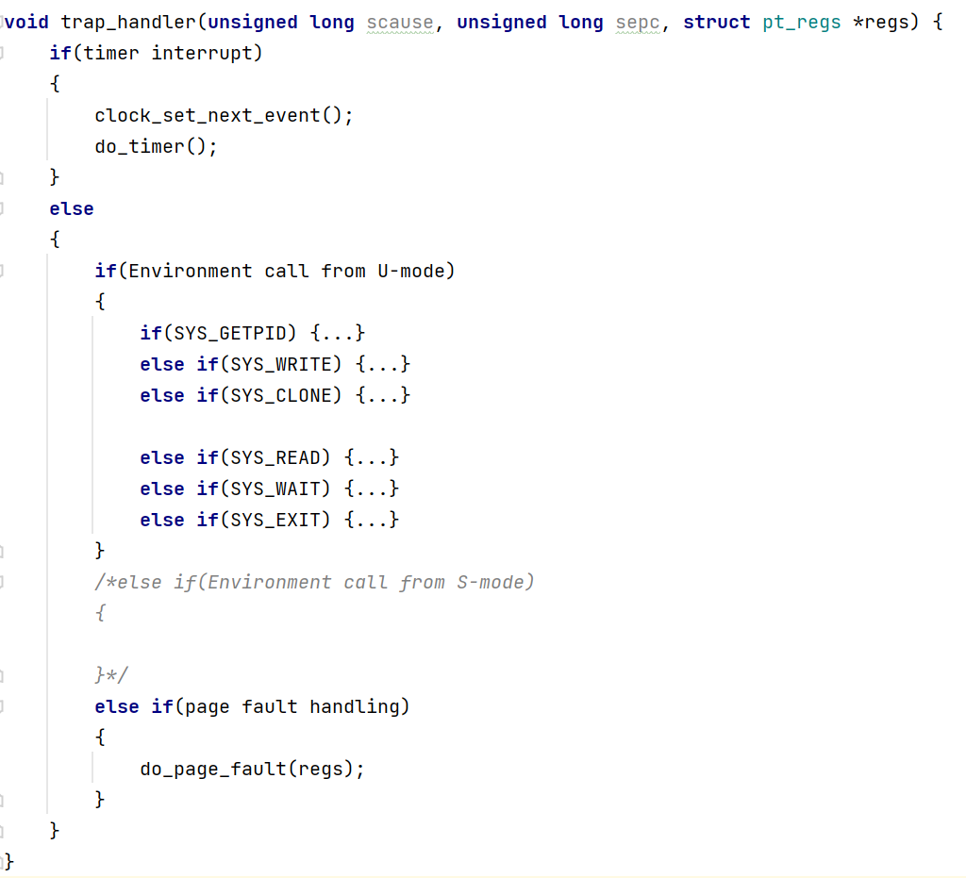
System Call Table
Computer System Final ProjectX-Part Toy-O
S
12 / 22

Slide 32
System Call Table
sys-call Implemented in X-Part
sys-call in buddy system
Computer System Final ProjectX-Part Toy-O
S
12 / 22
Notes:
接下来是我们在X-Part中实现的系统调用功能
首先是在buddy system中的调用, 主要有涉及到内存管理的两个调用

Slide 33
System Call Table
sys-call Implemented in X-Part
sys-call in buddy system
sys_mprotect
sys_munmap
Computer System Final ProjectX-Part Toy-O
S
12 / 22
Notes:
sys_mprotect, 更改指定内存区域的访问权限
sys_munmap, 解除指定内存区域的内存映射

Slide 34
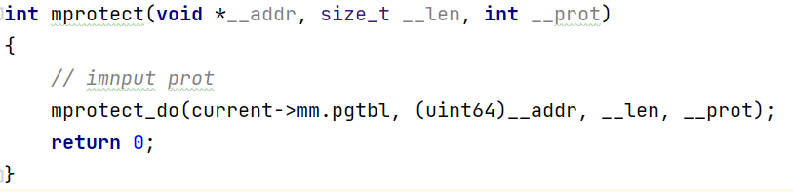
System Call Table
sys-call Implemented in X-Part : In Buddy System (Referencing lab6)
sys-call 226 : SYS_MPROTECT
- change the memory access with specific content
- int mprotect(void __addr, size_t _len, int __prot)
Computer System Final ProjectX-Part Toy-O
S
12 / 22
Notes:
sys_mprotect, 更改指定内存区域的访问权限

Slide 35
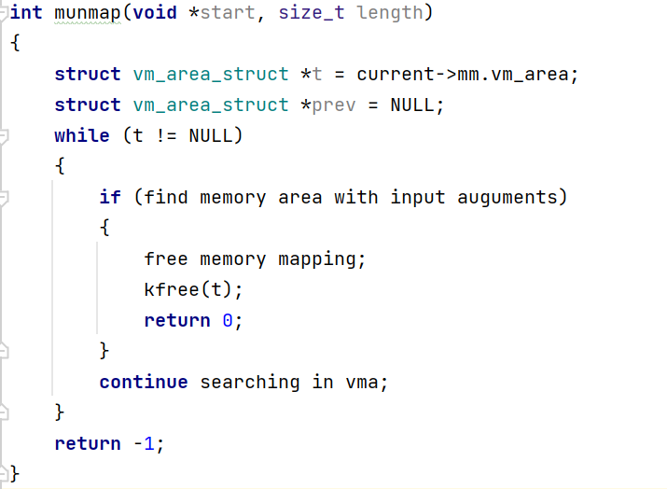
System Call Table
sys-call Implemented in X-Part : In Buddy System (Referencing lab6)
sys-call 215 : SYS_MUNMAP
- cancel virtual memory mapping in specific memory area, if success return 0, else return -1
- int munmap (void *__addr, size_t __len)
Computer System Final ProjectX-Part Toy-O
S
12 / 22
Notes:
sys_munmap, 解除指定内存区域的内存映射

Slide 36
System Call Table
sys-call Implemented in X-Part : In File system implementation and program loading (Referencing lab7)
Computer System Final ProjectX-Part Toy-O
S
12 / 22
Notes:
剩下的是我们在X-Part中实现的系统调用, 此部分我们参考了旧操作系统lab6和lab7中的部分内容, 这部分主要涉及到用户程序运行所需要的一些系统调用
sys_read, 可以将用户输入读入缓冲区
sys_wait, 将进程进入等待状态, 我们实现了进程的两种状态: RUNNING和WAITING, 将其设置为等待之后, 进行调度
sys_exit, 将进程退出
sys_exec, 最重要的系统调度, 将程序装在到内存中然后设置sepc执行

Slide 37
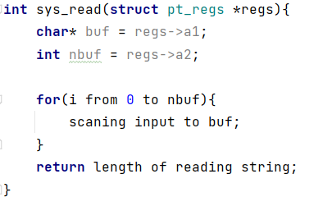
System Call Table
sys-call Implemented in X-Part : In File system implementation and program loading (Referencing lab7)
sys-call 63: SYS_READ
- sys_read(struct pt_regs *regs)
- read the string input from user program(shell), store it in buffer
Computer System Final ProjectX-Part Toy-O
S
12 / 22

Slide 38
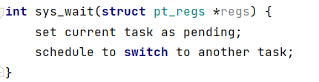
System Call Table
sys-call Implemented in X-Part : In File system implementation and program loading (Referencing lab7)
sys-call 260: SYS_WAIT
- We implement two states of process in OS kernel : TASK_RUNNING and TASK_WAITING, serving for process switch for user programs
- int sys_wait(struct pt_regs *regs)
- set the current process(in running state) to pending state, the perform schedule(), switching to other program
Computer System Final ProjectX-Part Toy-O
S
12 / 22

Slide 39
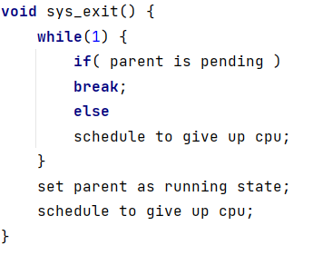
System Call Table
sys-call Implemented in X-Part : In File system implementation and program loading (Referencing lab7)
sys-call 93: SYS_EXIT
- void sys_exit()
- Exit current children process, return to parent process - The difference from SYS_WAIT
Computer System Final ProjectX-Part Toy-O
S
12 / 22

Slide 40
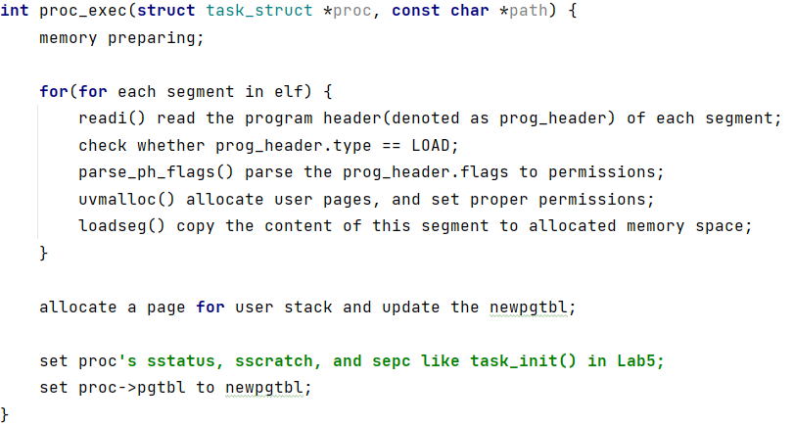
System Call Table
sys-call Implemented in X-Part : In File system implementation and program loading (Referencing lab7)
sys-call 211: SYS_EXEVCE
- int sys_exec(const char *path)
- execute user application with the giving path
- core function proc_exec
Computer System Final ProjectX-Part Toy-O
S
12 / 22

Slide 41
System Call Table
Summary
During these OS labs, we constructed a basic framework of systems call mechanism of a OS kernel.
Computer System Final ProjectX-Part Toy-O
S
12 / 22
Notes:
我们搭建了系统调用的总体框架, 同时实现了基本的系统调用以及异常处理来保证操作系统内核的基本运转

Slide 42
System Call Table
Summary
And implemented system call table with basic kernel function, which supports a toy-OS running
- information input and output (SYS_READ, SYS_WRITE, SYS_GETPID)
- basic memory management (SYS_MMAP, SYS_MPROTECT)
- process fork (SYS_CLONE)
- user program process management (SYS_WAIT, SYS_EXIT, SYS_EXECVE)
Computer System Final ProjectX-Part Toy-O
S
12 / 22
Notes:
在系统调用层面, 主要实现了信息的输入输出, 内存管理, 进程fork以及用户进程管理四方面的内容

Slide 43
Table of Contents
1
Background
2 Buddy-system
3
System Call Table
4 File Loader
5
Shell
6 Conclusions and Thoughts
Computer System Final ProjectX-Part Toy-O
S
Notes:
在这部分中, 我们参考操作系统lab7中的内容向内核中加入了一个简单的文件系统

Slide 44
File Loader
File system integrating into kernel.
We use a temporary file system: initramfs
Computer System Final ProjectX-Part Toy-O
S
15 / 22
Notes:
这是通过一个函数组作为文件读取接口来实现对文件系统的访问, 它接受文件路径, 将其定位并加载到内存中

Slide 45
File Loader
File system integrating into kernel.
We use a temporary file system: initramfs
The OS kernel will create a tmplfs file system to access the content
Computer System Final ProjectX-Part Toy-O
S
15 / 22

Slide 46
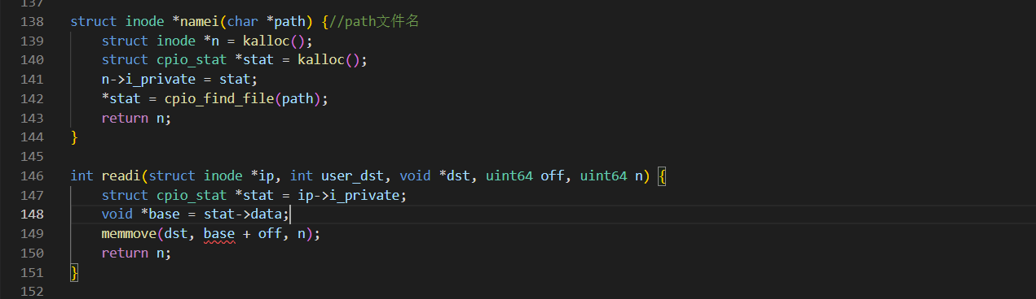
File Loader
We use a set of function serve as the file system interface of the Toy-OS: cpio, there are two major function in it
struct inode *namei(char* path): receive the path of the file, return the loaction(node) in inittramfs
int readi(struct inode *ip, int user_dst, void *dst, uint off, uint n);
Computer System Final ProjectX-Part Toy-O
S
Notes:
nami函数负责接受文件路径, 返回文件系统inittramfs中的节点
readi函数负责接受文件系统中的节点, 根据指定地址加载到内存中
要想在OS中实现这些功能,我们需要将cpio首先映射到内存中

Slide 47
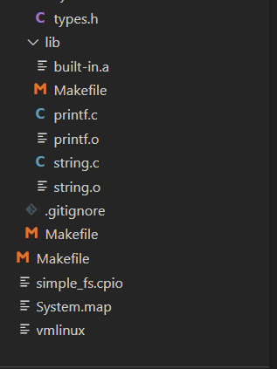
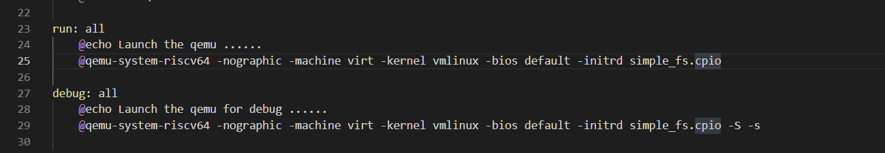
File Loader
•In this section, we managed to load cpio into kernel with mapping it into memory, then the interatction between the Toy-OS and file system could be established
•After a large amount of trial and analysis, we adjusted part of the file construction, make cpio integrated in our Toy-OS
Computer System Final ProjectX-Part Toy-O
S
Notes:
nami函数负责接受文件路径, 返回文件系统inittramfs中的节点
readi函数负责接受文件系统中的节点, 根据指定地址加载到内存中
要想在OS中实现这些功能,我们需要将cpio首先映射到内存中

Slide 48
File Loader
•In this section, we managed to load cpio into kernel with mapping it into memory, then the interaction between the Toy-OS and file system could be established
•After a large amount of trial and analysis, we adjusted part of the file construction, make cpio integrated in our Toy-OS
Computer System Final ProjectX-Part Toy-O
S
Notes:
因为cpio的加入, 我们修改了代码的部分文件组织和makefile, 使得cpio模块能够接入操作系统内核中

Slide 49
File Loader
•Elf Loader: make program running on our kernel
•Overview of ELF header
- main segment:
•.text
•.rodata
•.data and .bss
- elf header and program header store basic infomation about elf file
•including the offset of program header table and section header table
Computer System Final ProjectX-Part Toy-O
S
Notes:
第二部分是实现elf loader, 也就是将elf文件装载到内存中

Slide 50
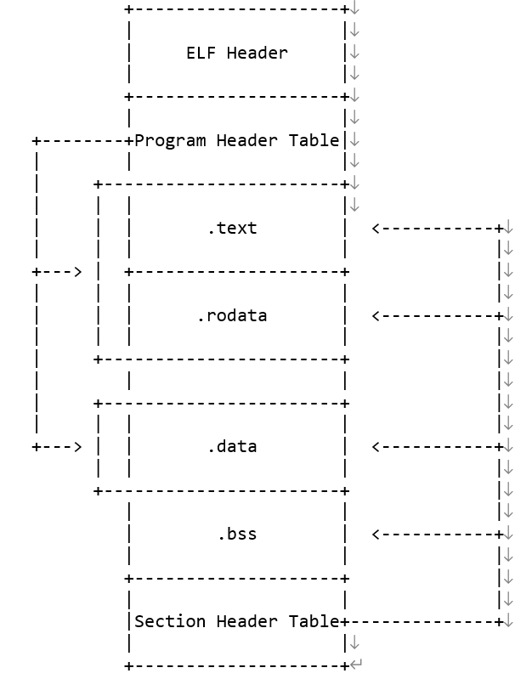
File Loader
•Elf Loader
Computer System Final ProjectX-Part Toy-O
S
Notes:
这里看到elf文件的格式, 可以看到其中重要的部分是program header table

Slide 51
File Loader
The Implemation: function loadseg() and function system call exec, for the exec() is described before, this time we focus on loadseg().
– int loadseg(page_table_t pagetable, uint64 va, struct inode *ip, uint offset, uint filesz);
• the function will walk through the pagetable, get the physical address of corresponding virtual address from given arguments
• when fetch the physical address, it will use readi() function, casting the content of the segment to memory physical address
• finally, turn to exec to execute the loaded program
Computer System Final ProjectX-Part Toy-O
S
Notes:
程序装载的部分比较简洁, 但是是整个程序最重要的部分, 在实现上, 我们使用函数loadseg函数来讲文件中的内容读取到内存当中, 然后通过exec系统调用来启动装载好的程序

Slide 52
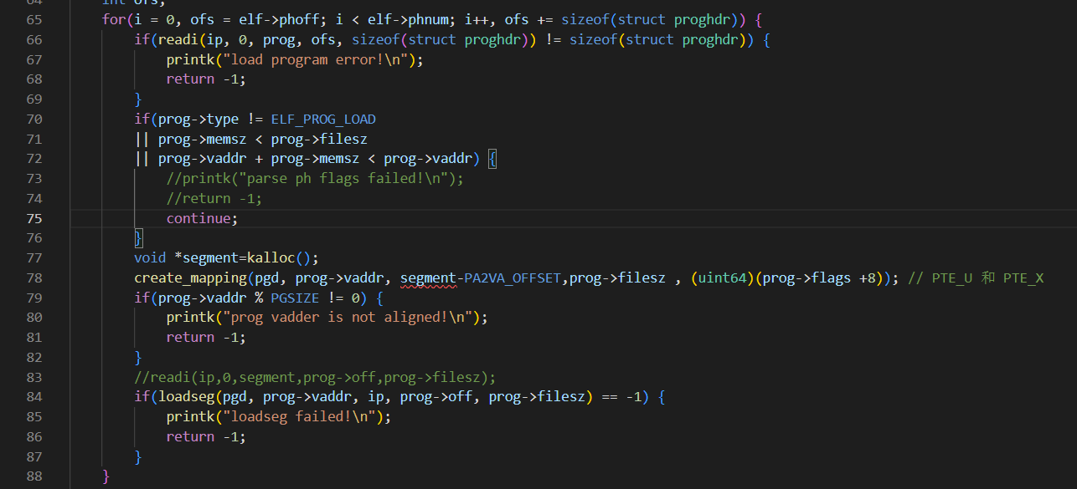
File Loader
The Implemation: function loadseg() and function system call exec, for the exec() is described before, this time we focus on loadseg().
Computer System Final ProjectX-Part Toy-O
S
Notes:
程序装载的部分比较简洁, 但是是整个程序最重要的部分, 在实现上, 我们使用函数loadseg函数来讲文件中的内容读取到内存当中, 然后通过exec系统调用来启动装载好的程序

Slide 53
Table of Contents
1
Background
2 Buddy-system
3
System Call Table
4 File Loader
5
Shell
6 Conclusions and Thoughts
Computer System Final ProjectX-Part Toy-O
S

Slide 54
In lab7, the shell program is not provided, so wo implement a simple shell program to make user interact with the toy-os, to show the implementation of this program, we prepared two user programs: hello
Shell
Computer System Final ProjectX-Part Toy-O
S
18 / 22
Notes:
shell 程序的内容: 接受用户输入, 存入缓冲区, 然后根据指令内容执行对应代码
我们在内核中放置了两个应用程序
当输入指令的时候, 程序会执行fork, 创建新的进程为程序提供空间, 随后执行寻找, 装载和执行部分

Slide 55
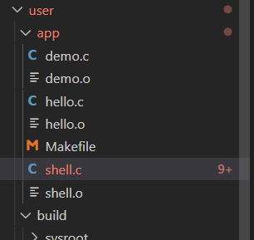
In lab7, the shell program is not provided, so wo implement a simple shell program to make user interact with the toy-os. To show the implementation of this program, we prepared a user programs: hello
Shell
Computer System Final ProjectX-Part Toy-O
S
18 / 22
Notes:
shell 程序的内容: 接受用户输入, 存入缓冲区, 然后根据指令内容执行对应代码
我们在内核中放置了两个应用程序
当输入指令的时候, 程序会执行fork, 创建新的进程为程序提供空间, 随后执行寻找, 装载和执行部分

Slide 56
Shell
Shell program introduction
• mainly a simple endless loop, waiting for user input
Computer System Final ProjectX-Part Toy-O
S

Slide 57
Shell
Shell program introduction
• mainly a simple endless loop, waiting for user input
• when receiving the user input, executing specific program
– the kernel will fork a children process for the application to execute
– the runcmd function will:
• load the specific program from file system to memory (unsing namei() and loadseg())
• then execute the program
Computer System Final ProjectX-Part Toy-O
S

Slide 58
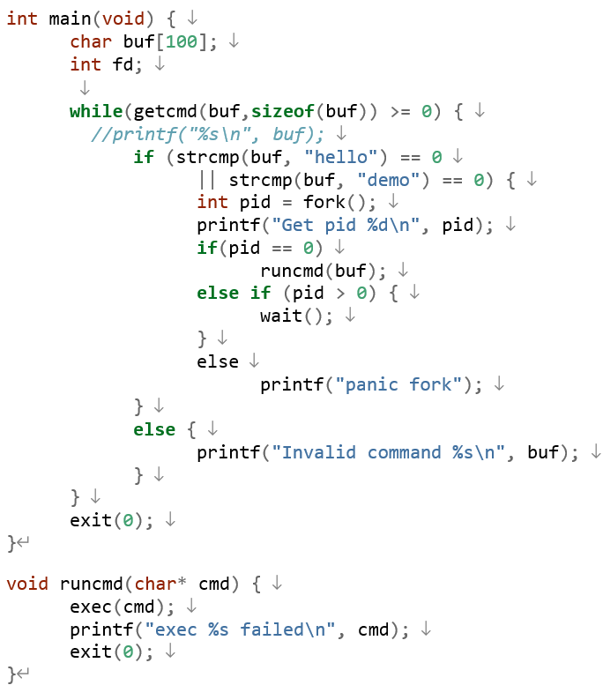
Shell
Shell program introduction
Computer System Final ProjectX-Part Toy-O
S

Slide 59
Shell
Shell program implementation
• The shell program is simple, but the procedure to load it is more complicated
– Need to call function elf_loader to load shell program into memory
– The function is called in task_init, after the idle process is inited
Computer System Final ProjectX-Part Toy-O
S
Notes:
在操作系统启动的时候, 需要先将shell程序添加到内存中并运行, 这是需要调用函数elf_loader来进行, 函数的内容与proc_exec相近
在第一个进程初始化完毕后开始执行

Slide 60
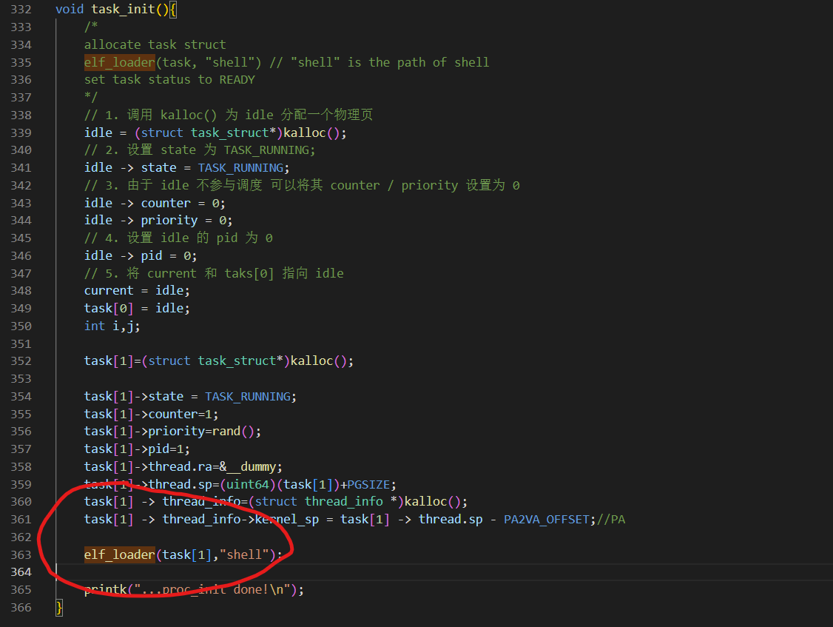
Shell
Shell program implementation
Computer System Final ProjectX-Part Toy-O
S
Notes:
在操作系统启动的时候, 需要先将shell程序添加到内存中并运行, 这是需要调用函数elf_loader来进行, 函数的内容与proc_exec相近
在第一个进程初始化完毕后开始执行

Slide 61
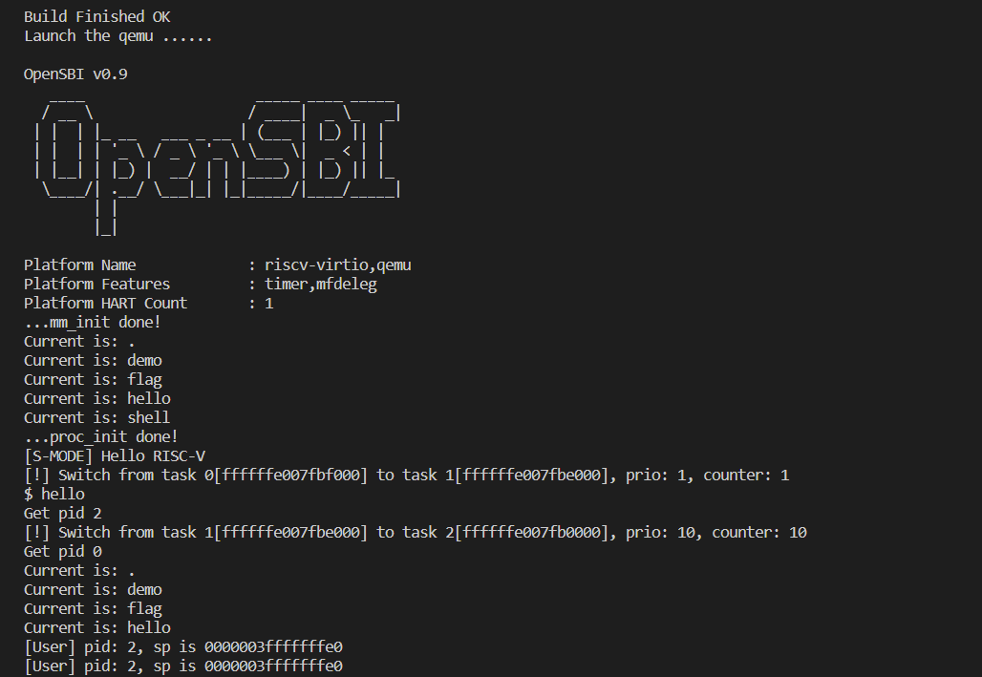
Shell
Shell program execution
Computer System Final ProjectX-Part Toy-O
S
Notes:
在操作系统启动的时候, 需要先将shell程序添加到内存中并运行, 这是需要调用函数elf_loader来进行, 函数的内容与proc_exec相近
在第一个进程初始化完毕后开始执行

Slide 62
Table of Contents
1
Background
2 Buddy-system
3
System Call Table
4 File Loader
5
Shell
6 Conclusions and Thoughts
Computer System Final ProjectX-Part Toy-O
S

Slide 63
Conclusions and Thoughts
Computer System Final ProjectX-Part Toy-O
S
21 / 22

Slide 64
Thanks!
Computer System Final ProjectX-Part Toy-O
S
22 / 22

