Slide 1

EDGE AI &
MACHINE LEARNING INFERENCE
A Comprehensive Practical Guide
3–6 Hours
Windows + VS Code
YOLO + ONNX
Engineering
Duration
Platform
Focus
Level
National University of Management | National Polytechnic Institute of Cambodia · 2026
Notes:
Welcome and introduce yourself. Explain the session plan: 3-6 hours covering Edge AI fundamentals through practical YOLO deployment. Ask students about their background with Python and AI.

Slide 2







Session Agenda
3–6 hours · Practical + Theory
01
Introduction to Edge AI
05
Advanced Applications
⏱ 30 min
⏱ 60 min
30 min
60 min
02
Theory & Architecture
06
Tracking & Analytics
⏱ 40 min
⏱ 50 min
40 min
50 min
03
Environment Setup
07
Projects & Assessment
⏱ 45 min
⏱ 45 min
45 min
45 min
04
YOLO Model Deployment
08
Future of Edge AI
⏱ 60 min
⏱ 30 min
60 min
30 min
Notes:
Walk through the agenda. Emphasize that labs are hands-on — students should have their computers ready. The schedule is flexible; adjust pacing based on student progress.

Slide 3
Learning Objectives
By the end of this session, you will be able to:
Explain Edge AI principles and compare with cloud-based AI architectures
Build real-time applications: ROI detection, people counters, and tracking
LO1
LO5
Set up a Python development environment with VS Code and virtual environments
Apply model optimization: quantization, pruning, and architecture selection
LO2
LO6
Deploy pre-trained YOLO models for real-time object detection via webcam
Create professional monitoring dashboards for Edge AI systems
LO3
LO7
Export models to ONNX format and benchmark inference performance
Design and evaluate Edge AI projects for real-world deployment
LO4
LO8
Notes:
Review each learning objective. Connect LO3–LO5 to the hands-on lab exercises. Encourage students to refer back to these objectives as they progress through sections.

Slide 4
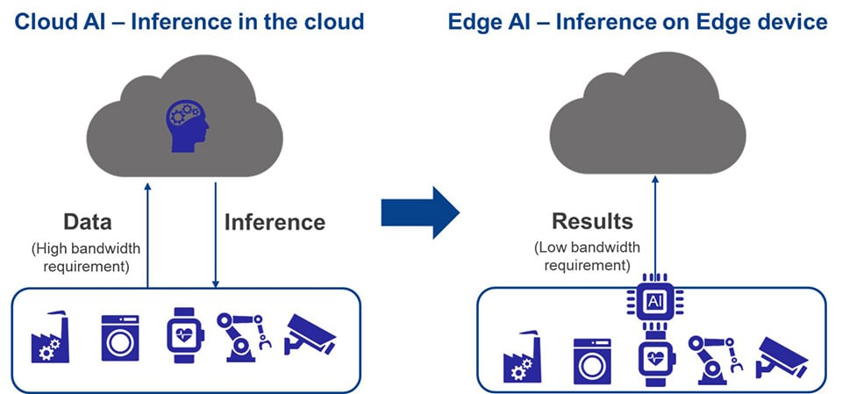


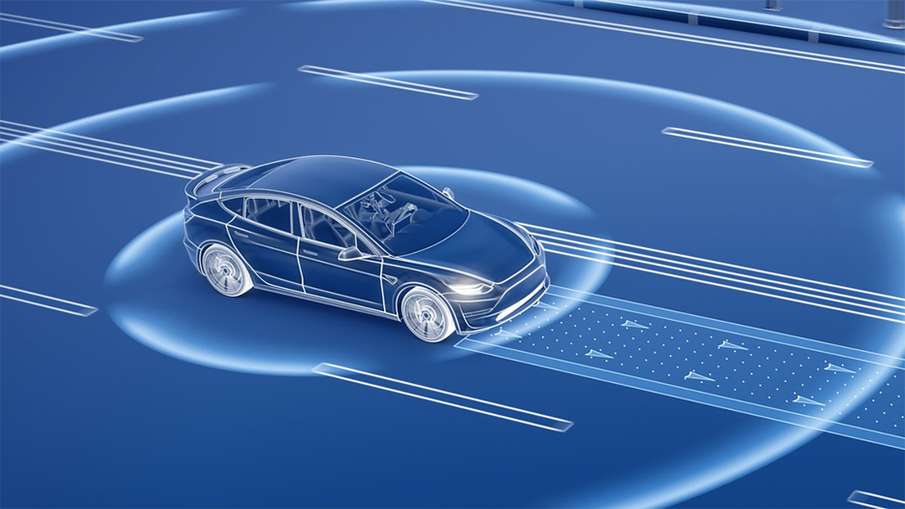
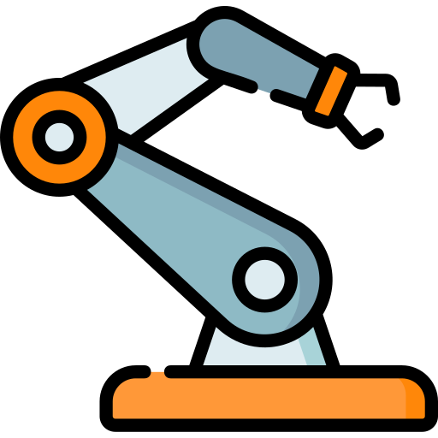
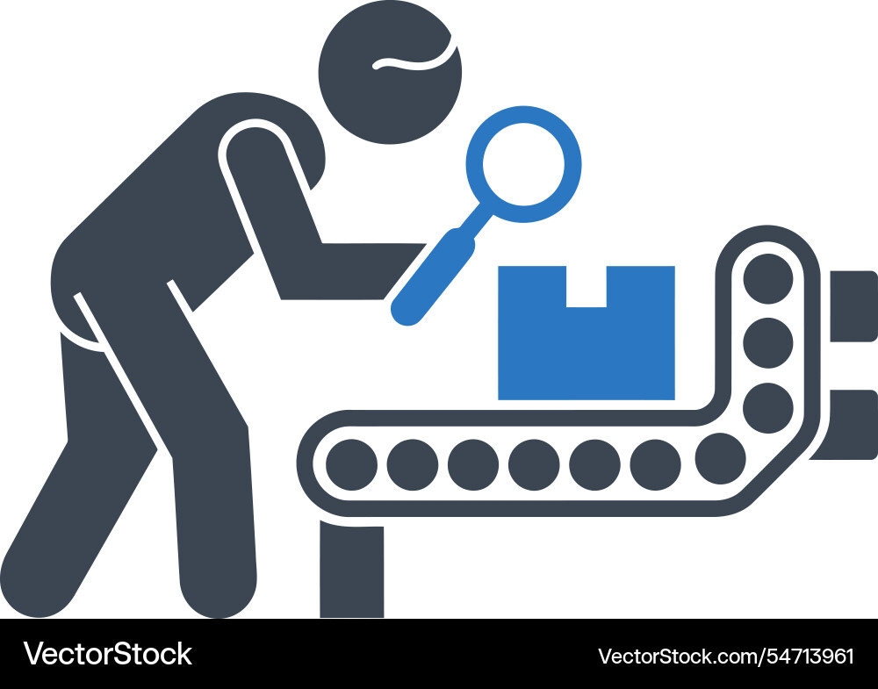



SECTION 01
Introduction to Edge AI
What Is Edge AI?
Edge AI deploys and executes AI algorithms directly on local hardware — microcontrollers, single-board computers, smartphones, and embedded systems — rather than relying on centralized cloud servers. This brings computation physically closer to the source of data.
Real-Time
Privacy
Offline
Sub-50ms latency
for critical decisions
Data stays on device
never leaves premises
Works without
internet connectivity
Key Applications:
Autonomous Vehicles
Industrial Robotics
Quality Inspection
Medical Monitoring
Smart Security
Agriculture
Notes:
Define Edge AI clearly. Emphasize the shift from cloud-centric to on-device computation. Ask: 'What happens if your self-driving car loses WiFi?' This motivates why edge matters. Spend ~5 minutes on this slide.

Slide 5


Edge AI vs. Cloud AI — Architectural Trade-Offs
Cloud AI
Edge AI
Latency
50–500+ ms (network round-trip)
1–50 ms (on-device)
Privacy
Data leaves premises to remote servers
Data stays on machine always
Bandwidth
High — raw data must be uploaded
Minimal — only metadata/alerts
Cost at Scale
Recurring API/GPU rental fees
One-time hardware investment
Model Power
Unlimited (cloud GPU clusters)
GPU/NPU-dependent
Scalability
Elastic, on-demand scaling
Per-machine deployment
✓ Edge wins for: Real-time control · Privacy-sensitive data · Remote/offline sites · Continuous high-throughput inference
Notes:
Walk through each row. The key insight: Edge doesn't win everything, but for IoT and safety-critical scenarios, the latency and privacy advantages are decisive. Cloud still wins for very large models and burst workloads.

Slide 6

Why Edge AI Matters — 4 Key Drivers
01
Latency Reduction
02
Privacy & Data Sovereignty
5–50 ms
Cloud AI: 50–500+ ms round-trip
0 bytes
HIPAA, GDPR, CCPA compliance
On-Device
Critical for AV, robotics, surgery
Sent to cloud
Medical images stay on device
100 ms extra latency = safety risk
No raw video transmitted
03
Bandwidth & Offline
04
Cost Efficiency
1.5 Gbps
Edge sends only metadata/alerts
$0
No recurring API fees at scale
1080p raw stream
Works in mines, ships, rural sites
Per inference
One-time hardware investment
Air-gapped deployments supported
Laptop = dev + deployment platform
Notes:
For each driver, give a real example: Latency→autonomous emergency brake; Privacy→hospital X-ray analysis; Bandwidth→multi-camera factory floor; Cost→startup budget constraints. Allow 8-10 minutes here.
Key Drivers កត្តាជំរុញសំខាន់ៗ
HIPAA, GDPR, CCPA compliance ការអនុលោមតាម HIPAA, GDPR, CCPA

Slide 7

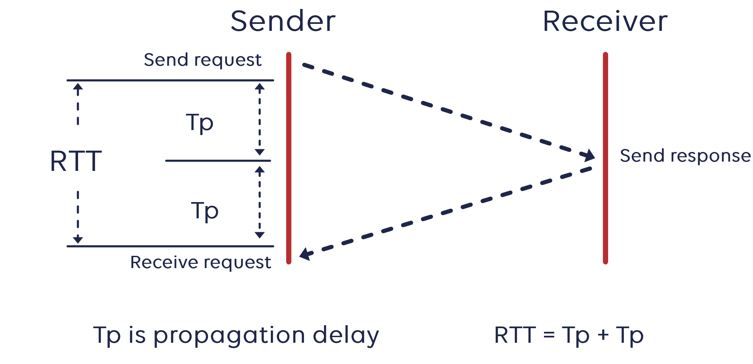
Why Edge Inference Matters
Latency
<5ms
50-200ms
Critical for real-time:
Autonomous driving
AR/VR pipelines
Industrial robot control
Medical monitoring
Edge inference
(on-device)
Cloud inference
(network round-trip)
Eliminating network round-trips enables applications where milliseconds determine safety outcomes.
4 / 26

Slide 8


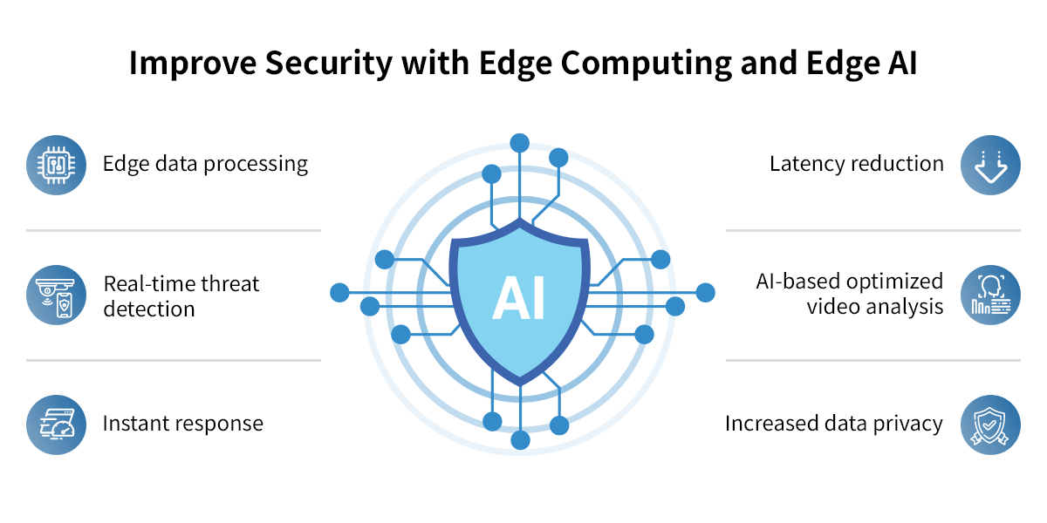
Why Edge Inference Matters
Privacy & Data Sovereignty
Data never leaves the device
Biometrics, health data, conversations stay local
Regulatory compliance
GDPR, HIPAA satisfied by design
Reduced attack surface
No cloud transmission = fewer interception vectors
User trust
Consumers demand on-device processing for personal data
5 / 26

Slide 9

Why Edge Inference Matters
Bandwidth & Connectivity
75B+
2.5 EB
40%
IoT devices
by 2030
Daily global
data generated
Unreliable
connectivity worldwide
Edge AI processes data locally, sending only results to the cloud. This dramatically reduces bandwidth requirements and enables disconnected operation.
6 / 26
Notes:
2.5 EB = 2621440 TB
Edge AI ដំណើរការទិន្នន័យនៅ locally ដោយផ្ញើតែលទ្ធផលទៅកាន់ cloud ប៉ុណ្ណោះ។ នេះកាត់បន្ថយតម្រូវការ bandwidth យ៉ាងខ្លាំង និងអាចឱ្យប្រតិបត្តិការផ្តាច់ចេញ។

Slide 10
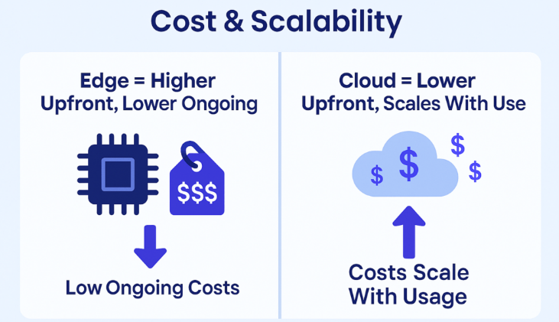

Why Edge Inference Matters
Cost Efficiency
Key cost benefits:
No per-inference API charges
Reduced cloud provisioning
Lower data transfer costs
One-time HW vs. recurring cloud fees
7 / 26
Notes:
អត្ថប្រយោជន៍សំខាន់ៗនៃការចំណាយ៖
គ្មានការគិតថ្លៃ API ក្នុងមួយការសន្និដ្ឋាន
កាត់បន្ថយការផ្តល់សេវាកម្មលើ Cloud
កាត់បន្ថយការចំណាយលើការផ្ទេរទិន្នន័យ
ថ្លៃសេវា HW ម្តងបើប្រៀបធៀបទៅនឹងថ្លៃសេវា Cloud ដដែលៗ

Slide 11


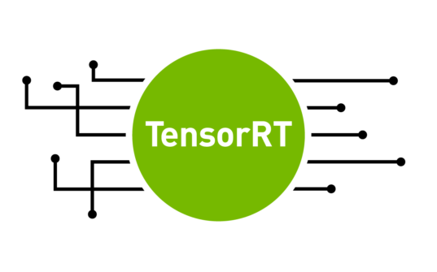
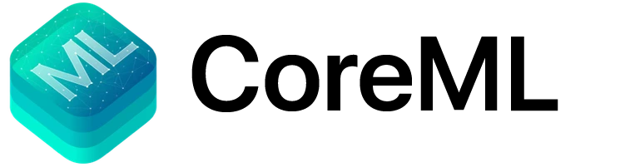
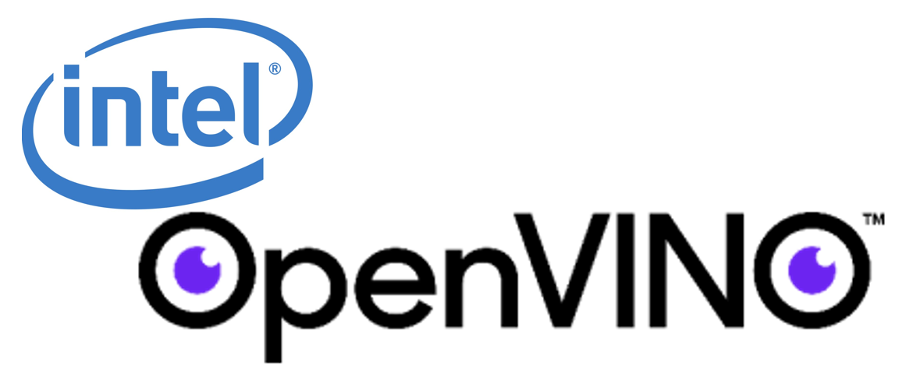

Common Frameworks & Deployment Tools
Framework | Vendor | Target Platform
TensorFlow Lite | Google | Mobile, embedded, microcontrollers
ONNX Runtime | Microsoft | Cross-platform, multi-framework
TensorRT | NVIDIA | GPU-optimized inference
Core ML | Apple | iOS/macOS native inference
OpenVINO | Intel | Intel CPU/GPU/VPU optimization
MediaPipe | Google | Real-time ML pipelines
Choose based on target hardware, model format, and deployment constraints.
10 / 26

Slide 12
ML Lifecycle: Training vs. Inference
This guide focuses exclusively on the Inference phase — deploying pre-trained models to edge devices for real-time prediction.
TRAINING
INFERENCE
Definition:
Learning model parameters from labeled data
Definition:
Using trained model to make predictions
Compute:
GPU clusters, TPU pods — extremely high
Compute:
Moderate to low — runs on edge devices
Data:
Thousands to millions of labeled samples
Data:
Single sample or small batch at a time
Location:
Cloud data centers, HPC clusters
Location:
Edge devices, local machines
Duration:
Hours to weeks per training run
Duration:
Milliseconds per prediction
Goal:
Maximize accuracy and generalization
Goal:
Minimize latency, memory, and power
Frequency:
Periodic (retrain on new data batches)
Frequency:
Continuous (every sensor reading/frame)
🎯 Session Focus: Inference only — models are pre-trained; we deploy, optimize, and benchmark them on local hardware
Notes:
Students often confuse training and inference. Clarify: we're NOT training models today. The model was already trained by Ultralytics on COCO dataset. We load and run it. This is edge INFERENCE. Training requires 100x more compute.

Slide 13



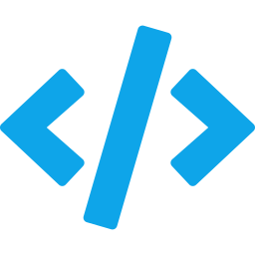
The Edge AI Technology Stack
05 Integration Layer
MQTT, gRPC, REST, GPIO, USB — connects pipeline to sensors, actuators, dashboards
04 Application Layer
← Today
Orchestration: capture → preprocess → infer → post-process → visualize → alert
03 Model Layer
← Today
Pre-trained neural network: quantization, pruning, knowledge distillation applied
02 Runtime Layer
← Today
Inference engine: ONNX Runtime, TensorRT, TFLite, OpenVINO, CoreML, SNPE
01 Hardware Layer
Physical compute: CPU, GPU, NPU, TPU, FPGA, or dedicated AI accelerator chip
Notes:
This stack diagram grounds everything we do today. Our focus: Runtime (ONNX), Model (YOLOv8), and Application layers. The hardware is your laptop CPU/GPU. Integration (MQTT) is covered briefly in future sessions.

Slide 14

YOLO — You Only Look Once
The industry standard for real-time object detection at the edge — single forward pass through the network.
Single-Stage Detection
Model Comparison
Predicts boxes AND class probabilities simultaneously in one pass — no proposal generation bottleneck
Model
Params
mAP50
CPU ms
Anchor-Free (v8+)
YOLOv8n
3.2M
37.3
~80ms
★
Direct keypoint prediction — better generalization to unusual object shapes and aspect ratios
YOLOv8s
11.2M
44.9
~130ms
Multiple Sizes
Nano (3.2M params) to Extra-Large (68.2M params) — choose based on hardware constraints
YOLOv8m
25.9M
50.2
~240ms
Multi-Task Support
YOLOv8l
43.7M
52.9
~400ms
Detection, segmentation, pose estimation, classification, oriented bounding boxes — one API
YOLOv8x
68.2M
53.9
~600ms
★ We use YOLOv8n (Nano) for all lab exercises
Notes:
YOLO = You Only Look Once. Key insight: two-stage detectors (Faster R-CNN) first find regions then classify. YOLO does both in one pass. This is why it's fast enough for real-time edge use. YOLOv8n has only 3.2M parameters — tiny enough for embedded devices.

Slide 15

SECTION 02 — Environment Setup
01
Install Python 3.11
02
Install VS Code
python.org/downloads → Python 3.11.x 64-bit
code.visualstudio.com → latest stable
CHECK ✓ 'Add python.exe to PATH'
Check 'Add to PATH' during install
Verify: python --version → Python 3.11.x
Install Python extension (ms-python.python)
⚠ Do NOT use Python 3.12+ (package compatibility issues)
⚠ Also install Pylance, Jupyter, GitLens extensions
03
Create Virtual Environment
04
Install Dependencies
mkdir edge-ai-project && cd edge-ai-project
pip install ultralytics opencv-python numpy
python -m venv venv
pip install torch onnxruntime matplotlib psutil
.\venv\Scripts\Activate.ps1 (PowerShell)
pip install -r requirements.txt
⚠ If error: Set-ExecutionPolicy RemoteSigned -Scope CurrentUser
⚠ GPU users: pip install onnxruntime-gpu (then test with nvidia-smi)
Notes:
LAB TIME: Have students follow steps 01-04. Common issues: PATH not set (Python), PowerShell execution policy, GPU vs CPU PyTorch. Walk around and help. Allow 45 minutes. Students should get all 4 verification scripts passing.

Slide 16
Environment Verification — 4 Tests
Step 1
gpu_test.py
Step 2
nvidia-smi
PyTorch & GPU check
NVIDIA driver check
import torch
print(torch.__version__)
print(torch.cuda.is_available())
nvidia-smi
✓ Expected: PyTorch version: 2.x.x
CUDA available: True (or False)
✓ Expected: GPU table with name, driver, CUDA version
→ 'not recognized' = no GPU (use CPU mode)
Step 3
test_opencv.py
Step 4
test_yolo.py
OpenCV & webcam check
YOLO model check
import cv2
print(cv2.__version__)
cap = cv2.VideoCapture(0)
if cap.isOpened(): print('Webcam OK')
from ultralytics import YOLO
model = YOLO('yolov8n.pt')
print(f'{len(model.names)} classes')
✓ Expected: OpenCV version: 4.x.x
Webcam OK — Frame size: 640x480
✓ Expected: Model loaded: 80 classes
Inference OK — 0 detections on noise
Notes:
All 4 tests must pass before moving on. If CUDA shows False — that's OK, CPU mode works for learning. If webcam fails, check camera index 0 vs 1. If YOLO model download fails, check internet connection.

Slide 17
SECTION 03 — YOLO Model Deployment
LAB 6.1 Model Exploration
LAB 6.2 Real-Time Webcam Detection
File: lab_6_1_model_info.py
File: lab_6_2_webcam_detection.py
from ultralytics import YOLO
model = YOLO('yolov8n.pt')
params = sum(p.numel() for p in
model.model.parameters())
print(f'Classes: {len(model.names)}')
print(f'Params: {params:,}')
cap = cv2.VideoCapture(0, cv2.CAP_DSHOW)
cap.set(cv2.CAP_PROP_FRAME_WIDTH, 1280)
while True:
ret, frame = cap.read()
results = model(frame, conf=0.5)
annotated = results[0].plot()
cv2.imshow('Detection', annotated)
if cv2.waitKey(1) & 0xFF == ord('q'):
break
✓ 80 classes · 3,157,200 total parameters · YOLOv8n on COCO 2017
✓ Live annotated window · FPS counter · Press Q to quit
Neural Network Inference Pipeline
1
2
3
4
5
6
Input
Acquisition
→
Pre-
processing
→
Model
Loading
→
Forward
Pass
→
Post-
processing
→
Action /
Output
💡 Troubleshooting Tips:
Black screen → try camera index 1 or 2. | Slow FPS → reduce frame resolution or confidence threshold. | Camera busy → close Zoom/Teams/OBS before running.
Notes:
LAB 6.1: Students run model_info script — confirm 80 classes and 3.1M parameters. LAB 6.2: Webcam detection — this is the exciting moment! Students see real-time detection on their own webcam. Allow 20-25 minutes. Common issue: cv2.CAP_DSHOW vs no flag — try both if camera fails.

Slide 18

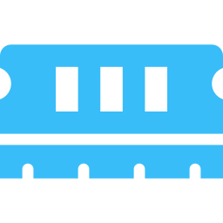
ONNX Export & Performance Benchmarking
What is ONNX?
Lab 6.5 — Benchmark Results (CPU Example)
Runtime optimization: operator fusion, constant folding, memory planning
Cross-platform: Windows, Linux, macOS, Android, iOS — one file
Hardware acceleration: CUDA, TensorRT, DirectML, OpenVINO, CoreML
Small footprint: ~50 MB runtime vs ~2 GB full PyTorch
Lab 6.3 — Export to ONNX
model = YOLO('yolov8n.pt')
export_path = model.export(
format='onnx',
imgsz=640,
simplify=True,
opset=17,
dynamic=False
)
ONNX: 20% faster latency · 26% higher FPS · works without PyTorch on deployment device
Discussion Questions
Q1: .pt vs .onnx — what's stored differently? Q4: Deploy to Raspberry Pi: PyTorch or ONNX? Q5: Why discard first 10 warm-up runs?
Notes:
Key insight for students: ONNX Runtime applies graph-level optimizations the original PyTorch framework doesn't. Export once, run anywhere. For Raspberry Pi: ONNX Runtime has an ARM build (~50MB) while PyTorch ARM is ~2GB. The warm-up discards JIT compilation overhead.

Slide 19

Model Optimization for Edge Deployment
Quantization
Pruning
Reduce numerical precision
Remove redundant weights
FP32 → FP16
Structured
50% size reduction, <1% accuracy loss. Default GPU start
Remove whole filters/layers. Reduces FLOPs directly
FP16 → INT8
Unstructured
75% reduction, 2–4× speedup. Needs 100–1000 calibration images
Zero individual weights. Needs sparse hardware for speedup
Dynamic Quant
Global Mag.
No calibration needed. Smaller speedup than static INT8
Remove lowest-magnitude weights globally across all layers
Knowledge Distillation
Architecture Selection
Teacher → Student transfer
Pick edge-optimized models
Soft Labels
MobileNetV3
Student learns from teacher's probability distribution (dark knowledge)
Depthwise separable convolutions. Ideal for mobile CPU inference
Feature Mimic
EfficientNet-Lite
Match intermediate activations, not just final output logits
NAS-optimized scaling. Best accuracy-per-FLOP on constrained devices
Result
YOLO Nano
Compact student outperforms same-arch model trained from scratch
3.2M params, 6.2 MB — runs at 30+ FPS on a laptop CPU
Notes:
The most impactful optimization is often architecture selection — choose YOLO Nano over YOLO Large. Quantization FP16 is almost always safe. INT8 needs calibration data. Pruning is complex; skip for this session. Knowledge distillation is for when you need a smaller custom model.

Slide 20
SECTION 04 — Advanced Real-Time Applications
LAB 7.1 Interactive ROI Detection
LAB 7.3 People Counter with Alert
Draw ROI rectangle with mouse click-drag
ALERT_THRESHOLD = 3 # Max people
TARGET_CLASS = 0 # person
model = YOLO('yolov8n.pt')
cap = cv2.VideoCapture(0, cv2.CAP_DSHOW)
while True:
results = model(frame, conf=0.5)
count = sum(1 for b in results[0].boxes
if int(b.cls[0]) == TARGET_CLASS)
alert = count > ALERT_THRESHOLD
status = 'ALERT: OVER CAPACITY'
if alert:
cv2.rectangle(frame, (0,0), ..., RED, 8)
Only count/detect objects inside ROI
Live dashboard: FPS, confidence, object count
Display ROI size and area in real-time
Class statistics panel (person: 3, chair: 1…)
Save snapshots with S key
CSV logging of all detections with timestamp
Normal: count ≤ threshold · green border · status OK
Adjustable confidence: UP/DOWN arrow keys
OVER CAPACITY: count > threshold · red flash border · alert text
Keyboard Controls
Mouse drag: Draw ROI
R: Reset ROI
S: Save snapshot
🏭 Production Use Cases
↑/↓: Confidence ±0.05
Q: Quit
Retail occupancy · warehouse safety zones · clean room limits · MQTT alert triggers · PLC relay activation
Notes:
LAB 7.1: Interactive ROI is the most impressive demo. Students draw zones with the mouse — very visual. LAB 7.3: People counter is simpler but more production-realistic. Discuss: what happens when an alert fires in a real factory? MQTT → PLC relay → light/alarm/conveyor stop.

Slide 21
SECTION 05 — Object Tracking & Video Analytics
Detection vs. Tracking — Key Differences
Capability
Detection Only
Detection + Tracking
Per-frame objects
✓ Bounding boxes + class labels
✓ Plus persistent unique ID per object
Identity across time
✗ Same object = new box each frame
✓ Object keeps ID until it leaves scene
Unique counting
✗ Unreliable — counts same object repeatedly
✓ Accurate — each object counted once
Path / trajectory
✗ Not possible
✓ Records position history per ID
Dwell time
✗ Not possible
✓ First-seen to last-seen timestamp
LAB 8.1 Real-Time Multi-Object Tracking
LAB 8.2 Bidirectional Line-Crossing Counter
results = model.track(frame,
persist=True,
conf=0.5)
# Draw trails
for box, tid in zip(boxes, ids):
track_history[tid].append(cx, cy)
cv2.line(frame, pts[i-1], pts[i],
(0, alpha, 255), 2)
LINE_Y = frame.shape[0] // 2
OFFSET = 30
if prev_y < LINE_Y - OFFSET
and curr_y >= LINE_Y - OFFSET:
count_down += 1
counted_ids.add(tid)
cv2.line(frame, (0, LINE_Y),
(w, LINE_Y), YELLOW, 3)
Notes:
BoT-SORT = combination of Kalman filter (motion) + Re-ID features (appearance) + IoU association. Key: model.track() with persist=True maintains tracker state across frames. For line-crossing: use Y-coordinate thresholds with an offset zone to avoid double-counting at the boundary.

Slide 22
SECTION 06 — Professional Dashboard Development
Why Dashboards Matter
Operators, engineers, and managers need real-time performance metrics, detection statistics, and system health in an intuitive visual format — transforming raw telemetry into actionable insight.
Live Video Panel
Performance Metrics
Detection Statistics
System Health Panel
Annotated camera feed with real-time bounding boxes and class labels
FPS, latency histogram, CPU gauge, RAM utilization bars
Per-class counts, confidence distribution, objects-over-time chart
GPU temp, memory pressure, disk usage, uptime, alert indicators
Lab 9.1 — Progress Bar Helper
Dashboard Design Best Practices
def draw_bar(canvas, x, y, w, h,
value, max_val, color, label):
fill_w = int(w * min(value/max_val, 1.0))
cv2.rectangle(canvas, (x,y), (x+w,y+h),
DARK_BG, -1) # background
cv2.rectangle(canvas, (x,y), (x+fill_w,y+h),
color, -1) # fill
cv2.putText(canvas, f'{label}: {value:.1f}',
(x, y-5), FONT, 0.45, LIGHT, 1)
Update Rate: smooth FPS with 5–10 frame moving average
Color Coding: green=normal, yellow=warning, red=critical
Information Hierarchy: critical info at top (FPS, alerts)
Dark Theme: standard for control rooms, reduces eye strain
Responsive Layout: relative positioning for any resolution
Notes:
LAB 9.1: Students build a dual-panel dashboard — left is camera feed, right is metrics panel. The draw_bar() helper is reusable. Encourage students to add a third panel. Extension: Flask API endpoint + Chart.js frontend for remote monitoring — mention for advanced students.

Slide 23




SECTION 07 — Capstone Deployment Projects
Complete at least 2 of 3 projects. Each integrates multiple techniques into a portfolio-ready application.
01
Intermediate
02
Intermediate
03
Advanced
Smart Parking Occupancy Monitor
Industrial PPE Safety Inspector
Retail Customer Flow Analytics
Monitor a parking area, count vehicles, display occupancy with color-coded status, log to CSV
Detect workers, verify hard hat compliance, alert on violations, generate audit-ready CSV report
Track shoppers, count entries/exits via line-crossing, measure dwell time, generate analytics report
Requirements:
Requirements:
Requirements:
Detect car/truck/motorcycle/bus in defined ROI
Detect 'person' class (class 0)
YOLO tracking with persistent IDs
Color-coded status: green/yellow/red by % full
Check upper-body region for helmet overlap
Bidirectional line-crossing counter
Log occupancy every 5 seconds to CSV
Green/red border for compliant/non-compliant
Dwell time per unique ID (first/last seen)
Side panel: count, capacity, utilization %
Log violations to violations/ directory
Post-session CSV + matplotlib histogram PNG
Skills used:
Skills used:
Skills used:
ROI filtering (Lab 7.1) · Class counting (Lab 7.3) · CSV logging · OpenCV panels
Detection pipeline · Bounding box geometry · Alert system · Session reports
model.track() (Lab 8.1) · Line crossing (Lab 8.2) · Dwell analysis · Matplotlib charts
Notes:
Students should begin with Project 1 or 2 (Intermediate). Project 3 extends Lab 8 significantly. Assessment rubric: Functionality 40%, Code Quality 20%, Performance Analysis 20%, Report 20%. Allow students to present their project results if time permits.

Slide 24
SECTION 08 — Emerging & Future Edge AI
Neural Processing Units (NPUs)
TinyML
Now → 2027
Production now
Intel Meteor Lake, AMD Ryzen AI, Apple Neural Engine, Qualcomm Hexagon — 10–45 TOPS at 5–15 watts. Every laptop by 2027 will have built-in AI acceleration for YOLO-class models at 30+ FPS.
Neural networks on microcontrollers with 256 KB RAM. TensorFlow Lite Micro, Edge Impulse, Apache TVM. Hearing aids, smart sensors, predictive maintenance, agriculture monitoring — under $5 hardware.
Federated Learning at the Edge
On-Device LLMs
Pilot → 2026
Expanding 2025–2027
Train across many devices without centralizing data. Each device shares only weight gradients. Preserves privacy, reduces bandwidth. Google Gboard and Apple Siri use this today in production.
Llama 3 (8B) running on 8 GB RAM laptops via 4-bit quantization (GPTQ, AWQ). Private AI assistants, offline document analysis, code completion — no cloud needed. Maturing fast.
Notes:
Exciting discussion: ask students where they see Edge AI going in 5 years. NPUs in laptops are happening NOW — Intel AI PC certification. TinyML is real — show Edge Impulse demo if time. Federated learning is why Siri gets smarter without your data leaving your phone.

Slide 25
Quick Reference — Commands & Resources
Environment Commands
Verification Scripts
YOLO Key APIs
python -m venv venv
python gpu_test.py
model = YOLO('yolov8n.pt')
.\venv\Scripts\Activate.ps1
nvidia-smi
results = model(frame, conf=0.5)
pip install -r requirements.txt
python test_opencv.py
results = model.track(frame, persist=True)
pip install torch torchvision --index-url ...
python test_yolo.py
model.export(format='onnx', imgsz=640)
pip install onnxruntime-gpu
python lab_6_1_model_info.py
session = ort.InferenceSession('model.onnx')
Reference Documentation
Ultralytics YOLOv8 Docs
OpenCV Python
ONNX Runtime
docs.ultralytics.com
docs.opencv.org
onnxruntime.ai/docs
PyTorch
NVIDIA TensorRT
Edge Impulse (TinyML)
pytorch.org/docs
developer.nvidia.com/tensorrt
docs.edgeimpulse.com
Notes:
Keep this slide visible as a desktop reference during lab time. Students can refer to it for exact commands. Also mention the books: 'AI at the Edge' by Daniel Situnayake (O'Reilly, 2023) and 'TinyML' by Pete Warden (O'Reilly, 2020).

Slide 26
Session Complete
You can now independently design, build, deploy, benchmark, and optimize a production-grade Edge AI inference pipeline on a standard Windows workstation — with zero cloud dependencies.
— Session Competency Target
Key Takeaways
Edge AI runs inference on local hardware — no cloud required
YOLOv8n delivers real-time detection at 20–30 FPS on CPU alone
ONNX Runtime: lighter, faster, cross-platform inference engine
FP16 quantization: 50% size reduction, <1% accuracy loss
model.track() adds persistent IDs for counting and analytics
NPUs in every laptop by 2027 — Edge AI is the career frontier
National University of Management / National Polytechnic Institute of Cambodia · 2026
Notes:
Closing slide. Summarize the journey: from understanding what Edge AI is, through setting up the environment, running YOLO, optimizing with ONNX, building advanced apps, to designing real projects. Next steps: complete the capstone project, explore TinyML on a Raspberry Pi, and follow CVPR / NeurIPS papers.

