Slide 1
Optimizing Revenue Streams: Leveraging Neural Networks in Market-driven E-commerce
PRESENTED BY :
SRUTHI BAGAM
PRIYA BANDHAVI SUKKA
PRAVEEN KUMAR BODDUPALLI
NAVEEN MALOTHU

Slide 2
Motivation
The primary motivation of market based ecom analysis with Deep Learning on Neural Networks is to detect the find out the highly sold product in the market.
In this work, the dataset containing the online sales will be taken into consideration.
The pre-processing will be applied in to the dataset and the noisy and null value data will be removed from the dataset.
After the data will be analysed and visualized for further processing.
The Convolutional Neural Networks algorithm will be chosen to make the market based prediction of highest sales of group of products.
.

Slide 3
OBJECTIVE
The objective of market based ecom analysis with machine learning is to detect the find out the highly sold product in the market.
In this work, the dataset containing the online sales will be taken into consideration.
The primary contribution is to apply the deep learning to find out the top selling profit items.
The pre-processing will be applied in to the dataset and the noisy and null value data will be removed from the dataset.
After the data will be analysed and visualized for further processing.
The Deep Learning neural network algorithm will be chosen to make the market based prediction of highest sales of group of products.
It will be helpful in all the ecom online sales web applications to find out the highest sales of the products.
.

Slide 4
RELATED WORK
The author Hamrouni[1] fostered a calculation for mining affiliation rules between sets of things in enormous data sets.
Affiliation rule mining is an in the event that/proclamation that assists with revealing connections between apparently irrelevant information in a social data set or other data vault. Affiliation rule mining strategy utilizes a two stage process.
The initial step is to recognize all the continuous item sets in view of the help count worth of the item sets. It utilizes the download conclusion property of item sets to eliminate the rare item sets.
The subsequent step is the age of affiliation rules from the continuous item sets utilizing the help and certainty.

Slide 5
RELATED WORK
B.-E. Shie, H.-F. Hsiao[2] fostered a calculation for mining successive examples without lower and higher threshold value.
In this system of successive item set mining, the significance of things, benefit and bought amounts of things are not thought of.
Successive item set in mobile may just contribute a little piece to the general benefit, and non-continuous item set may contribute an enormous part to the benefit.
The data mining development works on the proficiency of incessant mining as it doesn't produce applicant item sets during the mining system.
The downside of this approach is that it considers just the significant things in the continuous market anlayis.

Slide 6
RELATED WORK
Y.Liu, W.K. Liao and A. Choudhary[3] proposed a two stage calculation which was created to find high utility item sets, utilizing the download conclusion property of apriori.
The calculations have characterized the exchange weighted usage while keeping up with the download conclusion property.
In the principal data set check, the calculation finds all the one element exchange weighted use item sets and its outcomes structure the reason for two component exchange weighted usage item sets .
In the subsequent data set filter, the calculation finds all the two component exchange weighted use item sets and it brings about three component exchange weighted use item sets.

Slide 7
PROBLEM STATEMENT
Finding the top utility item which produce high profit in the online applications is very tedious as the size of the dataset is increasing regularly.
The user rating and the user opinion of the particular product while purchasing is different based on the variety of product items in the market.
The exact prediction of the most needed product in the market strategy analysis is most difficult.
In the large dataset the accuracy level identification is also very difficult to calcuate.

Slide 8
LIMITATION OF EXISTING SYSTEM
Less Performance
Uses more resources.

Slide 9
PROPOSED system
The proposed methods aim to find the top profit selling items in the market dataset. The accuracy levels of the identification of the products will be improved with the proposed system.
The deep learning on neural network will provide the better solution to solve the problem of identification of the profit selling products in the real world data.
The Convolutional Neural Network algorithm will check the data in more compact with training and testing the data.
It will provide more accuracy as compared with the other type of techniques.
The online ecommerce dataset will be taken as the input to the application and the dataset will be passed into the Convolutional Neural Network algorithm and the data will be analysed with the different visual graphs.

Slide 10
ADVANTAGES OF PROPOSED SYSTEM
HIGH Performance
Good Accuracy level.
Increase in profit ratio
Can predict the top level selling items in market

Slide 11
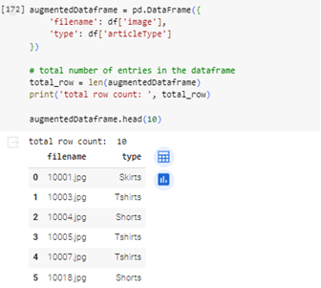
Experimental results
The pre-processing is applied to the dataset where all the noisy data are removed and the image is reshaped as per the mapping of 255pixel.

Slide 12
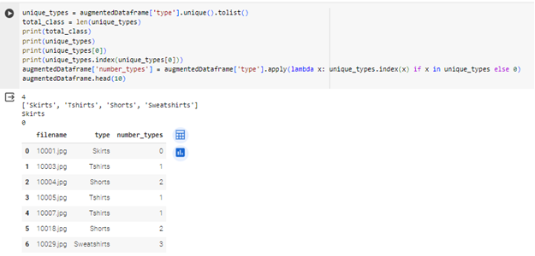
Experimental results
The products are categorized based on the product ID with respect to the number of sales items in the market dataset.

Slide 13
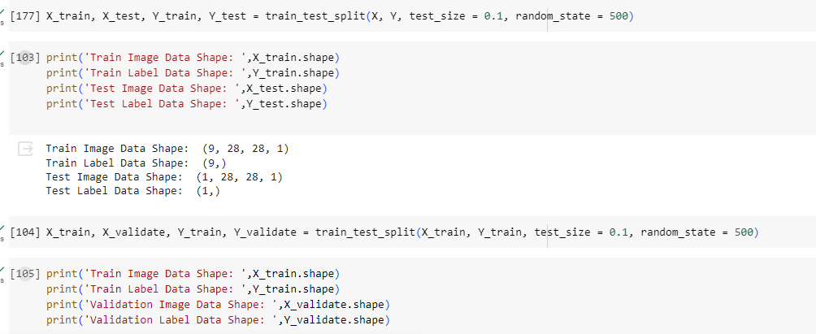
Experimental results
The image dataset is divided into testing and training to pass in to the neural network model.

Slide 14
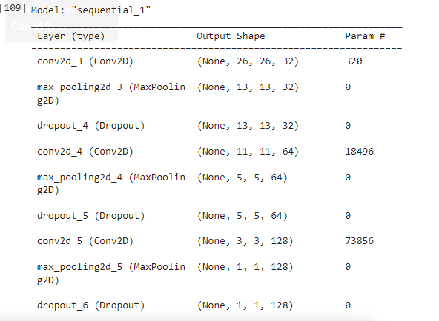
Experimental results
The Convolutional Neural Networks algorithm is applied with creating the sequential model. The output of the sequential model with layers is displayed.

Slide 15
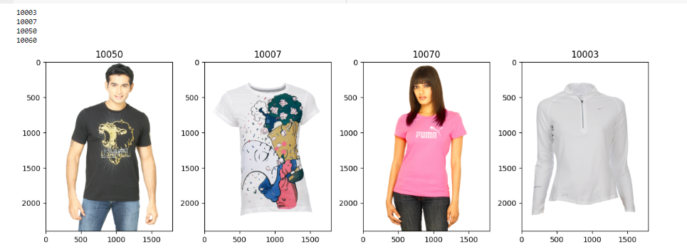
The final results based on the similarity and top utility items based on the profit are displayed.
Experimental results
The final results based on the similarity and top utility items based on the profit are displayed.

Slide 16
CONCLUSION
The convolutional neural network calculations are applied to figure out the top high utility item things from the amazon dataset.
Future work in this field can include, a distributed and dynamic method. It generates complete set of high utility item sets from large databases.
Mining high utility item sets from databases refers to finding the item sets with high profit

Slide 17
REFERENCE
[1] T. Hamrouni, S. Yahia, and E. M. Nguifo, “Sweeping the disjunctive search space towards mining new exact concise representations of frequent item sets ,” Data Knowl. Eng., vol. 68, no. 10, pp. 1091–1111, 2009.
[2] B.-E. Shie, H.-F. Hsiao, V. S. Tseng, and P. S. Yu, “Mining high utility mobile sequential patterns in mobile commerce environments,” in Proc. Int. Conf. Database Syst. Adv. Appl., 2011, vol. 6587, pp. 224–238..
[3] Y.Liu, W.K. Liao and A. Choudhary, ―A two phase algorithm for fast discovery of high utility itemset‖, Cheng, D. and Liu. H. PAKDD, LNCS. PP: 689-695, 2005.
[4] J.Hu, A. Mojsilovic, ―High utility pattern mining: A method for discovery of high utility itemssets‖, in: pattern recognition. PP: 3317-3324, 2007.
[5] Y.-C. Li,j,-s. Yeh, and C.-C. Chang, ―Isolated Items Discarding Strategy for Discovering High Utility Item sets ,‖ Data and Knowledge engg., pp: 198-217, 2008.

Slide 18
REFERENCE
[7] Liu Jian-Ping, Wang Ying Fan-Ding, ‖UP- Growth Mining algorithm Pre-FP in Association Rule Based on FP-tree‖, Networking and Distributed Computing, International Conference, pp: 199-203, 2010.
[8] Ahmed CF,Tanbeer SK,Jeong B-S, Lee Y-K (2011) ―HUC-Prune: An Efficient Candidate Pruning Technique to mine high utility patterns‖ Appl Intell PP: 181–198, 2011.
[9] Shih-Sheng Chen, Tony Cheng-Kui Huang, Zhe-Min Lin, ―New and efficient knowledge discovery of partial periodic patterns with multiple minimum supports‖, The Journal of Systems and Software 84, pp. 1638–1651, 2011, ELSEVIER.
[10] Chowdhury Farhan Ahmed, Syed Khairuzzaman Tanbeer, Byeong-Soo Jeong, Young-Koo Lee a,Ho-Jin Choi(2012) ―Single-pass UP- Growth and interactive mining for weighted frequent patterns‖, Expert Systems with Applications 39 pp.7976– 7994, ELSEVIER 2012.

Slide 19
THANk YOU !!!

